Slide 1
6.089
Designing Interactive Technology
IAP 2010
Michael Bernstein
http://courses.csail.mit.edu/iap/6.089

Slide 2
what is this class?
Introductory design studio course
+ hands-on prototyping technology
January 2010
M | Tu | W | Th | F
M | Tu | W | Th | F
M | Tu | W

Slide 3
design.
prototype.
build.

Slide 4
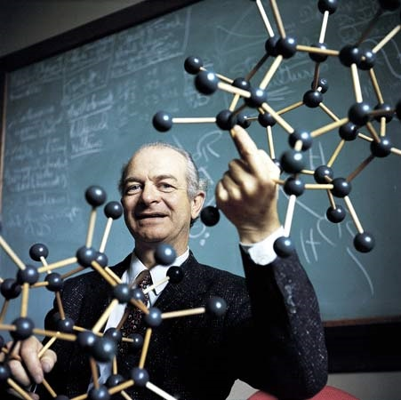
design.
“The best way to have a good idea is to have lots of ideas.”
– Linus Pauling
Notes:
Linus Pauling may be the premier chemist of the twentieth century. He was awarded the Nobel Prize for his work on describing the nature of chemical bonds.
What his work philosophy shares with that of professional de signers is the practice of trying out multiple alternative ideas, approaches, solution strategies.

Slide 5
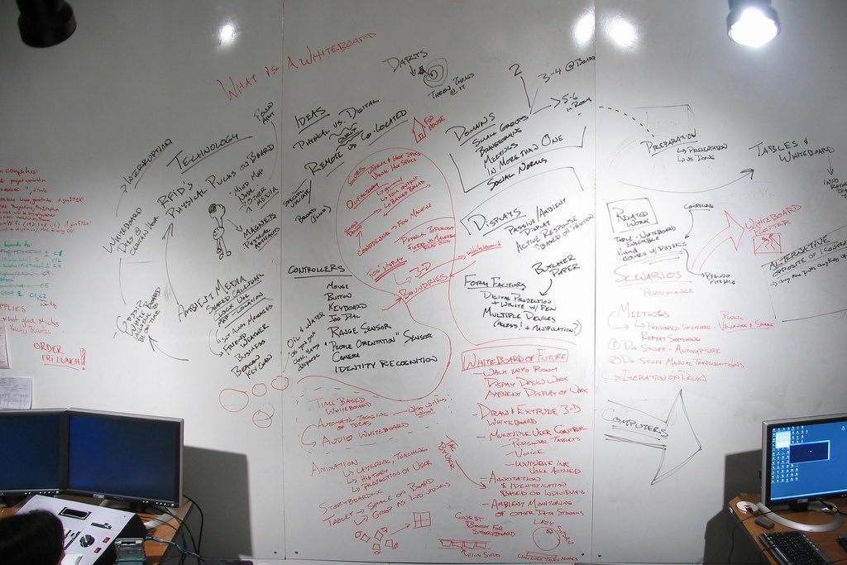
design.

Slide 6
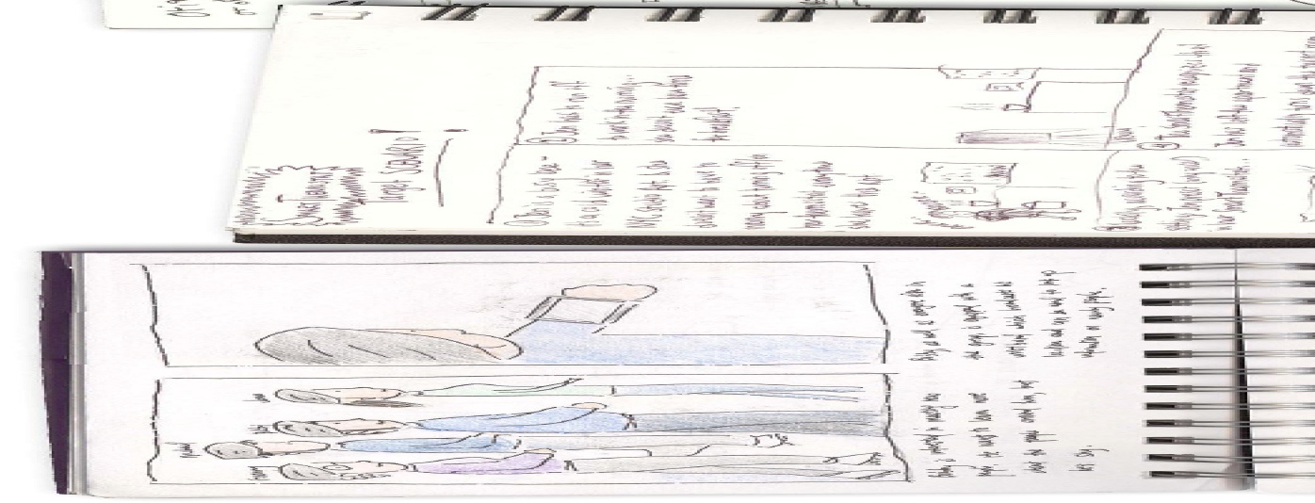
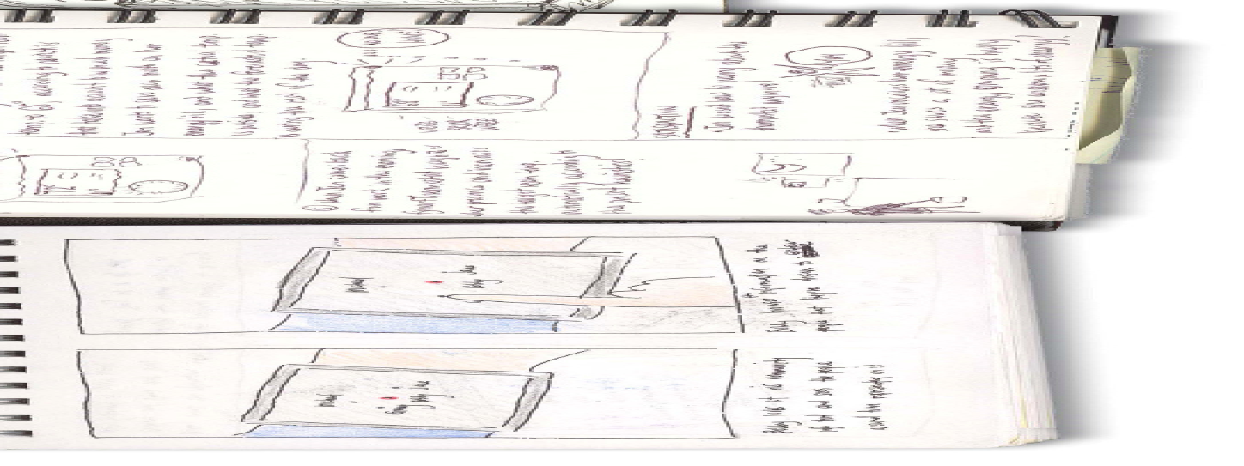
design.

Slide 7

prototype.
Prototypes for the Microsoft mouse
From Moggridge, Designing Interactions
Notes:
For example, Paul Bradley at IDEO built about eighty foam models for the original Microsoft mouse to quickly explore different directions.

Slide 8
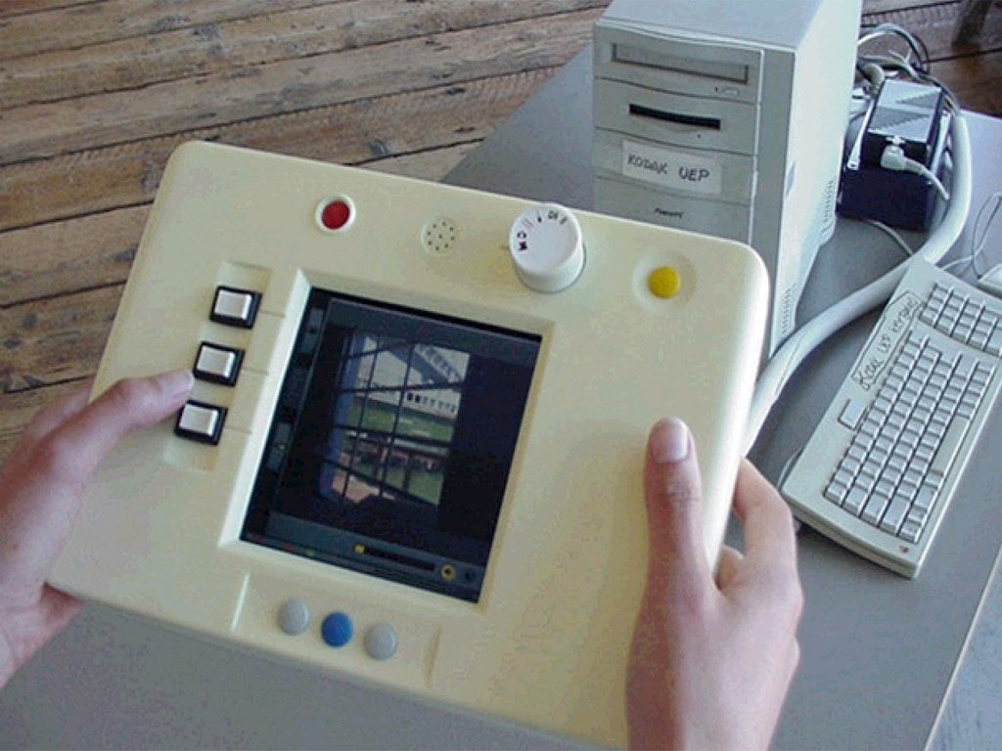
prototype.

Slide 9
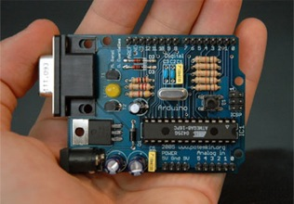
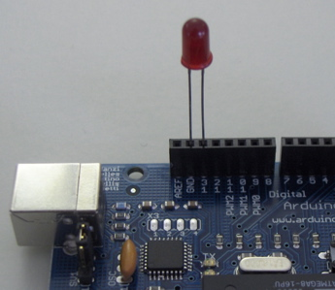
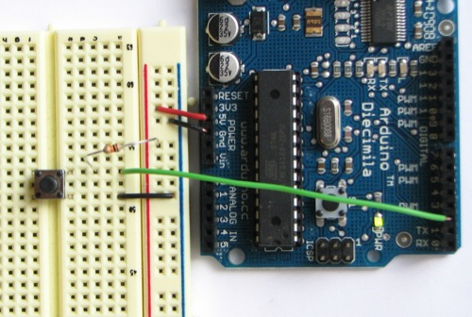
build.
Arduino
void loop() {
digitalWrite(ledPin, HIGH); // sets the LED on
delay(1000); // waits for a second
digitalWrite(ledPin, LOW); // sets the LED off
delay(1000); // waits for a second
}

Slide 10
prereqs
Highly recommended: basic programming or scripting skills
e.g., 6.00, 6.01, 1.00
Helpful: basic electronics skills
Unnecessary: drawing or design experience

Slide 11
grading
Requirements for passing:
  Sketchbook
  Deliverables
  Teamwork

Slide 12
contact
6089@csail.mit.edu

