Slide 1
6.964
Designing Interactive Technology
IAP 2009 Michael Bernstein

Slide 2
what is this class?
Introductory design studio course + hands-on prototyping technology
January 2009
M | Tu | W | Th | F
M | Tu | W | Th | F
M | Tu

Slide 3
design.
prototype.
build.

Slide 4
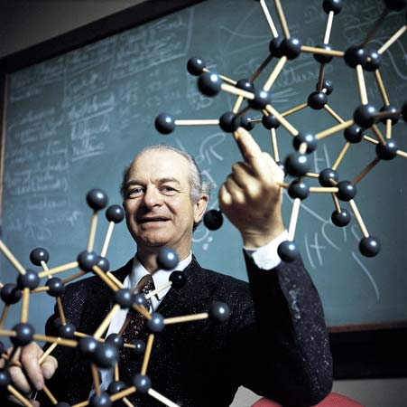
design.
“The best way to have a good idea is to have lots of ideas.”
– Linus Pauling
Notes:
Linus Pauling may be the premier chemist of the twentieth century. He was awarded the Nobel Prize for his work on describing the nature of chemical bonds.
What his work philosophy shares with that of professional de signers is the practice of trying out multiple alternative ideas, approaches, solution strategies.

Slide 5
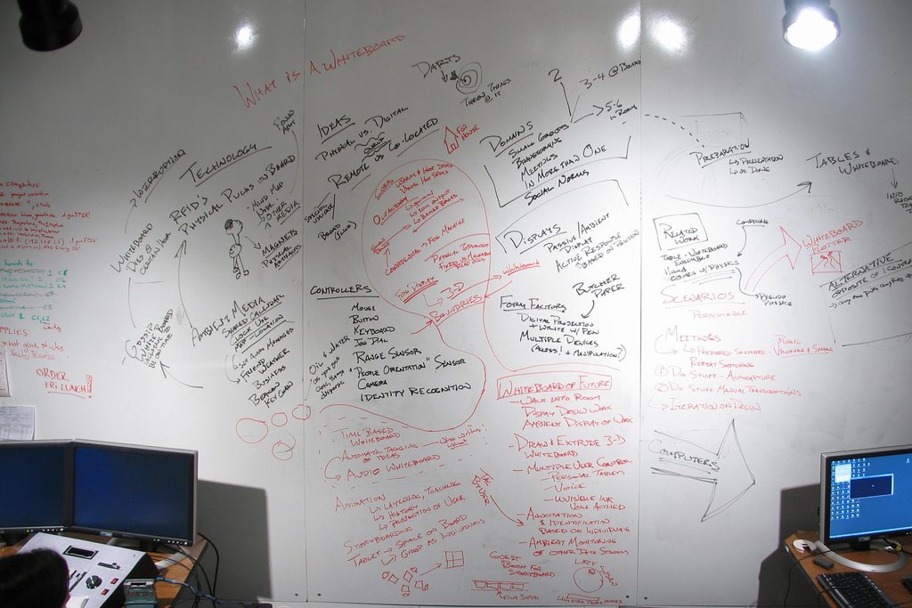
design.

Slide 6
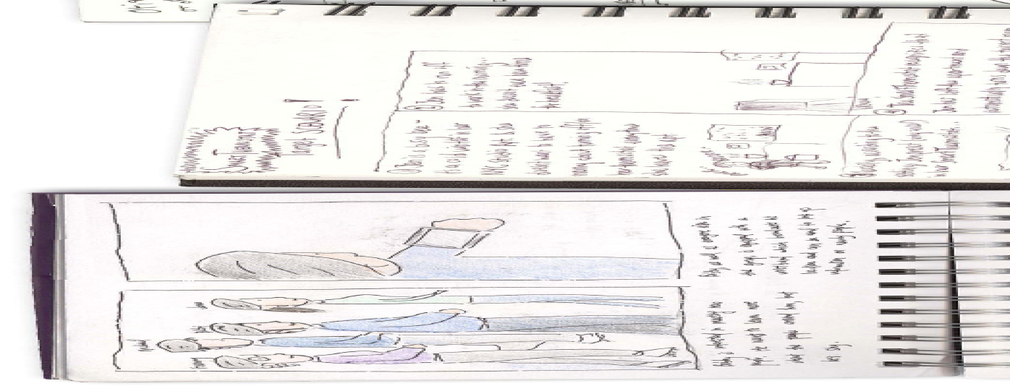
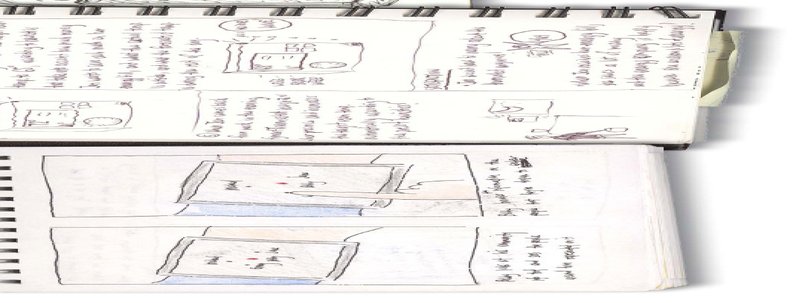
design.

Slide 7
prototype.
Prototypes for the Microsoft mouse
From Moggridge, Designing Interactions
Notes:
For example, Paul Bradley at IDEO built about eighty foam models for the original Microsoft mouse to quickly explore different directions.

Slide 8
prototype.

Slide 9
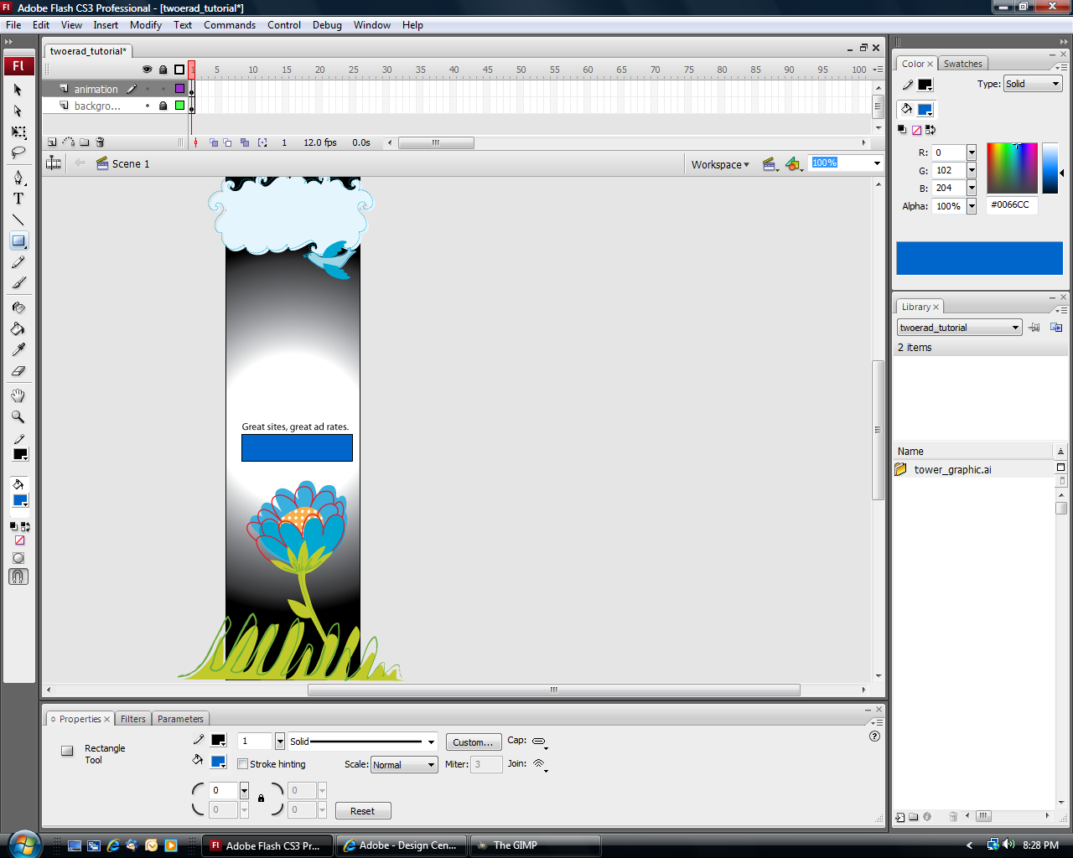
build.
Adobe Flash

Slide 10
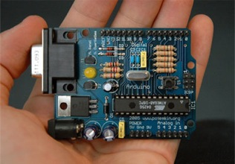
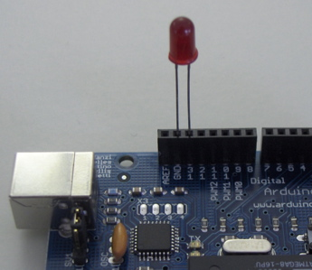
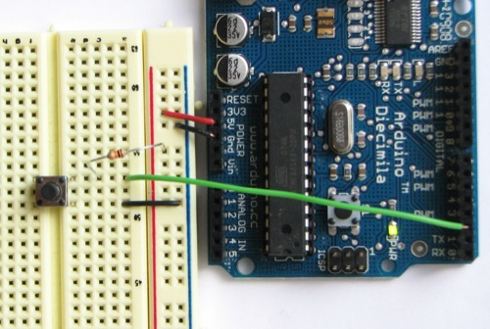
build.
Arduino
void loop() {
digitalWrite(ledPin, HIGH); // sets the LED on
delay(1000); // waits for a second
digitalWrite(ledPin, LOW); // sets the LED off
delay(1000); // waits for a second
}

Slide 11
prereqs
Highly recommended: basic programming or scripting skills
e.g., 6.00, 6.01, 1.00
No assumed drawing or design experience
Purchase an unlined, large sketchbook and pens today
Pearl Art (579 Massachusetts Avenue) Artist & Craftsman Supply (580 Massachusetts Avenue)
MIT Coop

Slide 12
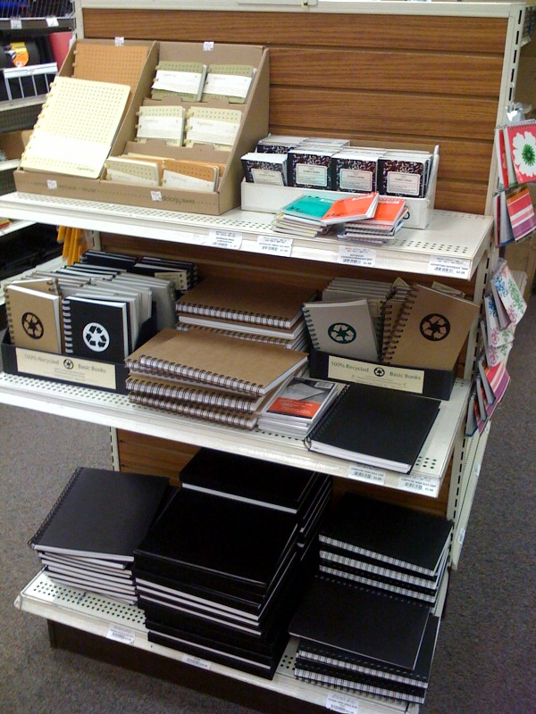
prereqs

Slide 13
grading
Requirements for an ‘A’:
Sketchbook
Deliverables
Teamwork

Slide 14
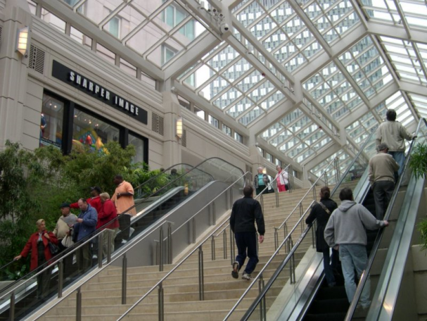
P1
Adobe Flash
Urban computing
Teams of 3
P2
Arduino
Social and crowd computing
Teams of 4

Slide 15
this week
Today: sketching
Tomorrow: needfinding field trip
Wednesday: brainstorming, Adobe Flash
Thursday: more Flash, static prototypes
Friday: design iterations, user feedback
Next Monday: P1resentations

Slide 16
contact
6964@csail.mit.edu

Slide 17
Who am I?

Slide 18
?
Who are you?

