Slide 1
Assistive Technology – Our Scope and Challenges
IS&T
Customer Support Assistive Technology Information Center
Kathy Cahill & Mary Ziegler

Slide 2
Assistive Technology Information Center (ATIC)
Our scope
Assistive technology to perform tasks related to work and study at MIT (not living or recreational needs)
Commercially available hardware and software: desktop, mobile, or standalone apps and devices
Our goals
Accessibility of MIT academic course materials
Match assistive technology to individual needs
Provide specialized assistive technologies for students with disabilities

Slide 3
Universal and Accessible Design
Universally designed products are designed with the widest possible audience in mind.
Most products are made accessible in one of 4 ways:
Directly accessible
...a open captioned video is directly accessible to the deaf
Accessible via standard options or accessories
...the iPhone is accessible to the blind via VoiceOver option
Compatible with third party assistive technologies
... web pages that interact with JAWS screen reading
Require custom modification(s)
... No current commercial product meets the need of the user

Slide 4
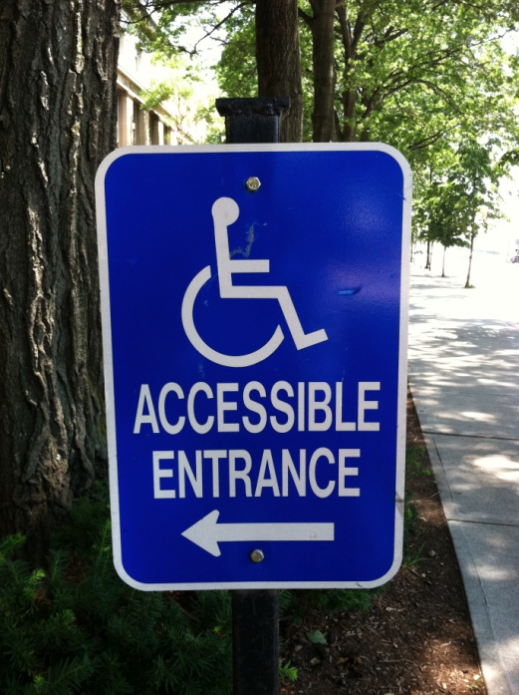
ATIC – Initial Conversation with Customers
Functional needs or gaps
Physical and situational
Task goals (reading, writing)
Area of study or work
Technical skills, expertise, preferences
Operating system (Windows/Mac)
Hardware (Laptop, Tablet)
AT or strategies they have tried
Support network
Family, friends, care providers, government/nonprofit agencies
Notes:
Situational –
Language
Multiple Settings

Slide 5
ATIC – Technology Research and Trials
ATIC consultants research and test products
Requirements, Operating System
Feature Sets match needs?
Try them out for functionality, usability
Make recommendations
Students/staff try out products
Product selection reviewed, re-evaluated
Person’s abilities and needs may change over time (stable vs. progressive disability)
Tasks or tools required may change

Slide 6
Our Challenges
STEM (Science Technology Engineering Math) materials difficult to read/create with current technologies
Standard assistive technologies meet standard disability types
Real people have more complex needs / preferences
Personal preferences don’t match existing products
Rates of abandonment high
time to learn technology
training and support is hard to find or non-existent
usability/ease of use over time is poor
AT is expensive and can become obsolete quickly

Slide 7
ATIC Example
Blind student needed access to biology and physics visuals
Scope out technology to meet student need: IVEO tactile graphics tablet
Team formed to create graphics, including subject matter experts and those with drawing expertise
Team produced simplified Braille diagrams over 3 months
Student tried diagrams with assistance from tutors and did not find them useful
Back to square one!? #%*
…hopefully, another student will utilize the diagrams

Slide 8
Assistive Technologies Commonly Used at MIT
Technology Category / Products | Access created through / Disability-type
Alternative Keyboards and Pointing Devices Kinesis Advantage Contoured, Evoluent Mouse | Modified position Repetitive Strain Injury, Physically impairment
Captioning CART (Communication Access Realtime Transcription) | Visual rendering of all audio content Hearing-impairment, Visual learner
Magnification VisioVoice, ZoomText, Amigo, Acrobat LCD | Enlargement of standard sized text/images Low-vision
Reading software and devices Kurzweil 3000, ReadtoGo, DAISY readers | Reading with audio and/or visual support Auditory learner, Visual impairment
Screen Reading Software JAWS, Window-Eyes, NVDA, Orca, VoiceOver | Keyboard only control Audio reading of visual content Blindness, Low-vision
Speech Recognition Software Dragon Natspeak / Dragon Dictate | Control with speech Physical impairment, Hand injury

Slide 9
Operating System Built-in Accessibility Options
Accessibility Feature | Operating System
Screen Reading | Mac OS X – Voiceover iOS Ubuntu - Orca
Magnification and Enhanced Display Options | Mac OS X - Zoom Windows 7 – Magnifier iOS Ubuntu - Magnifier
Sticky Keys – a sequence of keys can be pressed instead of a key combination | Mac OS X Windows 7 Ubuntu
Slow Keys – key must be held down for a specific amount of time to activate | Mac OS X Windows 7 Ubuntu
Mouse Keys – Use keyboard numpad as a mouse | Mac OS X Windows 7 Ubuntu

Slide 10
AT Equipment at MIT
ATIC, Room 7-143, provides:
Desktop computers (Windows, Macintosh, DebAthena)
Assistive Software (JAWS, ZoomText, Kurzweil, etc.)
Alternative keyboards and pointing devices
Scanners (High-speed document, flatbed)
Note taking devices (EchoSmart Pen)
Reading devices (Kindle, iPad)
Braille devices (Viewplus Premier, Perkins Brailler)
Tactile tablet (IVEO)
Magnifying devices (Note-Taker, Acrobat)

Slide 11
ATIC Devices/Examples With Us Today
IVEO Tablet Braille Diagrams
Perkins Brailler
Reading App: iPad Read2Go
Magnifier: Amigo Handheld
One-handed Keyboards
BAT, FrogPad, Mini keyboard
Pointing Devices
BIGTrack, Bili Footmouse

Slide 12
Recommended Resources
DO-IT (Disabilities, Opportunities, Internetworking, and Technology) at U of Washington http://www.washington.edu/doit/
CATEA (Center for Assistive Technology and Environmental Access) at Georgia Tech http://catea.gatech.edu
Trace Center, University of Wisconsin-Madison
http://trace.wisc.edu/resources/at-resources.php
http://trace.wisc.edu/resources/ud-resources.php
Scherer, Marcia. Living in the State of Stuck – How Assistive Technology Impacts the Lives of People with Disabilities

Slide 13
Contacts / Questions
MIT Assistive Technology Information Center (ATIC)
atic@mit.edu
Kathy Cahill, Assistive Technology Consultant
kcahill@mit.edu
Mary Ziegler, Manager of Accessibility and Usability
maryz@mit.edu
QUESTIONS?

