Slide 1


But Why the Red Sox? Principles and Practice of Assistive Technology Massachusetts Institute of Technology October 26, 2011 Robert J. Mendoza, Psy.D. Tufts Medical Center Tufts University School of Medicine Boston Forensic Associates The Boston Home

Slide 2
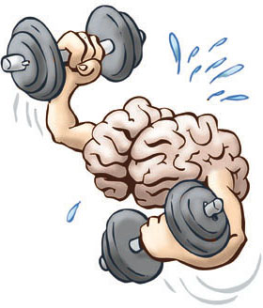
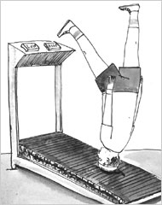


Slide 3
Multiple Sclerosis- 4 Different Types
Relapsing/Remitting- Relapses or episodes of the disease. (80%) May experience symptoms not shown before, and may also see other symptoms experienced before either worsen, change or not be present. Remission phase-symptoms lessen, and the effects or may completely disappear. Periods of remission greatly vary (a few days to years).
Secondary Progressive- Usually a second stage of relapsing/remitting MS. 90% of those with relapsing/remitting MS will progress to this type. Remissions are characterized by worsening of the disease, so that relapses become more severe. After a while there can be very few relapses. This process can take many years.
Progressive Relapsing- Characterized by acute attacks, with little recovery during relapses (5%).
Primary Progressive multiple sclerosis (10% ) - The body becomes gradually disabled, but the person tends not to suffer from acute attacks.

Slide 4
MS- A quick neurocognitive snapshot
Declines noted:
Learning/memory (new learning/episodic)
Speed of information processing
Working memory
Word finding problems
Cognitive flexibility/Problem Solving (executive functions)

Slide 5
MS- A quick neurocognitive snapshot
50% of people with MS will experience some form of cognitive dysfunction.
Memory problems are varied but are commonly associated with remembering recent events and remembering to do things.

Slide 6
Memory: The really, really, really short version
procedural memory -
Remember how to do things. In multiple sclerosis, generally remains intact.
semantic memory –
Memory for certain events , things, words and planning. Impacted in multiple sclerosis.

Slide 7
The Boston Home Storyline:
8 out 10 TBH residents have statistically significant cognitive declines

Slide 8
Cognition and Mood Together
“…at a certain stage of the disease [patients] may show marked enfeeblement of the memory, conceptions are formed slowly; the intellectual and emotional faculties are blunted in their entirety.” -Charcot (1877)

Slide 9

Mnemosyne

Slide 10


Slide 11


St. Thomas Aquinas

Slide 12
“Acquiring the treasure of knowledge, this is the advice I pass on to you: that you should choose to enter by the small rivers, and not go right away into the sea, because you should move from easy things to difficult things.“ - St. Thomas Aquinas

Slide 13
“Memory develops not only from nature, but owes much to learned skill and hard work.” - St. Thomas Aquinas

Slide 14
“…he should find certain things [or mental images] that match the things he wants to remember, but this should not be at all usual: because we marvel more at things which are unusual, and the soul is held by such things more and with greater force; whence it happens that we remember more those things that we see in childhood.” - St. Thomas Aquinas

Slide 15
“… the devising of such likenesses and images is necessary, because simple and spiritual intentions fall out of the soul very easily if they are not linked to some physical likenesses: because human cognition is more powerful with regard to sensible things.” - St. Thomas Aquinas

Slide 16
“… a man should apply interest and emotional energy to the things he wants to remember: because the more deeply something is impressed upon the soul, the less does it drop out of the soul.” - St. Thomas Aquinas

Slide 17
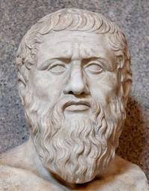
Doctrine of Reminiscence
Plato

Slide 18

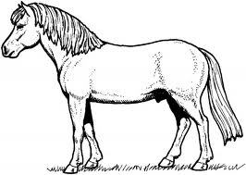

Von Restorff Effect

Slide 19
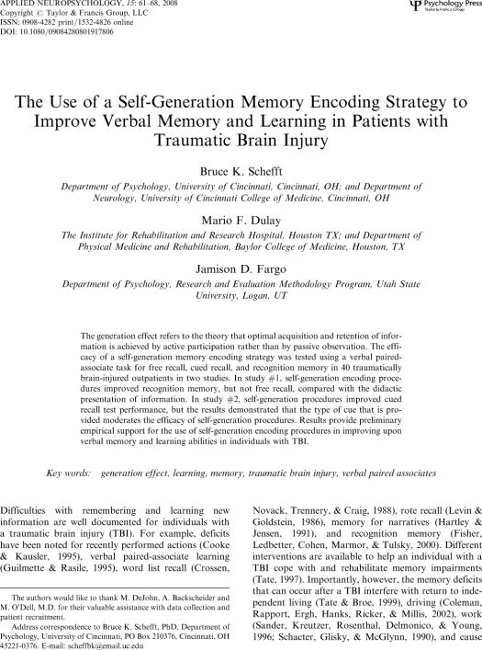

Slide 20
But Why the Red Sox?

Slide 21
Convinced?
1. Meaningfulness
2. Emotional Valence
3. Don’t forget the caregiver
4. Look to the past for the future
5. If in doubt, Remember the Red Sox!

