Slide 1
6.S196 / PPAT: Principles and Practice of Assistive Technology
Today: User-Centered Design
[C&H Ch. 4]
Friday, 16 Sept. 2011
Prof. Rob Miller

Slide 2
Today’s Topics
Design process
Iterative design
User-centered design
Information gathering
User analysis
Task analysis
Contextual inquiry
Defining success end-to-end
Notes:
Today’s lecture concerns two topics.
First, we’ll look at UI design from a very high-level, considering the shape of the process that we should use to build user interfaces. Iterative design is the current best-practice process for developing user interfaces. It’s a specialization of the spiral model described by Boehm for general software engineering.
Second, we’ll look at a specific kind of iterative design called the user-centered design process, which is a widely-accepted way to build user interfaces with good usability properties. Your term project is structured as a user-centered design process.

Slide 3
Iterative Design
Design
Evaluate
Build
Notes:
Iterative design offers a way to manage the inherent risk in system design. In iterative design, a system is refined by repeated trips around a design cycle: first imagining it (design), then realizing it physically (implementation), then testing it (evaluation).

Slide 4
Spiral Model
Design
Evaluate
Prototype
Notes:
The spiral model reduces the cost of iterating over a design. We build room for several iterations into our design process, and we do it by making the early iterations as cheap as possible.
The radial dimension of the spiral model corresponds to the cost of the iteration step – or, equivalently, its fidelity or accuracy. For example, an early prototype of a software user interface might be a paper sketch or mockup. It’s low-fidelity, only a pale shadow of what it would look and behave like as a finished product. But it’s incredibly cheap to make, and we can evaluate it by showing it to users and asking them questions about it.

Slide 5
Iterative Design of User Interfaces
Early iterations use cheap prototypes
Parallel design is feasible: build & test multiple prototypes to explore design alternatives
Later iterations use richer implementations, after UI risk has been mitigated
More iterations generally means better UI
Only mature iterations are seen by the world
Notes:
Why is the spiral model a good idea? Risk is greatest in the early iterations, when we know the least. So we put our least commitment into the early implementations. Early prototypes are usually intended to be thrown away. If we find ourselves with several design alternatives, we can build multiple prototypes (parallel design) and evaluate them, without as much expense.
After we have evaluated and redesigned several times, we have (hopefully) learned enough to avoid making a major design error. Then we build a prototype that we intend to keep. Then we evaluate it again, and refine it further.
The more iterations we can make, the more refinements in the design are possible. We’re hill-climbing here, not exploring the design space randomly. We keep the parts of the design that work, and redesign the parts that don’t. So we should get a better design if we can do more iterations.

Slide 6
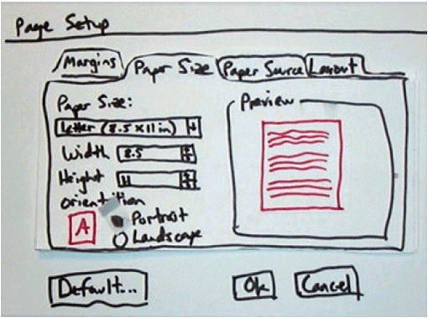


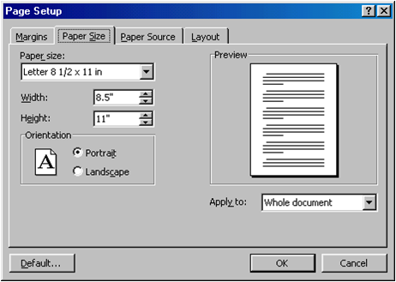
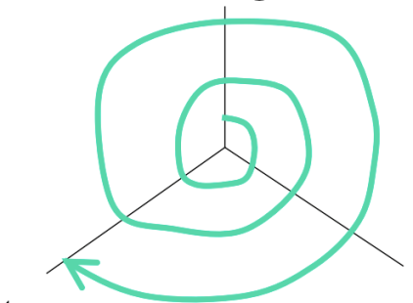
Early & Late Prototypes

Slide 7
User-Centered Design
Spiral design
repeated iterations of cheap prototypes
Early focus on users and tasks
user analysis: who the users are
task analysis: what they need to do
involving users as evaluators, consultants, and sometimes designers
Constant evaluation
users are involved in every iteration
every prototype is evaluated somehow
Notes:
Iterative design is a crucial part of user-centered design, the design process for user interfaces that is widely accepted among UI practitioners. It has three parts:
- iterative design using rapid prototyping
- early focus on users and tasks
- evaluation throughout the iterative design process.

Slide 8
User Analysis: Know Your Client
Identify characteristics of target user
Age, gender, culture, language
Education (literacy? numeracy?)
Functional limitations
Technology experience (computers? typing?)
Motivation, attitude
Relevant environment and other social context
Relevant relationships and communication patterns
Notes:
The reason for user analysis is straightforward: since you’re not the user, you need to find out who the user actually is.
User analysis seems so obvious that it’s often skipped. But failing to do it explicitly makes it easier to fall into the trap of assuming every user is like you. It’s better to do some thinking and collect some information first.
Knowing about the user means not just their individual characteristics, but also their situation. In what environment will they use your software? What else might be distracting their attention? What is the social context? A movie theater, a quiet library, inside a car, on the deck of an aircraft carrier; environment can place widely varying constraints on your user interface.
Other aspects of the user’s situation include their relationship to other users in their organization, and typical communication patterns. Can users ask each other for help, or are they isolated? How do students relate differently to lab assistants, teaching assistants, and professors?

Slide 9
Skills Evaluation: Sensory
Visual function
acuity, field, tracking, scanning
Visual perception
depth, spatial relationships
Tactile function
Auditory function
Notes:
C&H, Ch. 4, pp 101-107

Slide 10
Skills Evaluation: Motor
Range of motion
Muscle strength
Muscle tone
Balance
Tremor/involuntary movement
Functional grasp patterns
Notes:
C&H, Ch. 4, pp 101-107

Slide 11
Skills Evaluation: Cognitive
Memory
Problem-solving
Sequencing
Language

Slide 12
Skills Assessment
Bring a questionnaire
Sample assessment forms in C&H Ch. 4, pp. 128-142
Don’t have to ask every question
Focus on assessments likely to be relevant to target user and target activity
Which sensory evaluations are relevant to a blind client?
vision? audio? tactile?

Slide 13
Task Analysis
Identify the individual tasks the assistive technology might address
Each task is a goal (what)
Start with a high-level activity
Then decompose it hierarchically into subtasks (how)
Notes:
The next step is figuring out what tasks are involved in the problem. A task should be expressed as a goal: what needs to be done, not how. You’ll get into the how – those are the subtasks of the task – but it’s important to start by expressing the goal, so you don’t miss the forest for the trees.
One good way to get started on a task analysis is hierarchical decomposition. Think about the overall problem you’re trying to solve. That’s really the top-level task. Then decompose it into a set of subtasks, or subgoals, that are part of satisfying the overall goal.

Slide 14
Essential Parts of Task Analysis
What needs to be done?
Goal
What must be done first to make it possible?
Preconditions
Tasks on which this task depends
Information that must be known to the user
What steps are involved in doing the task?
Subtasks
may be further decomposed, recursively
Notes:
Once you’ve identified a list of tasks, fill in the details on each one. Every task in a task analysis should have at least these parts.
The goal is just the name of the task, like “send an email message.”
The preconditions are the conditions that must be satisfied before it’s reasonable or possible to attempt the task. Some preconditions are other tasks in your analysis; e.g., before you can listen to your messages in the Olympic Message System, you first have to log in. Other preconditions are information needs, things the user needs to know in order to do the task. For example, in order to send an email message, I need to know the email addresses of the people I want to send it to; I may also need to look at the message I’m replying to.
Preconditions are vitally important to good UI design, particularly because users don’t always satisfy them before attempting a task, resulting in errors. Knowing what the preconditions are can help you prevent these errors, or at least render them harmless. For example, a precondition of starting a fire in a fireplace is opening the flue, so that smoke escapes up the chimney instead of filling the room. If you know this precondition as a designer, you can design the fireplace with an interlock that ensures the precondition will be met. Another design solution is to offer opportunities to complete preconditions: for example, an email composition window should give the user access to their address book to look up recipients’ email addresses.
Finally, decompose the task into subtasks, individual steps involved in doing the task. If the subtasks are nontrivial, they can be recursively decomposed in the same manner.

Slide 15
Other Questions to Ask About a Task
Where is the task performed?
What is the environment like?
noisy, dirty, dangerous, crowded
How often is the task performed?
What are its time or resource constraints?
What can go wrong?
exceptions, errors, emergencies
Who else is involved in the task?
What assistive technology (if any) is the client currently using for the task?
Notes:
There are lots of questions you might ask about each task.

Slide 16
Common Errors in Task Analysis
Thinking from the system’s point of view, rather than the user’s
“Notify user about appointment”
vs. “Get a reminder about appointment”
Fixating too early on a UI design vision
“A bell will ring to remind the user about an appointment…”
Bogging down in what the client does now (concrete tasks), rather than why they do it (essential tasks)
“Save file to disk”
vs. “Make sure my work is kept”
Duplicating a flawed existing method in your design
Failing to capture good aspects of existing method
Notes:
The requirements mindset can also affect task analysis. If you’re writing down tasks from the system’s point of view, like “Notify user about appointment”, then you’re writing requirements (what the system should do), not tasks (what the user’s goals are). Sometimes this is merely semantics, and you can just write it the other way; but it may also mean you’re focusing too much on what you think the system can do, rather than what the user needs. Tradeoffs between user goals and implementation feasibility are inevitable, but you don’t want them to dominate your thinking at this early stage of the game.
Task analysis derived from observation may give too much weight to the way things are currently done. A task analysis that breaks down the steps of a current system is concrete. For example, if the Log In task is broken down into the subtasks Enter username and Enter password, then this is a concrete task relevant only to a system that uses usernames and passwords for user identification. If we instead generalize the Log In task into subtasks Identify myself and Prove my identity, then we have an essential task, which admits much richer design possibilities when it’s time to translate this task into a user interface.
A danger of concrete task analysis is that it might preserve tasks that are inefficient or could be done a completely different way in software. Suppose we did a task analysis by observing users interacting with paper manuals. We’d see a lot of page flipping: “Find page N” might be an important subtask. We might naively conclude from this that an online manual should provide really good mechanisms for paging & scrolling, and that we should pour development effort into making those mechanisms as fast as possible. But page flipping is an artifact of physical books! It would pay off much more to have fast and effective searching and hyperlinking in an online manual. That’s why it’s important to focus on why users do what they do (the essential tasks), not just what they do (the concrete tasks).
An incomplete task analysis may fail to capture important aspects of the existing procedure. In one case, a dentist’s office converted from manual billing to an automated system. But the office assistants didn’t like the new system, because they were accustomed to keeping important notes on the paper forms, like “this patient’s insurance takes longer than normal.” The automated system provided no way to capture those kinds of annotations. That’s why interviewing and observing real users is still important, even though you’re observing a concrete task process.

Slide 17
Hints for Better Task Analysis
Questions to ask
Why do you do this? (goal)
How do you do it? (subtasks)
Look for weaknesses in current situation
Goal failures
Wasted time
User irritation or fatigue
Notes:
When you’re interviewing users, they tend to focus on the what: “first I do this, then I do this…” Be sure to probe for the why and how as well, to make your analysis more abstract and at the same time more detailed.
Since you want to improve the current situation, look for its weaknesses and problems. What tasks often fail? What unimportant tasks are wasting lots of time? It helps to ask the users what annoys them and what suggestions they have for improvement.
There are two other techniques for making user and task analysis more effective: contextual inquiry and participatory design, described on the next slides.

Slide 18
Contextual Inquiry
Observe client doing the tasks in their real environment
Be concrete
Establish a master-apprentice relationship
Client shows how and talks about it
You watch and ask questions
Challenge your own assumptions
Share your assumptions openly with client
Probe surprises
Notes:
The best sources of information for task analysis are user interviews and direct observation. Usually, you’ll have to observe how users currently perform the task. Contextual inquiry is a technique that combines interviewing and observation, in the user’s actual environment, doing and discussing the actual tasks. Contextual inquiry fosters strong collaboration between the designers and the users. (Wixon, Holtzblatt & Knox, “Contextual design: an emergent view of system design”, CHI ’90)

Slide 19
Participatory Design
Include user directly in the design team
Notes:
Participatory design goes a step farther by including users directly on the design team – participating in the task analysis, proposing design ideas, helping with evaluation. This is particularly vital when the target users have much deeper domain knowledge than the design team. It would be unwise to build an interface for stock trading without an expert in stock trading on the team, for example.

Slide 20
Success Metrics
Choose evaluation metric(s) with client
efficiency: time on task
success rate
errors: frequency or severity
fatigue: how many times task can be done
Set quantitative and qualitative targets
“get dressed in 2 minutes”
“make coffee without assistance”
“control my bed while hand is holding something else”
Use the metrics and targets in subsequent process
evaluate on system models
predict outcome
measure on prototypes

Slide 21
Challenges for UCD for Assistive Technology
Cognitive impairments
May need to include others in information-gathering
Hidden impairments
May be hard to find people
Notes:
One of the messages of this lecture is that user-centered design (UCD) for people with disabilities is actually very similar to user-centered design for the general population: early focus on the users and their tasks, iterative design with rapid prototyping, and constant evaluation remain useful techniques.
But here are a couple ways that UCD can be tricky when aimed at assistive technology.
First, if you’re aiming to help people with cognitive impairments that limit their ability to communicate or understand, the information-gathering steps (contextual inquiry) needs to draw help from people other than the target users. You need to do this in a way that still respects the individuality and autonomy of the target user: recognizing what they can help with in the process and what they can’t, and engaging the appropriate mix of family, caregivers, medical providers, whoever is important. The first step in your inquiry for cases like that should certainly be to collect information about which people to include in the inquiry.
Second, targeting hidden impairments can sometimes be challenging, because it may be hard to find target users willing to work with you. Hidden cognitive impairments include attention-deficit hyperactivity disorder (ADHD), autism spectrum, dyslexia, and learning disabilities; hidden physical impairments include chronic pain or chemical sensitivity. Many people with these impairments keep them hidden in order to avoid stigmatization. Their intimates and doctors may know about the problem, but not strangers. So if, for example, you try to find people with learning disabilities to talk to by putting up flyers around campus, you may not get any responses at all.

Slide 22
Summary
User-centered design manages project risk and stays focused on user needs
User analysis assesses the client
Task analysis discovers their tasks
Success metric keeps you on track

