Slide 1
Responding to the Changing Adaptive Equipment Needs
of Individuals with Neurodegenerative Disorders
Don Fredette
Adaptive Equipment Specialist
The Boston Home
Notes:
Title Page. Responding to the Adaptive Equipment Need of Individuals with Neurodegenerative Disorders

Slide 2
“Myelin dissolves, nerves short out, muscle atrophies, but the old brain, riddled now with sclerotic patches, goes on wailing, ‘I can do it myself!’ ”
Nancy Mairs
Notes:
This work to me is about empowerment
People don’t want to be dependent on others for all their needs

Slide 3
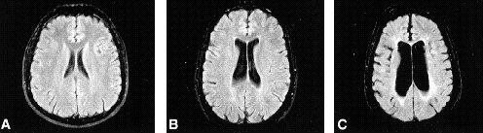
Brain Atrophy
Reprinted with permission from Rudick RA et al. Neurology. 1999;53:1698-1704.
Notes:
Brain Atrophy
This slide illustrates the process of brain atrophy. Panel A is from a 31-year-old healthy man; panel B, a 36-year-old woman with RRMS of 2 years’ duration; and panel C, a 43-year-old woman with secondary-progressive MS (SPMS) of 19 years’ duration.¹
Axial cranial MRI scans in 3 individuals show increasing ventricular size with decreasing brain parenchymal fractions (BPFs).
1. Rudick RA, Fisher E, Lee J-C, et al. Use of the brain parenchymal fraction to measure whole brain atrophy in relapsing-remitting MS. Neurology. 1999;53:1698-1704.

Slide 4
Pathology of MS
An immune-mediated disease in genetically susceptible individuals
Demyelination leads to slower nerve conduction
Axonal injury and destruction are associated with permanent neurological dysfunction
Lesions occur in optic nerves, periventricular white matter, cerebral cortex, brain stem, cerebellum, and spinal cord
Trapp BD et al. N Engl J Med. 1998;338:278-285.
Notes:
Pathology of MS
Inflammation leads to loss of the myelin sheath, or demyelination, which slows conduction along the nerve axon and leads to neurological symptoms.
When the inflammation associated with an acute attack lessens, the symptoms abate. However, there is evidence that the nerve axons are also damaged due to MS, and this damage is associated with permanent neurological dysfunction.¹
MS lesions tend to occur in specific areas of the central nervous system (CNS):
Optic nerves
Periventricular white matter
Brain stem
Cerebellum
Spinal cord
The specific type of symptoms a patient experiences is related to the location of the lesions within the CNS.
When acute inflammation lessens, symptoms remit, either partially or completely.
1. Trapp BD, Peterson J, Ranshoff RM, et al. Axonal transection in the lesions of multiple sclerosis. N Engl J Med. 1998;338:278-285.

Slide 5
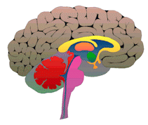
Sources of Symptoms
Symptoms vary widely in incidence and severity
Cognitive loss
Emotional disinhibition
Tremor,
Ataxia
Optic neuritis
Diplopia
Vertigo
Dysarthria
INO
Sensory symptoms,
Lhermitte’s
Pain
Proprioception
Bladder dysfunction
Notes:
Sources of Symptoms
Symptoms can be described on the basis of the area of the CNS that is involved.¹
Inflammation of the optic nerve can cause retrobulbar pain, color desaturation, and visual loss.
Brain stem lesions may cause changes in eye movement, such as diploplia; can also cause vertigo, dysarthria, dysphagia, and facial weakness.
Cerebellar lesions may cause ataxia and tremor.
Spinal cord lesions may cause bowel, bladder, and sexual dysfunction, and spastic gait difficulties.
Cerebral and corpus callosum lesions, as well as generalized brain atrophy, may cause cognitive dysfunction.
Common symptoms in diagnosed MS can include²:
Fatigue
Pain
Spasticity
Elimination dysfunctions
Cognitive impairment
Sexual dysfunction
1. Vollmer T. Multiple sclerosis: the disease and its diagnosis. In: van den Noort S, Holland NJ, eds. Multiple Sclerosis in Clinical Practice. New York: Demos; 1997:7.
2. Costello K, Hill CA, Tranter MC. Multiple sclerosis in the primary care setting: key issues for diagnosis and management. American Journal for Nurse Practitioners. 2000;October:9-30.

Slide 6
Common MS Symptoms
Fatigue
Depression
Focal muscle weakness
Visual changes
Bowel/bladder/sexual dysfunction
Gait problems/spasticity
Paresthesias
Notes:
Common MS Symptoms
MS patients may experience a wide range of symptoms.
Symptoms can be described on the basis of the area of the CNS that is involved.¹
It is extremely important to address these symptoms promptly and effectively, since they can lead to other problems and can profoundly affect patients’ quality of life.
Common MS symptoms can include:
Fatigue
Depression
Focal muscle weakness
Visual changes
Bowel/bladder/sexual dysfunction
Gait problems/spasticity
Paresthesias (abnormal touch sensations, such as burning or prickling)
1. Costello K, Hill CA, Tranter MC. Multiple sclerosis in the primary care setting: key issues for diagnosis and management. American Journal for Nurse Practitioners. 2000;October:9-30

Slide 7
Less Common MS Symptoms
Dysarthria, scanning speech, dysphagia
Lhermitte’s phenomenon
Neuritic pain
Vertigo/ataxia
Cognitive dysfunction
Tremor/incoordination
Notes:
Less Common MS Symptoms
Less common MS symptoms can include:
Dysarthria, scanning speech, dysphagia
Lhermitte’s sign
Neuritic pain
Vertigo/ataxia
Cognitive dysfunction
Tremor/incoordination

Slide 8
Rare MS Symptoms
Decreased hearing
Seizures
Tinnitus
Mental disturbance
Paralysis
Notes:
Rare MS Symptoms
Rare MS symptoms can include:
Decreased hearing
Seizures
Tinnitus (ringing in the ears)
Mental disturbance
Paralysis

Slide 9
Implications of MS
Cognition
Speech
Fatigue
Pressure wounds
Vision
Impaired Memory
Depression
Spasticity
Decreased Motor Function

Slide 10
Rehabilitation
Nursing
Mental Health
Social Services
Occupational Therapy
Physical Therapy
Mobility

Slide 11
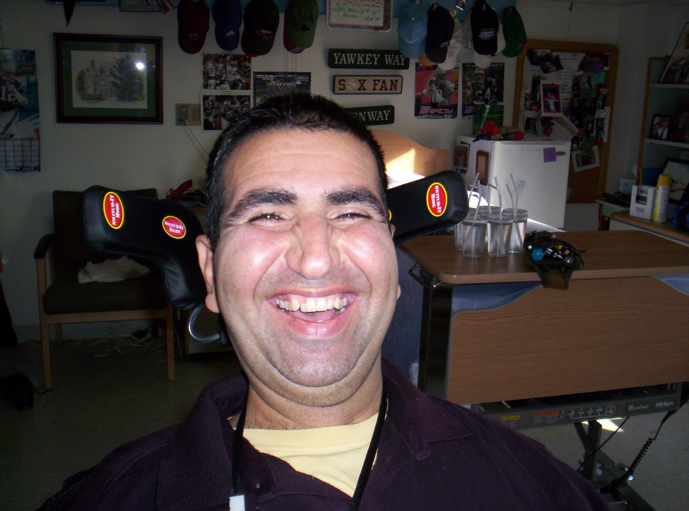
Farzin
Notes:
Farzin is 10 year resident of the Boston Home and one of the participants in the PPAT course,

Slide 12
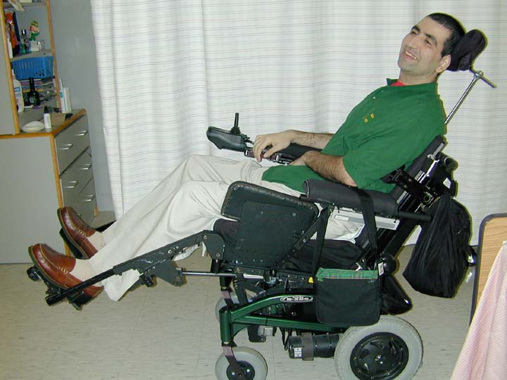
Early Days at TBH
Notes:
At the time of his arrival at the Boston Home, Farzin was able to operate his power chair with a standard proportional Joystick

Slide 13
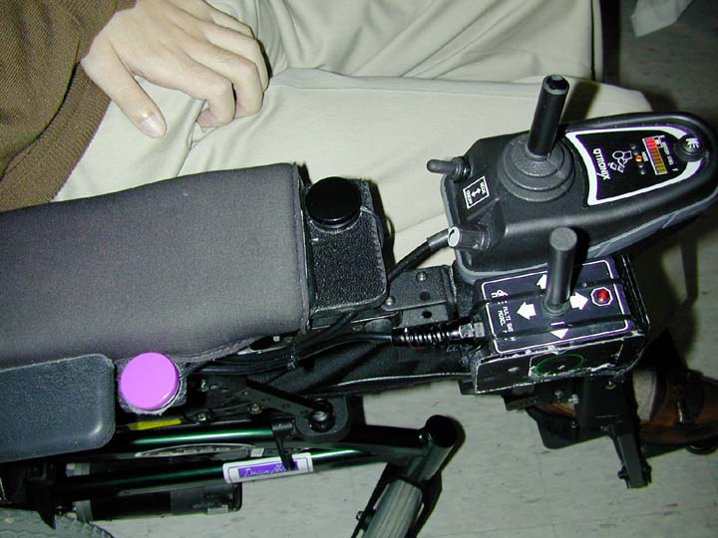
Notes:
With increasing difficulty in operating the toggle switch on the hand control, adapted switches and button switches were added. This allowed Farzin to continue to operate his tilt, recline and elevating leg rest functions.

Slide 14
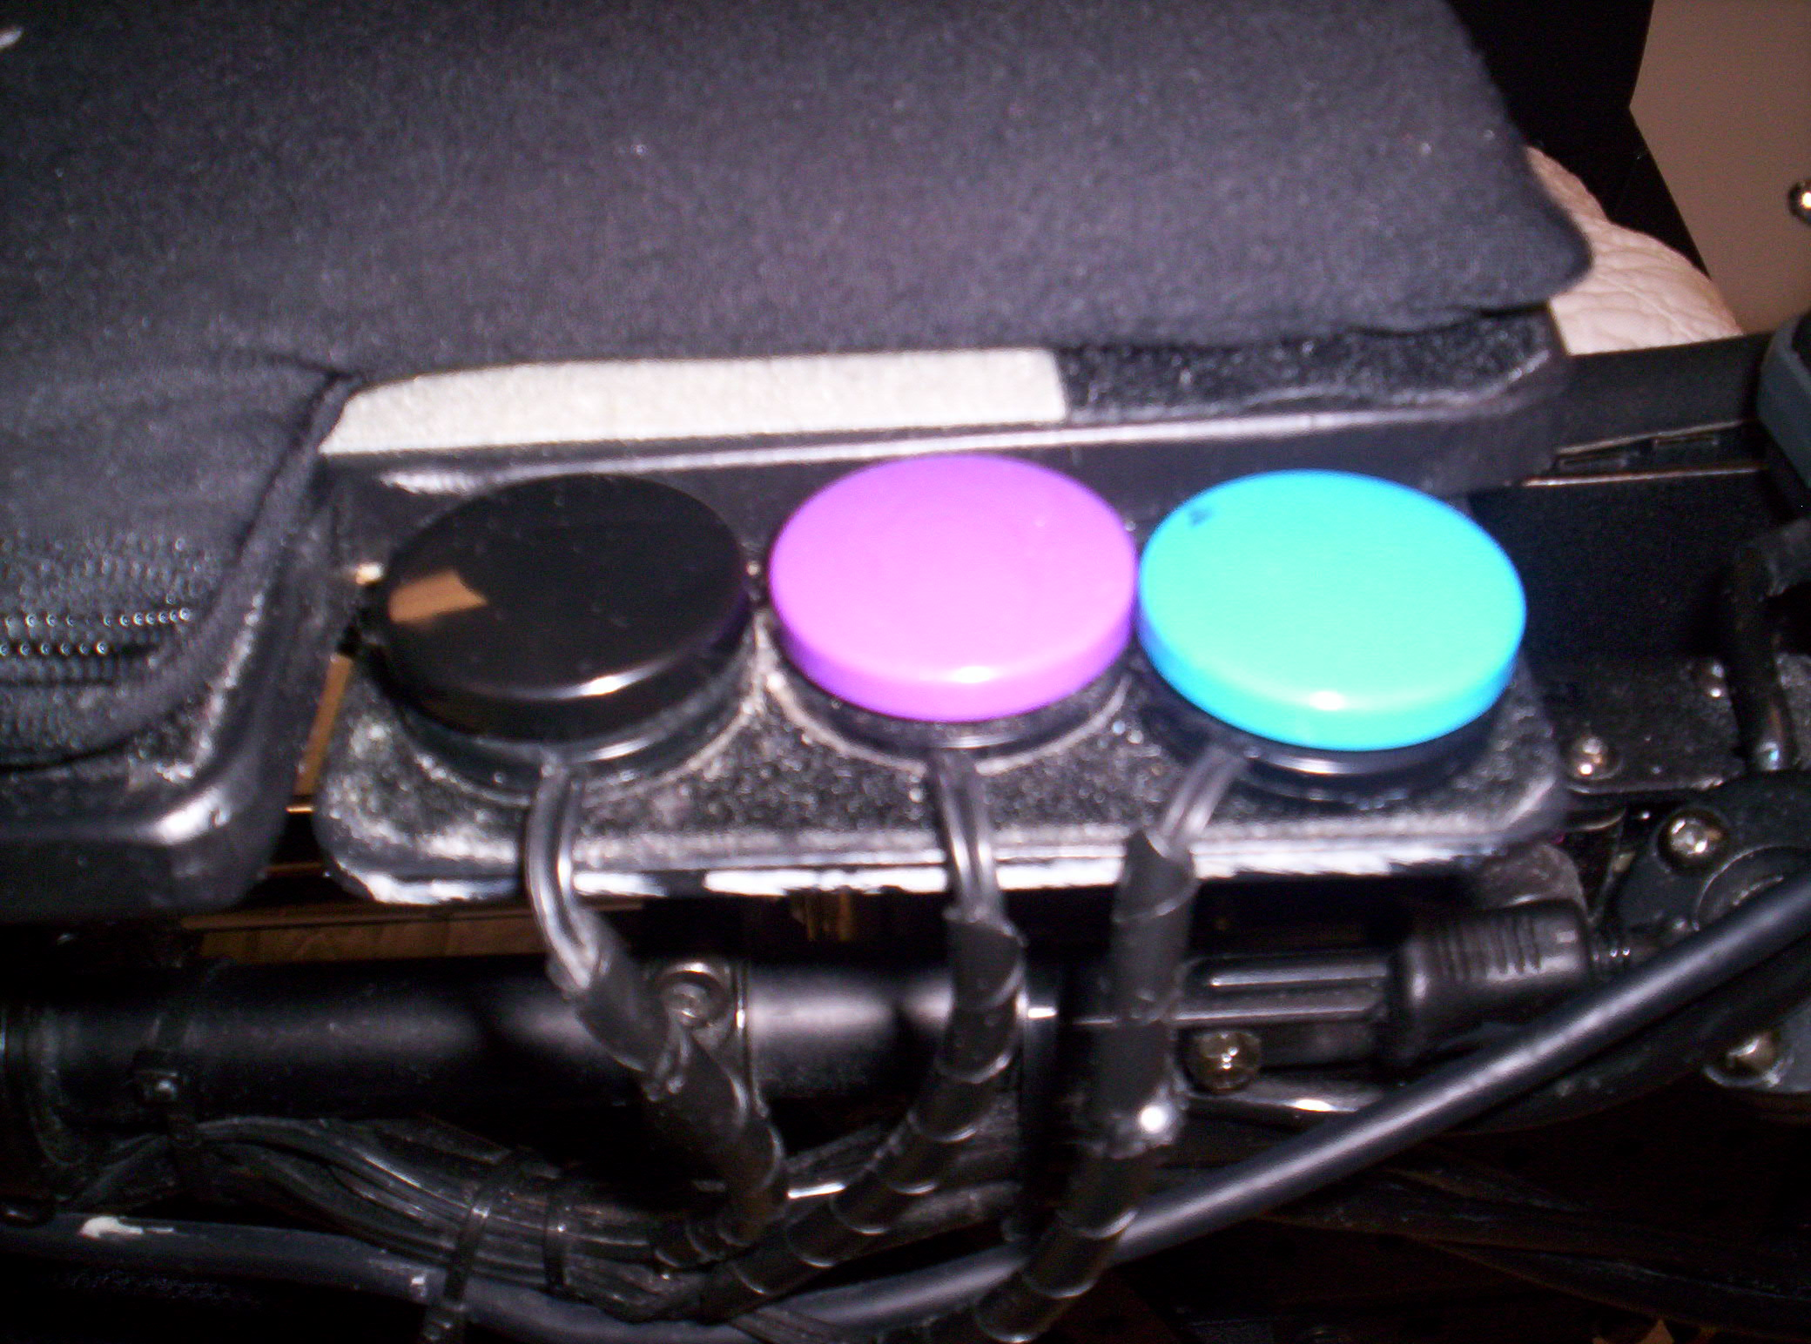
Notes:
A cluster of switches were added to accommodate a limited range of motion.

Slide 15
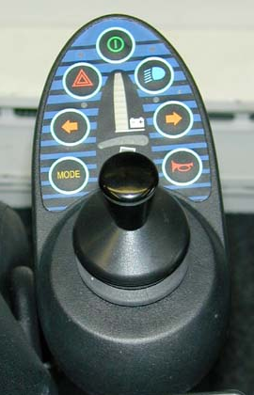
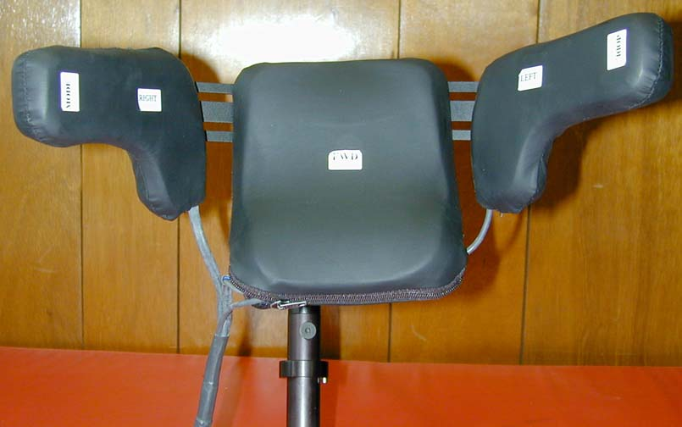
Drive Control Systems
Notes:
With decreasing hand function we soon added a proportional head array and a special converter switch which allowed Farzin to switch between hand control and head control as his fatigue increase as the day progressed.

Slide 16
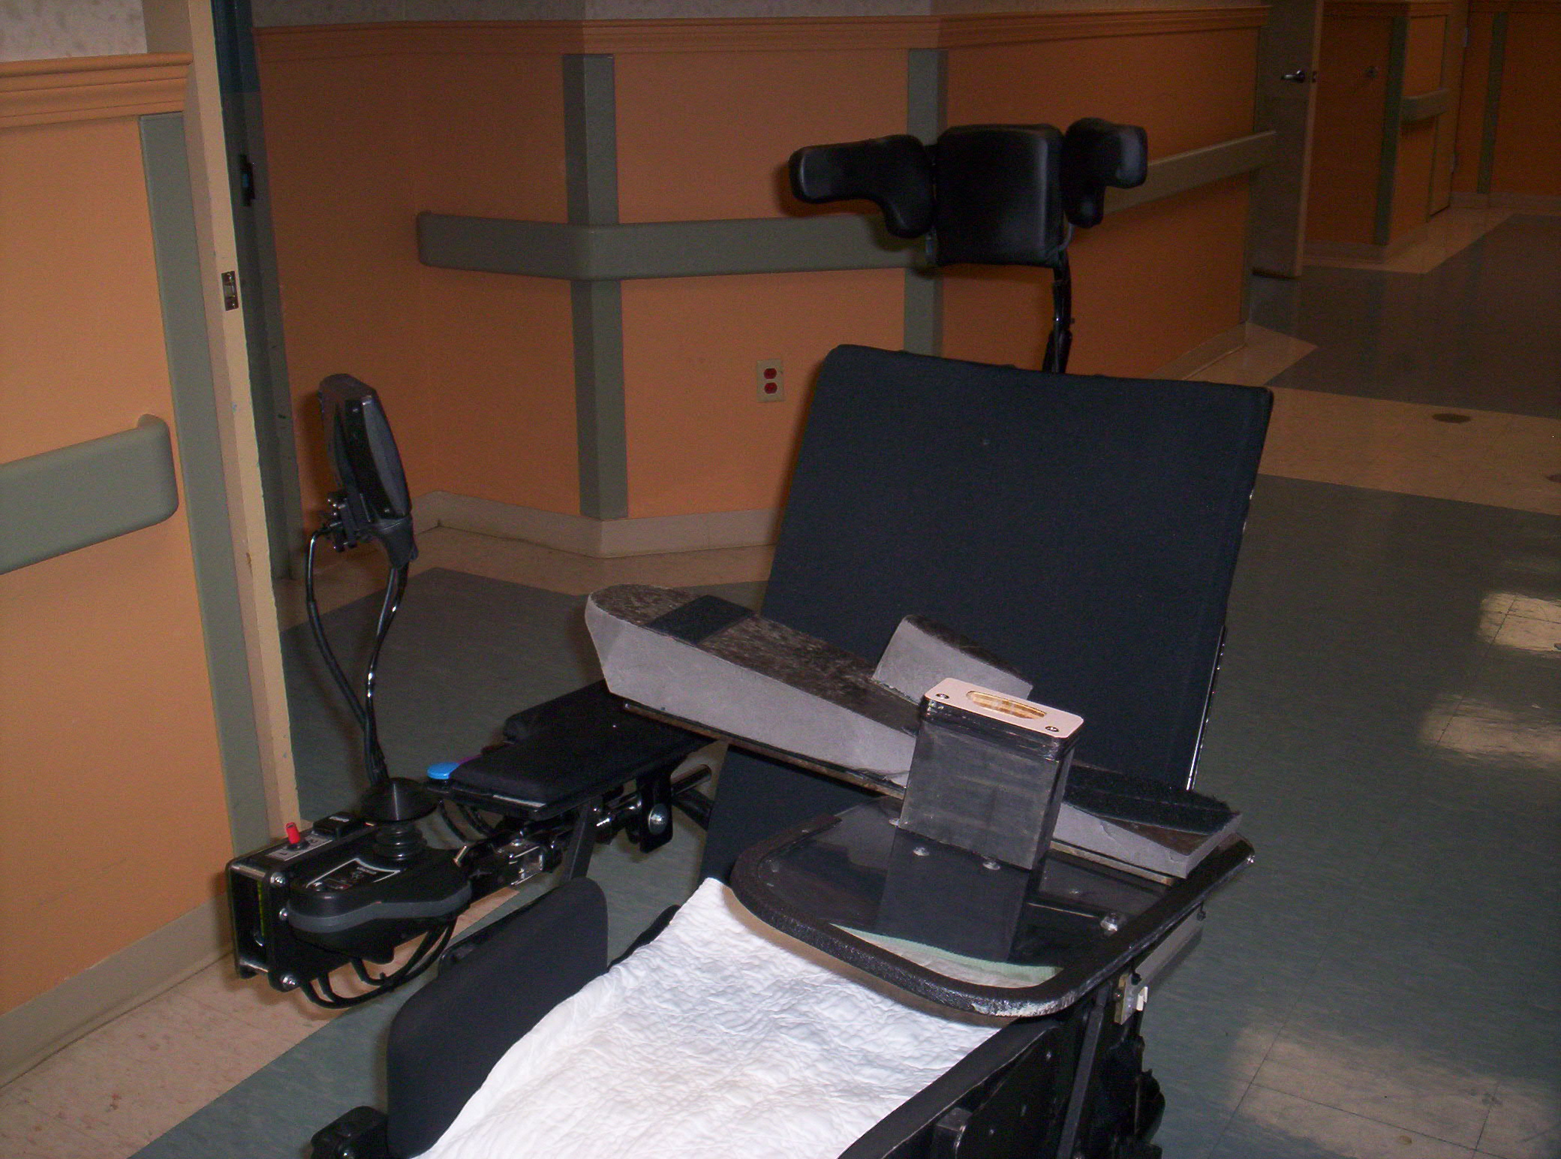
Notes:
The drive function switchbox is located to the right of the hand control and swings away with the joystick to allow increased access to tables and allow for easier transfers. The custom ½ tray provided for left arm and was angled to help control edema. A tall display allows the user to observe and control the alternative drive and accessory functions of the chair.

Slide 17
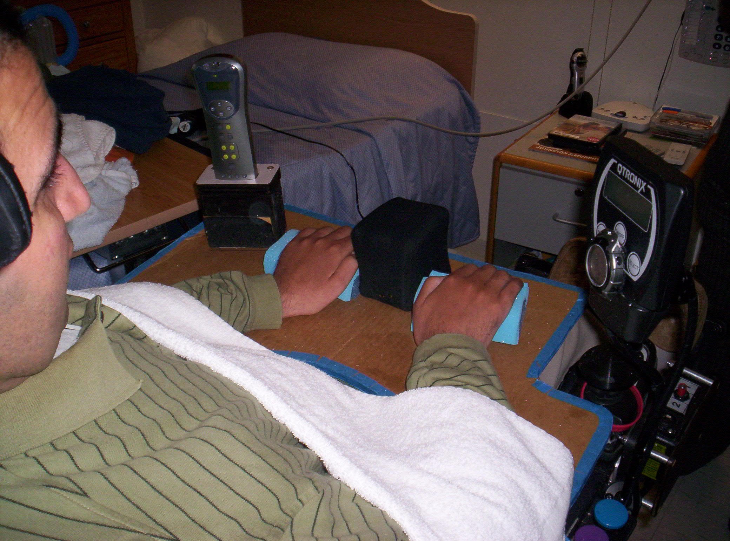
Notes:
With no functional movement left in Farzin’s right arm a tray and hand padding was built for improved upper extremity support. Here you will see a cardboard template that was constructed to finalize the details of the tray.

Slide 18
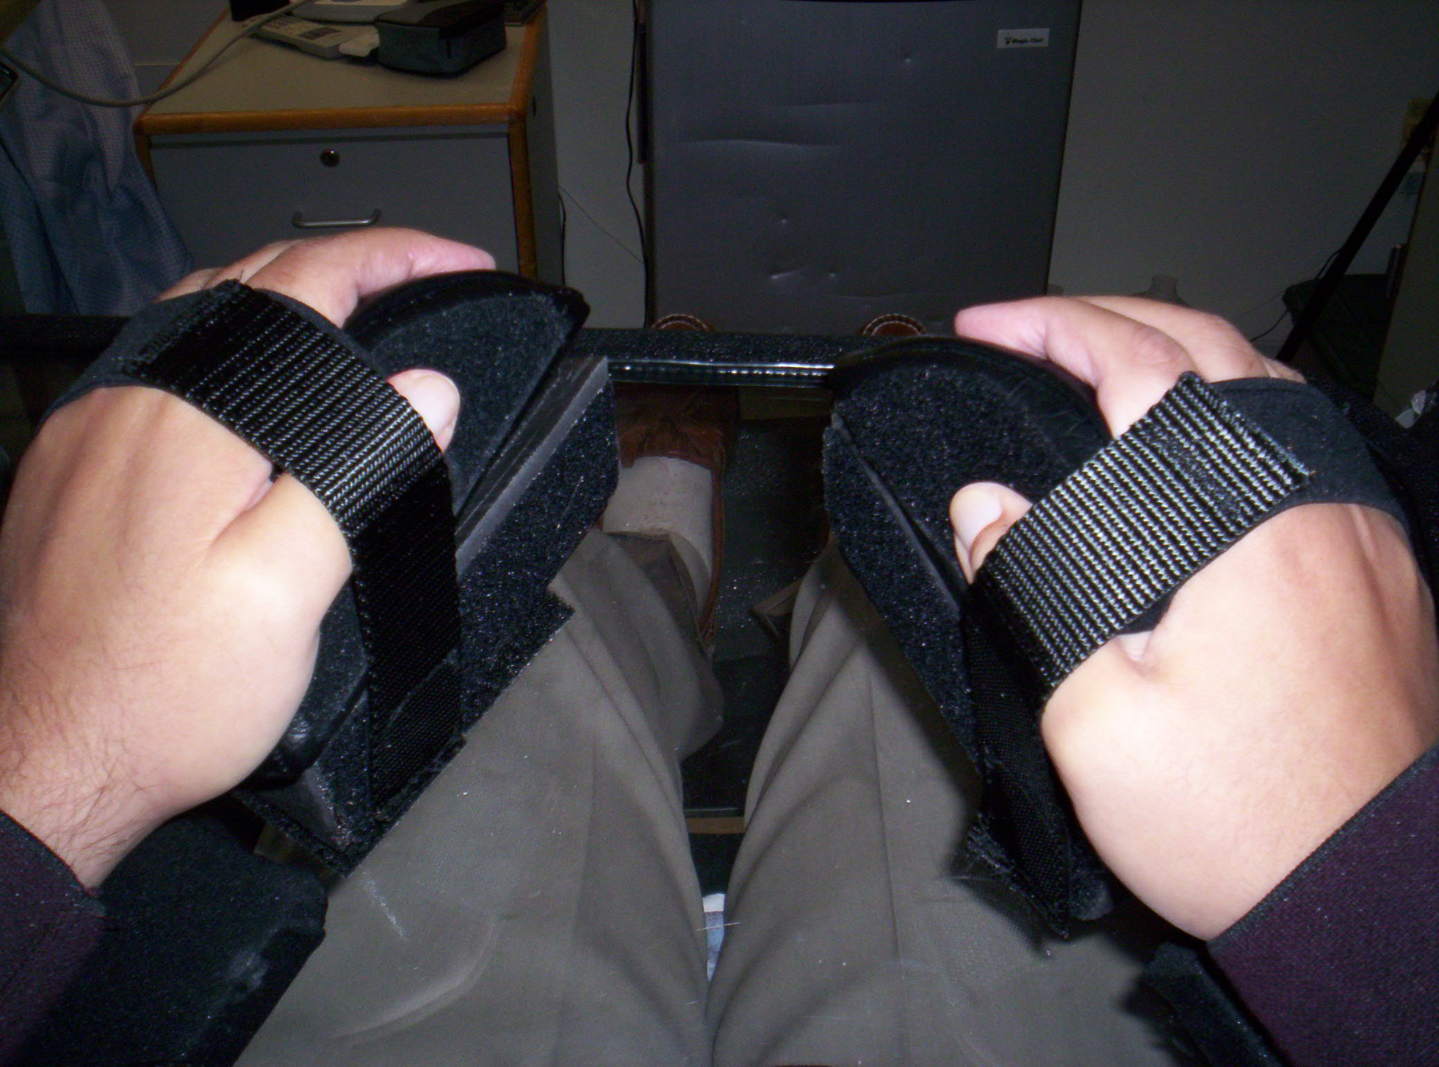
Notes:
Padded hand supports provided a comfortable support surface and position hands at an ideal angle.

Slide 19
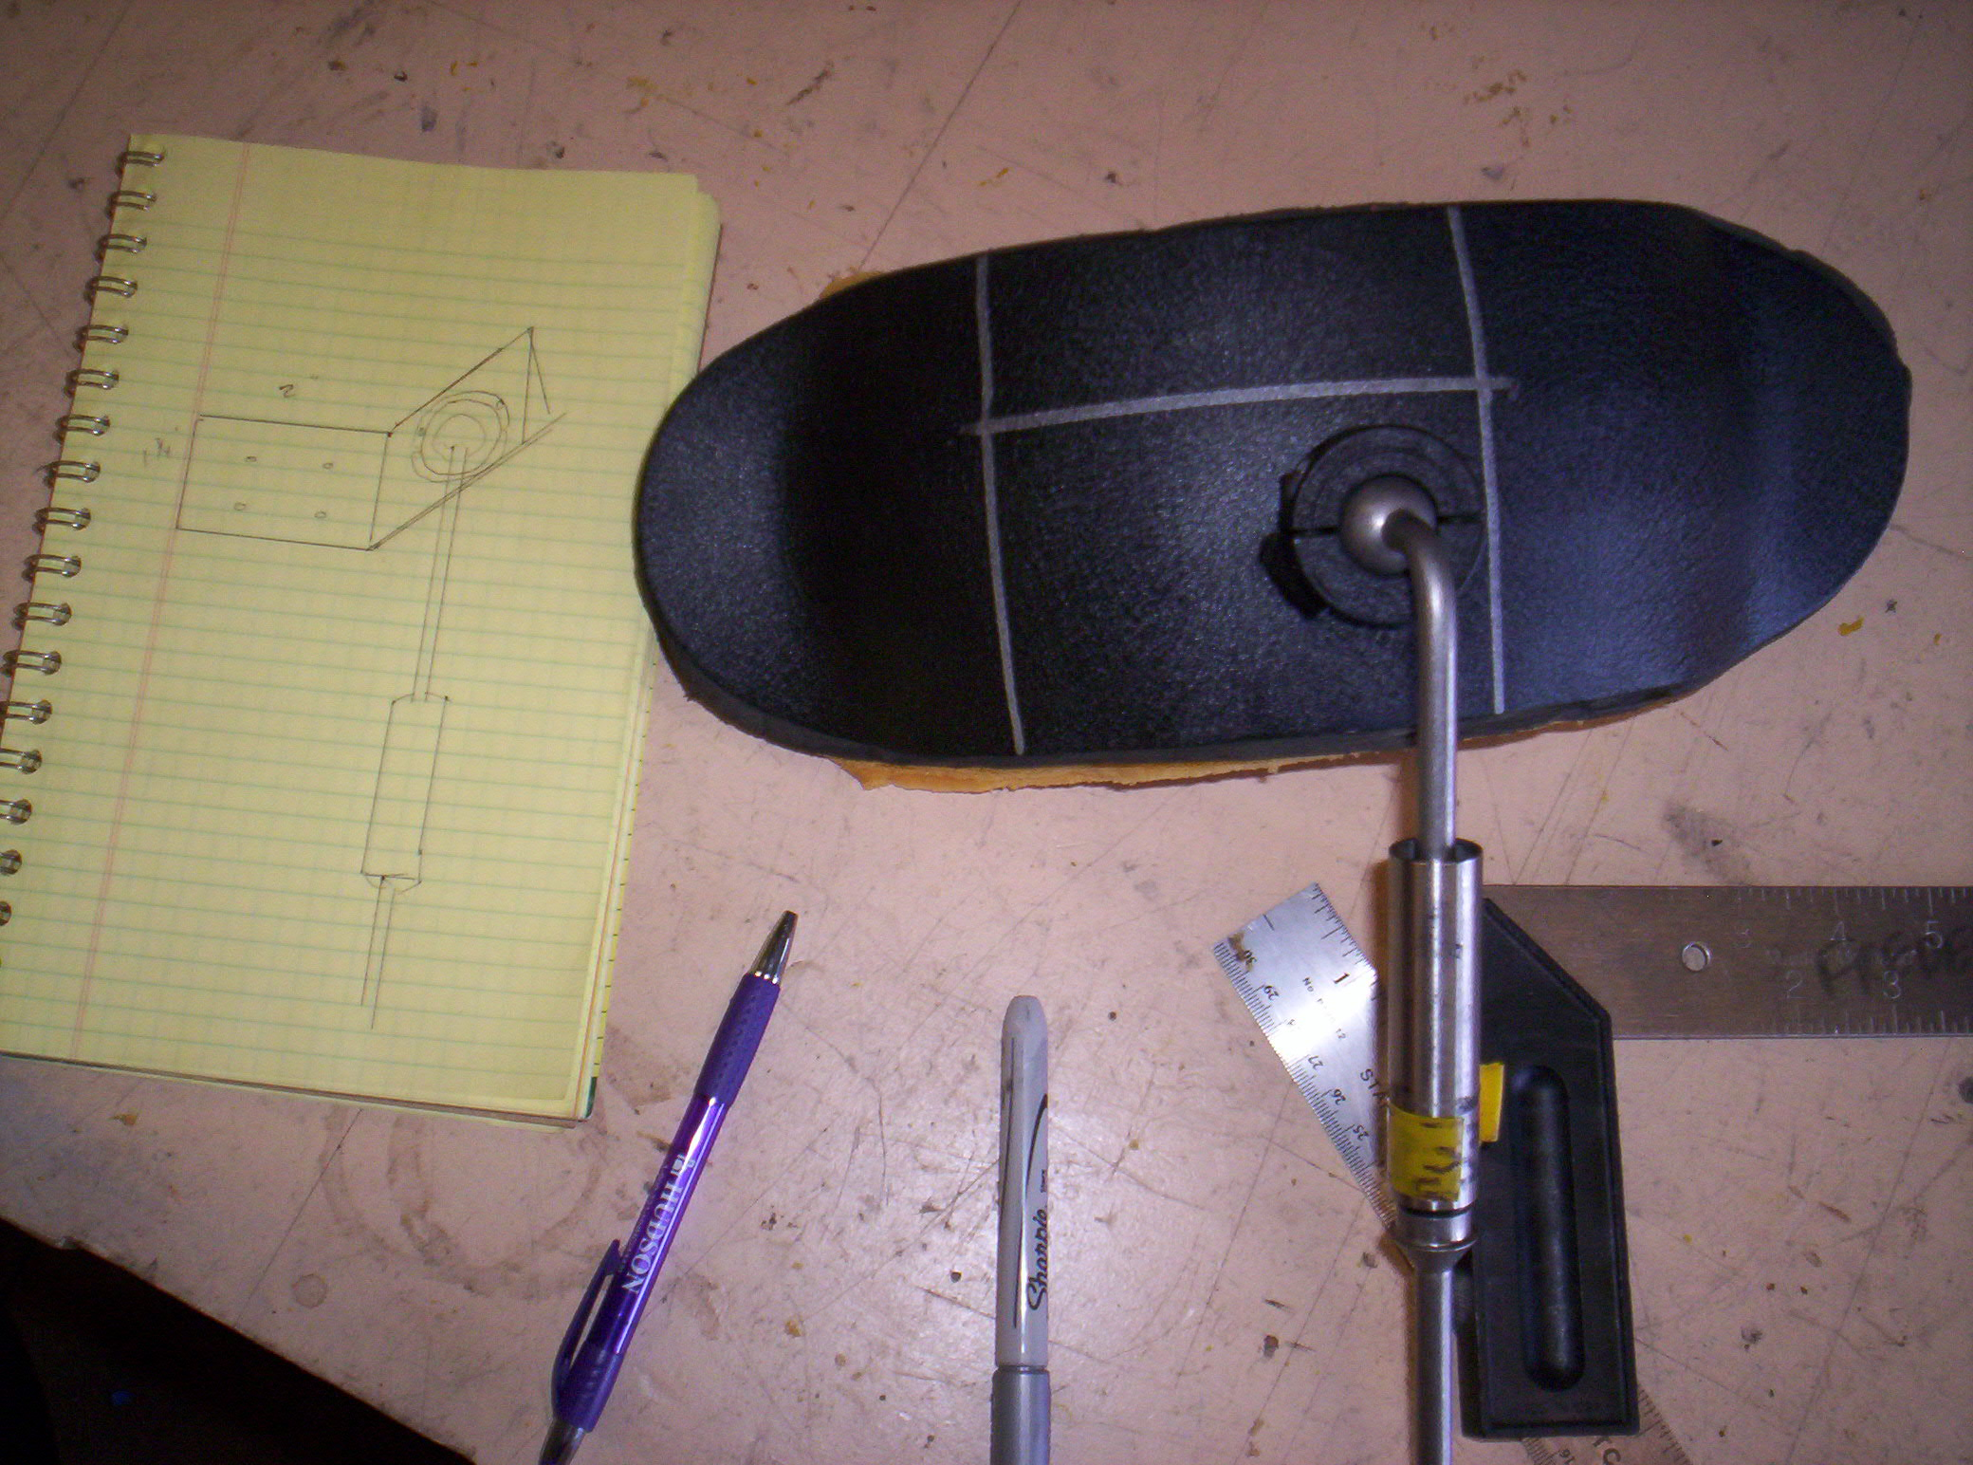
Notes:
Farzin is always looking for creative solutions for unique challenges. The tall display impeded easy transfers. The next series of sides demonstrate how a flip down display support was created using headrest components and basic shop tools and construction techniques

Slide 20
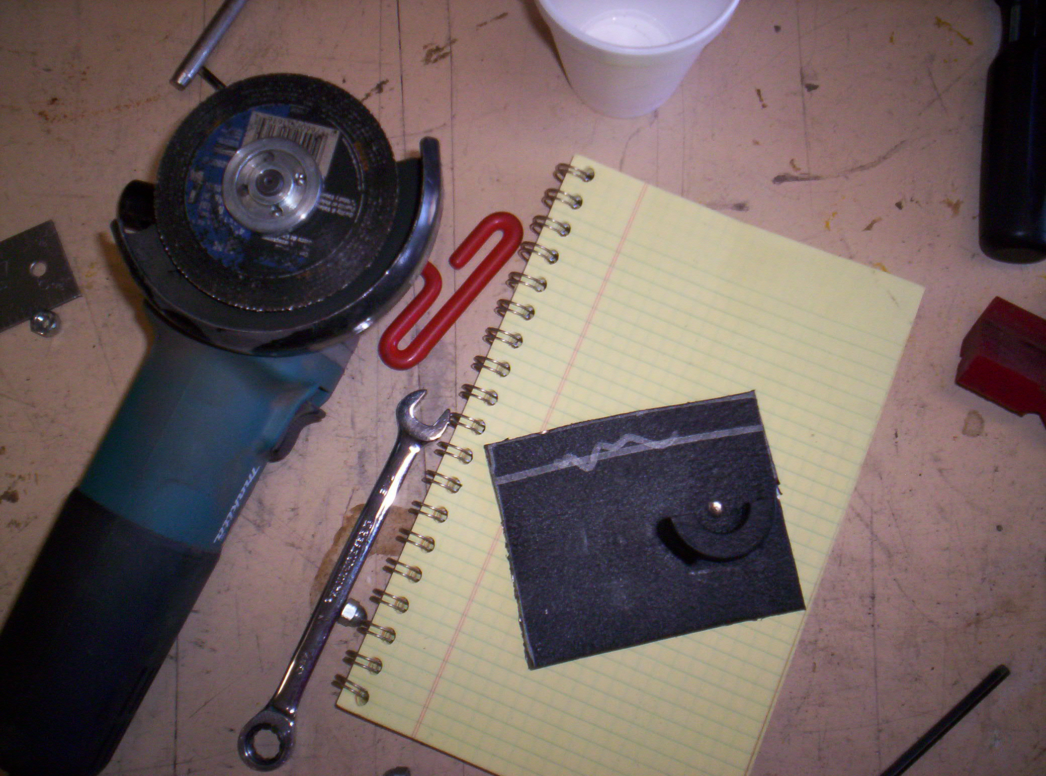

Slide 21
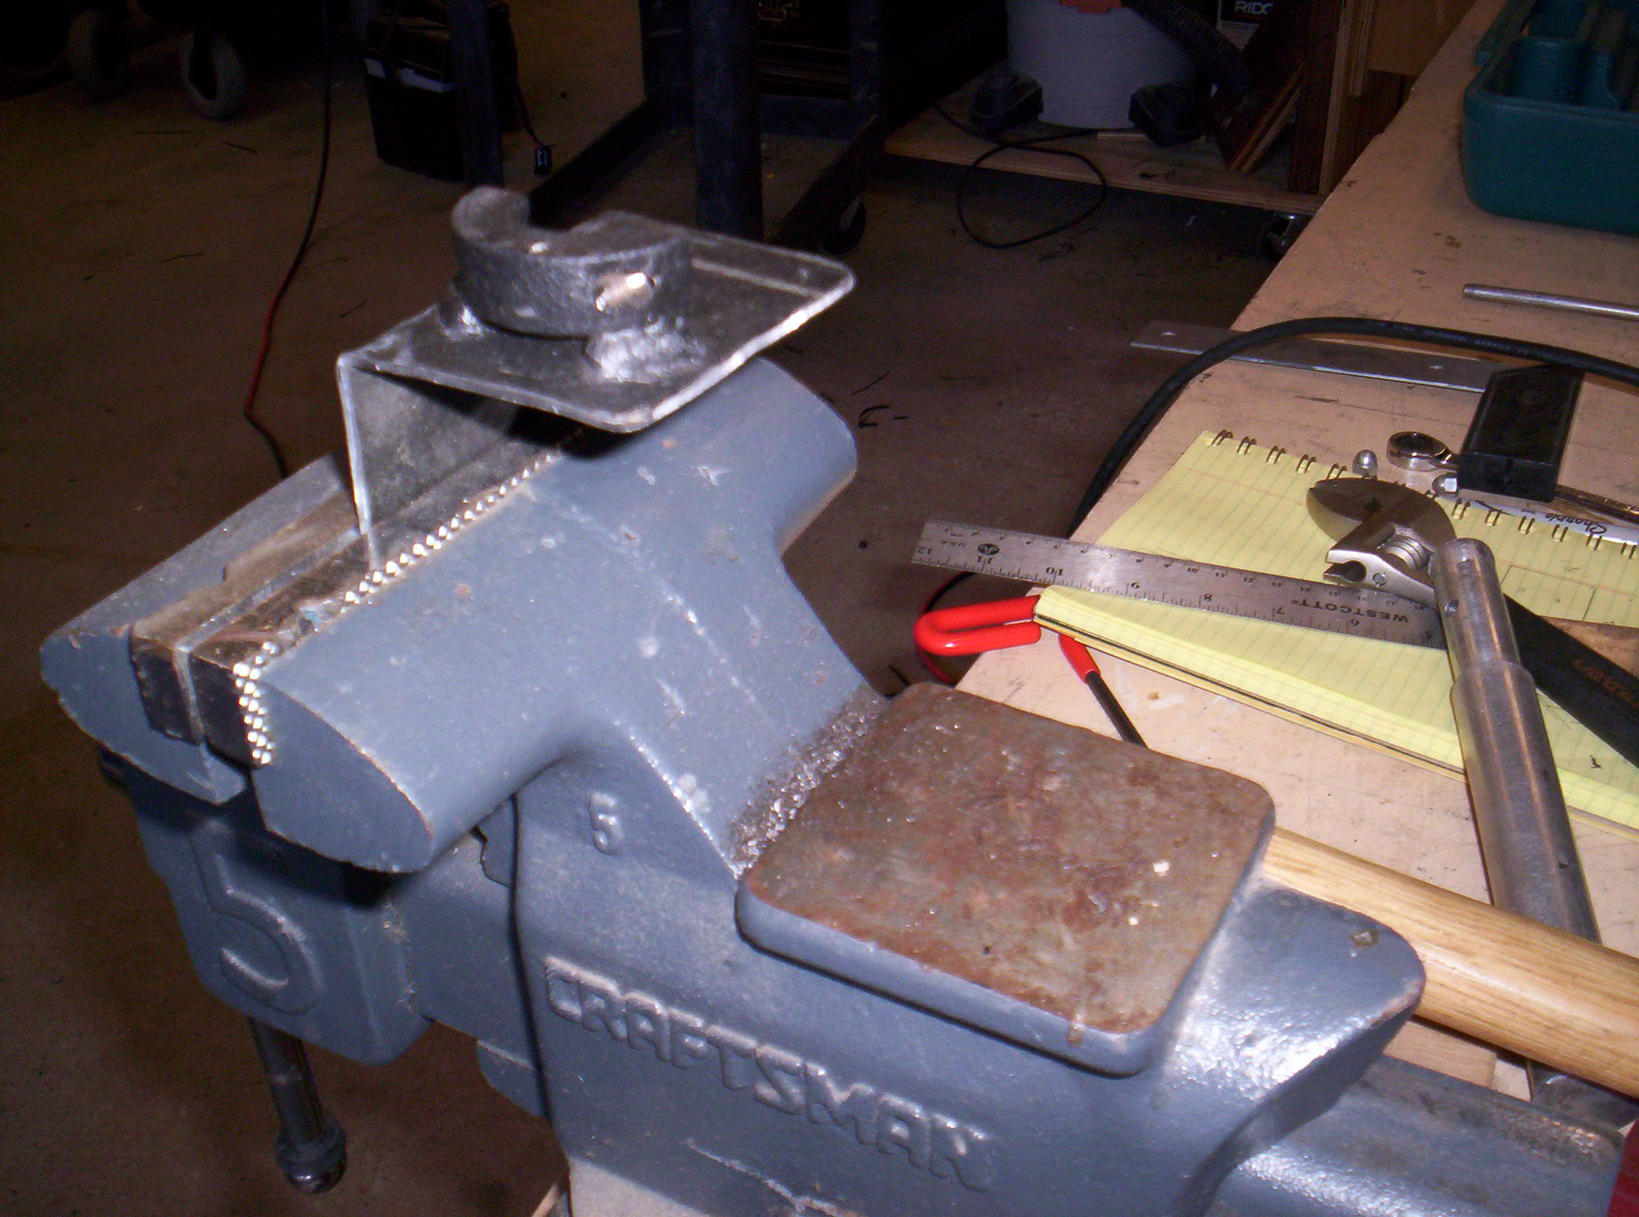

Slide 22
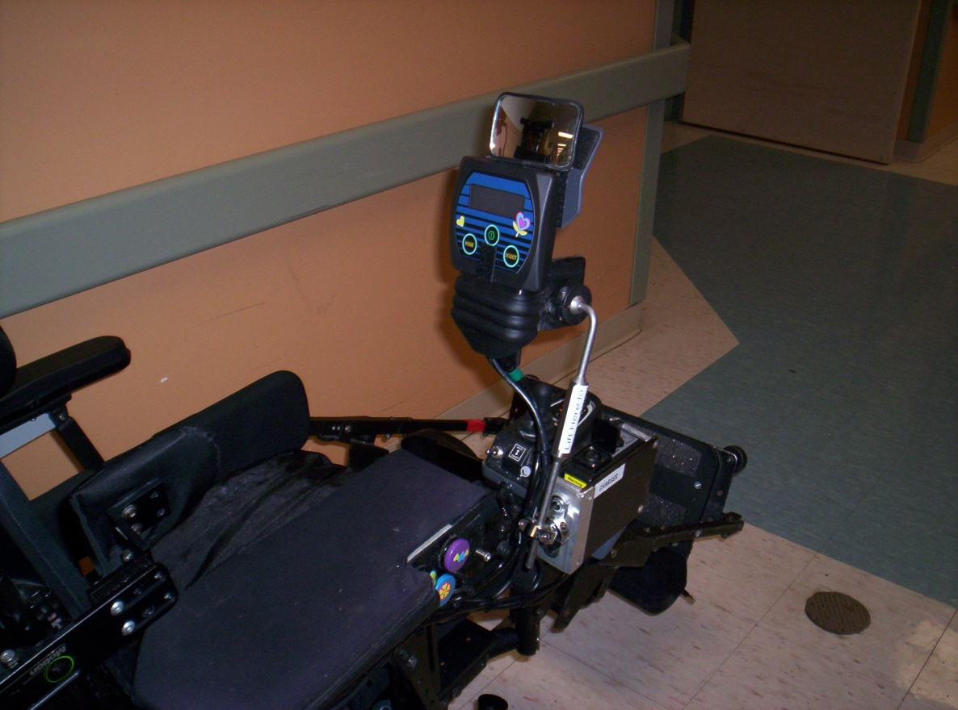
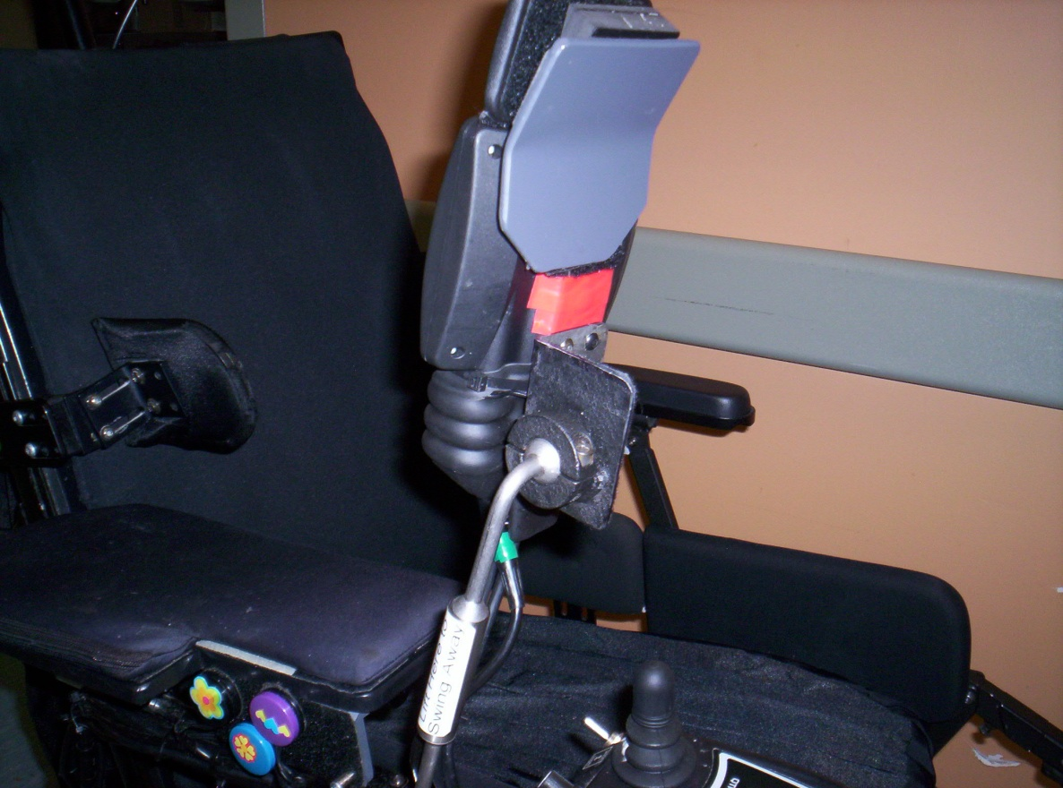

Slide 23
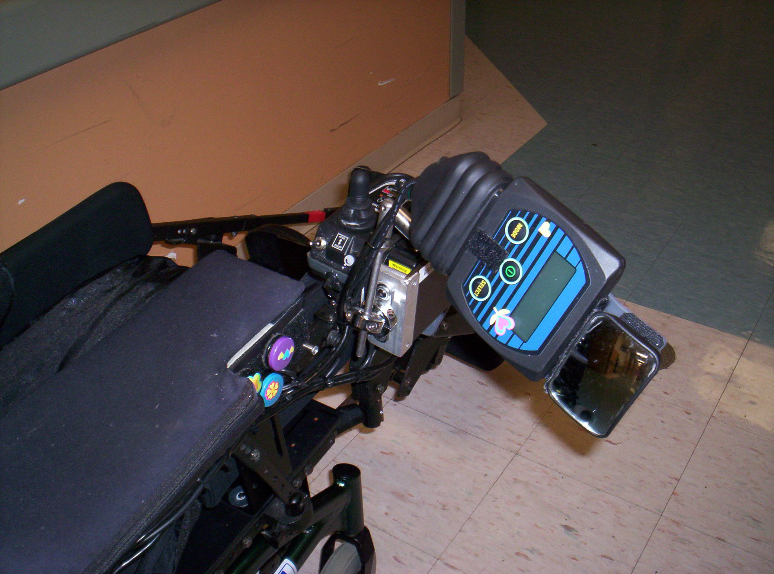
Notes:
A rear view mirror was added for Farzin’s convenience.

Slide 24
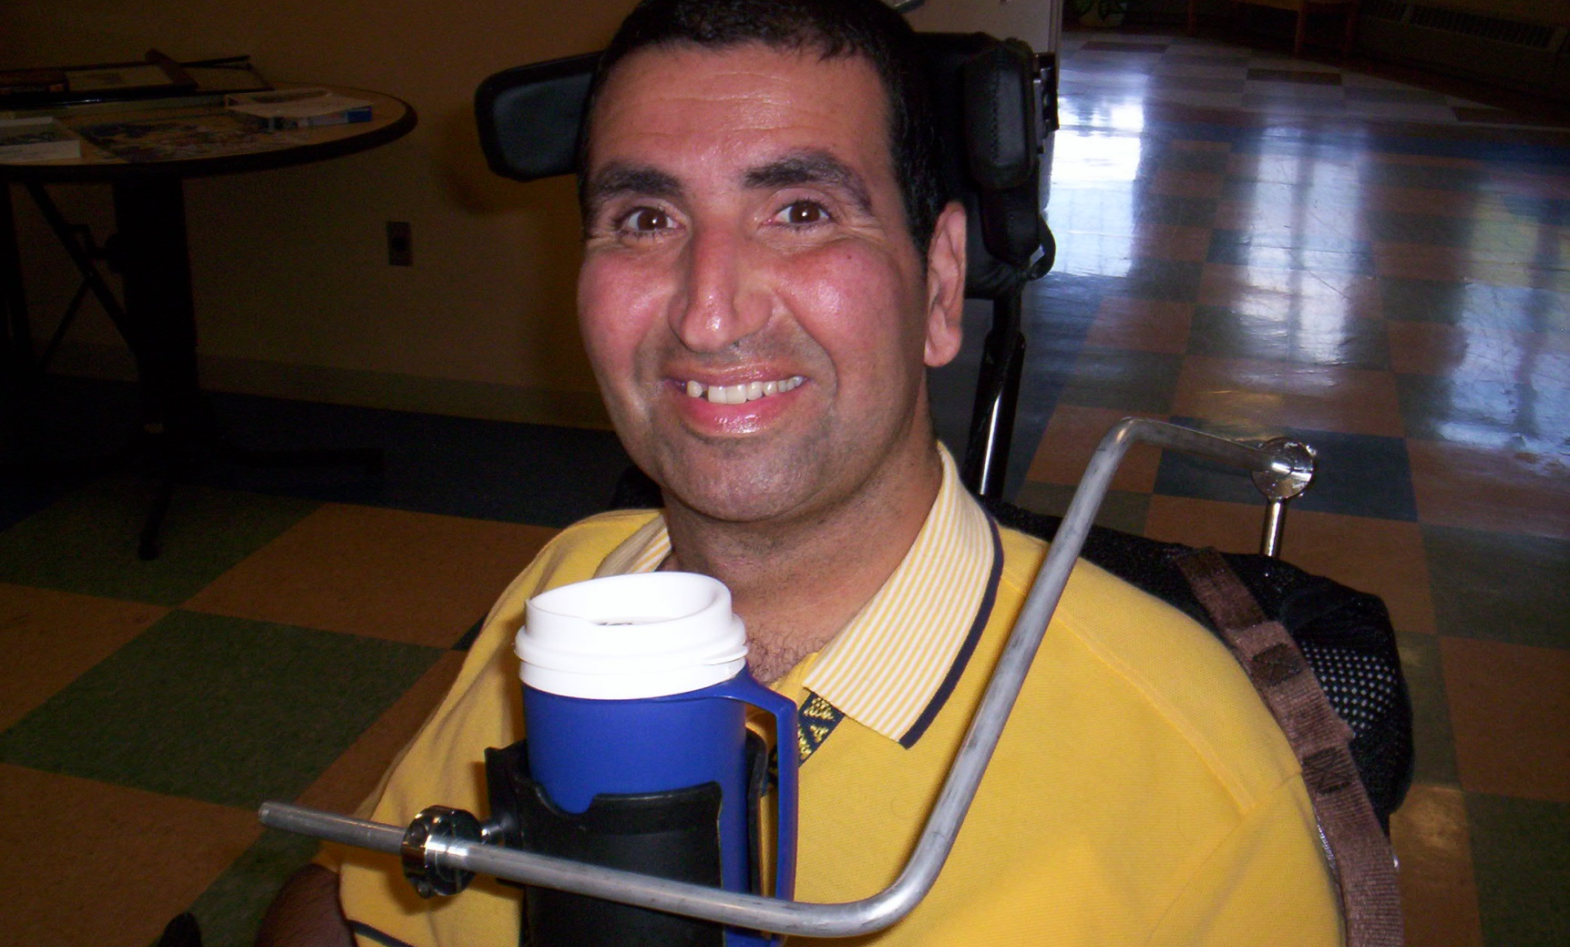
Drink Aid
Notes:
An adapted drink support was installed to ensure proper hydration

Slide 25
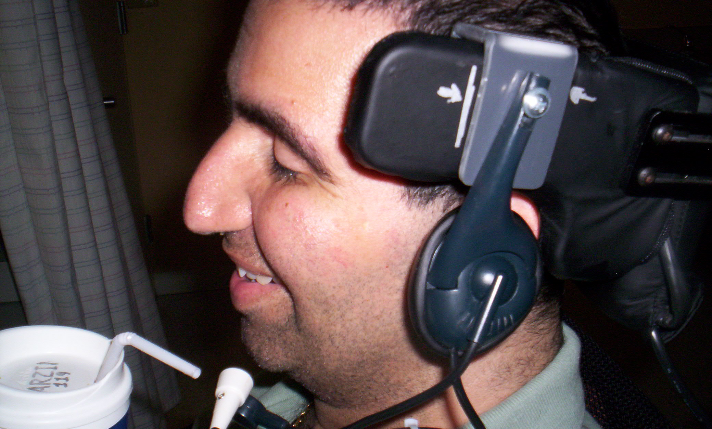
Access to Adapted Phone
Utilizes Head rest as mounting platform for Headphone/Mircophone
Notes:
Farzin utilizes an Ameriphone adapted telephone. The head array provides an opportune mounting support for hands free operation of the headset accessory.

Slide 26
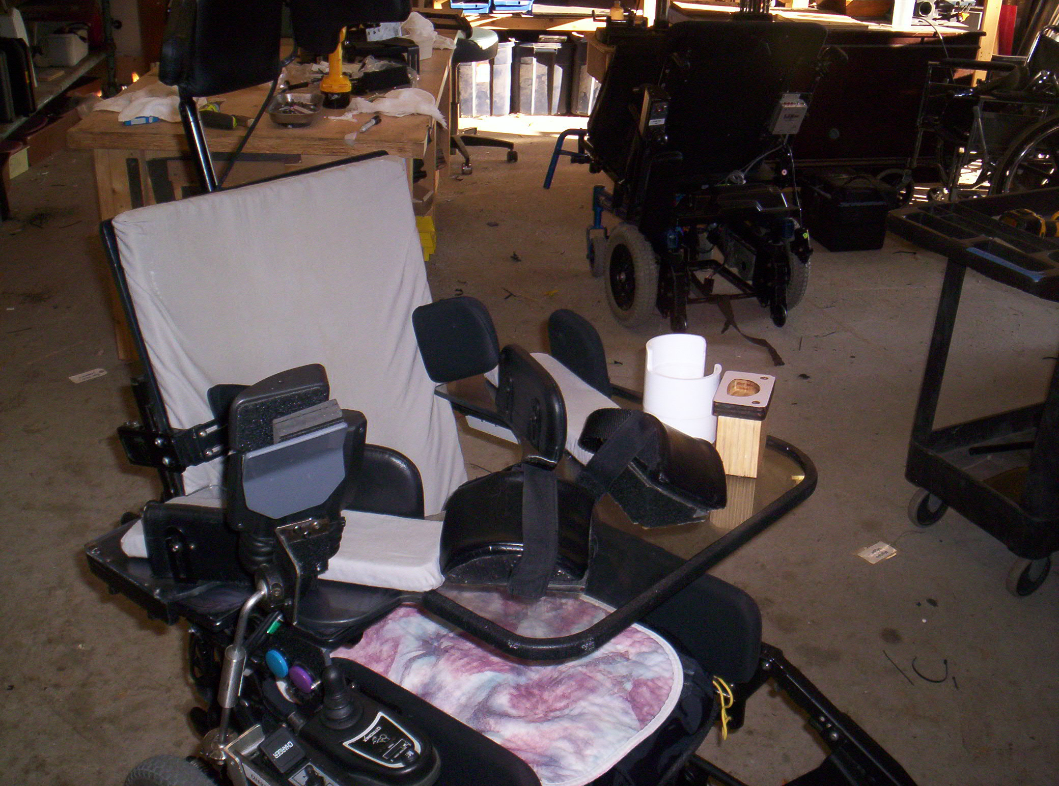
Current Wheelchair Configuration
Notes:
This is the current configuration of the wheelchair which seems a stark contrast to wheelchair ten years prior.

Slide 27
Alternative Drive Control Devices
Notes:
Examples of Various alternative drive controls. The enable a user to control a power chair when hands and arms function will no longer control a proportional hand control.

Slide 28
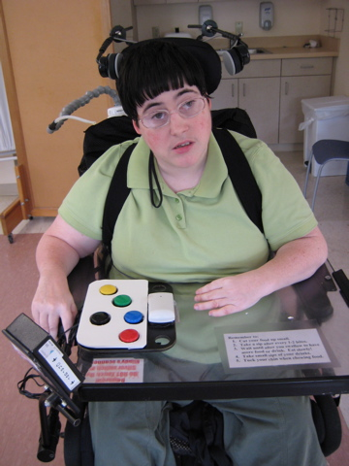
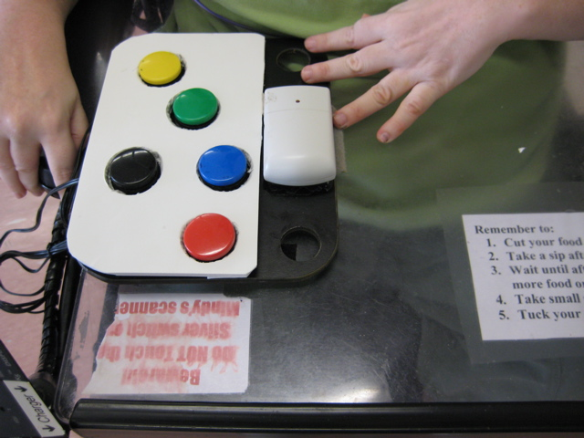
Single Switches
Notes:
Single switches allow for individual operation of each drive direction

Slide 29
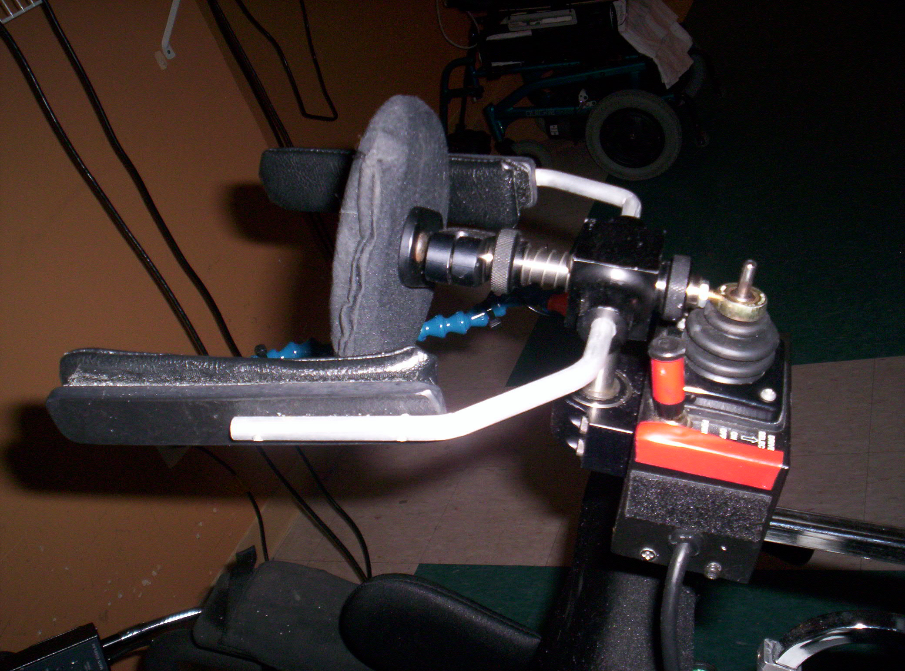
RIM System
Notes:
This head array allows for proportional control of the chair using head movement.

Slide 30
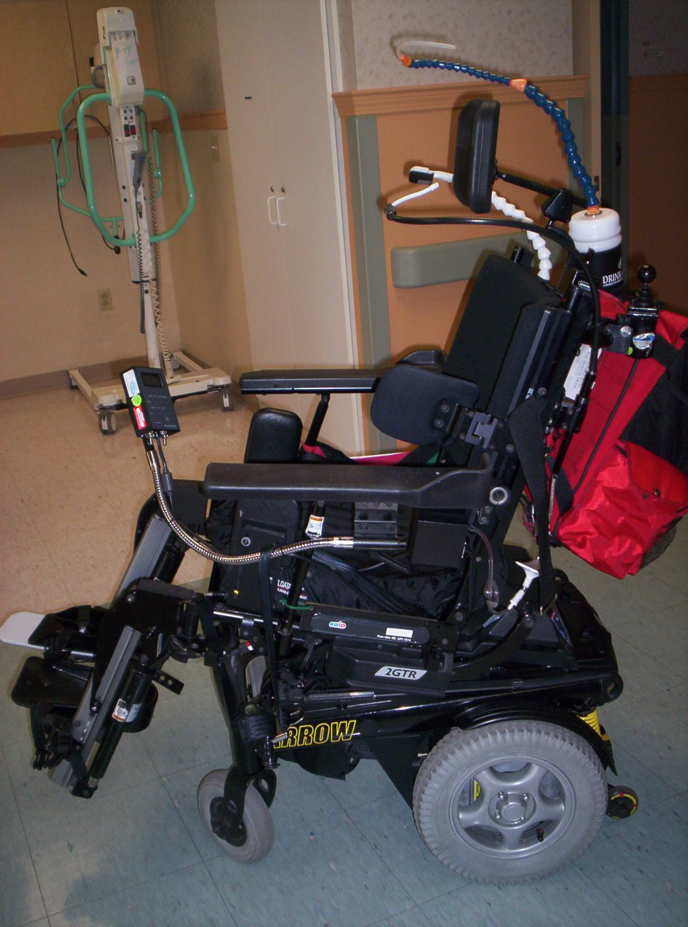
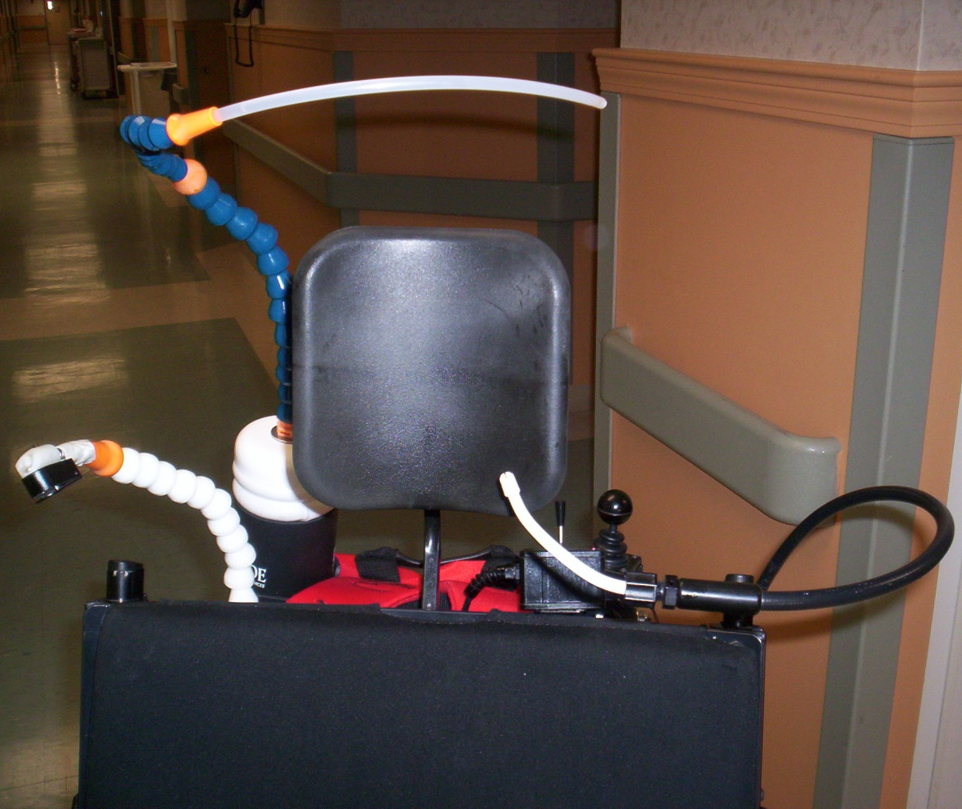
Sip’n Puff System
Notes:
A digital interface with pneumatic switching allow for a soft puff / hard puff – soft sip / hard sip activation of drive direction.

Slide 31
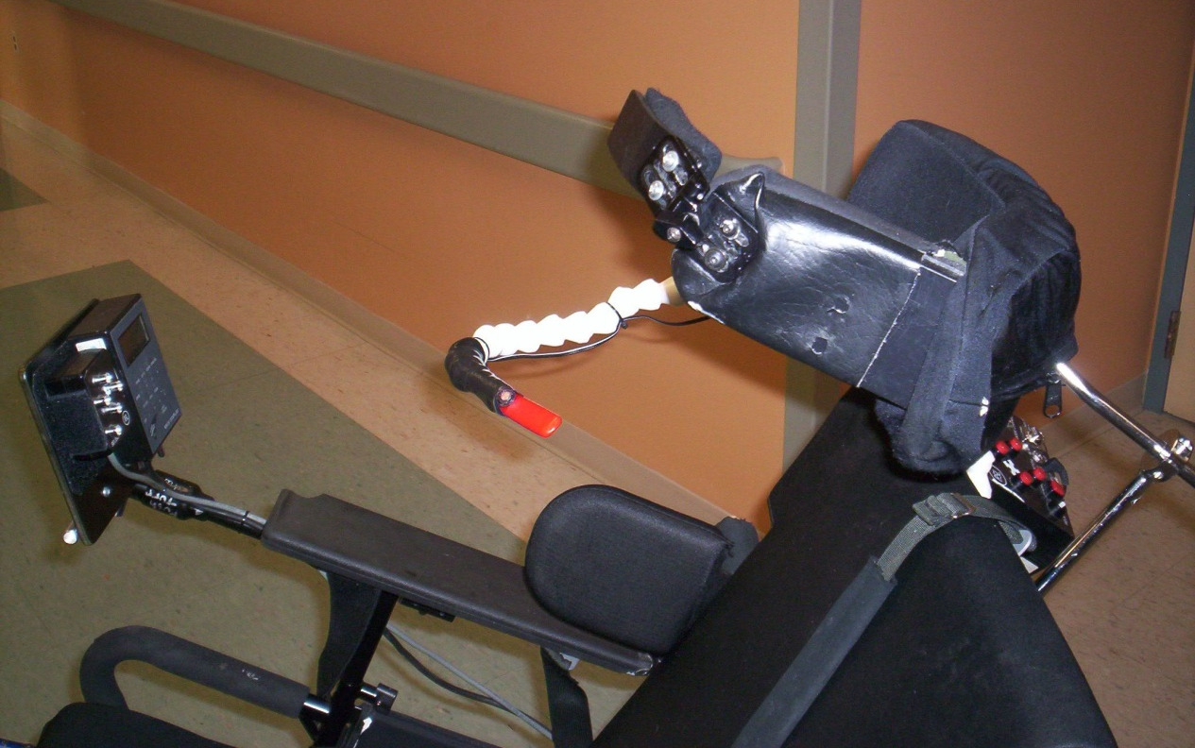
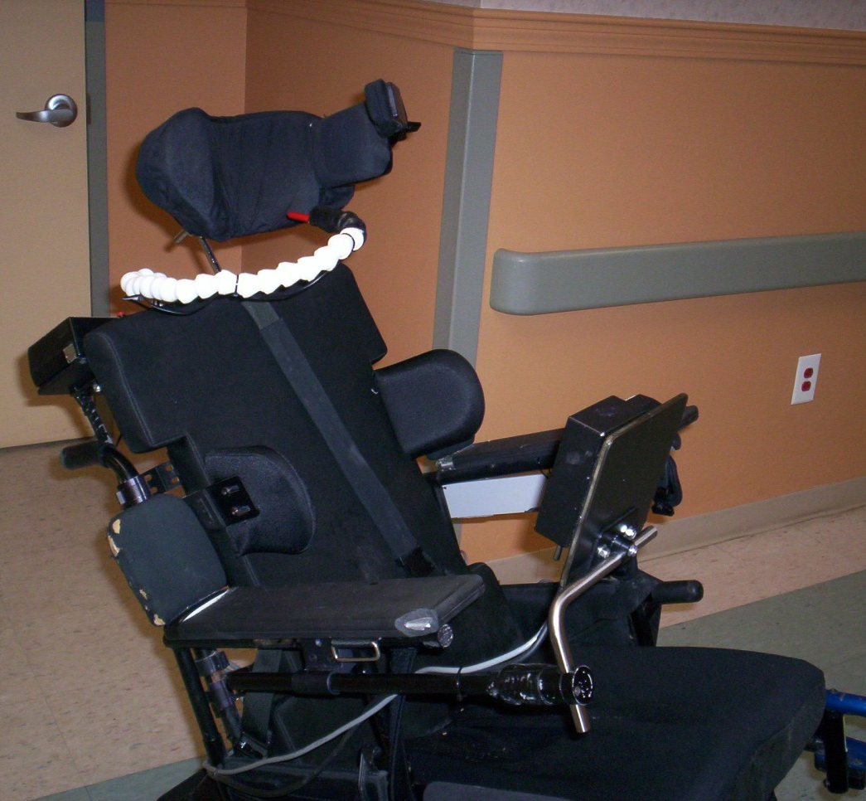
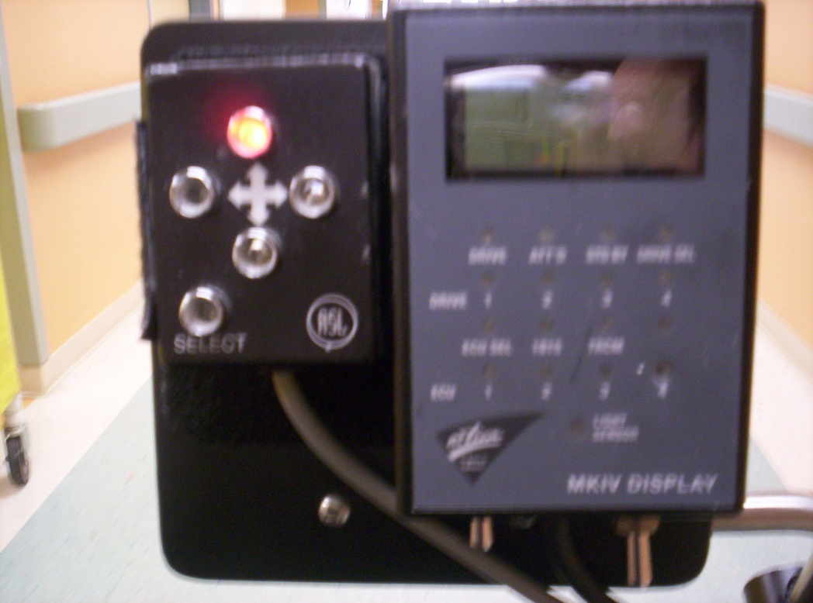
Single Switch Scanner
Notes:
With the single switch scanner, the single activation of a switch while following the four directional scanning light will drive the chair.

Slide 32
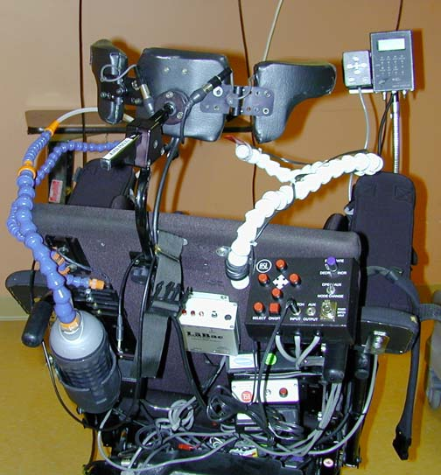
Notes:
This hybrid system allows the user to drive the chair with multiple systems. A single switch scanner to drive the chair when the neck muscles fatigued preventing the operation of the chair with the proximity sensor head array.

Slide 33
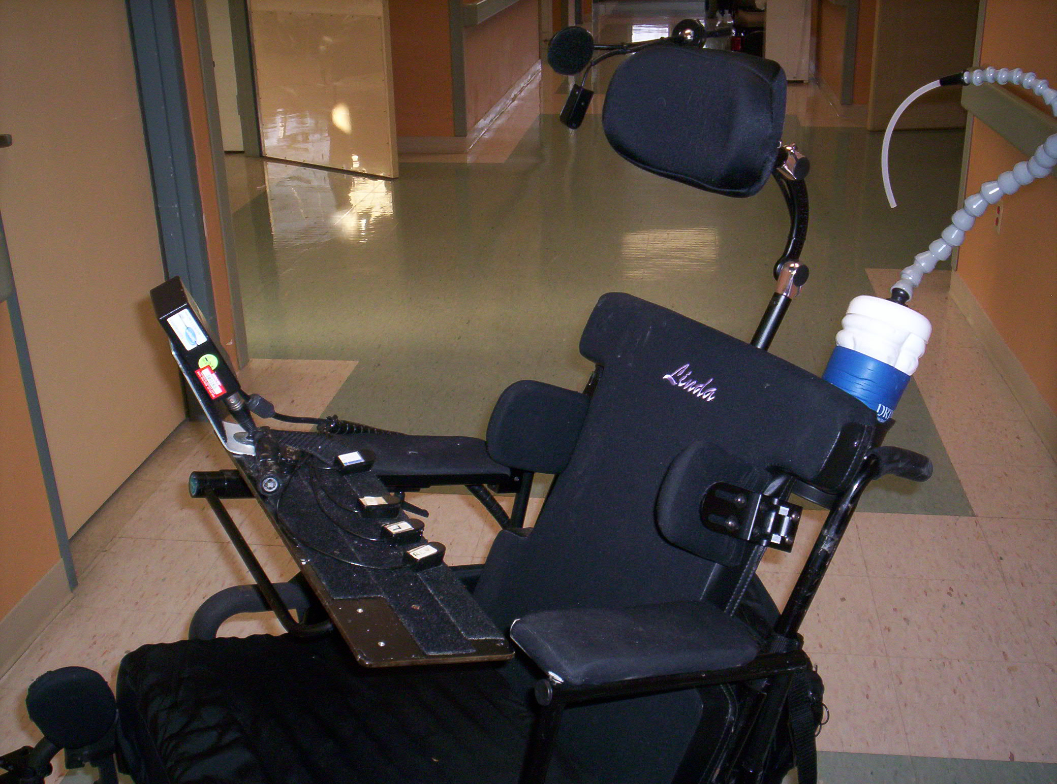
Notes:
Microlite switches require very little force to activate.

Slide 34
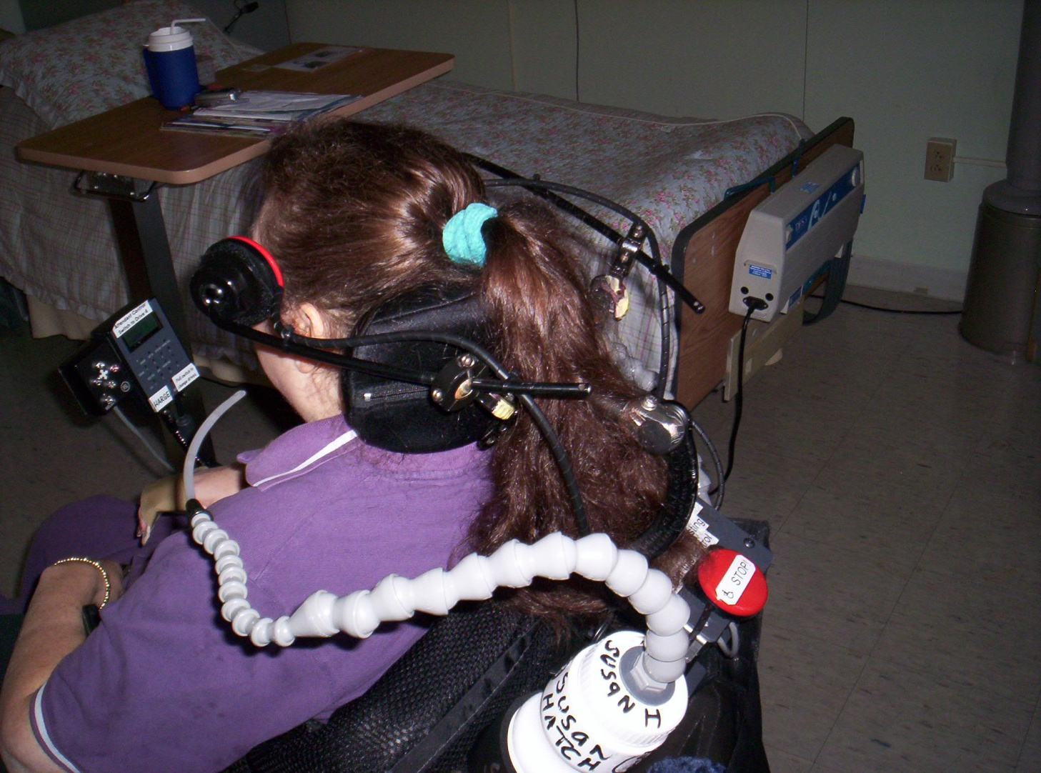
Hybrid System

Slide 35
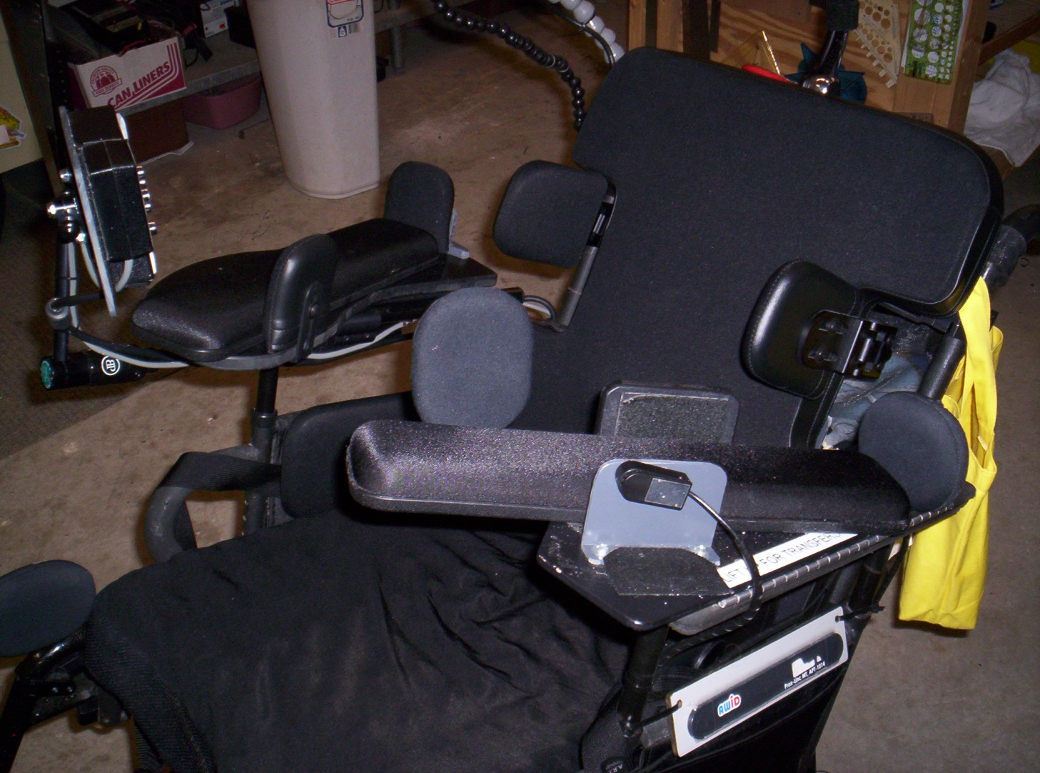
Upper Extremity Support System

Slide 36
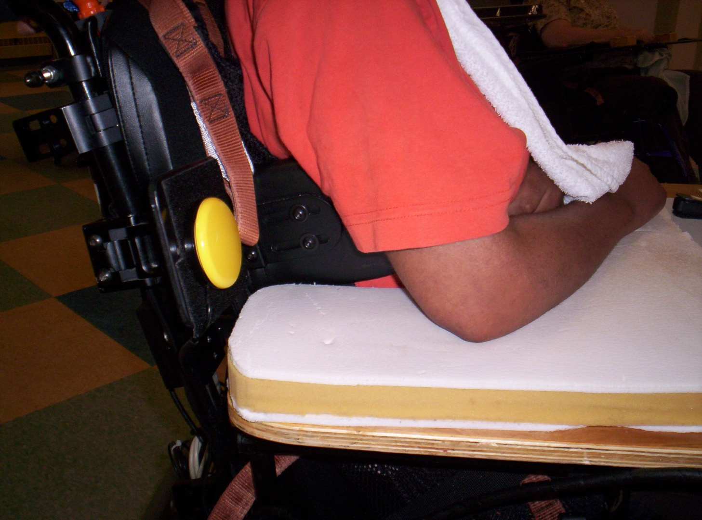
Creative Placement of Switches

Slide 37
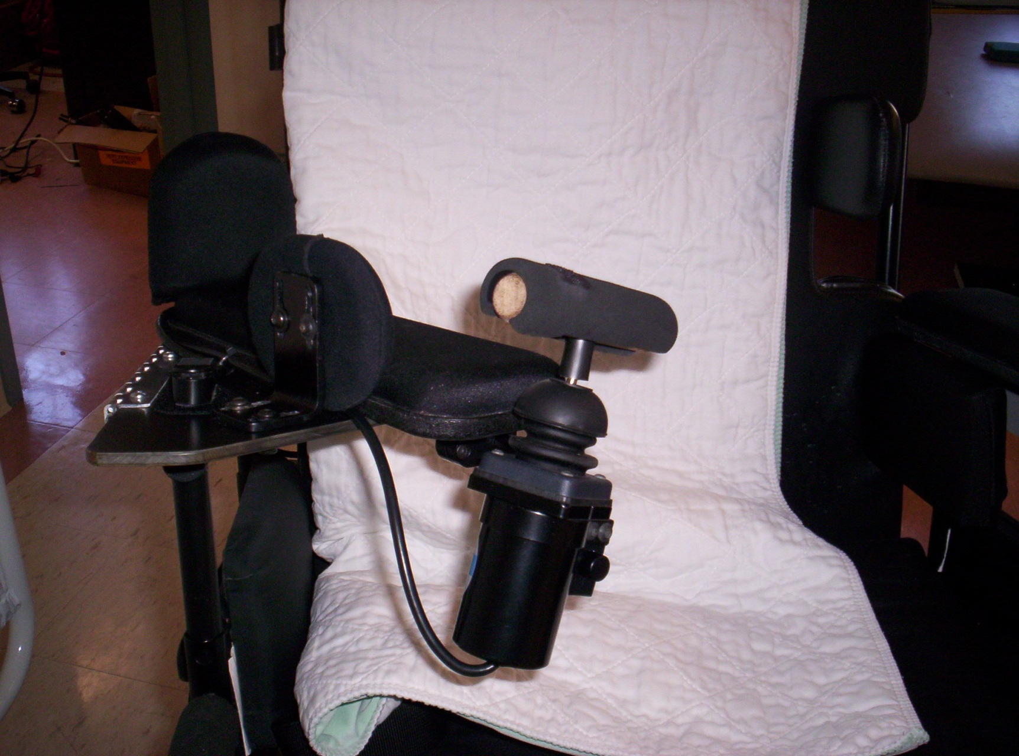

Slide 38
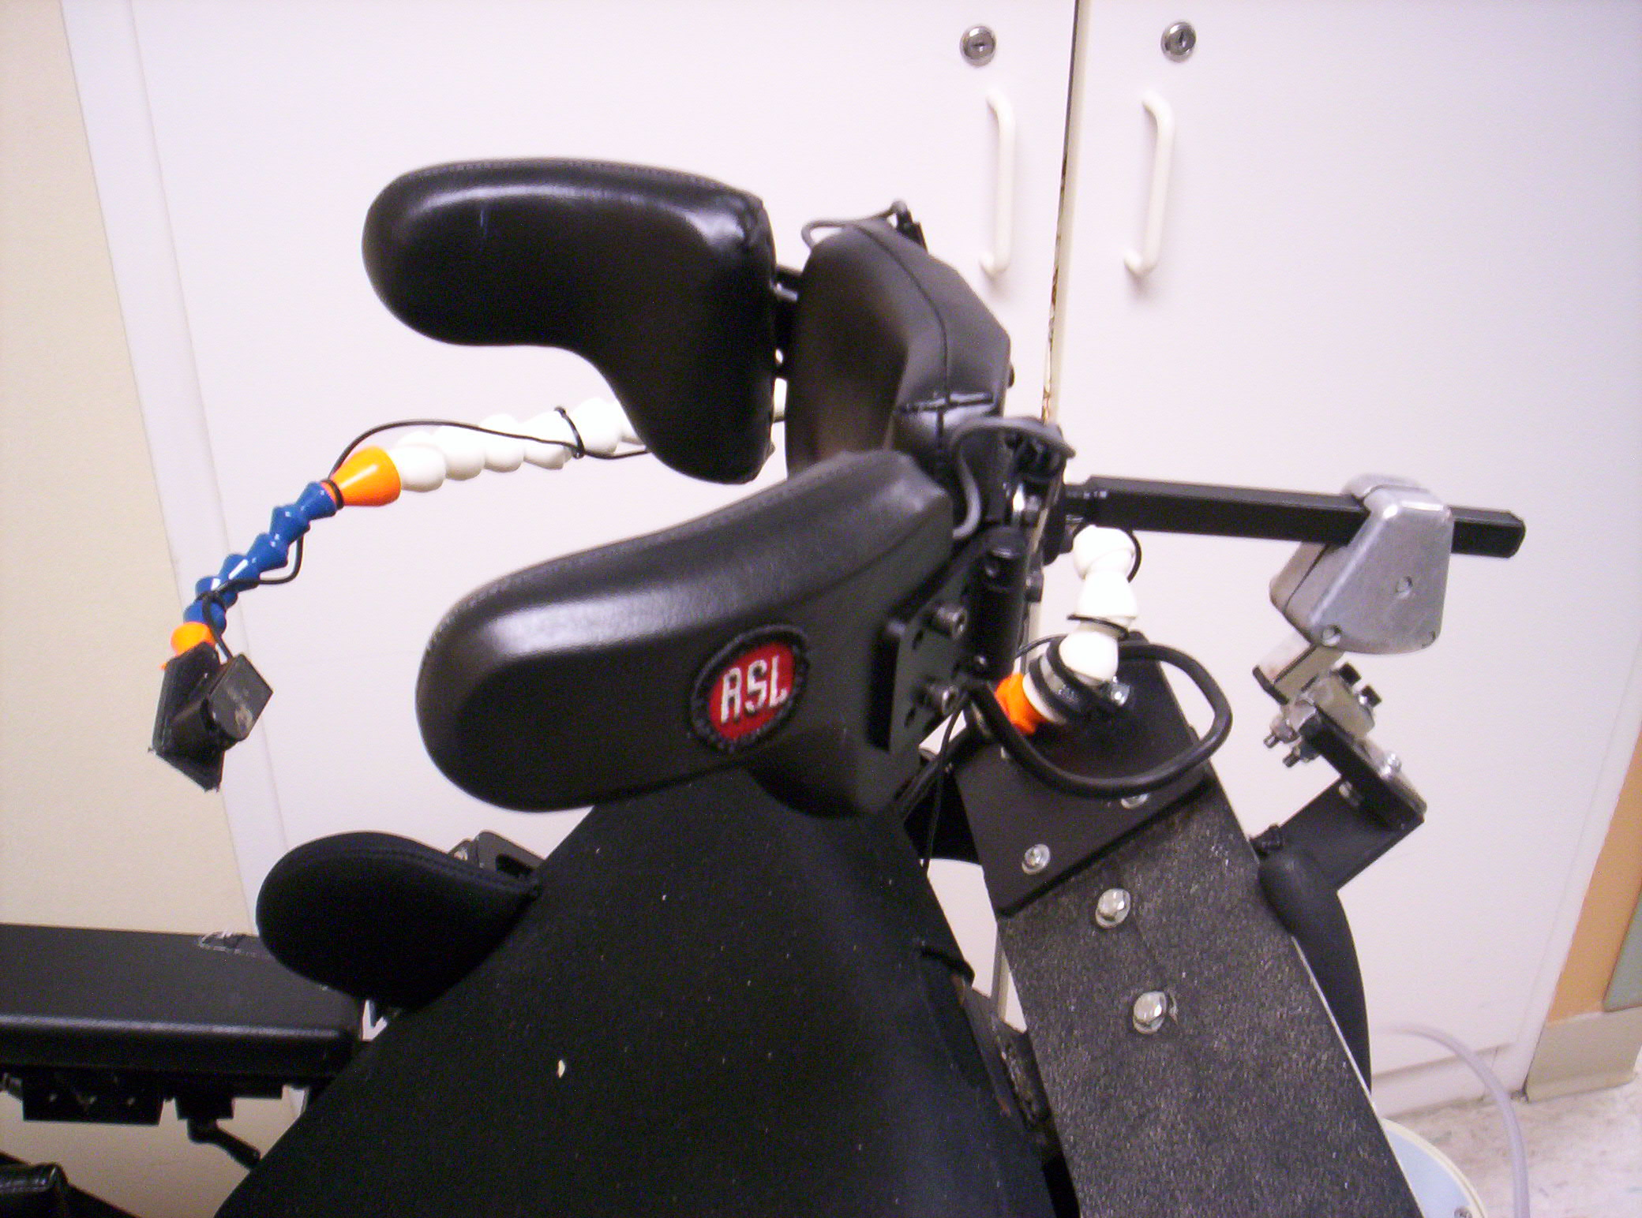

Slide 39
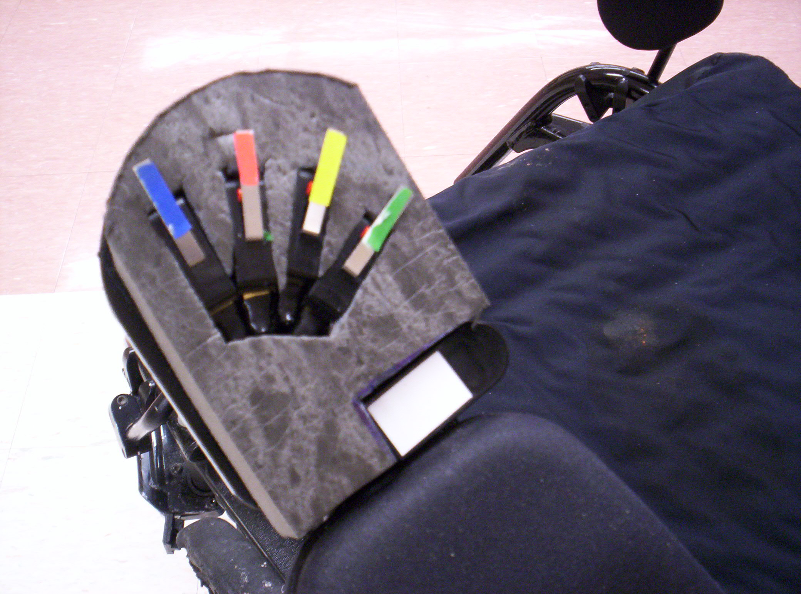

Slide 40
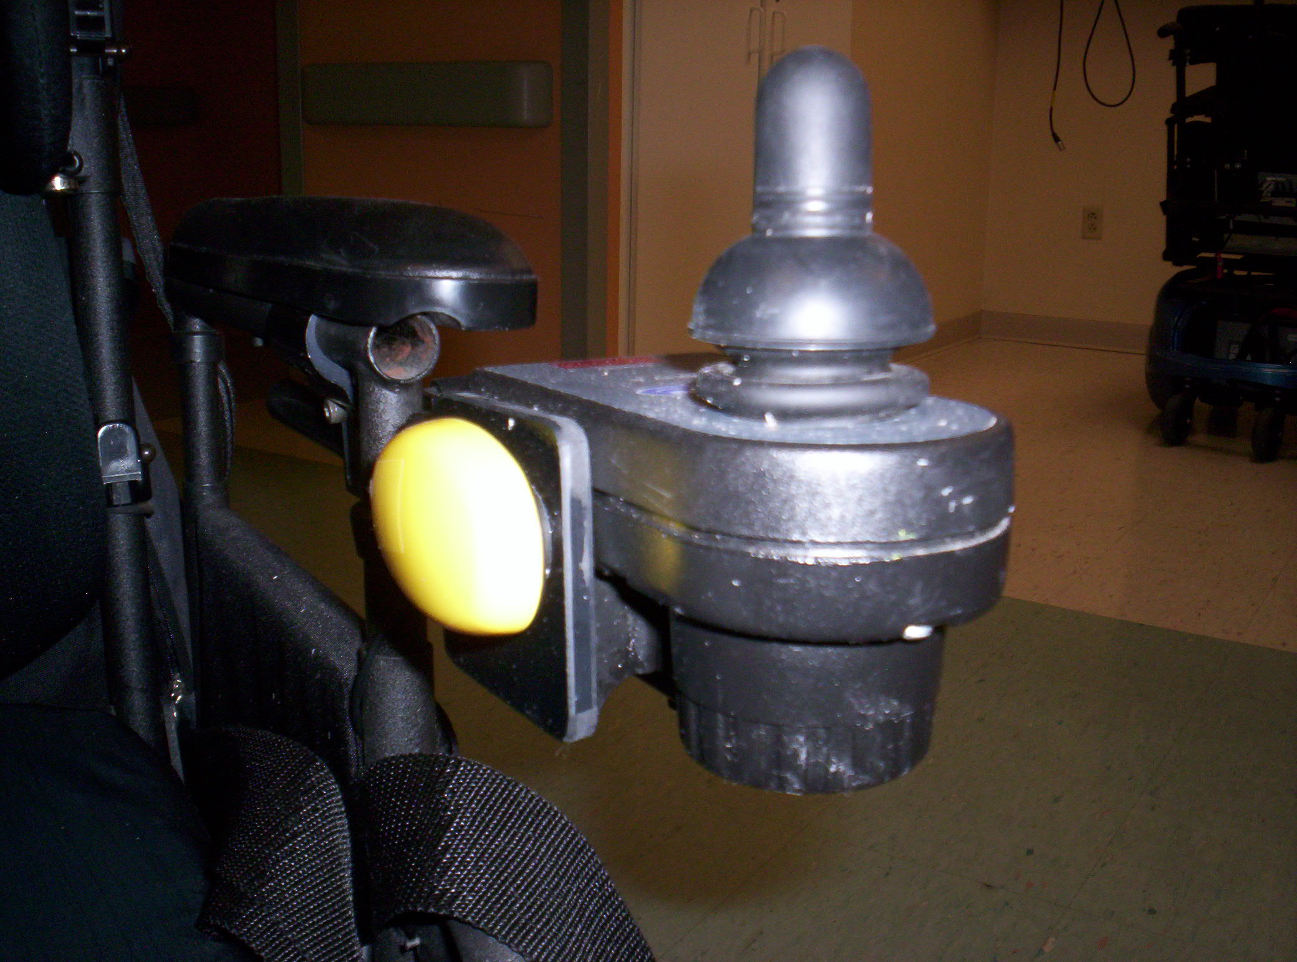

Slide 41
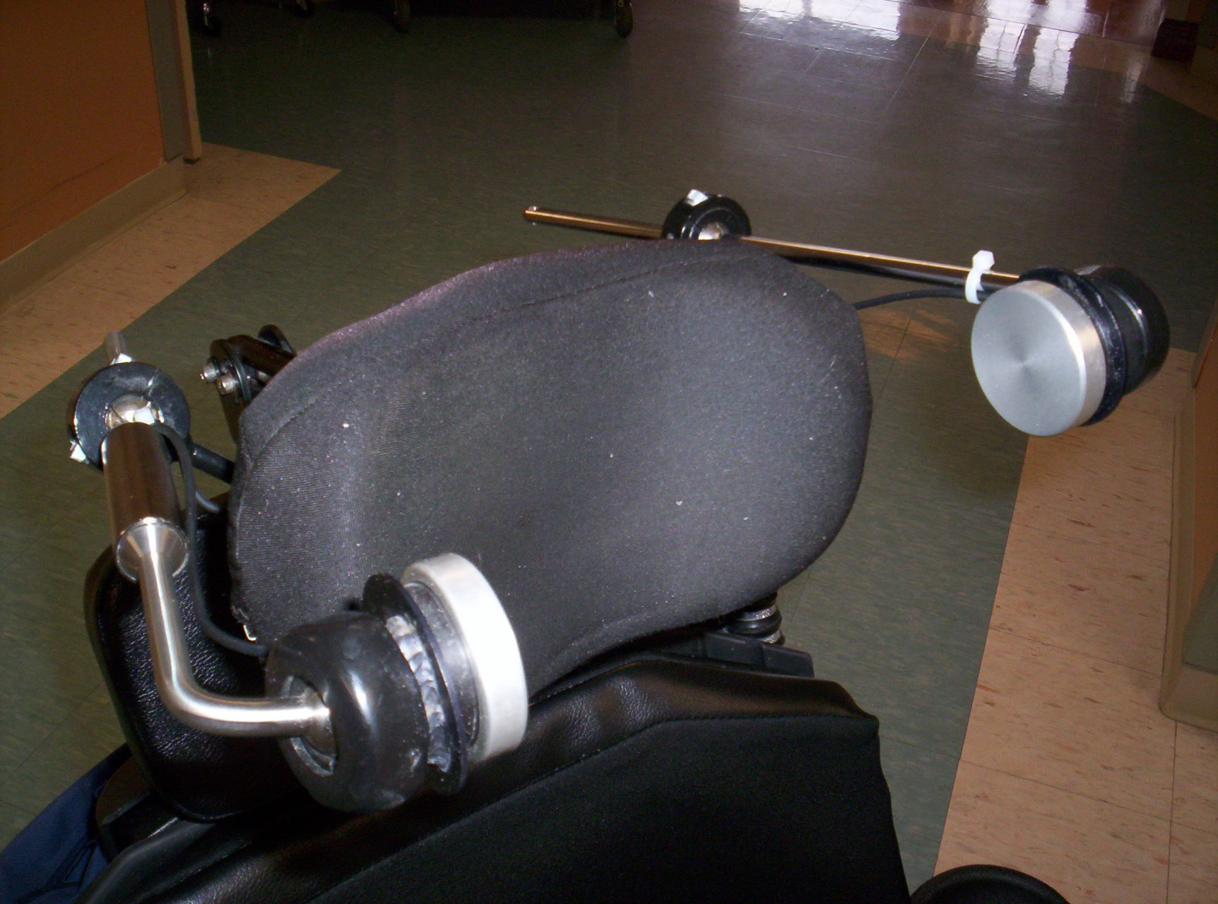

Slide 42
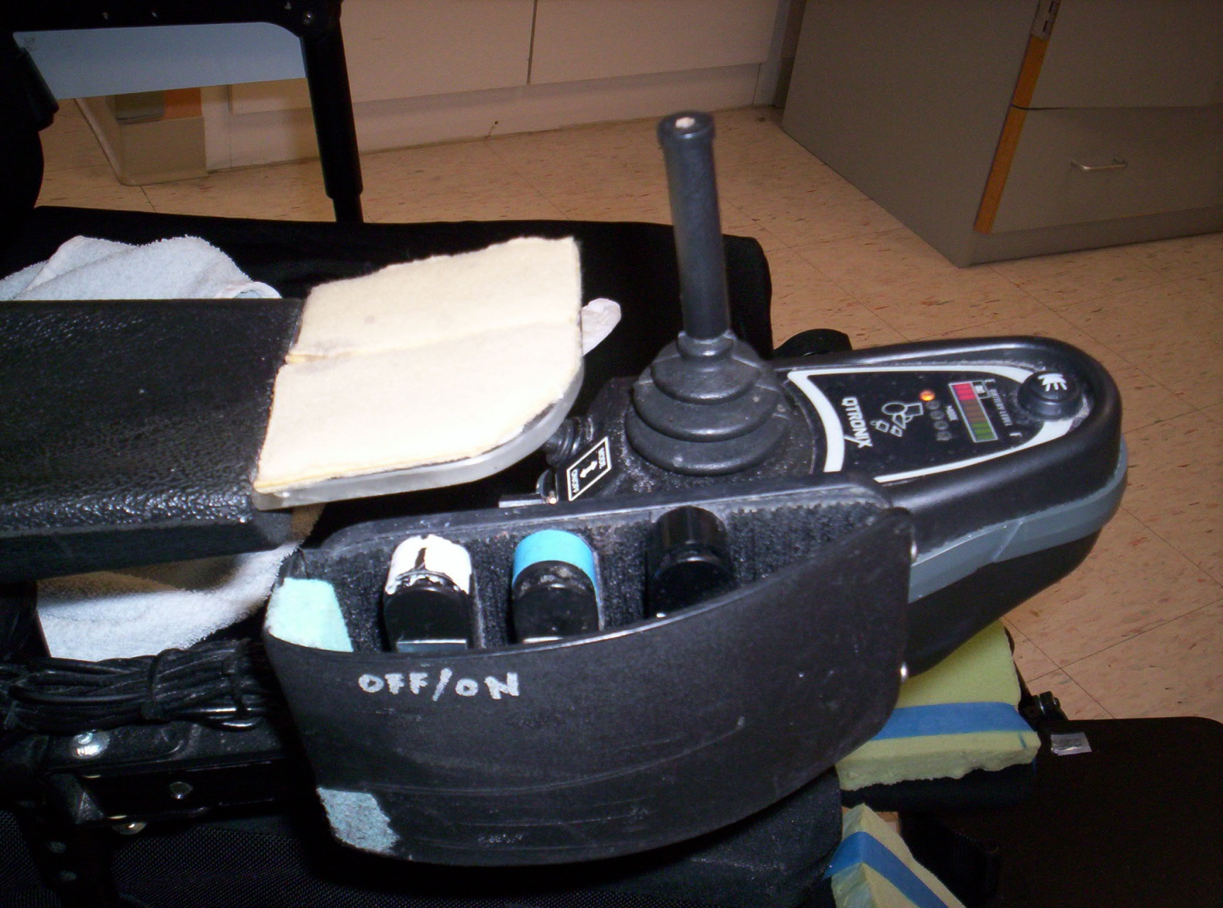

Slide 43
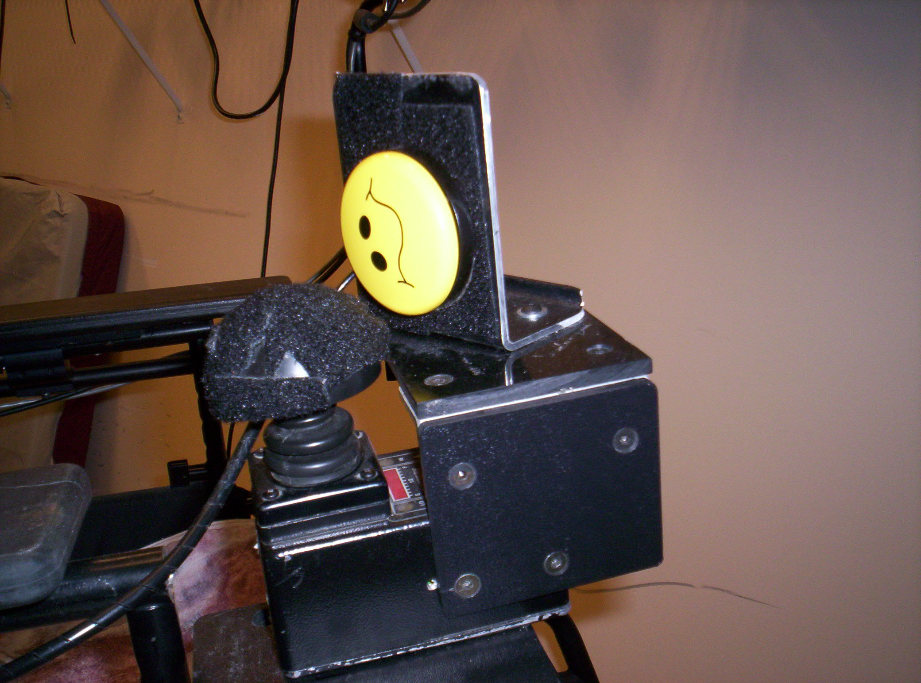

Slide 44
Wound Management
Wound committee meets 2 to 4 times per month
Address problems and possible solutions to assist in healing of wounds
For seating issues - assess seat cushions, back cushions and foot support - common problem areas

Slide 45
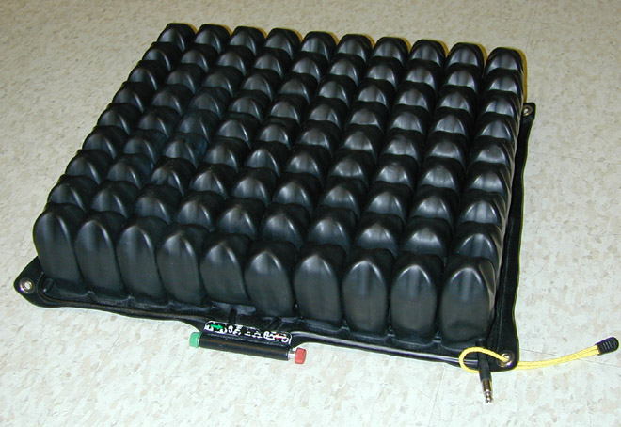

Slide 46
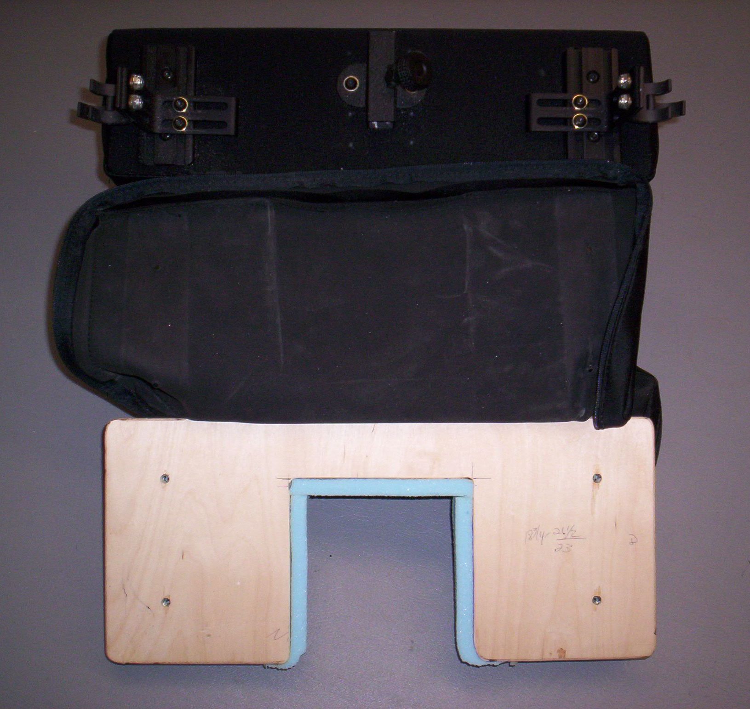

Slide 47
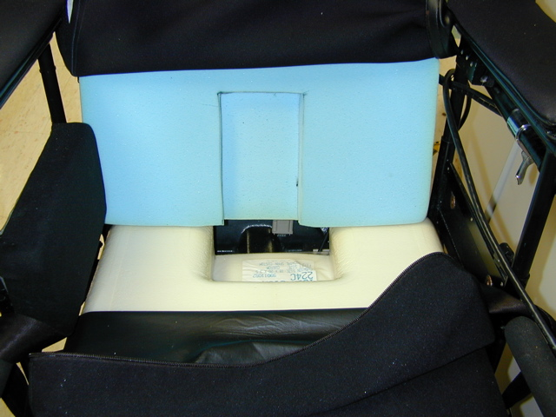

Slide 48

Quality of Life
Quality of Life

Slide 49
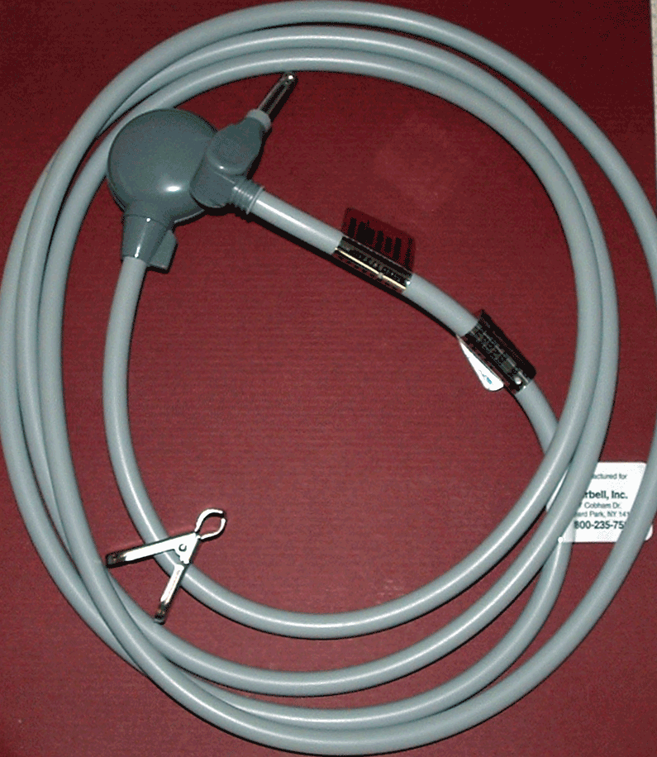
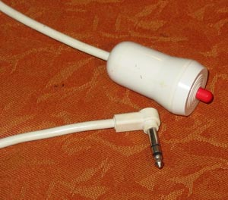
Nurse Call Access

Slide 50
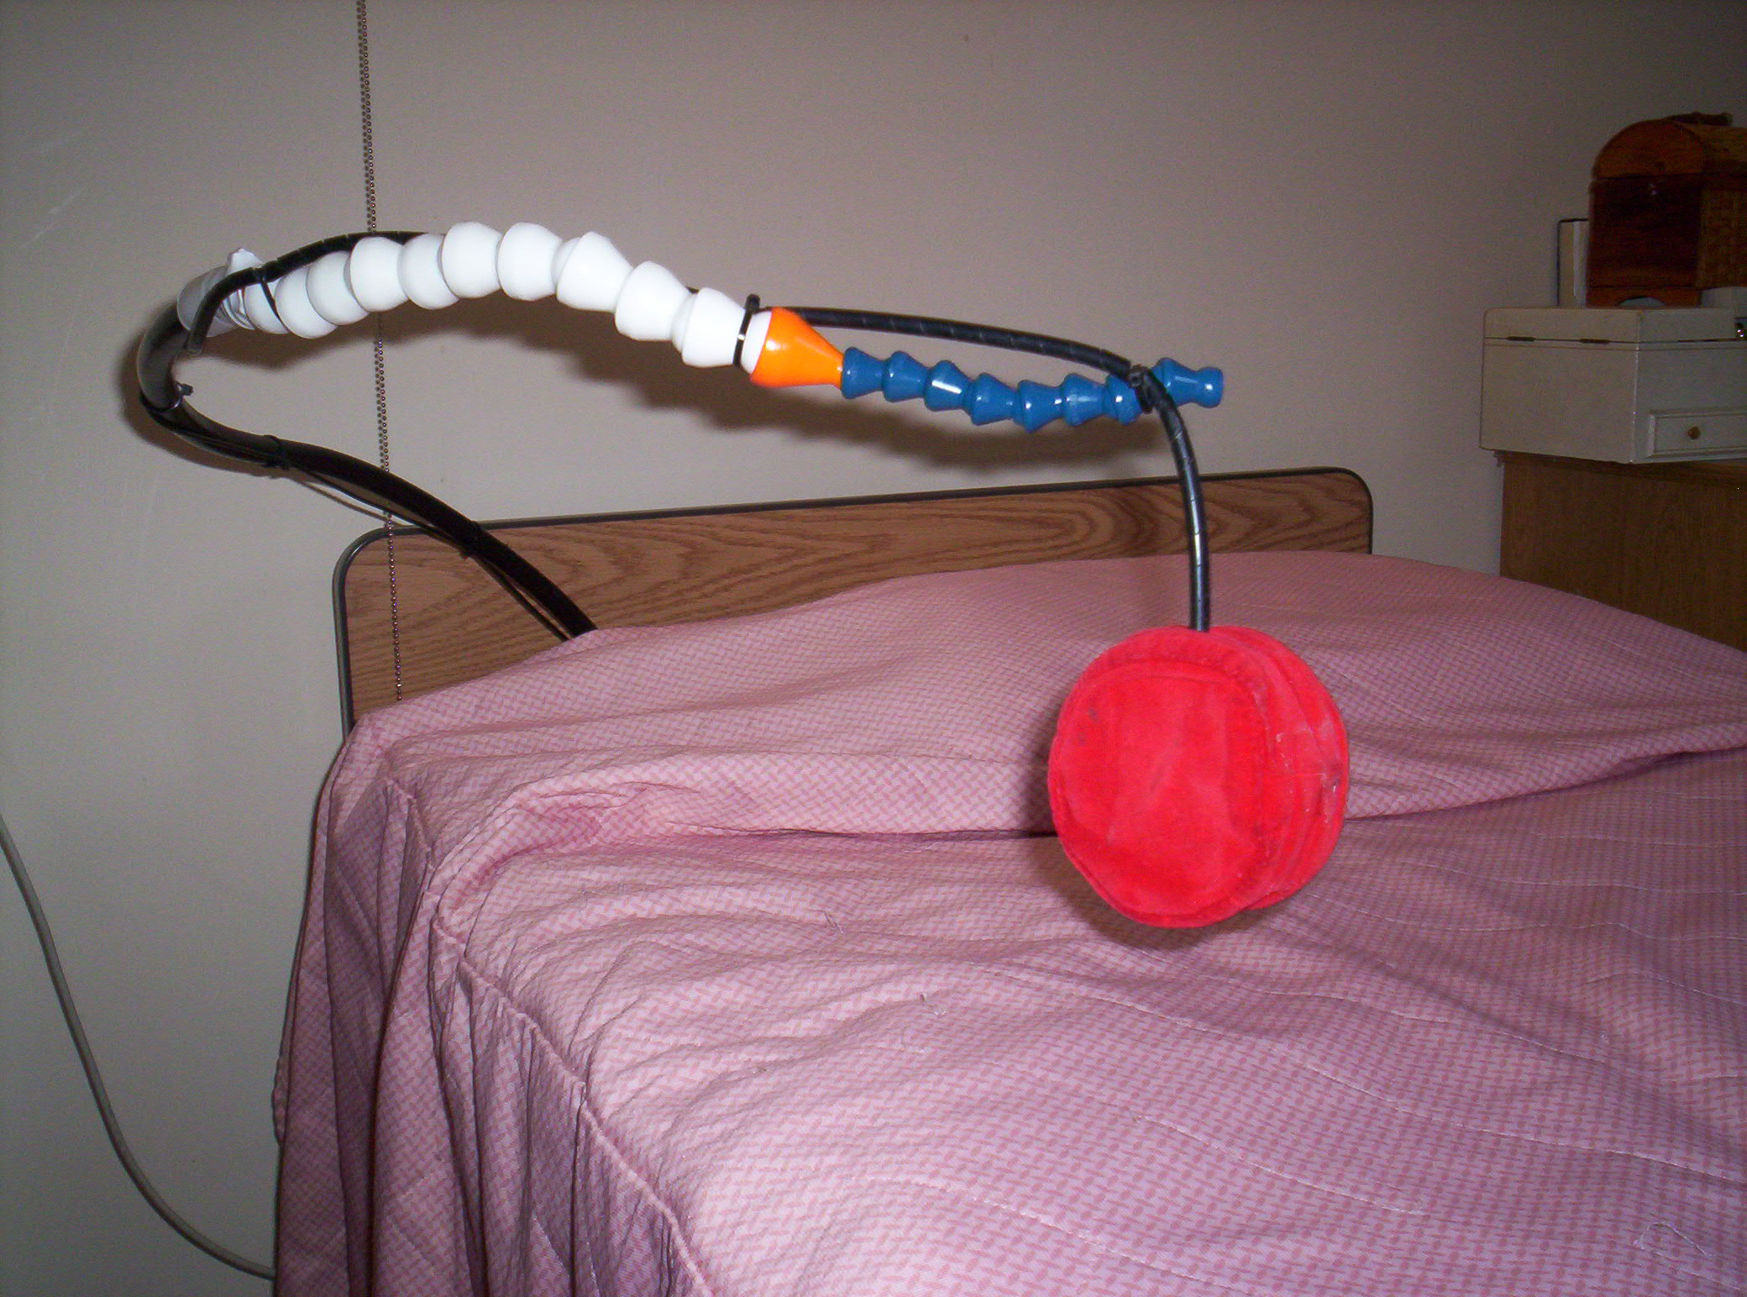
Foam Switch

Slide 51
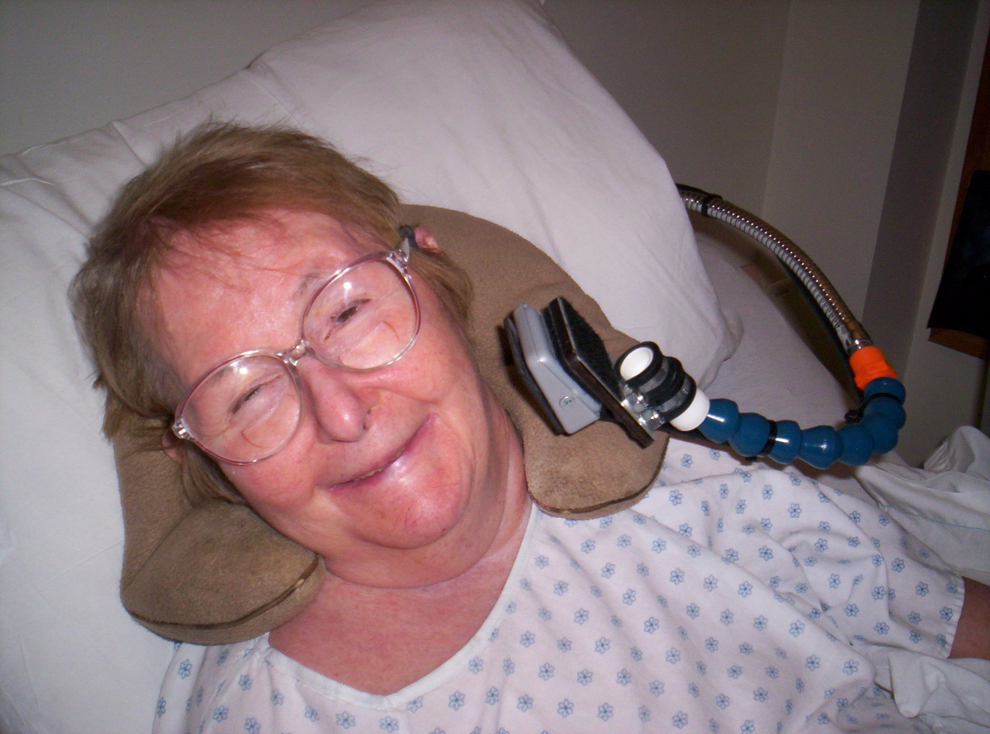

Slide 52
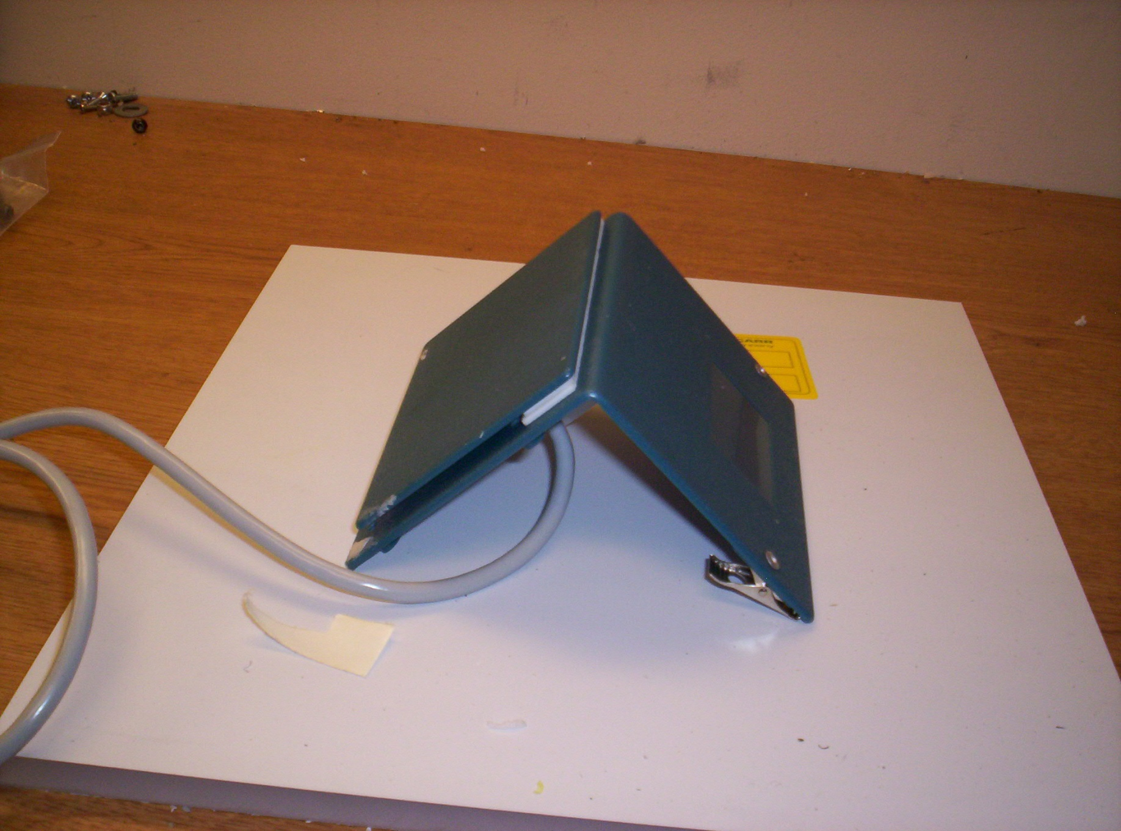

Slide 53
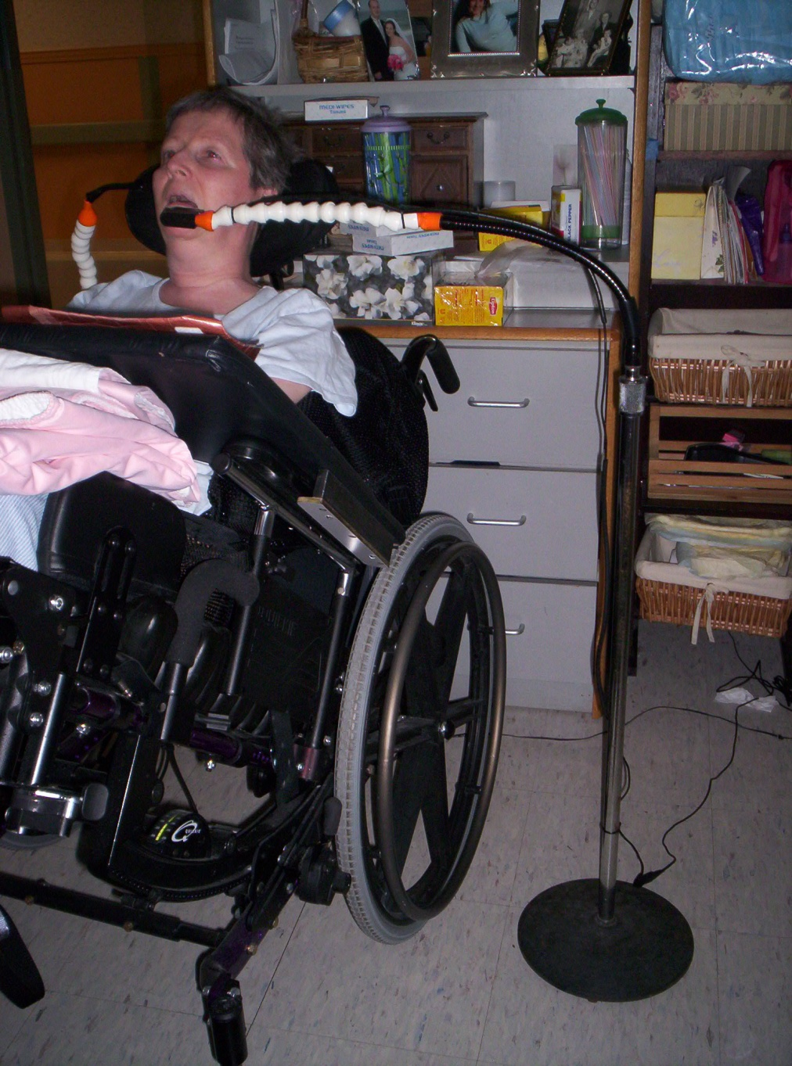

Slide 54
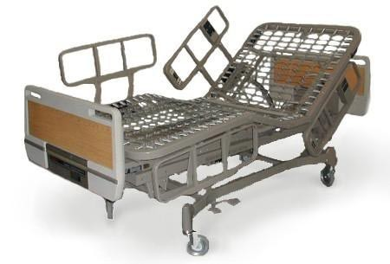
Bed Controls

Slide 55

“Bumps”
Hardwired to PC board

Slide 56

Modified Hill-Rom Bed Control

Slide 57

Tash Mini Relax
Allows six infrared commands from any remote to be controlled in a scanning fashion by the push of a button

Slide 58

Basic Implementation

Slide 59

In-Voca

Slide 60
In-Voca

Slide 61


Slide 62



Communication

Slide 63

Tray Mounted Communication System

Slide 64




Slide 65


Slide 66


Slide 67

Voice Amplifier

Slide 68


Slide 69
Telephone Access
Notes:
Basic or core human need is need to communicate
Essential device of our time is the telephone

Slide 70


Slide 71


Slide 72


Slide 73


Slide 74



Slide 75


Slide 76

Phase I

Slide 77

Phase II

Slide 78


Phase III

Slide 79
Computer Access

Slide 80


Slide 81


Slide 82



Slide 83


Slide 84


Slide 85


Slide 86


Slide 87


Slide 88


Slide 89


Slide 90

Desk Mounted Kindle

Slide 91

Kindle Reader

Slide 92
Environmental Control
(ECU)
Electronic Aids to Daily Living(EADL)

Slide 93
Quartet

Slide 94


Slide 95
Imperium

Slide 96

Art at the Boston Home

Slide 97


Slide 98


Slide 99


Slide 100

MIT Collaborations
“Hobby Shop”
Notes:
Achieving creative solutions through coolborative processes.
MIT
BU

Slide 101


Slide 102


Slide 103


Slide 104


Slide 105


Slide 106


Slide 107


Slide 108


Slide 109


Slide 110


Slide 111
Miscellaneous Projects

Slide 112

Cell Phone Access

Slide 113


Entertainment

Slide 114


Slide 115


Slide 116

Proper Hydration

Slide 117


Slide 118




Slide 119


Slide 120


Slide 121


Slide 122


Slide 123


Slide 124


