Slide 1
6.S196 / PPAT:
Principles and Practice of Assistive Technology
Today: Project Follow-up Opportunities
Monday, 12 December 2011

Slide 2
Follow-up Opportunities
What remains to be done?
  Creating a functional device for your client
  Scaling up your solution so that it can benefit more people
  Creating assistive devices for other people with disabilities
  Addressing the gap between needed and available assistive technology

Slide 3
Outline
Opportunities at MIT
  IDEAS Global Challenge, Public Service Center, MIT100K
Disseminating your work
  External competitions
  Funding opportunities
Aspiration: making useful AT widely available (affordable/accessible)
  Assistive technology economics

Slide 4

MIT IDEAS Global Challenge
Identify problems and propose solutions to pressing global problems
Focus on innovation and feasibility of idea
Receive seed funding, mentorship, and publicity opportunities
Many successful assistive technology teams in the past

Slide 5
MIT IDEAS Global Challenge: Process
Submit “Initial Scope Statement” (next deadline: 25 January 2012)
  Can include “Development Grant Request”
Receive feedback from Public Service Center and alumni volunteers
If invited, submit formal proposal (due April 8, 2012)
Judging through interviews (in-person and telephone) and showcase (May 2012)
Awards ceremony (May 2012)
Winners Retreat (June 2012)
Implementation (June 2012-May 2013)

Slide 6
MIT IDEAS Global Challenge:
Elements of Successful Proposals
A well-articulated need
A feasible approach to addressing the need
A team with the skills to solve the problem
A partner organization

Slide 7
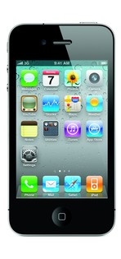

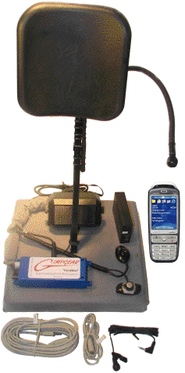








THE NEED
Smartphone accessibility for people with fine motor impairments
$ 599
$749 (no cellphone)

Slide 8
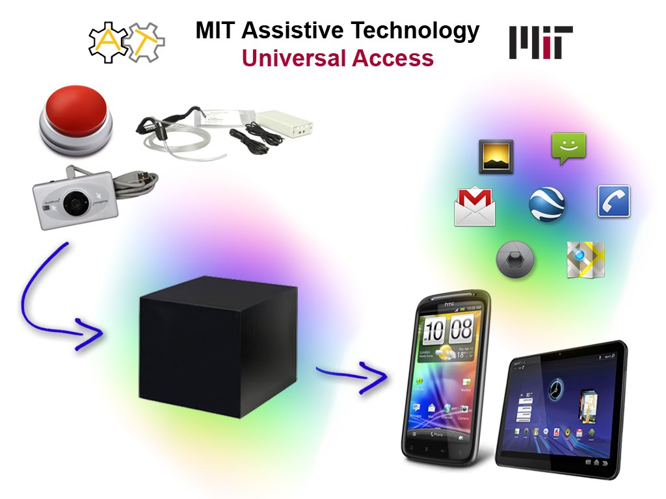
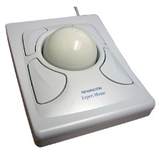
THE IDEA
Many Input
Many Functions

Slide 9
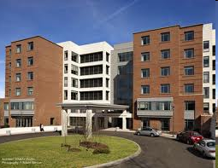

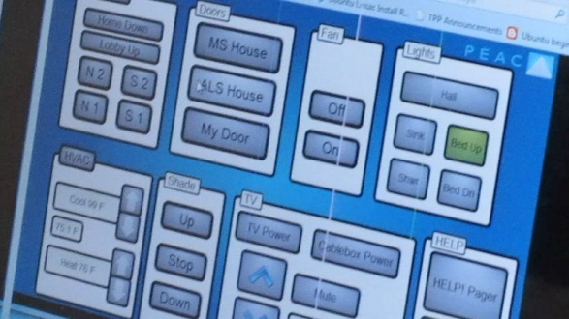
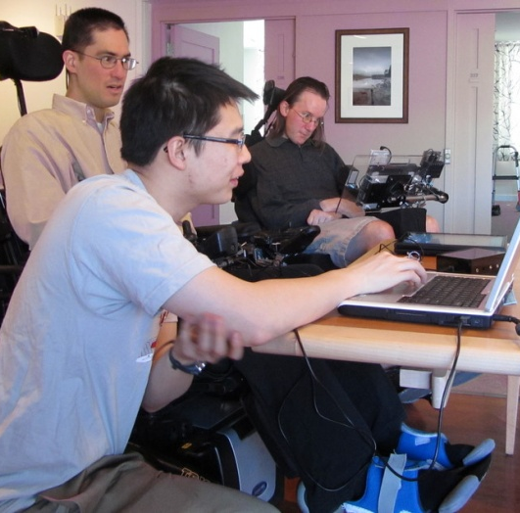
OUR WORK
Partner with Leonard Florence Center
Design : Iterative feedback from end users and early adopters with ALS and MS
Demonstrate daily use: Residents with different motor skills will use the device to access building control system
Collaborate with ALS/MS groups, vendors, and assisted living facilities.

Slide 10
MIT IDEAS Global Challenge:
Elements of Successful Proposals
Need: Unlocking smartphones for people with fine-motor impairments
Idea: Enabling USB-based switch/mouse access
Team: MechE/CS/business/policy students
Partner: Leonard Florence Center

Slide 11
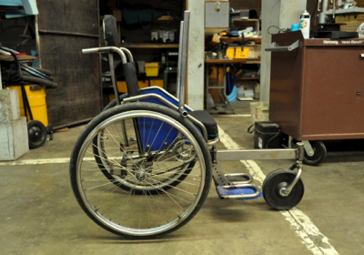
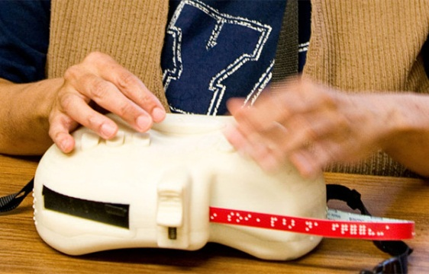
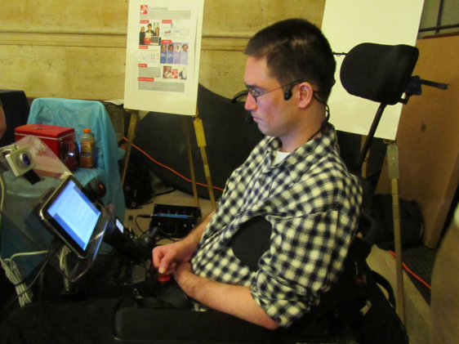
MIT IDEAS Global Challenge:
Past AT Winners
Leveraged Freedom Chair (2008)
6dot Braille Labeler (2009)
Smartphone Universal Access Hub (2011)

Slide 12
MIT IDEAS Global Challenge:
Awards
Cash awards of $5,000-$10,000
2011: 20 awards totaling $145,000
  8 x $10K
  2 x $7.5K
  10 x $5K
Contact:
  http://globalchallenge.mit.edu
  Kate Mytty, W20-549, kmytty@mit.edu

Slide 13
MIT Public Service Center:
Other Funding Opportunities
Travel/Materials Grants: can cover expenses for prototyping
Service Fellowships (for working with particular community organizations)
More information:
  http://web.mit.edu/mitpsc/
  http://web.mit.edu/mitpsc/whatwedo/grants/

Slide 14
Entrepreneurship: MIT100K
Business Plan Contest:
  Timeline: February-May 2011
Stronger focus on business model
Can enter both the IDEAS Global Challenge and MIT100K
More Information:
  http://mit100k.org/

Slide 15
External Opportunities:
Design Competitions
Competition | Due Date | Submission Requirements
ASME Undergraduate Design Competition in Rehab/Assistive Devices | 13 January 2012 | www.asmeconferences.org/SBC2012/UndergraduateCompetition.cfm
Microsoft Web Accessibility Challenge | 4 February 2012 | http://www.w4a.info/2012/submissions/challenge
Ability One Network Design Challenge (to help people with disabilities overcome barriers to employment) | 20 April 2012 | http://www.instituteforempowerment.org/design-challenge
Rehabilitation Engineering Society of North America (RESNA) | 4 May 2012 | aac-rerc.psu.edu/ wordpressmu/RESNA-SDC/
ACM SIGACCESS Conference on Computers and Accessibility (ASSETS) | 29 June 2012 | www.sigaccess.org/assets12/

Slide 16
External Opportunities:
Student Design Competitions
Competition | Due Date | Submission Requirements
IEEE Presidents’ Change the World Competition | 31 January 2012 | www.ieeechangetheworld.org
NCIIA BMEidea (undergrad/grad students); BMEStart (undergrad only) | 6 April 2012; 11 May 2012 | nciia.org/bmeidea nciia.org/bmestart
IEEE Engineering in Medicine and Biology Society (EMBS) | 1 June 2012 | www.ieee.org/membership_services/membership/students/awards/eng_medicine_undergrad_design.html
da Vinci Awards for Accessibility and Universal Design | August 2012 | www.davinciawards.org/

Slide 17


MIT Assistive Technology Club
Current/Past Work
Receive requests and take on projects for low-cost, customized assistive devices
Participate in IDEAS Global Challenge
Guest speakers/field trips related to AT
Mailing list: http://bit.ly/atmit
http://assistivetech.mit.edu

Slide 18
Making Assistive Technology Widely Available (Affordable/Accessible)

Slide 19
Assistive Technology Economics
Beyond the Prototype
Key Challenges
Significant technical challenges
Small market sizes (compared to mainstream consumer products)
Financial limitations
  Challenging employment prospects for people with disabilities
  2009 employment/population ratio: 19.2% (64.5% for rest of population) (Bureau of Labor Statistics)

Slide 20
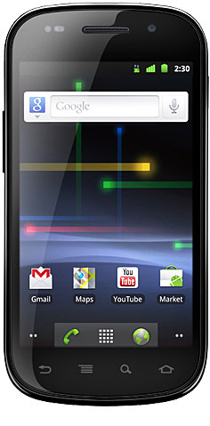
High Cost of AT
$529
$599
$749
(cellphone not included)

Slide 21
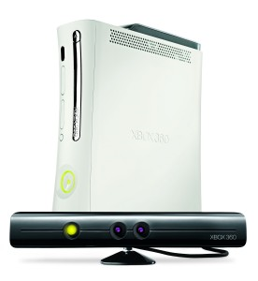
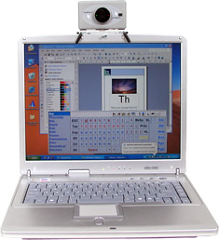
High Cost of AT
$399
$995
(laptop not included)

Slide 22
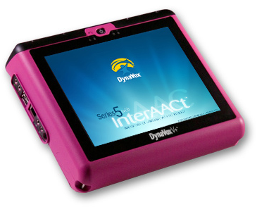
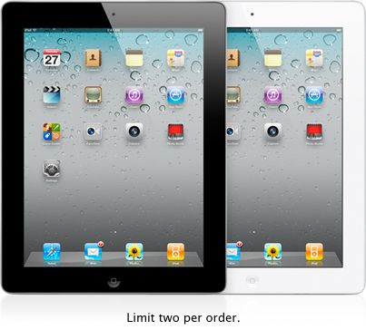
High Cost of AT
$1658
$7820

Slide 23
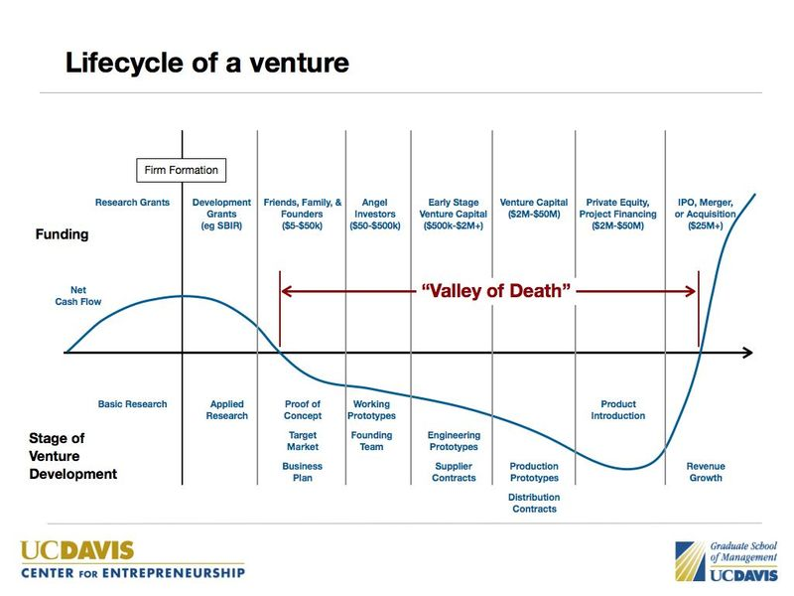
Assistive Technology Economics
Credit: Andrew Hargadon, UC Davis

Slide 24
Assistive Technology Economics
The “Valley of Death”
cash
flow
typical consumer product
small market AT product
time
higher research costs due to technical complexity
small markets, lower capacity to pay
Lack of venture funding due to small market sizes

Slide 25
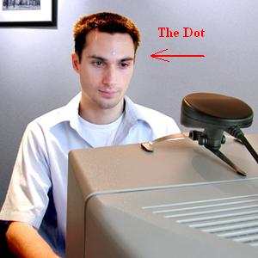
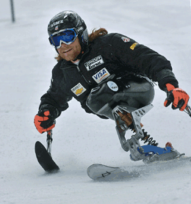
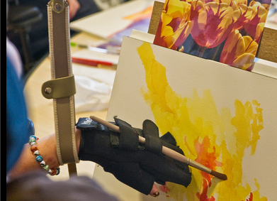
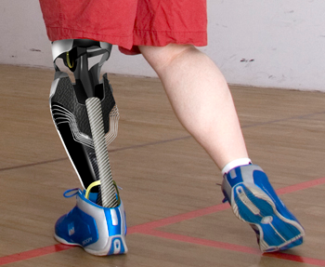
Assistive Technology as a Business
How do new AT products become successful in the marketplace?

Slide 26
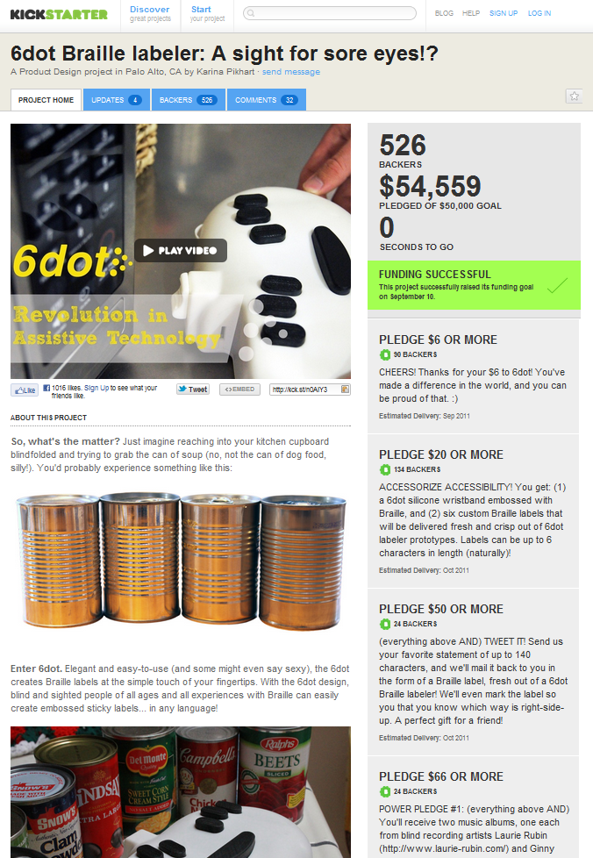
Raising Funds
U.S. Small Business Innovation Research (SBIR) grants
Angel investors
New sources of funding, e.g. kickstarter.com

Slide 27
Making Industry Connections
Assistive Technology Industry Association (ATIA) Annual Conference
Closing the Gap Annual Conference
CSUN International Technology and Person with Disabilities Conference
  Held annually in San Diego

Slide 28
Alternative Approaches

Slide 29
Open-Source Models
GitHub/Google Code/freeware models
instructables.com
Limitations for AT adoption?

Slide 30


Volunteer Organizations
Examples: MIT Assistive Technology Club, Tetra Society of North America, Remap UK, individual volunteers

Slide 31

Social Enterprise
Social and financial bottom lines
Benetech
  Problem: less than 5% of print materials are accessible to people with visual/reading disabilities
  Mix of staff and volunteers scan, upload, and proofread books and make them accessible
  Free for students; $50/year otherwise

Slide 32
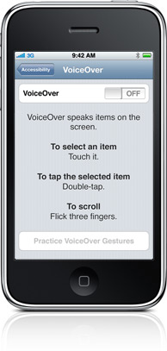
Social Enterprise
Social and financial bottom lines
Apple iOS Accessibility
  Why has Apple prioritized accessibility for blind people?
  What implications exist for more open approaches (e.g. Android OS)?
  Is there a quality of experience vs. customizability tradeoff in AT?

Slide 33
Other Design Approaches
Conventional technologies with assistive applications
  Speech recognition, smartphones/tablets
Universal design
  Curb cuts, low-floor buses, slider-top resealable bags
Limitations?

Slide 34
“Situational Impairments”
People experience impairments:
  In poor environmental conditions, e.g. lighting, noise, distractions, extreme weather
  While in motion
Examples
  Interacting with controls in a car
  Typing on a phone while walking
  Controlling a mouse while typing?
Could devices be designed to be usable in these situations?

Slide 35
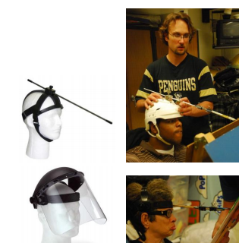
Do-It-Yourself (DIY) Efforts
Could assistive technology users be empowered to create solutions for themselves?
Increasing availability of rapid prototyping facilities and resources
  3D printing: Shapeways.com
  Materials/Tools: Sugru, Arduino
  Low barriers to software development?
Limitations?
Further reading: A. Hurst and J. Tobias, “Empowering Individuals with Do-It-Yourself Assistive Technology,” ASSETS 2011
Hurst and Tobias, ASSETS 2011

Slide 36
Other Design Approaches
Conventional technologies with assistive applications
  Speech recognition, smartphones/tablets
Universal design
  Curb cuts, low-floor buses, slider-top resealable bags
Limitations?

Slide 37
Beyond Design
Design- and technology-savvy people are needed in:
  AT training and education
  Disability service/advocacy organizations
  Clinical (OT/PT/SLP) roles
  Social work
  AT/disability public policy

Slide 38
Takeaways
Consider the IDEAS Global Challenge to carry on and scale up your work
Sign up and contribute to the AT@MIT mailing list: http://bit.ly/atmit
Share your work with others through design competitions and other venues
Unsolved problems remain in making AT widely available, affordable, and accessible

