Slide 1
6.S196 / PPAT: Principles and Practice of Assistive Technology
Today: Functional Deficits that Accompany Aging
Monday, 7 November 2011
Prof. Seth Teller

Slide 2
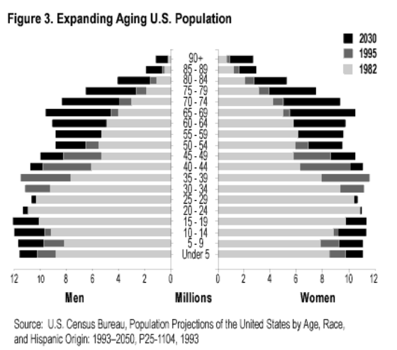
Demographics of Aging

Slide 3
Changes Associated with Aging
Physical
Skin, hair, height, weight, speed, strength
Decreased night vision, lung capacity, gait speed
Sensory/perceptual
Hearing, vision, touch, proprioceptive, kinesthetic
Cognitive
Memory, speed, dementia, psychological
Social
Reduced participation, increased dependence

Slide 4
Sensory/Perceptual Function
Hearing
Vision
Taste
Smell
Touch
Proprioception
Kinesthetic sense

Slide 5
Hearing Impairment
Common causes
Deterioration of inner ear mechanisms
Persistent/traumatic exposure to loud noises
Some medications (e.g. painkillers, antibiotics)
Insufficient nutrients in diet
Genetic factors

Slide 6
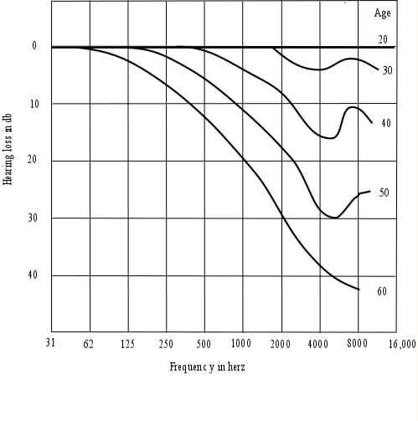
Manifestations
Loss of response at high frequencies
Typically ~40 dB at 8 Khz by age 60
Distortion hinders speech understanding
Especially on telephone, or out of line of sight
cpsc.ucalgary.ca

Slide 7
Technological/contextual aids
Hearing aid / cochlear implant
Differential frequency response, amplification
Signal processing for frequency compression
Accommodation by speech partners
Speak with greater volume (without shouting)
Effort to use a lower pitch when speaking
Clearer articulation of speech sounds
Speaking from within field of listener’s vision
Slower speech, enabling listener to grasp intent

Slide 8
Vision Impairment
Common causes
Age-related macular degeneration
Cataracts
Diabetic retinopathy
Glaucoma

Slide 9
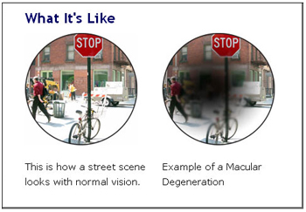
Age-Related Macular Degeneration
Loss of light-sensitive cells in macula
lighthouse.org

Slide 10
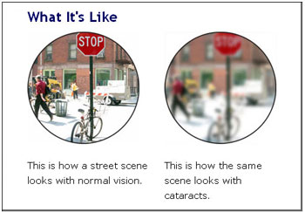
Cataracts
Clouding of lens of one or both eyes
lighthouse.org

Slide 11
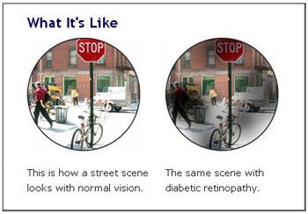
Diabetic Retinopathy
Complication of diabetes (insufficient regulation of blood insulin, glucose)
Interference with functional tissues of retina
lighthouse.org

Slide 12
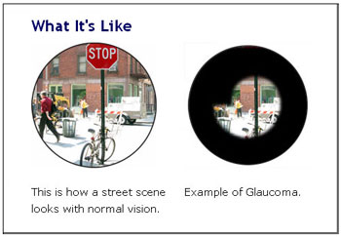
Glaucoma
Excessive fluid pressure damages optic nerve
Blur, halos, blank spots, loss of peripheral vision
Symptoms develop gradually, can be hard to notice
lighthouse.org

Slide 13
Technological/contextual aids
AT devices for low vision
Lighting, magnification, contrast enhancement
Optical character recognition, speech synthesis
Retinal / occipital cortex implants
Still in experimental stage
Facilitation by partners/caregivers
Awareness of functional regions of visual field
Awareness of visual system effective resolution
Arrange lighting, presentation to suit abilities
Accompaniment by audible/tactile stimuli

Slide 14
Mobility and Manipulation
Deficits in proprioception
Problems with balance, dizziness
Slower reaction times, less effective reflexes
Gait abnormalities, increased fall risk
Deficits in fine manipulation
Higher thresholds for touch, pain sensitivity
Slower nerve conduction speeds, less dexterity
Declining strength and endurance
Implications for physically demanding tasks

Slide 15
Top Fall Risks (Anderson, 2004)
Main accidental cause of death for those 65+ !
(Increases in winter due to ice/darkness, but most falls are indoors.)
Stairs (especially those without handrails)
Footwear providing poor traction
Standing on chairs or other objects to reach
Furniture that obstructs path
Throw rugs that slip when walked upon
Narrow and/or twisting passages
Non-furniture obstacles (cords, clothes, shoes, clutter)
Dim or insufficient lighting
Lack of traction strips in bathtub/shower
Anderson, Fear of falling: senior citizens face serious injury, death
from losing their balance. Atlanta Journal-Constitution, 6 Jan 2004.

Slide 16
Mitigating Fall Risks (Enix et al. 2011)
Orthostatic hypotension Rise slowly after sitting
Postprandial hypotension Evaluate carbohydrate intake
Low back pain Chiropractic care/physical therapy
Muscle weakness Exercise, tai chi, yoga, walking
Balance problems Fall exam, walker, 3-point cane
Transferring to bed, toilet, couch Lower bed/raise toilet, add railings
Lighting, clutter, stairs, slippers Home inspection/Occupational therapy
Medication increased fall risk Review medications, like psychotropics
Fear falls/loss of independence Medic-Alert pendant/bracelet
Enix et al., Balance Problems in the Geriatric Patient,
Topics in Integrative Health Care 2011, Vol. 2(1)
CDC, Injury Prevention & Control: Home and Recreational Safety
http://www.cdc.gov/homeandrecreationalsafety/falls/index.html

Slide 17
Cognitive Deficits
Impaired senses of hearing, vision, touch
Vulnerability to poor aural/visual conditions
Slower reaction/response times
Declines in sustained attention
Less effective working memory, recall
Difficulty with multi-tasking
Difficulty learning new routines
Difficulty identifying salient information

Slide 18
Dementia
Majority of cases due to Alzheimer’s disease
Plaques and tangles in neural tissue
About 6-8% of those over 65 affected
More than 30% of those over 85 affected
Symptoms
Wandering/getting lost, memory loss, poor personal hygiene, failure to take meds
However many with dementia can orient to place, person and time into advanced stages

Slide 19
Personal/Societal Costs
Decreased quality of life
Loss of independence in activities of daily living
Loss of privacy (family, outside caregivers)
Associated costs (est. $100B annually in US)
Family caregivers: lost wages, opportunities
Non-family caregivers: wages
Implications when receiving medical care
Difficulty giving medical history information
Difficulty following medical recommendations

Slide 20
Technological/contextual aids
Medical (some reversible/treatable causes)
Thyroid; B12 deficit; sensory deficit; depression
Wander detection / navigation aids
Alert to caregivers (e.g. MIT system at TBH)
Prompted/unprompted guidance “home”
Cognitive aids for sequencing tasks
Daily routines, medical regimens, etc.
Independent validation is challenging

Slide 21
AT Perspective
Aging tends to bring a mix of impairments
Sensory, motor, cognitive, psychosocial
Variety of mitigating strategies
Contextual: lighting, physical modifications
Technical: hearing aids, vision enhancements
Caregiver: prompting, assistance with ADLs
Ripe area for development of novel AT
Use of machine sensing, mobility, manipulation
Very challenging: safety, abandonment, social
Pressing problem: demographics to 2100

Slide 22
Demographics of Aging

Slide 23
Coming Up
Today (Monday) in lab:
Check-ins with each team
Wednesday lecture:
Prof. Krzysztof Gajos
Wednesday lab:
Assistive technologies for efficient text input

