Slide 1
Principles and Practice of Assistive Technology
Lab 01
September 7, 2011

Slide 2
Agenda
Introductions
Course Survey
Disability Etiquette
Preamble
Quiz
Video: “The Ten Commandments”
Discussion

Slide 3
Communication Etiquette
Communicating/interacting with people who have a disability
Communicating about people who have a disability

Slide 4
Preamble
Safe space for open discussion
Be respectful of others
People have different experiences and backgrounds with disability and assistive technology
Don’t be afraid to ask questions or voice your thoughts!
“Answers” are not always clear-cut

Slide 5
Quiz
“Dotmocracy”
10 different sheets of paper with statements about disability etiquette
Rate from “strong agreement” to “strong disagreement” – fill in a dot
Write comments underneath the survey

Slide 6
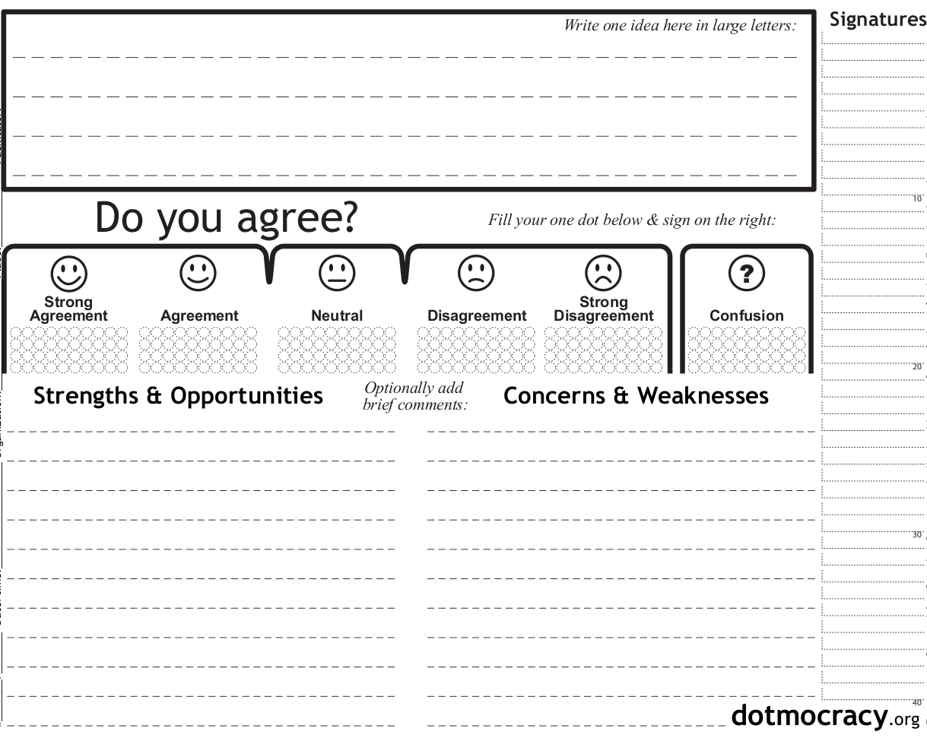
If someone cannot shake hands with their right hand, it is acceptable to shake left hands.

Slide 7
Video
“The 10 Commandments of Communicating With People With Disabilities”
26 minutes, 1994 hairstyles

Slide 8
Video
“The 10 Commandments of Communicating With People With Disabilities”
26 minutes, 1994 hairstyles

Slide 9
Video Discussion
What were your impressions?
Was there any part of the video you disagreed with?

Slide 10
Video Assisitive Technologies
Closed captioning
Video description

Slide 11
Quiz Answers
“Etiquette for Communicating with People with Disabilities” brochure from MIT Student Disability Services

Slide 12
When introduced, you should offer to shake hands with someone who has limited hand use or an artificial limb.

Slide 13
If someone cannot shake hands with their right hand, it is acceptable to shake left hands.

Slide 14
When meeting someone who is blind, always identify yourself and others who may be with you orally (e.g. “Hey, it’s Alex.”)

Slide 15
If a person is assisted by a companion or sign language interpreter, you should speak to his or her assistant first.

Slide 16
When dining with a friend who is blind or has low vision, offer to read the menu and ask if you can describe what is on his or her plate.

Slide 17
It is polite to offer assistance to someone with a disability without being asked.

Slide 18
Wheelchair users consider their wheelchair as part of their personal space.

Slide 19
You should not use terms like "see you later" or "did you hear about this?" to someone who has a vision or hearing disability.

Slide 20
If you are having difficulty understanding someone, just pretend that you understand them and keep the conversation flowing.

Slide 21
When leading a blind person, offer him or her your arm so that the person can more easily follow where you are going.

Slide 22
You should always use "people-first" language, like "person with a disability" or "person living with a hearing impairment", instead of "disabled person", "paralyzed person", or "blind person.“

Slide 23
People-First Language
Reading from Texas Council on Developmental Disabilities

Slide 24
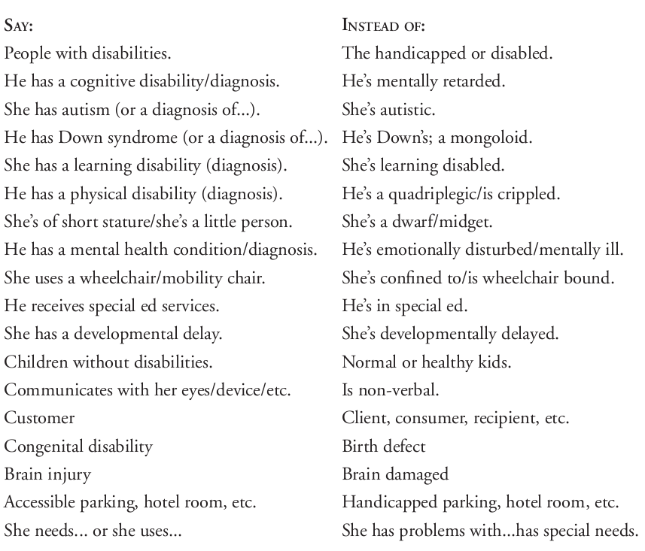
People-First Language

Slide 25
National Federation of the Blind (1993)
WHEREAS, the word “blind” accurately and clearly describes the condition of being unable to see, as well as the condition of having such limited eyesight that alternative techniques are required to do efficiently the ordinary tasks of daily living that are performed visually by those having good eyesight; and
WHEREAS, there is increasing pressure in certain circles to use a variety of euphemisms in referring to blindness or blind persons―euphemisms such as “hard of seeing,” “visually challenged,” “sightless,” “visually impaired,” “people with blindness,” “people who are blind,” and the like; and
WHEREAS, a differentiation must be made among these euphemisms: some (such as “hard of seeing,” “visually challenged,” and “people with blindness”) being totally unacceptable and deserving only ridicule because of their strained and ludicrous attempt to avoid such straightforward, respectable words as “blindness,” “blind,” “the blind,” “blind person,” or “blind persons;” others (such as “visually impaired,” and “visually limited”) being undesirable when used to avoid the word “blind” and acceptable only to the extent that they are reasonably employed to distinguish between those having a certain amount of eyesight and those having none; still others (such as “sightless”) being awkward and serving no useful purpose; and still others (such as “people who are blind” or “persons who are blind”) being harmless and not objectionable when used in occasional and ordinary speech but being totally unacceptable and pernicious when used as a form of political correctness to imply that the word “person” must invariably precede the word “blind” to emphasize the fact that a blind person is first and foremost a person; and

Slide 26
National Federation of the Blind (1993)
WHEREAS, this euphemism concerning people or persons who are blind--when used in its recent trendy, politically correct form--does the exact opposite of what it purports to do since it is overly defensive, implies shame instead of true equality, and portrays the blind as touchy and belligerent; and
WHEREAS, just as an intelligent person is willing to be so designated and does not insist upon being called “a person who is intelligent” and a group of bankers are happy to be called bankers and have no concern that they be referred to as persons who are in the banking business, so it is with the blind―the only difference being that some people (blind and sighted alike) continue to cling to the outmoded notion that blindness (along with everything associated with it) connotes inferiority and lack of status; now, therefore,
BE IT RESOLVED by the National Federation of the Blind in Convention assembled in the city of Dallas, Texas, this 9th day of July, 1993, that the following statement of policy be adopted:
We believe that it is respectable to be blind, and although we have no particular pride in the fact of our blindness, neither do we have any shame in it. To the extent that euphemisms are used to convey any other concept or image, we deplore such use. We can make our own way in the world on equal terms with others, and we intend to do it.

Slide 27
Questions for Discussion

Slide 28
Questions for Discussion
How much does language matter?
What are the issues and problems with
Are there differences in language usage from one disability to the next?
How might attitudes and vocabulary change in the next 10 years? In the next 100 years?

Slide 29
Language Usage
Disability as identity: “Deaf culture”
Terminology at partner organizations:
“resident” instead of “patient”
“dining room” instead of “cafeteria”
“Disabled” versus “differently abled”; “able-bodied” versus “temporarily able”

