Slide 1
MCMC Inference over Latent Diffeomorphisms
Angel Yu

Slide 2
Diffeomorphisms
A space of transformations on manifolds
These transformations are:
Bijective
Differentiable
Inverse also differentiable

Slide 3
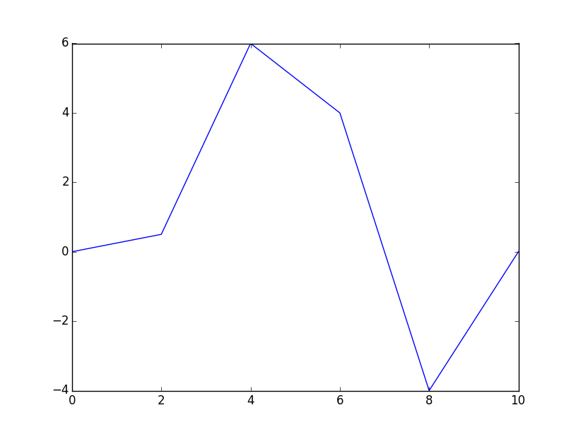
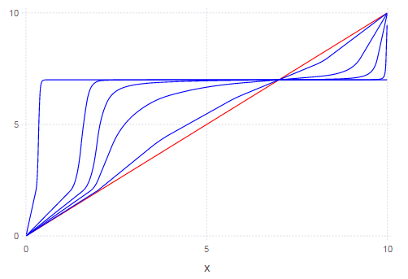
CPAB Transformation
Integrate Continuous Piecewise Affine velocity fields over time t.

Slide 4
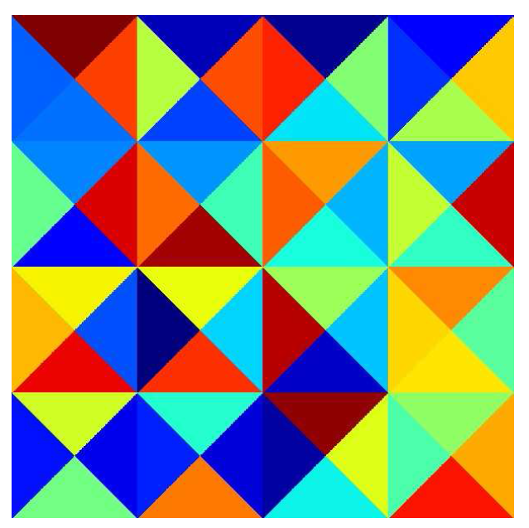
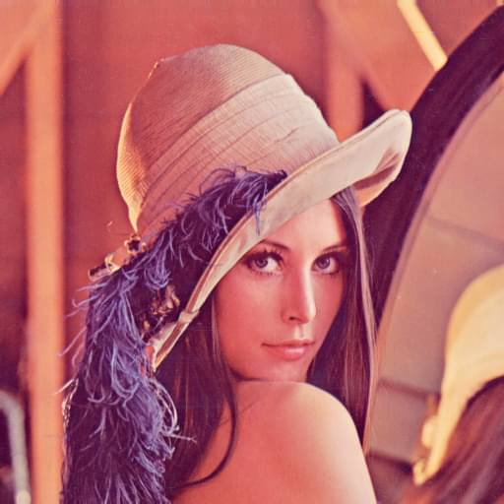
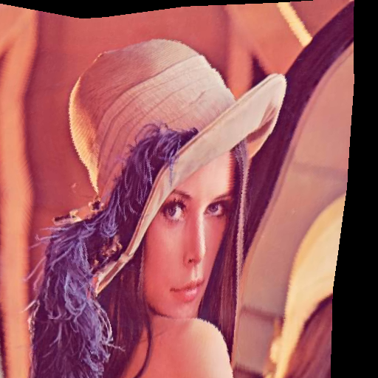
2D CPAB Transformation
Tessellate into triangles
Example CPAB transformation
64 triangles => 58 parameters

Slide 5
Parallel Computation of CPAB
Computation of CPAB transformation is independent at each point
Embarrassingly parallel over the points
Time to compute a 2D CPAB transformation on a 512x512 image:
Computation time is fast enough that the communication overhead is significant.

Slide 6
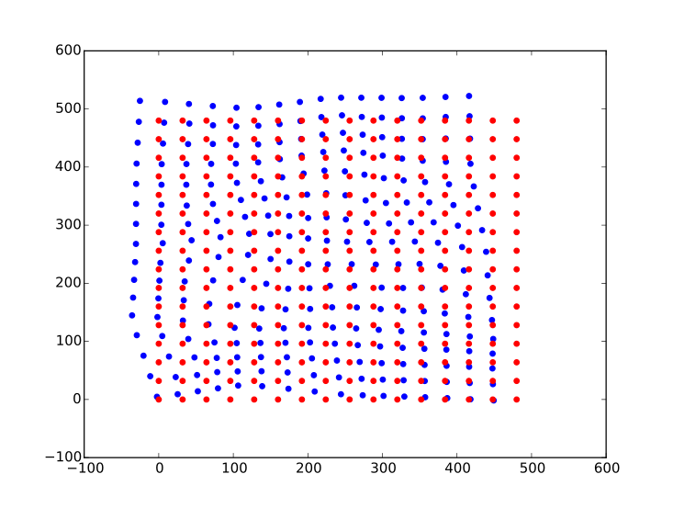
Infer underlying transformation
Given 2 images and correspondences between the 2 images
Infer the parameters in the underlying transformation by minimizing least squared objective function:
Using:
Gradient Descent
Metropolis’ Algorithm
Particle Filter

Slide 7
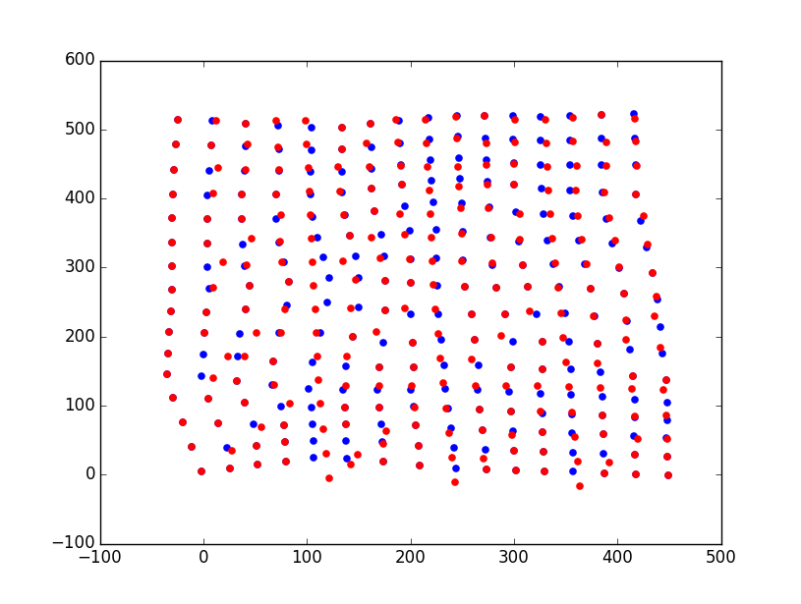
Gradient Descent
A common optimization algorithm.
Algorithm:
Start with initial $θ_{0}$
At each iteration $i$, take $θ_{i+1}=θ_{i}−γf′(θ_{i})$
Easy to get stuck at local minimums

Slide 8
Metropolis’ Algorithm
An MCMC Sampling algorithm used to sample from a target distribution $P(x)$
Start off with an initial sample $x_{0}$
At each iteration
Sample $x′$ from a proposal distribution ${Q(x|x}_{i})$ usually a Gaussian centered at $x_{i}$
Calculate $α=P(x′)/P(x_{i})$
Accept if $x′$ with probability $α$ and set $x_{i+1}=x^{′}$
Otherwise reject and set $x_{i+1}=x_{i}$
To use this to minimize our objective function we take:

Slide 9
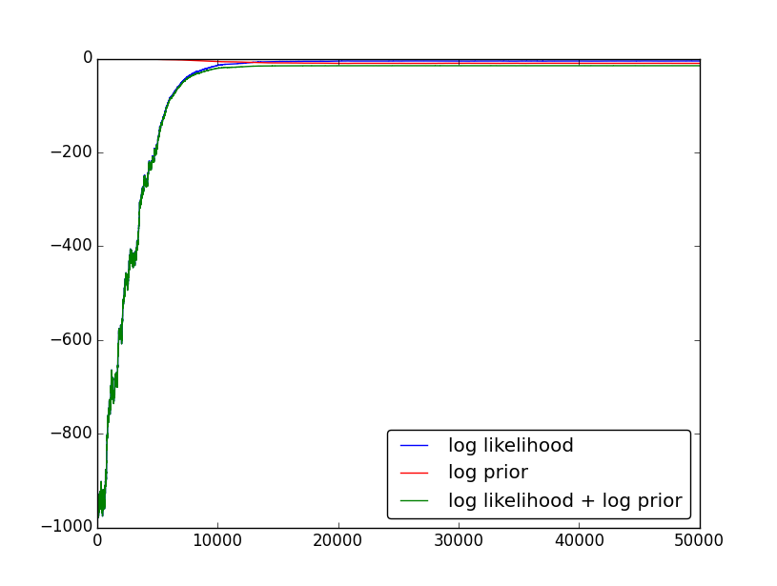
Metropolis Algorithm Results
Takes 91s for 50,000 iterations

Slide 10
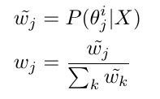
Particle Filter
Another MCMC sampling algorithm primarily used for changing $P(x)$:
Start off with $n$ particles randomly sampled from the prior
At each iterations:
Calculate the weights for each particle proportional to its probability
Resample from the current particles based on the distribution of weights
Perturb each particle using a perturbation distribution, usually a Gaussian centered at the particle
In our case, our weights are:
Allows easy parallelization over the number of particles.

Slide 11
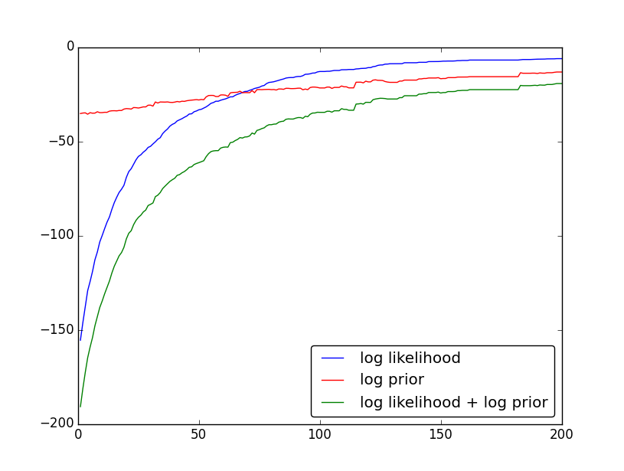
Particle Filter Results

Slide 12
Particle Filter Timings
Time required for 200 iterations on 16x16 correspondences:
Time required for each iteration on 512x512 correspondences:

Slide 13
Summary
Implemented the calculation of CPAB transformations in Julia
Both Serial and Parallel
Works with both SharedArrays and Darrays
Implemented Metropolis’ Algorithm and Particle Filter
Both produced good results on the inference problem
Almost linear speedup when using Parallel Particle Filter on large enough problems

