Slide 1

Parallelization for a Block-Tridiagonal System with MPI
2009 Spring
18.337
Term Project
Jungpyo Lee
Plasma Science & Fusion Center(PSFC), MIT

Slide 2
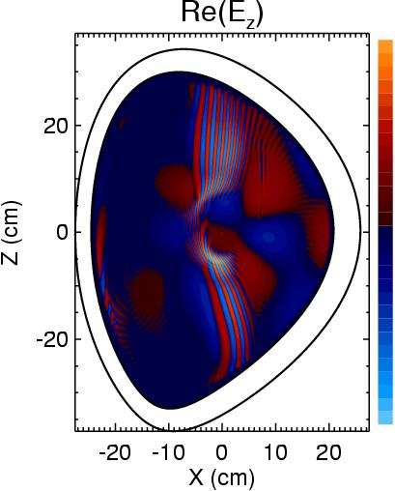
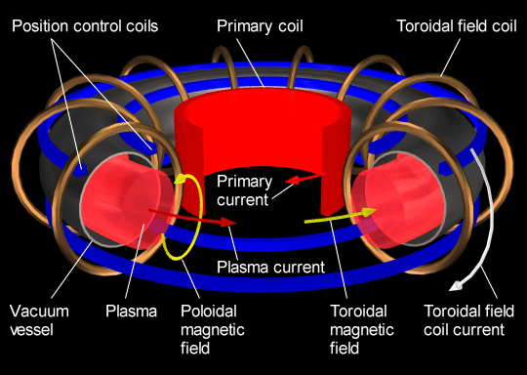
1. MOTIVATION
2D RF wave analysis in Plasma for TOKAMAK operation
TORIC(MPI Fortran based Code) –Using FEM for Maxwell eqns in Plasma
ICW
FW
IBW
TORIC at 240N_{r} x 255 N_{m}
J. Wright, PSFC, PoP, 2004

Slide 3
2. Block Tri-Diagonal system
Tri-diagonal equation along radial direction
Each block has poloidal components
for i=1,…
:
→Electric fields
:
,
.

Slide 4
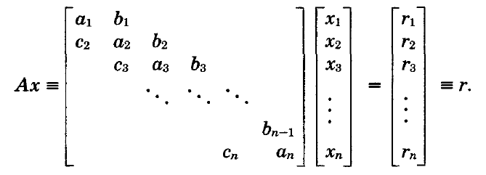
2.1. Current Version of TORIC: Radially Serial Calculation for Block- Tridiagonal system
Serial computation (Radial direction [i=1:270]) : Thomas Algorithm
Parallel computation (Poloidal direction [m=0:255]) : Scalpack matrix calculation (BLACS)
-1
=
_
*
*

Slide 5
2.2 The needs for parallelization of the radial direction as well as the poloidal direction
e.g. (Ni=270, Nm=32,Nproc=400)
Current: serial(raidal)+parallel(poloidal)
time~270*(32^2/400)→2D processors distribution(20*20)
If Nproc>>Nm^2, then I cannot use full processors (Saturation !!)
Communication time increased as block size per a processor decreased
Goal: parallel(radial)+parallel(poloidal)
time~(270/4)*(32^2/100)→
3D processors distribution(4*10*10)

Slide 6
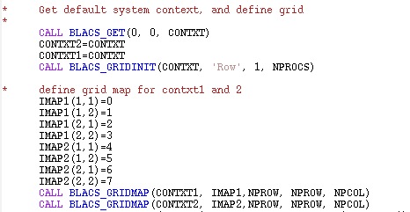
2.3. Use of BLACS for 3D processor grid
The need for 3-D grid
remove the saturation of improvement for the computation speed
Divide a big size of data for one block(6Nm*6Nm) in the memory of many processors
Use context array in BLACS for 3D processor grid

Slide 7
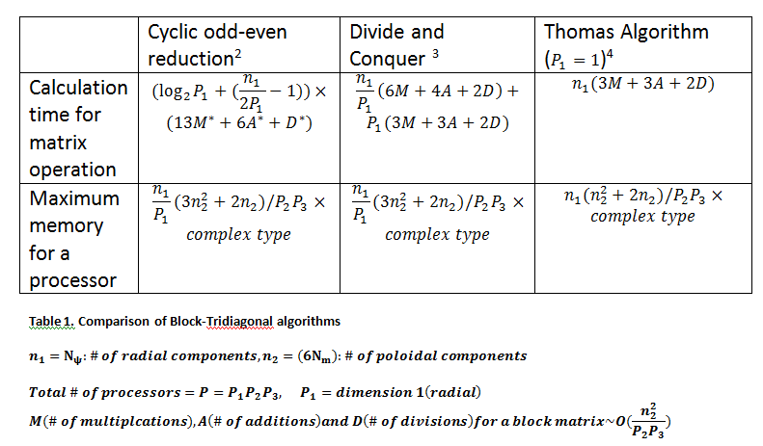
2.4 Algorithms comparison(1)
Comparison of computation time for typical algorithms of tridiagonal system
H.S.Stone, ACM transactions on Mathematical Software,Vol1(1975),289-307
H.H.Wang, ACM transactions on Mathematical Software,Vol7(1981),170-183
http://en.wikipedia.org/wiki/Tridiagonal_matrix_algorithm

Slide 8
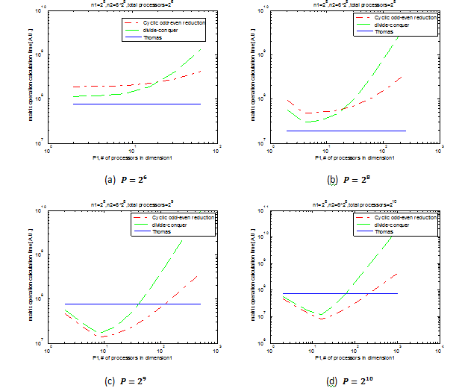
2.4 Algorithms comparison(2)
Estimation of computation time for three algorithms by theory (set limitation for maximum as by experience)
Thomas algorithm is faster below threshold(P=2^8)
There exists an optimization point for P1

Slide 9
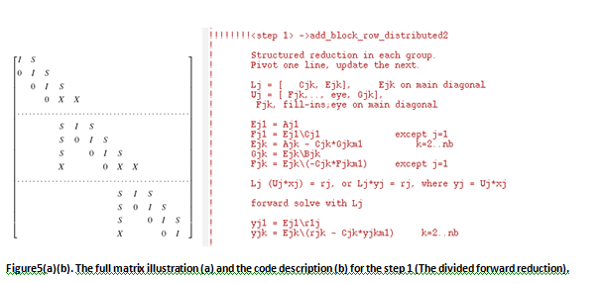
3. Implementation(1)
Use an algorithm having both merits of divide-and-conquer method and odd-even cyclic algorithm suggested by Garaud
Step 1. the serial forward reduction in each divided group
P.Garaud, Mon.Not.R.Astron.Soc,391(2008)1239-1258

Slide 10
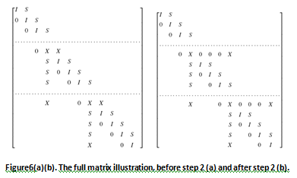
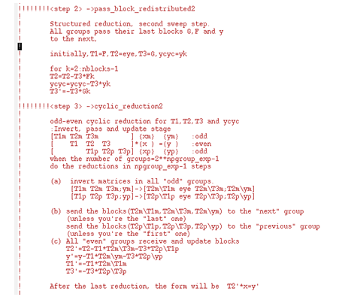
3. Implementation(2)
Step 2. Pass the blocks in the last lines and redistribute for tridiagonal forms
Step 3. Odd-even cyclic reduction for the blocks in the first lines of all groups

Slide 11
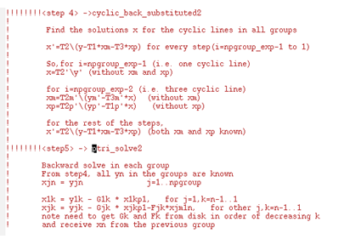
3. Implementation(3)
Step 4. Cyclic back substitution in the first lines of all groups
Step 5. Serial back substitution in each group

Slide 12
4. Result(1)- Fast computation speed of the new solver
When I use only P1 in 3D grid (e.g. [P1,P2,P3]=[7,1,1] or [255,1,1])
About two times faster than old solver
Retardation of the saturation for improvement of computation speed

Slide 13
4. Result(2)- Good stability and accuracy of the new solver
Results of electric fields by the new solver are close to the results by older solver within 0.1% error
About 50 times smaller variance of results in terms of number of processors than older solver

Slide 14
5. Conclusions and Future works
Implementation of a parallel block-tridiagonal system solver
The use of the algorithm with a combination of divide-and-conquer and odd-even cyclic reduction
Two times faster speed and better precision of the results by the new solver
Ongoing development of the sovler for the use of full 3-dimensional grid to overcome the saturation of the speed
The needs of optimization for the ratio of the 3D grid in the future

Slide 15
6. Questions and Suggestions

