Slide 1
Companion Eye Systems for Assistive and Automotive Markets
Dr. Riad I. Hammoud
Nov 04, 2013
Guest Lecture at MIT (PPAT)

Slide 2
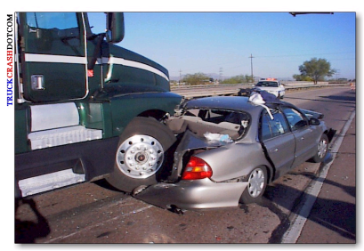

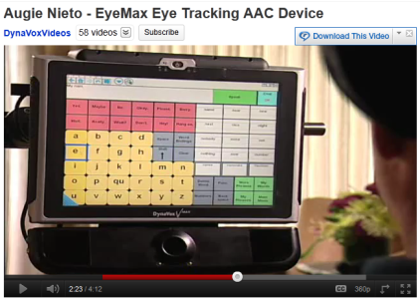
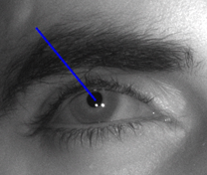
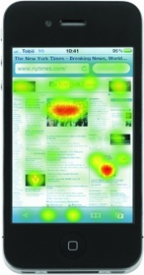
Eye Tracking as a Non-Invasive Tool to Collect Rich Eye Data for Various Applications
ADS
AAC
….
Operators
ALS/CP
Patients
Web
Surfers,…
Eye Tracking Device
Collect Eye Data
Interpret Eye Data
ADS: Advanced Driver Support Systems
AAC: Augmentative & Alternative Communication

Slide 3
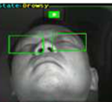
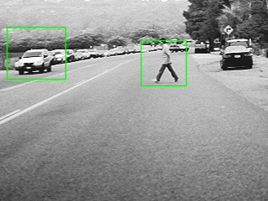
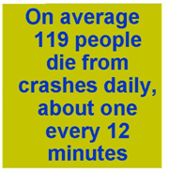
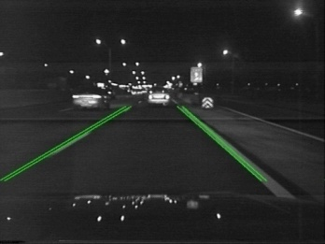

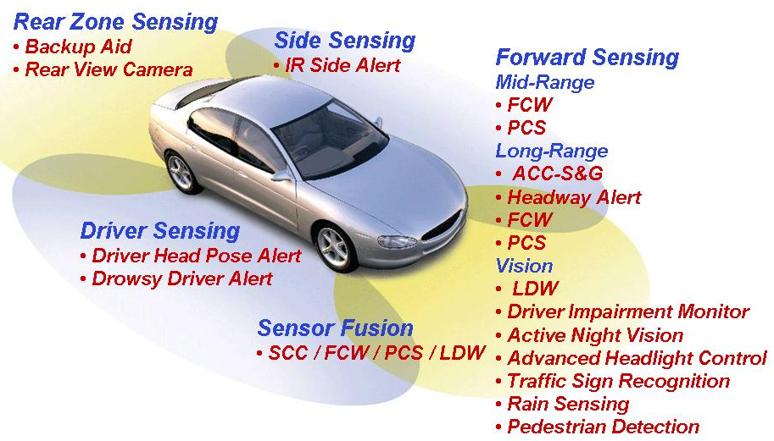
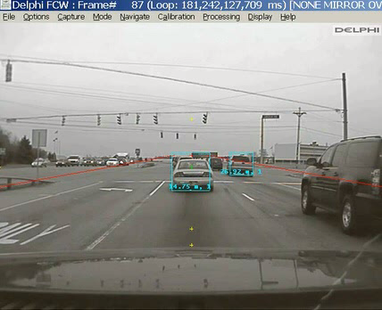
Eye Tracking is a Key Technology in Advanced Driver Support Systems (ADS)
Drowsy Driver Detection
Driver Distraction Alert

Slide 4
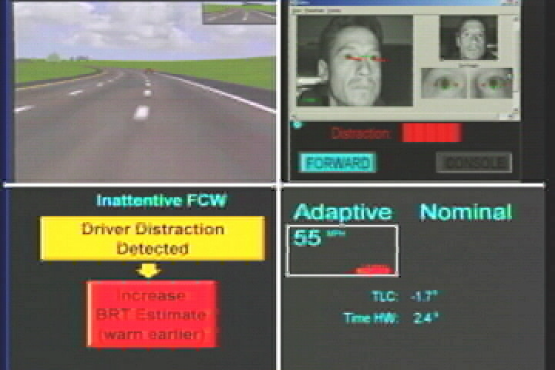
ADS: Visual Distraction Alert Reduces
Vehicles Crashes

Slide 5

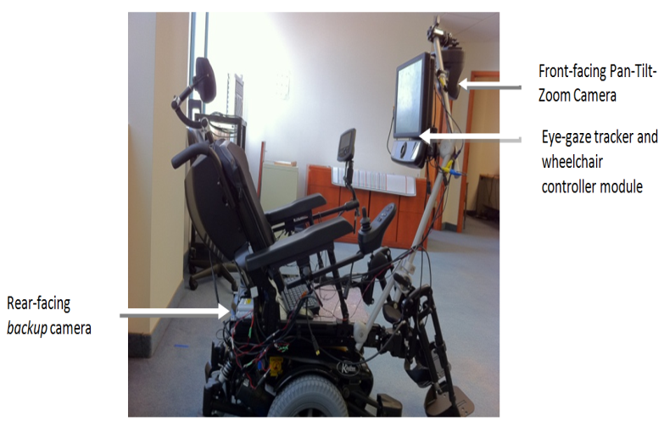

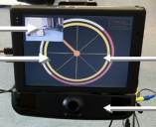
AAC Improves Quality of Lives
Eye Tracking Technology Allows Disabled People to Communicate
    Compose Text Messages
    Dial Phone Numbers
    Play Games
    Drive Power Wheelchair
http://www.youtube.com/watch?v=gDKFNqrmtZ4

Slide 6
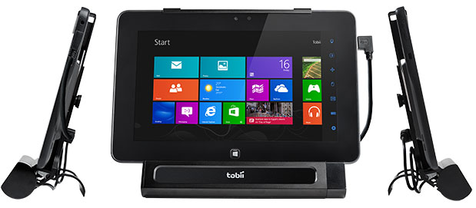
Eye Tracking Markets & Differentiators
Tobii
Smart Eyes
Seeing Machines
EyeTech Digital System
SensoMotoric Instruments GmbH
DynaVox
Companion Eye Systems
Price range
Accuracy & Robustness
Calibration
Head box
Power consumption
Onboard processing
Customer support

Slide 7


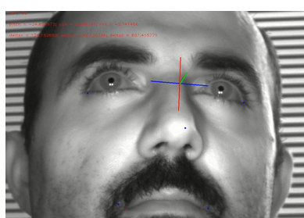

Accuracy Matters!
Eye Tracking Vs. Head Tracking
Eye Cursor Can Get as Precise as a Mouse Cursor
Head Tracker Lacks of Precision but Still Useful for those with Eye Diseases

Slide 8
Overview of HW and SW of an Eye Tracker Device
Eye–Gaze Tracking
  Eye detection/Tracking
  Gaze measurements form dark pupil & corneal reflections
  3D gaze tracking
    System Calibration
    Corneal/Pupil centers estimation
    Optical axis Vs. Visual axis
    User Calibration
    Experiments
Eye Closure Tracking (EC)
  Driver fatigue detection

Slide 9
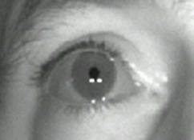
Choosing The Right Setup Helps Simplifying the Image Processing Algorithms and Increasing Accuracy
Near Infrared Camera
  880 nm
    Must respect the MPE threshold
      (eye safety threshold)
  Filter to block ambient lights
  >= 15HZ
  Global Shutter
Off Axis LEDs
  dark pupil
  Corneal reflexes (glints)

Slide 10
Eye Tracking Algorithmic Building Blocks
Area-of-interest
Pre-processing
Face detection/Single Eye region detection
Pupil/CR Tracking
Blink / Eye Closure detection
Input Video
Ctrl/switch LEDs
2D eye socket tracking
Switch cameras
Dual corneal ref. centers computation
Input Video
Eye Gaze measur. computation
in 2D & 3D
Brow / lips tracking
Command PTZ
Left & right pupil centers detection in 2D
Camera(s), LEDs & screen Calibration
2-5-9-16 pts calibration
Quality Control
Nose tip tracking
Eye corners, iris center detection
Track left & right eye gaze (2 eyes)
tracking recovery
Facial detection
Facial Action Code recognition
Head motion orientation
Global-local calibration scheme
3D Cornea center estimation
Estimation of the correction func. for head mvt
6DOF head pose
3D Pupil center est.
POG mapping from Camera coordinates to screen
Depth estimation
Gaze Error / Qual. Ass.
head pose & eye pose combination
<Vis. & Opt.> angle comp.
3D LOS
Calculation of the intersection point <LOS & plane>
Estimation of the Gaze Mapping function
Calibration auto-correction
smoothing, filtering, validation, history keeping
Data Analysis:
saccade, scanning path, fixation
Point of Gaze on the Screen / World coordinate system
Eye typing, Heat Map, Contingent display, controlled wheelchair, etc.

Slide 11
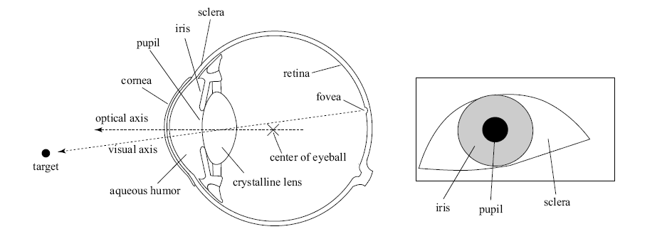
Understanding the Eye Anatomy Helps in the Formulation of the Image/Ray Formation
Aq. Humor refraction index = 1.3
Distance from corneal center to Pupil center = 4.5mm
Radius of corneal sphere = 7.8mm

Slide 12
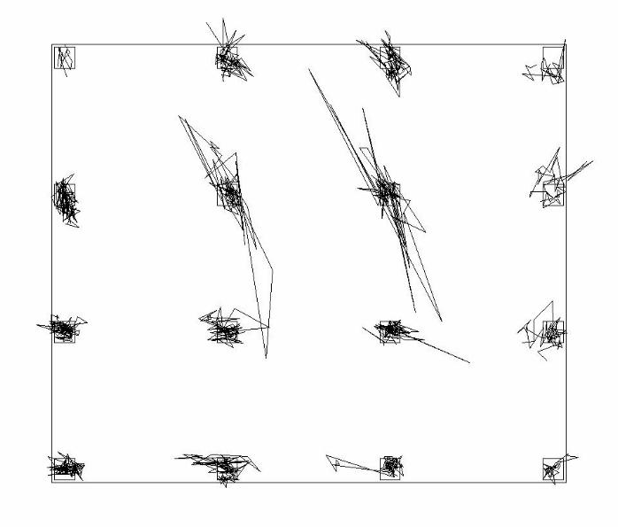
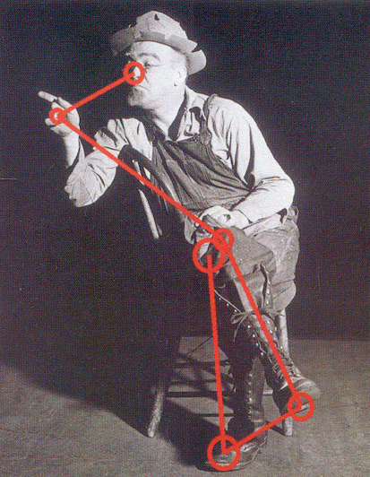
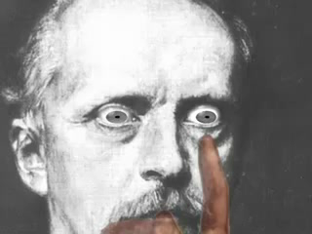
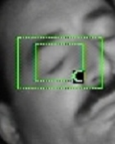
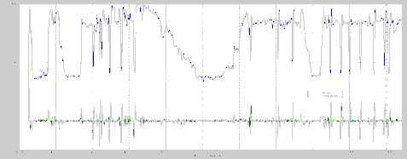
Eye Tracking Refers to Tracking All Types of Eye Movements
Fixation: Maintaining The Visual Gaze On a Single Location
Smooth Pursuit: Closely Following a Moving
Target
Saccadic: Abruptly Changing Point of Fixation
Eye Closure: Going from Open Eye State to Closed Eye State
www.youtube.com/watch?v=kEfz1fFjU78
Eye Blinking: Sequence of Blinks
Eye Gesture: Sequence of Eye Movements

Slide 13
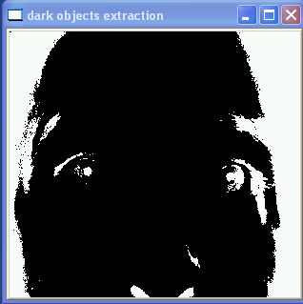
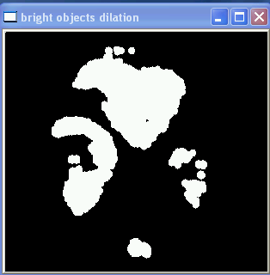
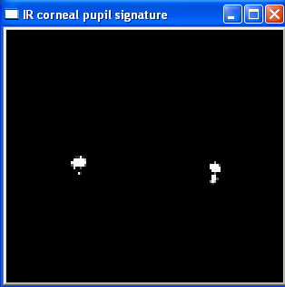
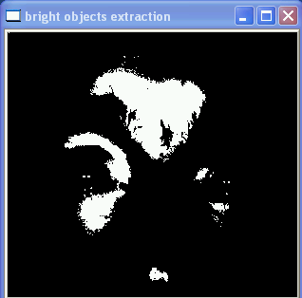
Extracting Infrared Eye Signatures for Eye Detection & Tracking
Low-pass filter
dot product filter
Input Image (dark pupil, two glints)
Region growing
High-pass filter
Potential eye candidates

Slide 14
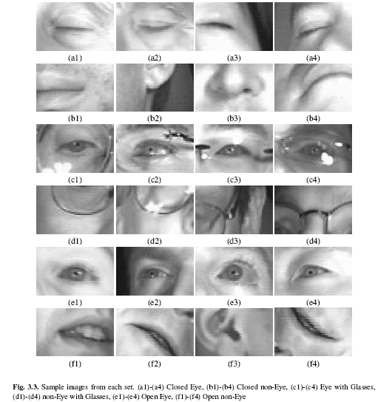
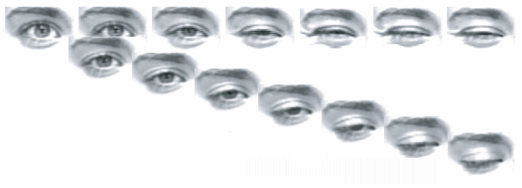





Learn an Eye/non-Eye Models using Machine Learning to Enhance the Automatic Eye Detection Process
Variations of the eye appearance due to lighting changes, eye wear, head pose, eyelid motion and iris motion
…

Slide 15
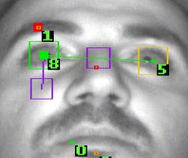
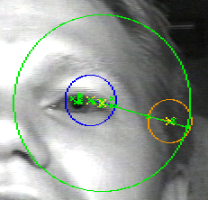
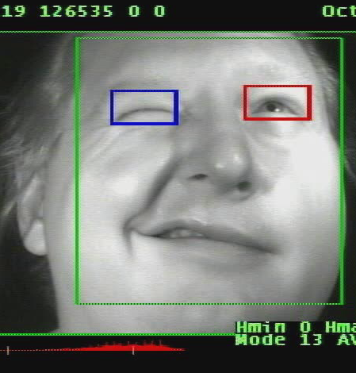
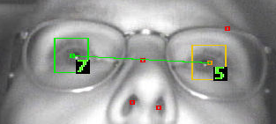
Filter Eye Candidates using Spatio-Temporal and Appearance Information

Slide 16
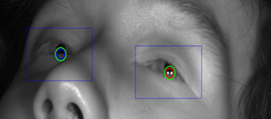
Example of Pupil/Glints Tracking During Fast Head Motion (Cerebral Palsy Subject)
Notes:
video

Slide 17
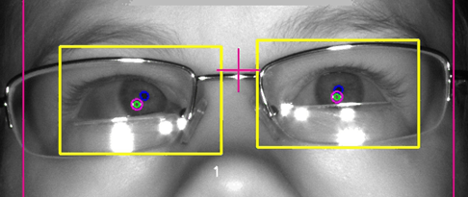
Example of Pupil/Glints Tracking During Fast Head Motion (Cerebral Palsy Subject)
Notes:
video

Slide 18
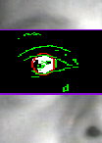
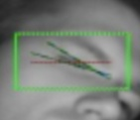




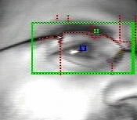
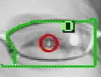
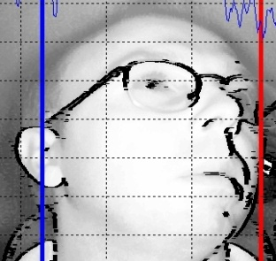
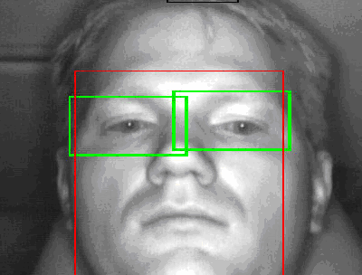
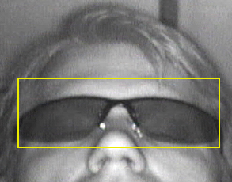
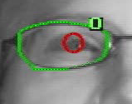

Tracking of Facial Features and Eye Wear Increases Efficiency and Allows Dynamic Camera/Illumination Control
Brow
Furrow
Iris
Upper & lower lids
Left eye + Right eye
Eye
&
Glasses
Head
Face ellipse

Slide 19
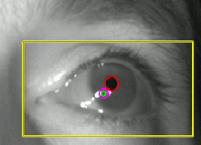
From eye detection to eye features localization and 2D gaze vector calculation
Extract left glint and right glint centers in 2D images
Define corneal region around the two glints to search for the pupil
Fit an ellipse on the convex-hull of the darkest region near the two glints (segment the region using mean-shift algorithm)
Compute the center of mass of the pupil in 2D images
Gaze vector / 2D gaze measurement in the image space to be mapped to the screen coordinate system
Next step: estimate the coefficient of a mapping function during a user calibration session & the system is ready for use!

Slide 20


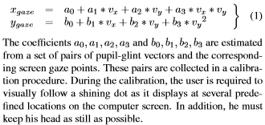

User’s Calibration for Eye Gaze Tracking
User to look at displayed target on the screen
System to collect gaze measurement for that target
Repeat for N targets
System to learn a bi-quadratic mapping function between the two spaces
.
.
.
Springer Book: Passive Eye Monitoring
Algorithms, Applications and Experiments, 2008
http://www.ecse.rpi.edu/~qji/Papers/EyeGaze_IEEECVPR_2005.pdf

Slide 21
3D GazeTracking Allows Free Head Motion
Screen Plane
Est POG
Offset
Camera(s), light source & screen(s) Calibration
Optical axis
GT POG
PC
Visual axis
CC
3D Cornea center estimation
Estimate corneal center in 3D
Estimate pupil center in 3D
Construct the 3D line of sight
Construct the monitor plane
Find the intersection point of the 3D LOS and Monitor plane
Compensate for the difference between optical axis and visual axis
3D Pupil center estimation
POG mapping from Camera coordinates to screen
Calculation of the LOS & Monitor intersection

Slide 22

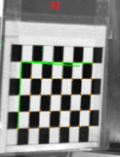
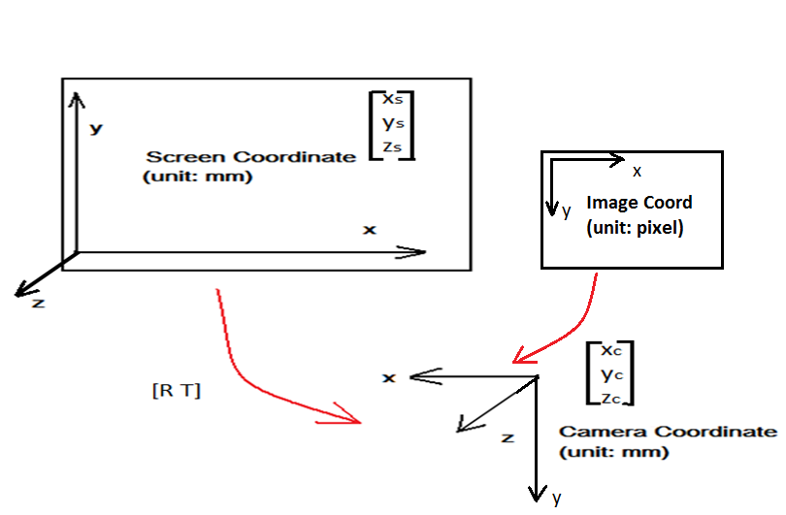


3D Gaze Tracking Requires Camera/System Calibration
top-left corner 3D position:
(-cx*3.75*10⁻³mm, -cy*3.75*10⁻³mm, (fx+fy)/2*3.75*10⁻³mm)
(Δx, Δy, Δz) = (3.75*10⁻³mm, 0, 0) if you walk along the column by one pixel
Rotation and Translation Matrix + screen width and height(unit:mm) + screen resolution(unit: pixel)
  Imager: Intrinsic, extrinsic parameters
  LCD: Screen relative to camera
  LEDs: Point light sources relative to camera

Slide 23




Construct and Solve a System of Non-Linear Equations to Estimate the 3D Corneal Center
Co-planarity: (L₁ – O) ˣ (C – O) · (G_{img1} – O) = 0
Spherical: |G₁ – C| = Rc
Reflection law: (L₁-G₁)·(G₁-C)/||L₁-G₁|| = (G₁-C)·(O-G₁)/||O-G₁||
3D Cornea
Radius
Reflection ray:
Cc
Point of incidence (G)
Incident light
Surface normal
Lighting source
(L)
9 variables
10 equations
Reflected light
G_{img1:} 3D position of the glint on the image plane (projected cornea reflection) (known)
L₁ : 3D IR light position (known)
O: imager focal point (known)
G₁/ G₂: 3D position of CR(unkown)
C: Cornea Center (unkown)
Rc: Cornea Radius (known, population average)
(O)
focal point
Image Plane
Lighting source
(R)
(Gimg)
3D Glint center
2D glint center in
the captured frame

Slide 24
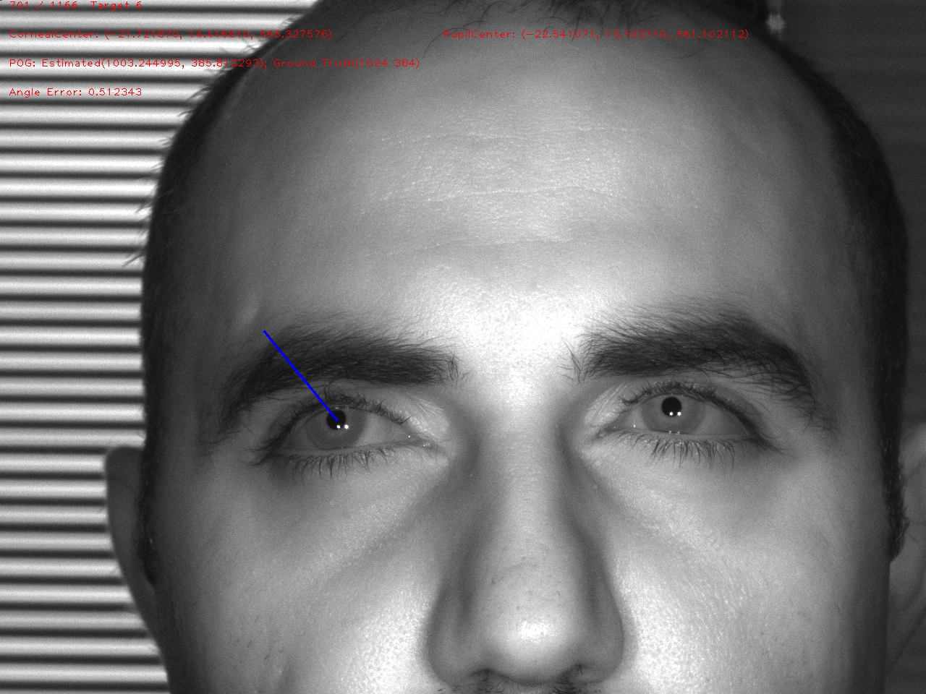
Input & Output
Input:
Frame nb, pupil center in 2D image, first glint, second glint, mid-glint point
160 979.534973 336.336365 991.500000 339.500000 978.500000 339.500000 985.000000 339.500000
161 978.229858 336.898865 989.500000 339.500000 977.500000 339.500000 983.500000 339.500000
162 973.933411 336.968689 987.500000 340.500000 974.500000 340.500000 981.000000 340.500000
163 -1 -1 -1 -1 -1 -1 -1 -1
164 975.000000 338.500000 987.500000 341.500000 975.500000 341.500000 981.500000 341.500000
Output :
Corneal Center (x, y, z):
(-31.85431, 38.07172, 470.4345)
Pupil center(x, y, z):
(-30.80597, 35.80776, 466.6895)

Slide 25
POG Estimation
Concept:
  Estimate the Intersection of Optical Axis and Screen Plane
Input:
  Estimated Corneal Center 3D Position
  Estimated Pupil Center 3D Position
  Screen Origin, Screen size
  Rotation Matrix in Camera Coordinate
Output:
POG Position
Screen Plane
Est POG
Offset
Optical axis
GT POG
PC
Visual axis
CC

Slide 26
Input & Output
Input:
Frame nb, pupil center in 2D image, first glint, second glint, mid-glint point
160 979.534973 336.336365 991.500000 339.500000 978.500000 339.500000 985.000000 339.500000
161 978.229858 336.898865 989.500000 339.500000 977.500000 339.500000 983.500000 339.500000
162 973.933411 336.968689 987.500000 340.500000 974.500000 340.500000 981.000000 340.500000
Output sample:
Corneal Center (x, y, z):
(-31.85431, 38.07172, 470.4345)
Pupil center(x, y, z):
(-30.80597, 35.80776, 466.6895)
POG(x, y):
(148.7627, 635.39)

Slide 27
Averaging Both Eyes Increases Accuracy
9 Targets POG Estimation Plot – With Glasses
5 pts Calibration → 4 pts Test

Slide 28

Eye Tracking Helps With The Detection of the Onset of Driver Drowsiness/Fatigue
Driver drowsiness has been widely recognized as a major contributor to highway crashes:
  1500 fatalities/year
  12.5 billion dollars in cost/year
Crashes and near-crashes attributable to driver drowsiness:
  22 -24% [100-car Naturalistic Driving study, NHTSA]
  4.4% [2001 Crashworthiness Data System (CDS) data]
  16- 20% (in England)
  6% (in Australia)
Source: NHTSA

Slide 29
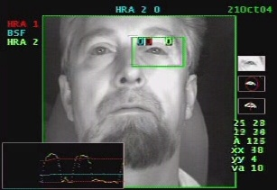
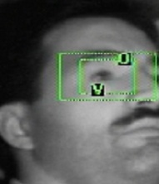
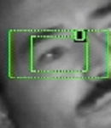










Eye Tracking: Hybrid Recognition Algorithm for Eye Closure Recognition
(1) Shape
(2) Pixel-density
(3) Eyelids motion & spacing
(4) Eye-size
Blob size
Time
(5) Iris-radius
Eye closure data
Velocity curve
(7) Slow closure vs. Fast closure
(6) Motion-like method (eye dynamic)

Slide 30


Participant Metrics
Ethnicity
Vision
Gender
Participant volume:113, December 2006 → December 2007

Slide 31





Extended Eye Closure (EEC) Evaluation
EEC accuracy is the same across groups

Slide 32

Drowsy Driver Detection Demo

Slide 33






SAfety VEhicle(s) using adaptive
Interface Technology (SAVE-IT) program
Utilize information about the driver's head pose in order to tailor the warnings to the driver's visual attention.
SAVE-IT: 5 year R&D program sponsored by NHTS and administered by Volpe

Slide 34


Eye Tracking & Head Tracking for Driver Distraction
78 test subjects
  Gender
  Ethnic diversity
  Height (Short(≤ 66”), Tall (> 66”))
  Hair style,
  Facial hair,
  Eye Wear Status and Type:
    No Eye Wear
    Eye Glasses
    Sunglasses
  Age (4 levels)
    20s, 30s, 40s, 50s

Slide 35

Thank you!
dr.hiryad@gmail.com
hammoud@csail.mit.edu
http://www.springer.com/engineering/signals/book/978-3-540-75411-4

