Slide 1
Principles and Practice of Assistive Technology
Lab 01
September 4, 2013

Slide 2
Agenda
Introductions
Disability Etiquette
Preamble
Opening Questions
Video: “The Ten Commandments”
Discussion

Slide 3
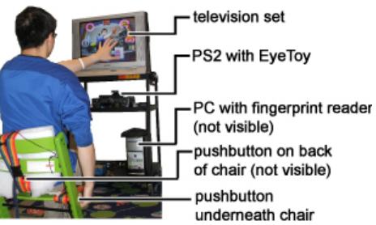
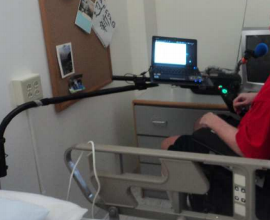
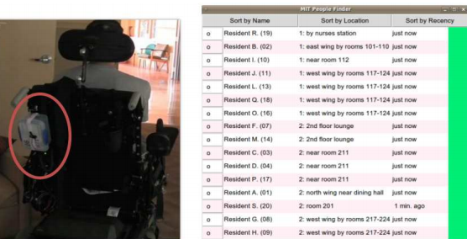
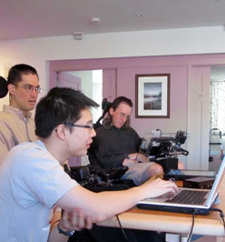
William Li: About Me
PPAT TA, Fall 2011
Research/volunteer experiences with assistive devices
Virtual reality therapy
Spoken dialog systems
MIT People Finder
MIT Assistive Technology Club

Slide 4
Communication Etiquette
Communicating/interacting with people who have a disability
Communicating about people who have a disability

Slide 5
Preamble
Safe space for open discussion
Be respectful of others
People have different experiences with disability and assistive technology
Don’t be afraid to ask questions or voice your thoughts!
“Answers” are not always clear-cut

Slide 6
Question:
Don’t use baby talk or talk down to people who have developmental disabilities.
TRUE
FALSE

Slide 7
Question:
When meeting someone who is blind, always identify yourself and others who may be with you orally
(e.g. “Hey, it’s me, Tom.”)
TRUE
FALSE

Slide 8
Question:
You should offer assistance to someone with a disability without being asked.
TRUE
FALSE

Slide 9
Question:
You should always use "people-first" language, like "person with a disability" or "person with Down syndrome", instead of "disabled person", "paralyzed person", or "blind person.“
TRUE
FALSE

Slide 10
Question:
If you are having difficulty understanding someone, it's OK to nod and keep the conversation flowing.
TRUE
FALSE

Slide 11
Question:
You should not use terms like "see you later" or "did you hear about this?" to someone who has a vision or hearing disability.
TRUE
FALSE

Slide 12
Video
“The 10 Commandments of Communicating With People With Disabilities”
26 minutes, 1994 hairstyles

Slide 13
Video
“The 10 Commandments of Communicating With People With Disabilities”
26 minutes, 1994 hairstyles

Slide 14
Video Discussion
What were your impressions?
Was there any part of the video you disagreed with?

Slide 15
Video Assisitive Technologies
Closed captioning
Video description

Slide 16
Common Practices
Provide your arm to help lead a blind person
Offer to shake hands, even if a prosthetic, or can only shake with his/her left hand
Don't touch a person's assistive aids/devices/technologies unless given permission

Slide 17
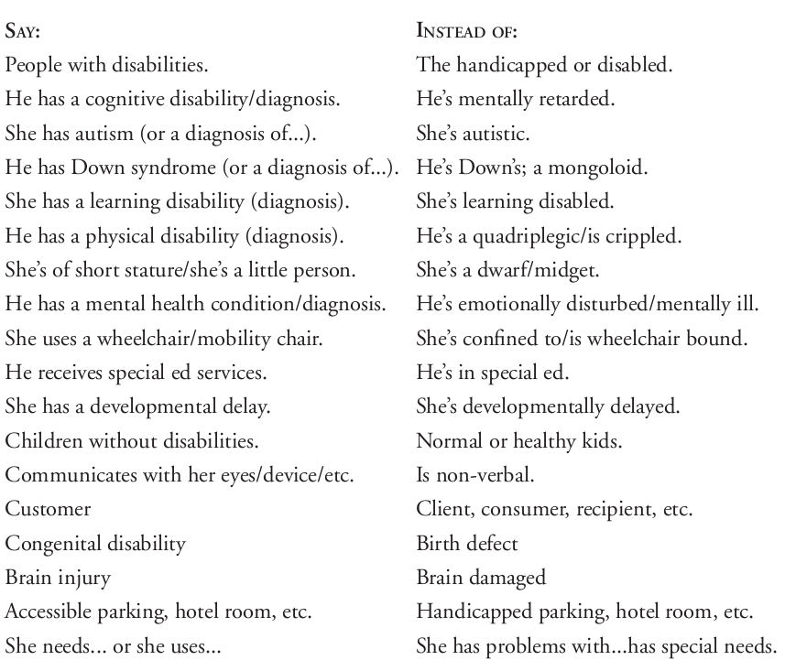
People-First Language

Slide 18
National Federation of the Blind (1993)
WHEREAS, the word “blind” accurately and clearly describes the condition of being unable to see, as well as the condition of having such limited eyesight that alternative techniques are required to do efficiently the ordinary tasks of daily living that are performed visually by those having good eyesight; and
WHEREAS, there is increasing pressure in certain circles to use a variety of euphemisms in referring to blindness or blind persons―euphemisms such as “hard of seeing,” “visually challenged,” “sightless,” “visually impaired,” “people with blindness,” “people who are blind,” and the like; and
WHEREAS, a differentiation must be made among these euphemisms: some (such as “hard of seeing,” “visually challenged,” and “people with blindness”) being totally unacceptable and deserving only ridicule because of their strained and ludicrous attempt to avoid such straightforward, respectable words as “blindness,” “blind,” “the blind,” “blind person,” or “blind persons;” others (such as “visually impaired,” and “visually limited”) being undesirable when used to avoid the word “blind” and acceptable only to the extent that they are reasonably employed to distinguish between those having a certain amount of eyesight and those having none; still others (such as “sightless”) being awkward and serving no useful purpose; and still others (such as “people who are blind” or “persons who are blind”) being harmless and not objectionable when used in occasional and ordinary speech but being totally unacceptable and pernicious when used as a form of political correctness to imply that the word “person” must invariably precede the word “blind” to emphasize the fact that a blind person is first and foremost a person; and

Slide 19
National Federation of the Blind (1993)
WHEREAS, this euphemism concerning people or persons who are blind--when used in its recent trendy, politically correct form--does the exact opposite of what it purports to do since it is overly defensive, implies shame instead of true equality, and portrays the blind as touchy and belligerent; and
WHEREAS, just as an intelligent person is willing to be so designated and does not insist upon being called “a person who is intelligent” and a group of bankers are happy to be called bankers and have no concern that they be referred to as persons who are in the banking business, so it is with the blind―the only difference being that some people (blind and sighted alike) continue to cling to the outmoded notion that blindness (along with everything associated with it) connotes inferiority and lack of status; now, therefore,
...
We believe that it is respectable to be blind, and although we have no particular pride in the fact of our blindness, neither do we have any shame in it. To the extent that euphemisms are used to convey any other concept or image, we deplore such use. We can make our own way in the world on equal terms with others, and we intend to do it.

Slide 20
Reflections
Communication: a fine balance (understand, but also consider fatigue and efficiency of communication)
Terminology at partner organizations:
“resident” instead of “patient”
Interactions can change over time

Slide 21
Practical Takeaways
Put the person first – take the time to understand your client
Figure out the best way to meet and communicate effectively
If you make a mistake, apologize, improve, and move on
Situational

