Slide 1
An Accessible Overlay for a Flat Touch Screen Panel
Abigail Klein
Jakub Sanak
Jose Marcon

Slide 2
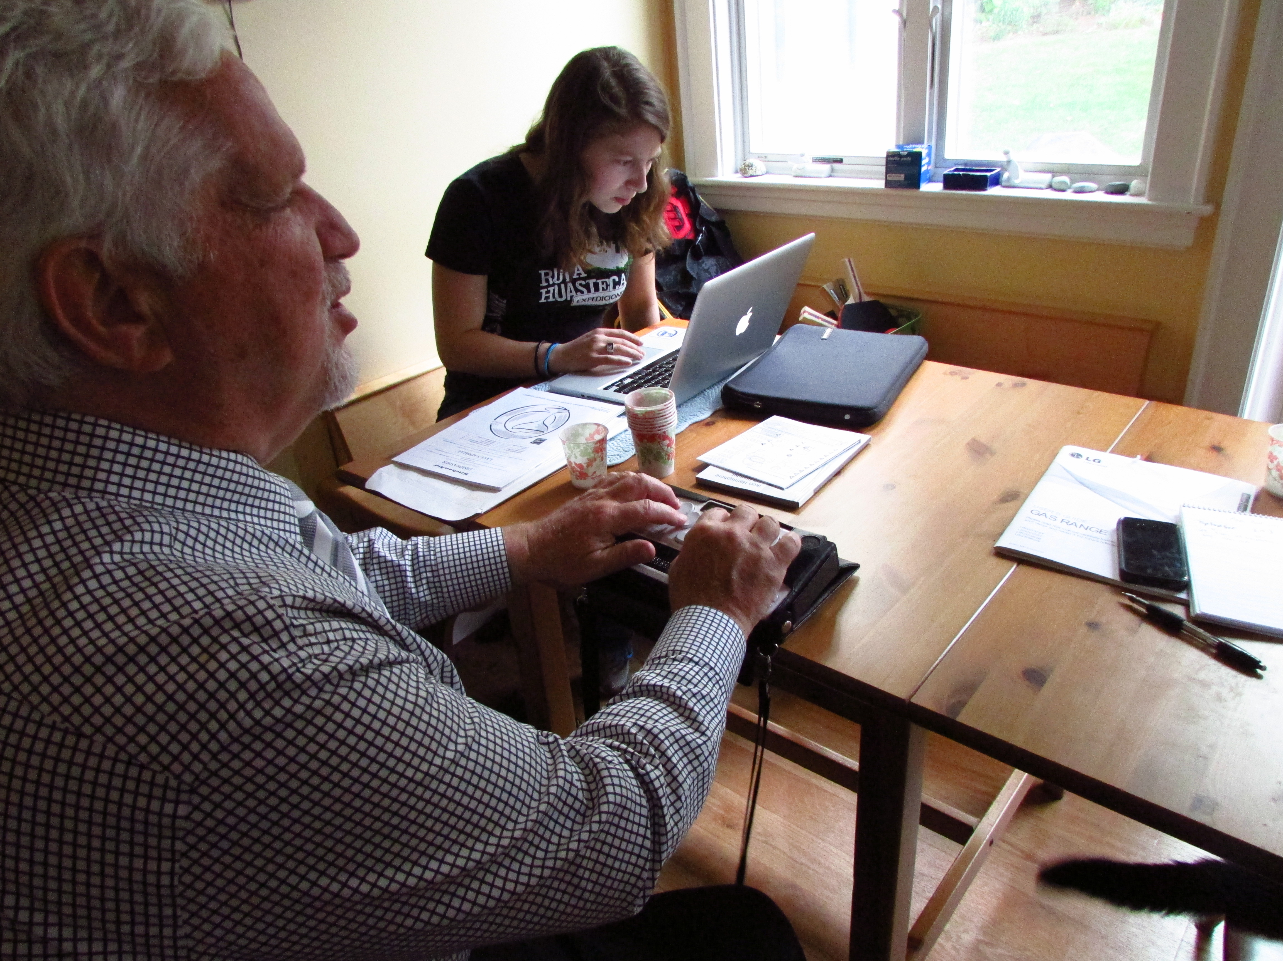
PauL
Middle aged man living with his wife, daughter and cat
Lost his sight in infancy
Very active, lives by the motto of never making excuses for his blindness
Fairly tech-savvy

Slide 3
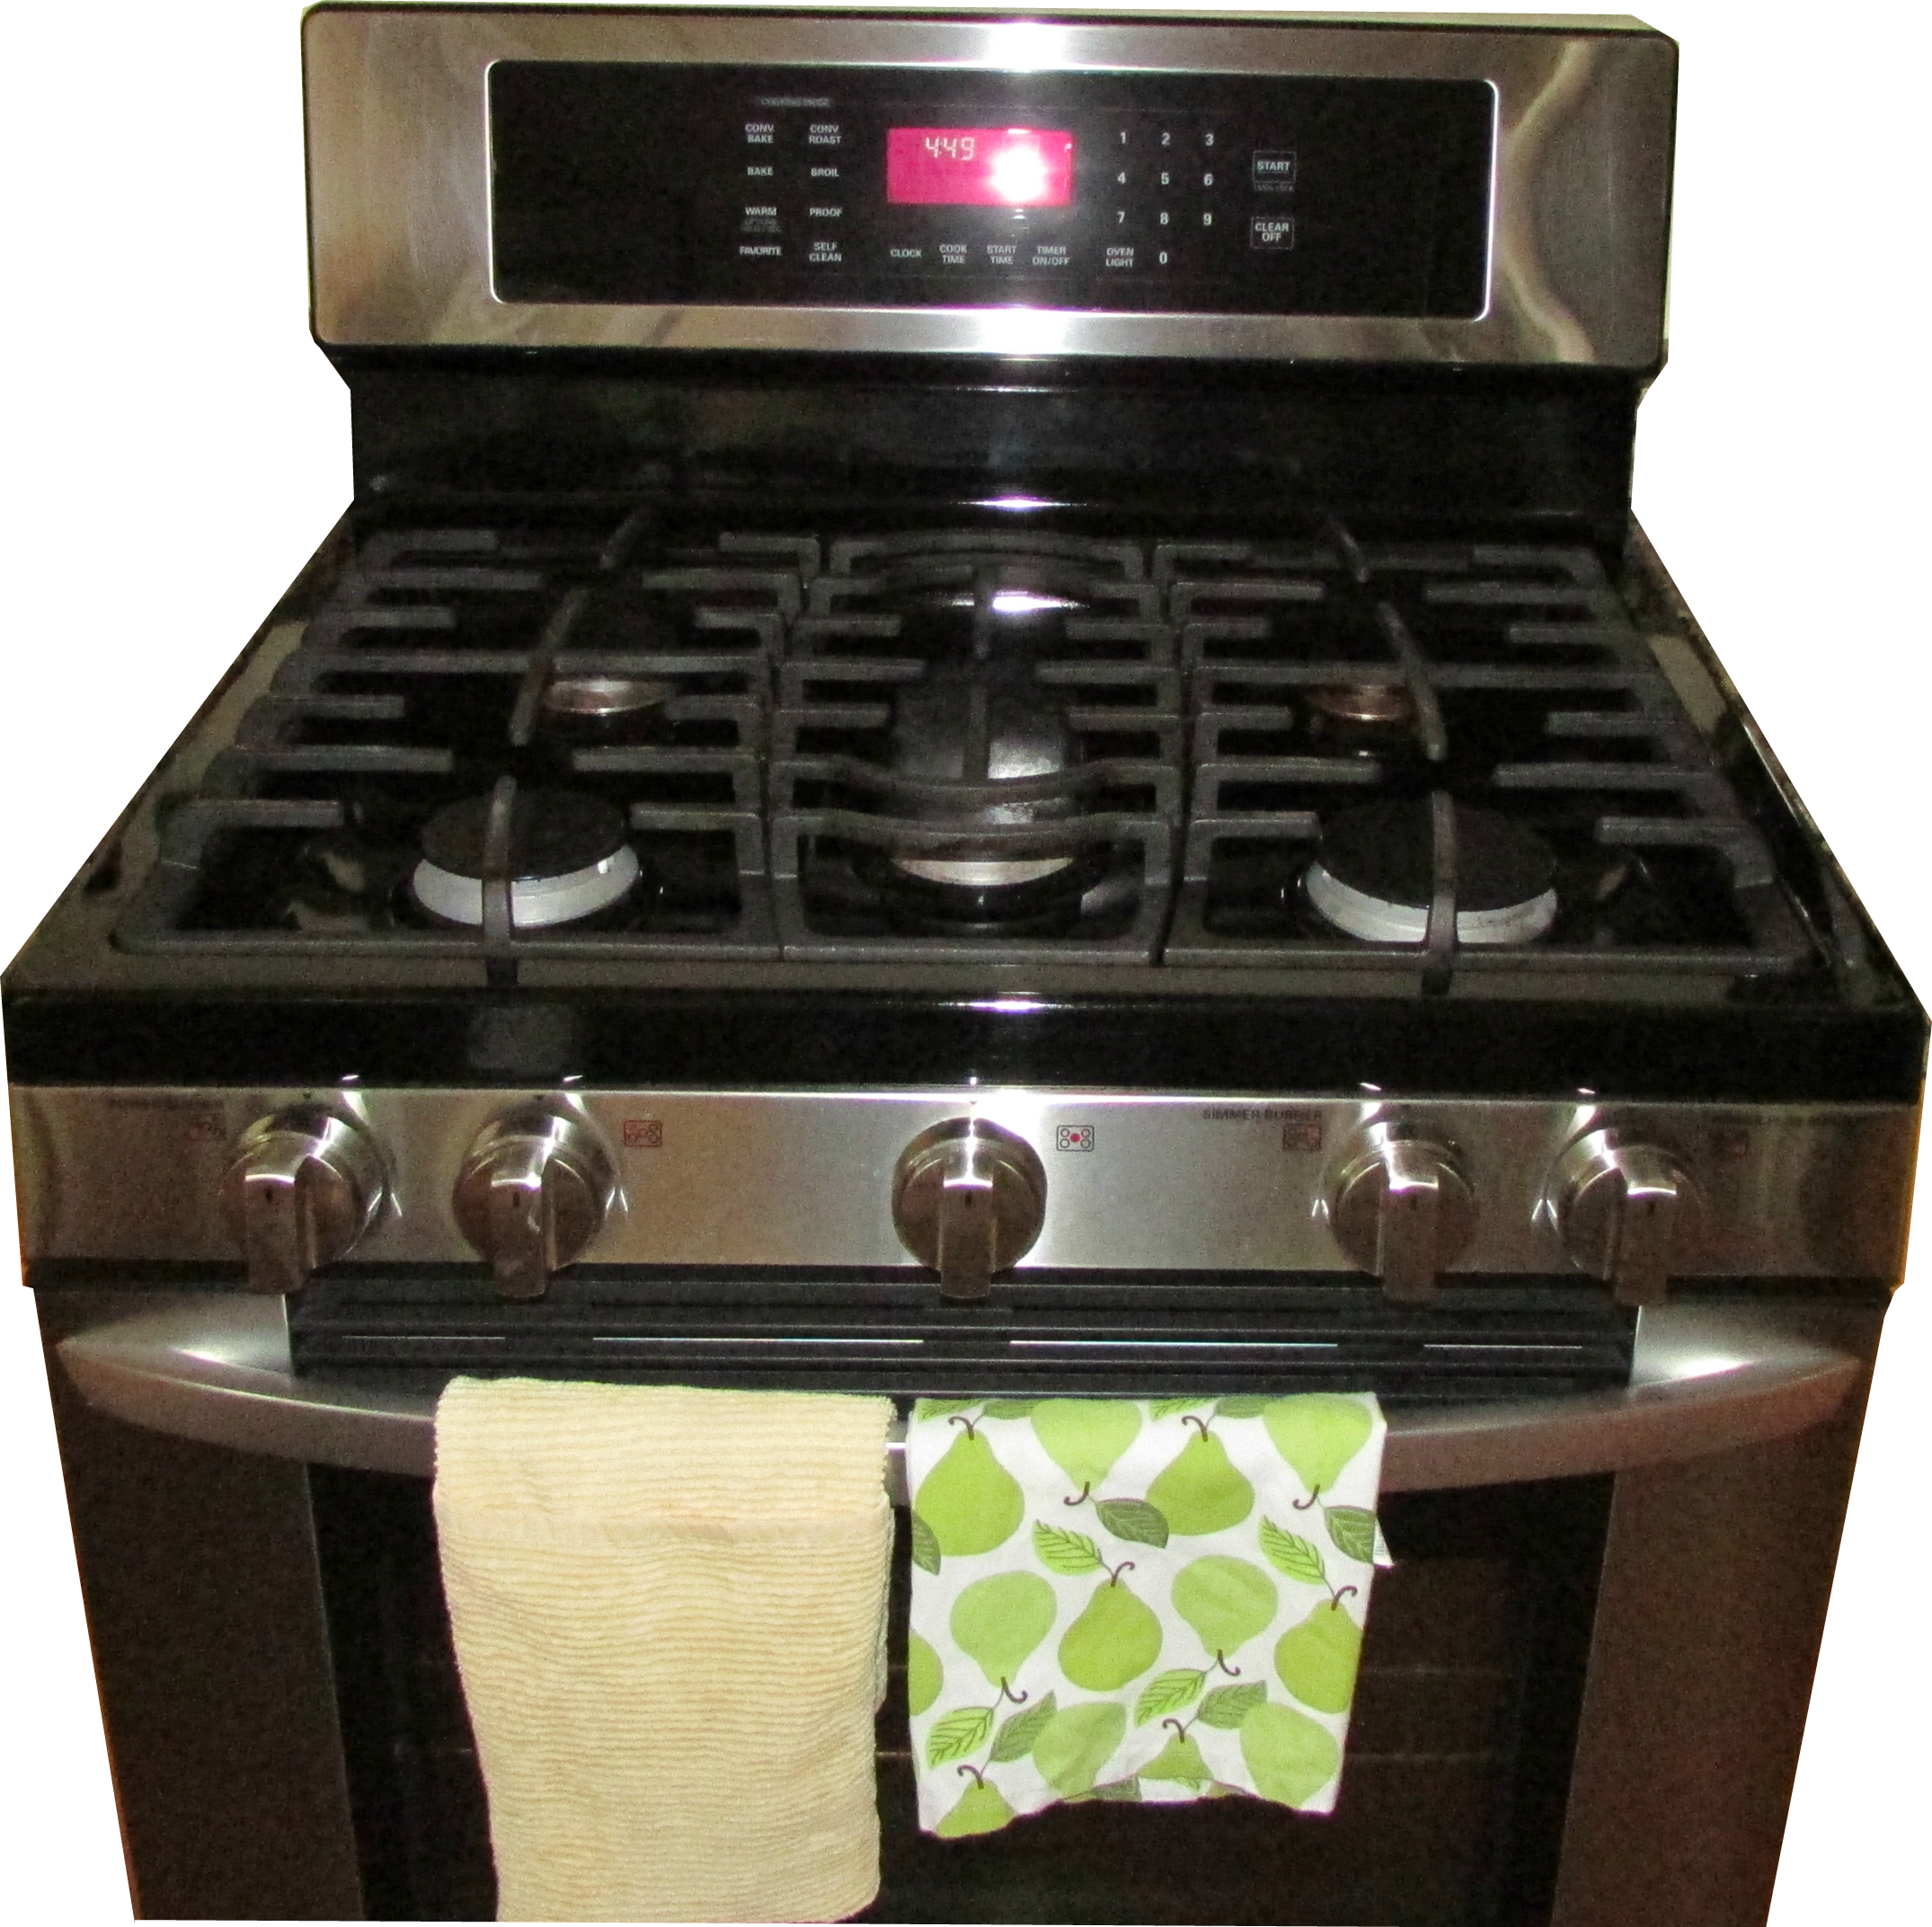
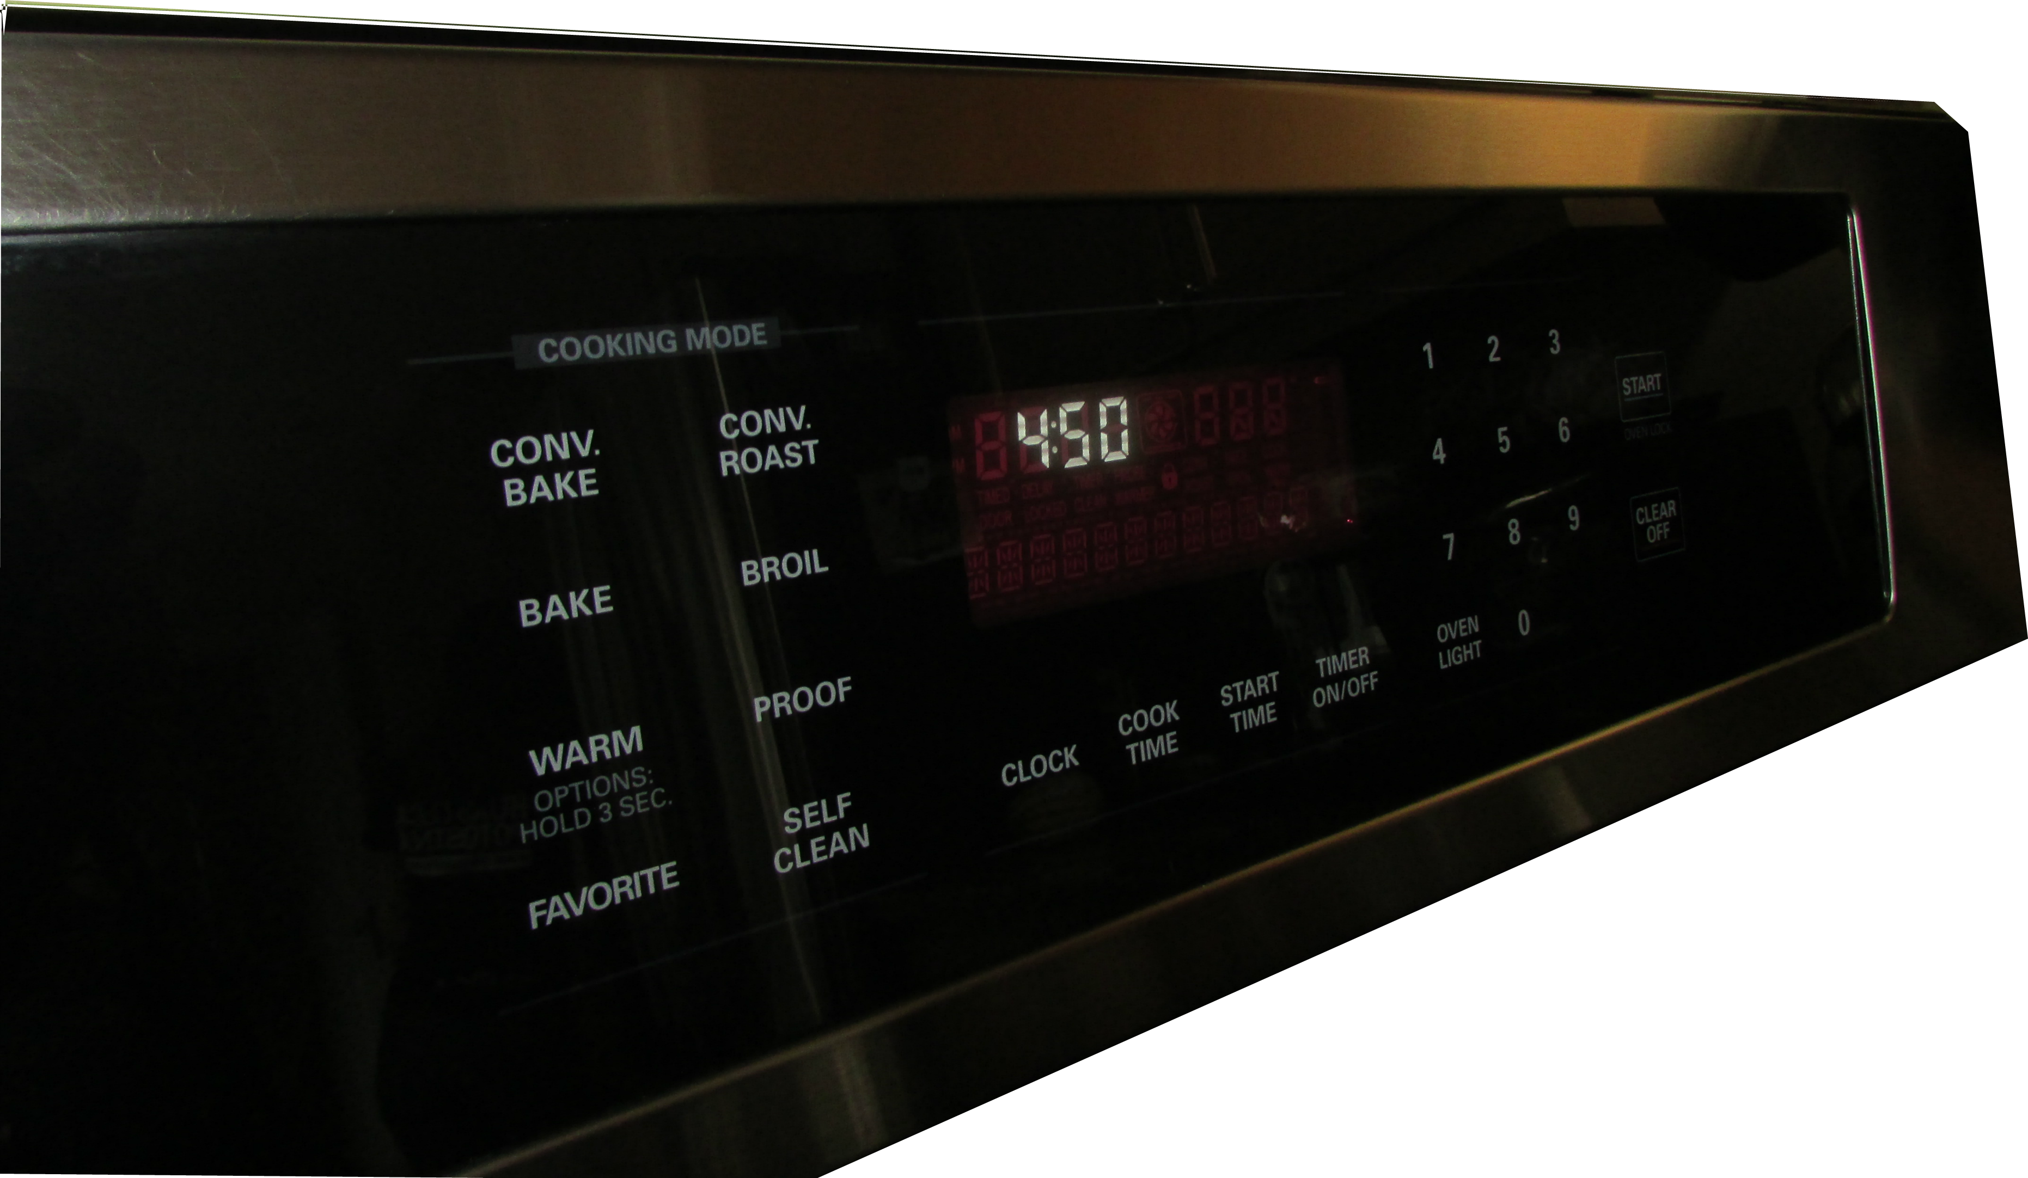
Paul’s oven
Flat touch screen panel
Same beep as audio feedback
Many functions
Cannot use Braille stickers

Slide 4
General Idea
Physical overlay
Braille labels
iPhone App for instructions and display reading

Slide 5
Initial metrics
Crucial
Turn oven on/off
Set baking mode
Important
Speed of use
Extra
Set timer and temperature
Provide feedback on oven’s state
Reliability
Aesthetics
Set clock
Oven Cleaning
Other functions

Slide 6
Oven Details
25 touch pads
8 cooking modes
4 timers
10 numbers
START, CLEAR OFF, OVEN LIGHT
Many steps to accomplish a task
Many ways to accomplish a task
Set Temperature, Timer and Timed baking are the same for all modes
Good audio feedback when time and temperature reach desired value

Slide 7
Oven Details
HOW TO SET THE OVEN FOR BAKING OR ROASTING
Step 1: Touch the "BAKE" pad.
Step 2: Touch the number pads to set the desired temperature.
Step 3: Touch the "START" pad.
Note: The word "BAKE" and 100° will be displayed. As the oven heats up, the display will show the changing temperature. When the oven reaches the temperature you set, the preheat alarm melody will sound and the oven light will flash.
Step 4 (optional): To change the oven temperature during a BAKE cycle, touch the "BAKE" pad and then the number pads to set the new temperature
Step 5: Touch the "CLEAR OFF" pad when cooking is complete

Slide 8
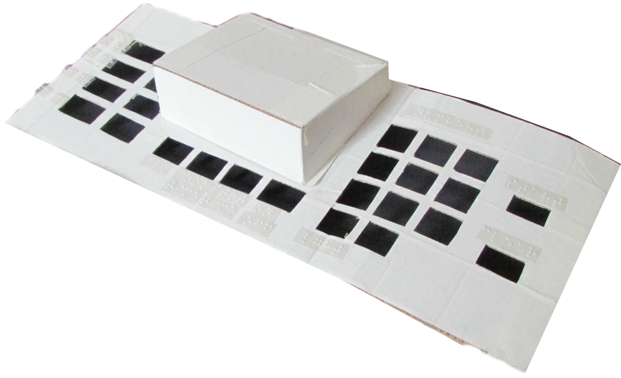
prototype
Cardboard
Real size
Braille labels by MIT Student Disabilities Services

Slide 9
Prototype – Paul's reaction
Task: Set BAKE with a specific TEMPERATURE and TIME
We guided him, reading the display messages and manual
We also held the overlay in the right position
Results
Success! Paul pressed all the right buttons and set the oven
Paul didn’t know which buttons to press because he had no instructions
Conclusion: Paul needs a condensed version of the oven manual to guide him

Slide 10
Prototype – Paul's Feedback
Approved!
First time he could feel how the panel is
Better Labels
Contract Braille
He offered help to create labels better for him
Smaller holes in order to reduce errors

Slide 11
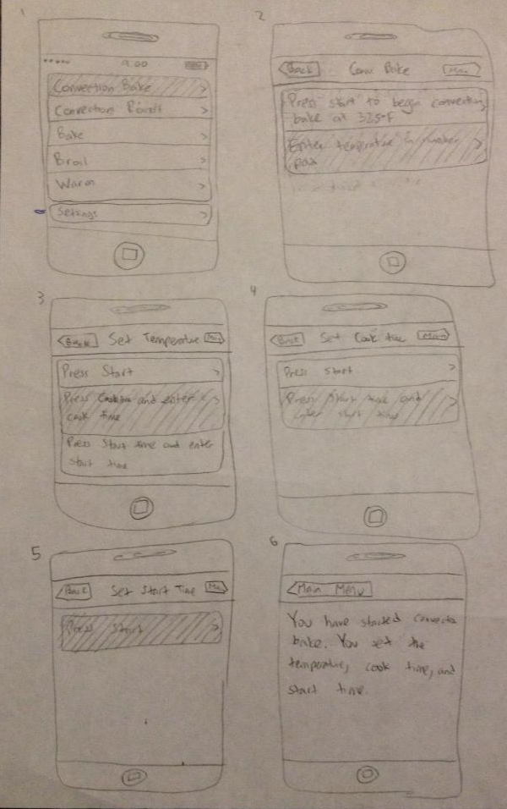
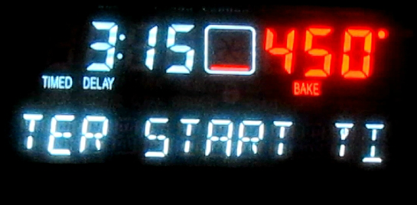
Change of plans: Iphone app
Plan A: iPhone App to read display
The phone would be placed 8 to 10 cm from display – too far
App would identify only Time and Temperature
Plan B: iPhone App to interpret display
Result: No more App

Slide 12
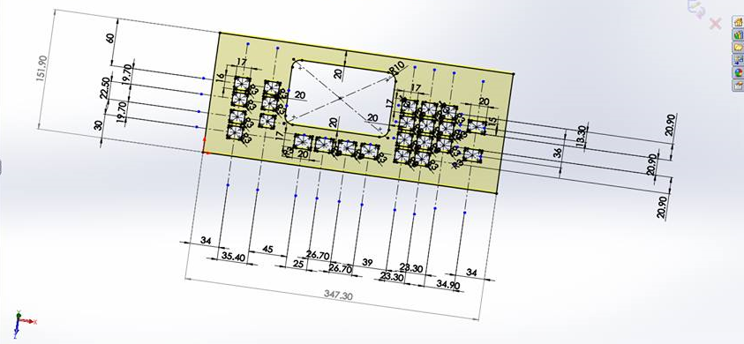
Final Design
Aluminum Sheet
Water Jet Cut
Hinges
Magnets
Adhesive Felt

Slide 13
Team
Abby
Brainstorming
Kuba
Brainstorming
Material Research
Jose
Brainstorming
Display Identification Research
iOs Develop Research
Guide App Prototype
CAD Design
OCR / State Machine
Design discussions w/ Paul
Design discussions w/ Paul
Design discussions w/ Paul

Slide 14
Outcomes
Understand user’s needs!
Simplicity matters
Thanks to Paul, Professor Teller, and Tom

Slide 15
Q&A
“Simplicity is about subtracting the obvious and adding the meaningful.”
― John Maeda, The Laws of Simplicity

