Slide 1
6.S196 / PPAT: Principles and Practice of Assistive Technology
Today: Ethics of Human Subject Research
Monday, 17 Sept 2012
Prof. Rob Miller

Slide 2
Ethics of Human Subject Research
Human subjects have been seriously abused in the past
Nazi concentration camps
Tuskegee Institute study
MIT Fernald School study
Yale electric shock study
Stanford prison experiment
Notes:
Human subjects have been horribly abused in the name of science over the past century. Let’s talk about some of the most egregious cases.

Slide 3
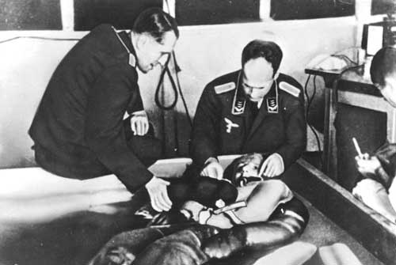
Nazi Concentration Camps (1940s)
Prisoners were used for horrific medical experiments
extreme cold
extreme low pressure
typhus, tuberculosis, malaria, hepatitis, ...
chemical weapons
Thousands of people were killed
Notes:
In Nazi concentration camps (1940-1945), doctors used prisoners of war, political prisoners, and Jews as human guinea pigs for horrific experiments. Some experiments tested the limits of human endurance in extreme cold, low pressures, or exposure. Other experiments intentionally infected people with massive doses of pathogens, such as typhus; others tested new chemical weapons or new medical procedures. Thousands of people were killed by these experiments; they were criminal, on a massive scale.
http://www.ushmm.org/wlc/en/article.php?ModuleId=10005168
image source: http://listverse.com/2008/03/14/top-10-evil-human-experiments/

Slide 4
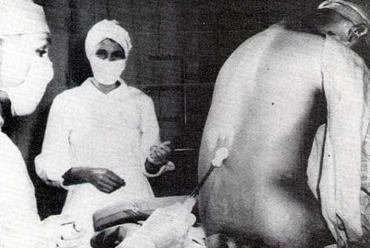
Tuskegee Institute Syphilis Study (1930s-72)
US Government (Dept of Public Health) + Tuskegee Institute researchers
recruited black males with syphilis, without telling them, and studied the progress of the untreated disease
Notes:
In the Tuskegee Institute syphilis study (1932-1972), the US government studied the effects of untreated syphilis in black men in the rural South. In exchange for their participation in the study, the men were given free health examinations. But they weren’t told that they had syphilis, or that the disease was potentially fatal. Nor were they given treatment for the disease, even as proven, effective treatments like penicillin became available. Out of 339 men studied, 28 died directly of syphilis, 100 of related complications. 40 wives were infected, and 19 children were born with congenital syphilis.
image source: http://listverse.com/2008/03/14/top-10-evil-human-experiments/

Slide 5
Fernald School & MIT Study (1940s-50s)
MIT researchers studying calcium/iron absorption from breakfast cereal
enrolled children at Fernald School for mentally-disabled
got parental permission, but omitted to mention the radioactive tracer isotopes
Notes:
In the 1940s and 1950s, MIT researchers cooperated with the Fernald School for mentally disabled children in Waverly, Massachusetts to gave radioactive isotopes of calcium and iron to some of the children in their milk and cereal, to study how minerals were taken up by the body. Permission letters were obtained from their parents, but neither parents nor children were warned that radioactive materials were being used.
In the late 90s, MIT and Quaker Oats (who funded the study) paid a $1.85 settlement to the participants.
image from http://www.falloutreport.com/mit-to-pay-victims-1-85-million-in-fernald-radiation-settlement

Slide 6
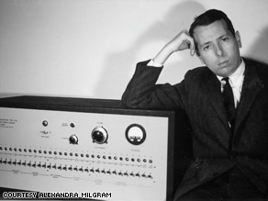
Yale Shock Study (1950s)
Yale psychologists studying power of authority to overcome personal morals
participants told to give electric shocks to another person (a confederate simulating real pain)
Notes:
In the 1950s, a famous study done at Yale told subjects to give painful electric shocks to another person. The shocks weren’t real, and the person they were shocking was just an actor. But subjects weren’t told that fact in advance, and many subjects were genuinely traumatized by the experience: sweating, trembling, stuttering.

Slide 7
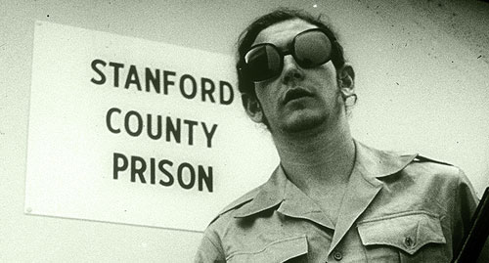
Stanford Prison Experiment (1971)
Stanford psychologists studying people’s responses to captivity
recruited Stanford undergrads to live in a mock prison, randomly assigned as either “guards” or “prisoners”
guards rapidly became abusive, and prisoners became traumatized
Notes:
image from http://listverse.com/2008/03/14/top-10-evil-human-experiments/

Slide 8
Basic Principles (Belmont Report)
Respect for persons
Beneficence
Justice
fair selection of subjects
Notes:
These cases have led to several reforms. The Nazi-era experiments led to the Nuremberg Code, an international agreement on the rights of human subjects. The Tuskegee study drove the US government to take steps to ensure that all federally-funded institutions follow ethical practices in their use of human subjects. The outcome of those steps was the Belmont Report (http://ohsr.od.nih.gov/guidelines/belmont.html) which outlined the basic principles of the rights of human subjects.

Slide 9
Respect for Persons
Voluntary participation
Informed consent
not only say yes, but understand what saying yes means
studies that require initial deception must meet a higher bar, and must eventually debrief
Protection of vulnerable populations
children
prisoners
people with disabilities (esp. cognitive)

Slide 10
Beneficence
Do no harm
not just physical well-being, but also privacy
Must weigh the risks vs. benefits
risks to participants should be commensurate with benefits of the work to the participants or to society as a whole

Slide 11
Justice
Fair selection of participants
opportunity to be in clinical trials of new treatments must be available to all (scientifically-appropriate) participants

Slide 12
Institutional Review Boards
Research with people is subject to scrutiny
All federally-funded institutions have an institutional review board (IRB) that approves human subjects research
MIT’s IRB is called the Committee on Use of Humans as Experimental Subjects (COUHES)
Notes:
The Belmont report led to Federal regulations on human subjects research. Every research experiment involving human subjects at a federally-funded institution must be reviewed and approved by an ethics committee at that institution, usually called an institutional review board. MIT’s review board is called COUHES.

Slide 13
What is Research?
IRB oversight is confined to research
“Research” is work leading to generalizable knowledge
“Practice” (clinical medicine, product development, class projects) does not require IRB approval
But all work with human beings should follow the IRB ethical guidelines, even if it doesn’t need to do IRB paperwork

Slide 14
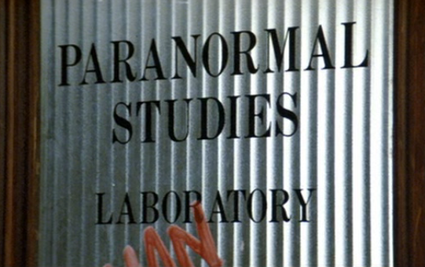
Case Study
Notes:
See Venkman, P. “The Effect of Negative Reinforcement on ESP Ability.” Unpublished monograph, 1984.

Slide 15
Treat the Client with Respect
Time
Don’t waste it
Comfort
Accessible & convenient meeting location
Energy & fatigue
Informed consent
Inform the client fully
Privacy
Preserve the client’s privacy
Control
The client can stop at any time
Notes:
The basic rule for human subjects ethics is respect for the person as a intelligent person with free will and feelings. We can show respect in 5 ways:
Respecting their time by not wasting it. Prepare as much as you can in advance.
Do everything you can to make the user comfortable. Make sure the meeting location is accessible. It's often necessary to go to homes or workplaces. Also think about the client's energy level -- clients may need breaks because of the disability, medication, inefficiency of AT, etc. Though many will have unusual reserves of energy and patience, since learning AT requires so much of it!
Give the person as much information as they need or want to know. Don’t hide things from them unnecessarily.
Preserve the person’s privacy as much as possible. If you’re collecting information about them and planning to publish a paper about it, don’t report the information in a way that allows them to be personally identified.
The client is always in control, not in the sense that they’re running the project or experiment and deciding what to do next, but in the sense that the final decision of whether or not to participate remains theirs, throughout the process. Just because they’ve signed a consent form, or sat down in the room with you, doesn’t mean that they’ve committed to the entire experience. A client has the right to give up and leave at any time, no matter how inconvenient it may be for you.

Slide 16
Summary
Know about the history of human subjects abuse
Treat people with respect, beneficence, justice
Respect your client’s time, comfort, informed consent, privacy, and control

