Slide 1
Parallelizing MiniSat
I-Ting Angelina Lee Justin Zhang
May 05, 2010
6.884 Final Project Presentation

Slide 2
Bottomline
Ok, so we parallelized MiniSat …
Parallel MiniSat executing on single worker seems to exhibit the same behavior as the original MiniSat.
Paralell MiniSat running on single worker runs 3~4 times slower than the original MiniSat.
Parallel MiniSat running on multiple workers is still buggy.
But regardless, we manage to collect some data …
Notes:
bottomline: if you want the one line summary, this is it.

Slide 3
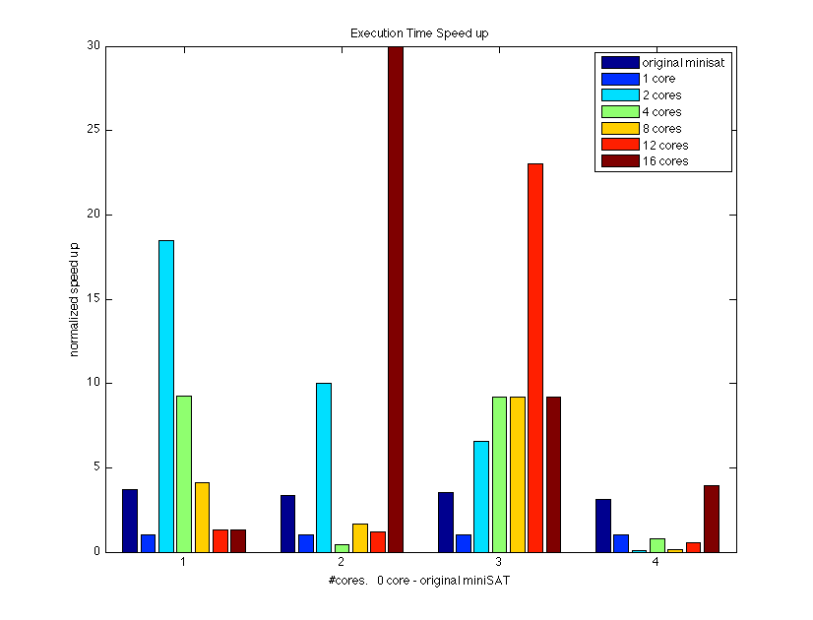
Normalized “Speedup”
Notes:
bottomline: this is the runtime, it’s kina of random. no correlation between time and #processors. no correlation between #proc and ..
deterministic amount of work… then yeah linear speed up
[ no correlation between running time. [ the amount of work in each run is different ]
same amount of work between first / second. second has spawn overhead. same search pattern.
avg.

Slide 4
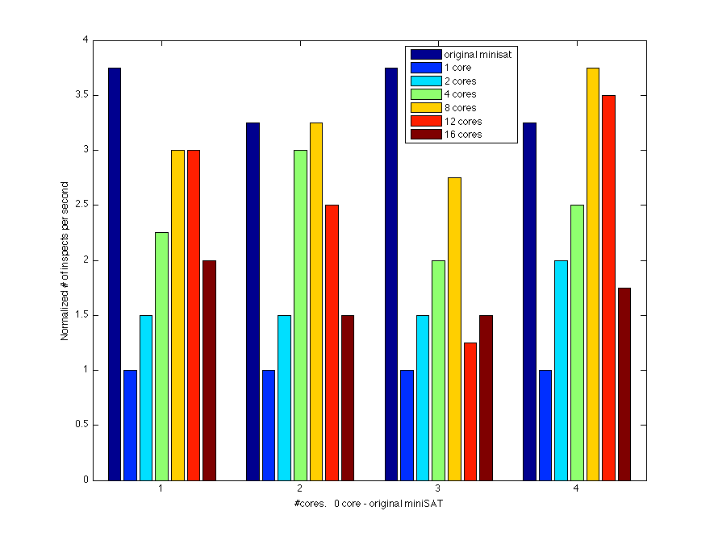
Normalized #Inspects / Second
Notes:
#inspects: ~proxy for amount of work performed. When a solver assigns value to a variable, it has a way to figure out which clauses may be affected by the assignment.
This value represent the number of such clauses the solver examine throughout execution.
bottomline:
speed up.. normalize everything by one worker…. collect minisat … bug in collecting minisat orig
more apple to apple to comparison
have good data (results): you don’t have to justify your work
the data justify itself.

Slide 5
What Is A SAT Solver?
f: Boolean formula written in Conjunctive Normal Form (CNF)
f
e.g. ( x₁∨x₂∨¬x₃ ) ∧ ( y₁∨y₂)
SAT Solver
Variables: x₁, x₂, x₃, y₁, y₂
Literals: a variable or
negation of a variable
SAT / UNSAT
Clauses: Literals OR-ed together
A SAT Solver solves the Boolean satisfiability (SAT) problem.
Notes:
remind people what the problem is
remind it is NP complete
the sat solver takes the instance and ddecide if this instance is satisfiable or not satisfiable.

Slide 6
Terminology
f: Boolean formula written in Conjunctive Normal Form (CNF)
e.g. ( x₁∨x₂∨x₃ ) ∧ ( y₁∨y₂)
Variables: x₁, x₂, x₃, y₁, y₂
Literals: a variable or negation of a variable
A literal can be either true, false, or free.
Clauses: Literals OR-ed together
A clause is true if it contains a least one true literal.
A clause is false if it contains all false literals.
A clause is asserting if it contains one free literal, and the rest of its literals are false.
A clause is free if it is not true, not false, and not asserting.
Notes:
remind people what the problem is
remind it is NP complete
the sat solver takes the instance and ddecide if this instance is satisfiable or not satisfiable.

Slide 7
MiniSat Overview
MiniSat uses the following two strategies:
Conflict-driven backtracking
Dynamic variable ordering
Notes:
bottomline: remind people, we are parallelzing minisat. Minisat uses ….
Briefly describe what it is: clause learning is used to prune search space
Briefly describe what it is: heuristics to order variables such that "critical" vars are assigned early on

Slide 8
Assume VS. Propagate
trail
F
x₇
T
x₇
¬x₃
x₉
¬x₁₇
¬x₄
x₈
x₇₇
Clause DB
x₂, ¬x₁
¬x₃,x₉,¬x₁₇
F
x₃
F
x₄
x₈, x₄
x₈
assume
x₁₅
T
F
x₇₇
x₇
x₄
x₇₇
Notes:
Point: backtracks on trail. it is depenent on clauseDB.
Show how backtracking works and how "clause DB" and "trail" are used. [this slide and next 3 slides need revision]
One can think of the search space as follows: at each level, a variable is selected to make an assignment. Each node has two branches, representing the T/F assignment of the variable. The serial MiniSAT traverse the search space in depth-first order. Once a conflict is found, MiniSAT undoes the variable assignments up to the level where there is no longer a conflict, and search down the other branch.
As MiniSAT traverses the tree, it keeps a clause DB and a trail on the side, where the clause DB store the input constraints to be checked, and the trail remembers the variable assignments made so far in chronological order so that it can backtrack.

Slide 9
Conflict-Driven Backtracking
trail
Clause DB
¬x₇
x₂
¬x₁
¬x₃
x₈
x₄
x₁₅
F
x₇
x₂, ¬x₁
reasons
F
x₃
x₈, x₄
assume
¬x₇
¬x₃
x₁₅
x₁₅
T
¬x₂
X
Notes:
Point:
Explain conflict-driven backtracking and show how "reasons" array is used
Sometimes, a variable assignment is made due to an *assumption*, because we could assign variables either way, but we decided to go down one branch before the other. We call such assignment as *assumed*. Other times, a variable assignment is made due to *propagation* --- because due to other assumed assignments, the variable is forced to take certain values in order to not generate a conflict. We call such assignment as *forced*.
When an assignment is forced, MiniSAT remembers the reason why the assignment is made. So MiniSAT also keeps a reason array, indexed by variables, which stores the "reason" why a variable is assigned.
When a conflict occurs, MiniSAT examine the conflicting clause, traverse backward the reasons why conflicting assignments are made, and generate a clause that prevents the same set of conflicting assignments. We call this clause a "learnt clause". The clause DB is extended with learnt clauses when conflicts occur. The learnt clauses helps MiniSAT to further prune the search space.
Using the reasons, miniSAT also figures out the level of which the conflicting assignment is made, and revert the state back to that level.

Slide 10
Conflict-Driven Backtracking
trail
Clause DB
¬x₇
x₂
¬x₁
¬x₂₃
F
x₇
reasons
¬x_{23,} x₂, ¬x₁
assume
¬x₇
Notes:
Point: Explain conflict-driven backtracking and show how "reasons" array is used
Sometimes, a variable assignment is made due to an *assumption*, because we could assign variables either way, but we decided to go down one branch before the other. We call such assignment as *assumed*. Other times, a variable assignment is made due to *propagation* --- because due to other assumed assignments, the variable is forced to take certain values in order to not generate a conflict. We call such assignment as *forced*.
When an assignment is forced, MiniSAT remembers the reason why the assignment is made. So MiniSAT also keeps a reason array, indexed by variables, which stores the "reason" why a variable is assigned.
When a conflict occurs, MiniSAT examine the conflicting clause, traverse backward the reasons why conflicting assignments are made, and generate a clause that prevents the same set of conflicting assignments. We call this clause a "learnt clause". The clause DB is extended with learnt clauses when conflicts occur. The learnt clauses helps MiniSAT to further prune the search space.
Using the reasons, miniSAT also figures out the level of which the conflicting assignment is made, and revert the state back to that level.

Slide 11
Dynamic Variable Ordering
trail
Clause DB
¬x₇
x₂
¬x₁
¬x₂₃
activities
F
x₇
reasons
order
¬x_{23,} x₂, ¬x₁
?
assume
¬x₇
Notes:
Sometimes, a variable assignment is made due to an *assumption*, because we could assign variables either way, but we decided to go down one branch before the other. We call such assignment as *assumed*. Other times, a variable assignment is made due to *propagation* --- because due to other assumed assignments, the variable is forced to take certain values in order to not generate a conflict. We call such assignment as *forced*.
When an assignment is forced, MiniSAT remembers the reason why the assignment is made. So MiniSAT also keeps a reason array, indexed by variables, which stores the "reason" why a variable is assigned.
When a conflict occurs, MiniSAT examine the conflicting clause, traverse backward the reasons why conflicting assignments are made, and generate a clause that prevents the same set of conflicting assignments. We call this clause a "learnt clause". The clause DB is extended with learnt clauses when conflicts occur. The learnt clauses helps MiniSAT to further prune the search space.
Using the reasons, miniSAT also figures out the level of which the conflicting assignment is made, and revert the state back to that level.
Point: Explain conflict-driven backtracking and show how "reasons" array is used

Slide 12
Parallelizing MiniSat
x₇
F
T
x₃
x₂
F
T
F
T
x₅
x₄
x₁₁
x₈
F
T
F
T
F
T
F
T
X
abort
Notes:
Each frame corresponding to a level of assume that can be stolen
POINT: recursion level and abort.. why we are doing it recursively? because we are doing abort.
BACKTRACK TO MAKE A NEW ASSUMPTION
- FOR ABORT
Show the same tree, one worker explore down one branch, and a second worker steals the other branch (Using different colors to represent execution on different workers.)
First worker encounters a conflict and wants to backtrack to near top passed the point where things have been stolen
Go through each level and abort other workers in the subtree until we reach the point where we want to backtratck f(n)=d.
Show the first worker then pick a different variable to explore
Point: show high level how we parallelize miniSAT -- what to spawn and how to use abort

Slide 13
How to Handle Various Data
MiniSat uses the following two strategies:
Conflict-driven backtracking
Assume: list of assumptions in chronological order
Clause DB: input constraints + learned clauses
Watch literals: used to quickly figure out which clauses are asserting.
Reasons: remembers why a variable assignment is made
Dynamic variable ordering
Activities: scores on how often variables are involved in conflicts
Order: variable ordering array sorted based on activity
Notes:
Point: Differentiate between context-dependent data from context-independent
data.
[need revision]
MiniSAT
- conflict-driven backtracking (or, backjumping)
- clause DB: input constraints + learnt clauses
- reasons: remembers why a variable assignment is made
- Dynamic variable ordering
- trail: list of assignments in choronological order
- order: variable ordering array sorted based on activity
- activity: scores on how often variables are involved in conflicts
Some data structures are "context" dependent, that is, the content of the
data structure only makes sense in certain context (i.e., where we are in
the search space).
* Highlight the ones that's context dependent: reasons, trail
Explain: for example, clause DB is not context dependent -- it includes learnt
clauses, and what we learn depends on what we have searched so far, but the
the learnt clauses can be used no matter where we are in the search space.
Similarly, the content of order and activity depend on what we have searched
so far, but its usage is independent of the context.
Hence, when a worker steals, the thief needs a snapshop of the
context-dependent data corresponding to the stolen work, such
a trail and reasons. On the other hand, it is nice to have other
non-context-dependent data as well, but not necessarily the snapshot
corresponding to the stolen work.

Slide 14
How to Handle Various Data
order
trail
reasons
Generate
watch list
Context
Local copy per worker
Gets updated by replaying assumes upon successful steal
assume
Copy upon successful steal
activities
Clause DB
Local copy per worker
Notes:
Point: Show how we suport context-dependent data in the user code
- WHY WE ARE HANDLING THE DATA THE WAY WE ARE HANDLNG IT
-- high level outline of the data.
upper three: depend on state… but also on other things …
Show that we make a copy of a trail upon a steal
Show that victim may realize that it is stolen and go off to do its own work-stealing before the thief finish copying
Show victim uses a different trail and leave the old one lying around so the thief can finish copying
How to recycle Space? We can safely deallocate any trail newly created in some frame when the frame sync.
Reasons is handled similary
Assumption trail

Slide 15
MiniSat Overview
while(no result yet)
confl = propagate();
if(confl) then
if( at root level ) then /* nothing to backtrack */
return UNSAT;
(blevel, learnt) = analyze(confl);
update_DB(learnt);
cancel_assignmts(blevel);
else /*no conflict*/
if( all vars assigned ) then
return SAT;
var = select_next();
assume( ~var );
Notes:
bottomline: step by step modification of the high level pseudo code… let’s look into a little detail. this is how it aborted.
Because we need to do abort, we need to do it recursively. [link to next slide]
convert to recursive first
then go to paralllel
?

Slide 16
Recursive MiniSat Overview
while(no result yet)
confl = propagate();
if(confl) then
if(at root level) then
set_result(UNSAT);
blevel = -1;
break;
(blevel, learnt) = analyze(confl);
update_DB(learnt);
cancel_assignmts(blevel);
break;
else /*no conflict*/
if(all vars assigned) then
set_result(SAT);
blevel = -1;
break;
var = select_next();
assume(~var);
blevel = search(depth+1);
if(blevel<depth)
break;
/*end of while*/
return blevel;
int search (int depth); /*returns blevel*/
Notes:
bottomline: modifiy it to be recursive by keeping track of the levels
instead of returning the result… We have d frames sitting on the stack. In stead of returning the result. We return blevel, and that communicate back to the caller which level (frame) we should backtrack to.
just need to mention:
set_result(..);
bevel = -1;
depth is kept.
[link to next slides: once we have this recursive version running, we can simply parallelize it using the spawn sync language when we do the function calls. (pointing to the section being expanded… ) ]
introduces blevel depth
while (blevel … )
if
if blevel ←
else blevel ←
else if blevel ←
else blevel ←

Slide 17
Parallel MiniSat Overview
while(no results yet)
confl = propagate();
if(confl) then
if( at root level ) then
set_result(UNSAT);
blevel = -1;
break;
(blevel, learnt) = analyze(confl);
update_DB(learnt);
cancel_assignmts(blevel);
if(blevel > depth)
break;
else /*no conflict*/
if( all vars assigned ) then
set_result(SAT);
blevel = -1;
break;
var = select_next();
assume(~var , assumes);
catch( spawn search(assumes) );
if(stolen and !aborting) then
blevel = replay(assumes, new_assumes);
if(blevel == depth) then
assume(var, new_assumes);
catch( spawn search(new_assumes) );
sync;
if(blevel<depth)
break;
blevel = replay(assumes, new_assumes);
Notes:
bottomline: use spawn and sync to express the parallel logic , let the other polarity stealable by a idle worker. Replay is needed to maintain the solver consistency.
← Assumes is just the assumptions.
← once the continuation is stolen.
Replay..
as we replay each assume, we also propagate the according to the localDB.
as we assume, we might find the assume is propagated by the earlier assume.
let’s consider the nature of this inconsistency.
it can be assigned the same value. then it is inconclusive whether this branch is going to be fruitful or not.
after first spawn: skip. other branch will handle it
after sync: conflict backtrack to the point where the conflict goes away
if it is consistent: backtrack to the place where the assume is made… pick a different assume
reason: we want to make the depth and levels consistent.
after sync it might not either of the worker returned.
added in spawn sync….
introduces assumes (keep track of assumes)
each worker has it own local db [figure]
get assumes out early
inlet abort … just get blevel from spawn
(replay…. what kind of problems can happen in the replay)
without global DB
while not results:
propagate:
if confl
HANDle unsat case;
blevel
else
handles SAT case
assume

Slide 18
Parallel MiniSat Overview
while(no results yet)
fetch_from_globalDB();
process_fetch_clauses();
confl = propagate();
if(confl) then
if( at root level ) then
set_result(UNSAT);
blevel = -1;
break;
(blevel, learnt) = analyze(confl);
update_DB(learnt);
cancel_assignmts(blevel);
if(blevel > depth)
break;
else /*no conflict*/
if( all vars assigned ) then
… …
var = select_next();
assume(~var , assumes);
catch( spawn search(assumes) );
if(stolen and !aborting) then
blevel = replay(assumes, new_assumes);
if(blevel == depth) then
assume(var, new_assumes);
catch( spawn search(new_assumes) );
sync;
if(blevel<depth)
break;
blevel = replay(assumes, new_assumes);
Notes:
bottomline:
[as we mentioned earler, we have a globalDB,
when every worker found a learnt clause, it post it to the globalDB.
before every worker do propagation,
it fetches the globalDB.
get clauses from globalDB. and try to incorporate such clauses into the solver’s local DB.
after incirporating the clauses into the localDB, the current assignment is not longer valid.
for example the clause can be false, or asserting, or it can be true but the literals’ assigning levels are incorrect.
Upon finding such inconsistency,
the solver need to backtrack to apropraite level to fix such problems.
explain update DB also post to globl DB only by words
depends on personal style:
play by play (Everyone knows what’s going on by just looking at the slides. The slide is self-contained) (person add colorful content)
this case it is too difficult to do that… try to have slides have enough hint…. hint will prompt you to say certain things
(something I have thought for a long time…. think in a daily basis… need to give the audience enough background…
always make sure you have the same volcabulry.. parallel computing means completely different things)
1. slides by slides

Slide 19
Conclusion
Our design is nondeterministic and worker-aware
An alternative design that is worker oblivious:
snapshot at every level
ignore learned clause from other worker
It seems challenging to make a deterministic parallel solver with the learning.
Notes:
bottomline: solver is nondeterministic. one reason is worker-awareness. We can think of an alternative design the is worker oblivious. But that has much overhead. In general, making a deterministic parallel solver with the learning seems hard.
source of non deterministic:
def. nondeterminism: running same case on same instance. the search pattern is always same. time cost.
def worker ware
one can imagine an alternative design that is worker oblivious
data structure,
do a snapshot at every level
ignore learning from siblings
we do not want to do a lot of copy, do not want to give up learning

Slide 20
MiniSat Overview
At each recursion level:
constraint_propagate();
if no conflict then
if all variables assigned then
return SAT;
else
decide();
else
analyze();
if at top level then
return UNSAT;
else
backtrack();
propagate unit clause
conflict: UNSAT clause exists
pick a new variable to assign value
analyze conflict: add a learnt conflict clause
undo assignments until conflict is resolved

Slide 21
Data Structures Used
trail: a log of variable assignments (in their assigning order)
learnt: the learnt conflict clauses
assign: the current assignment of variables, the reason for each assignment, and the “level” at which each variable is assigned.
order: order of variables sorted by a heuristic “activity” value
stats: statistics on the search, such as the number of decisions and inference propagations.

Slide 22
Goal #1: Parallelize a SAT Solver
Parallelization: explore both assignments to a given variable in parallel
trail
learnt
assign
order
stats

Slide 23
Goal #1: Parallelize a SAT Solver
Parallelization: explore both assignments to a given variable in parallel
trail: store on the frame
learnt: shared data structure protected with locks
assign: splitter – values must be restored when backtrack
order: worker-local copies, may effect the quality of ordering but not the correctness of the program.
stats: reducer – each worker can accumulate stats independently and combine later
Notes:
splitter consistency condition: when executed serially, the splitter value exhibits no net change from immediately before a spawn to immediately after the spawn.
That is, if the spawned subcomputation changes the value of the splitter during its execution, it must restore the value one way or another before it returns.

Slide 24
Goal #1: Parallelize a SAT Solver
Parallelization: explore both assignments to a given variable in parallel
trail: store on the frame
learnt: shared data structure protected with locks
assign: splitter – values must be restored when backtrack
order: worker-local copies, may effect the quality of ordering but not the correctness of the program.
stats: reducer – each worker can accumulate stats independently and combine later
Need better understanding of the use and implementation of a splitter.
Notes:
splitter consistency condition: when executed serially, the splitter value exhibits no net change from immediately before a spawn to immediately after the spawn.
That is, if the spawned subcomputation changes the value of the splitter during its execution, it must restore the value one way or another before it returns.

Slide 25
Goal #2: Enable Parallelizd SAT Solver In Cilk-M
Understand splitter better
Implement hyperobjects necessary in Cilk-M
Port the parallelized SAT solver to Cilk-M

Slide 26
Plan Of Execution
Parallelize MiniSat (or something like it) in MIT Cilk-5.
a crude implementation for splitters exists
manually simulate reducer, or forfeit the stats data structure all together.
Implement hyperobjects in Cilk-M
focus on the implementation for splitters
Port the parallelized SAT solver to Cilk-M

