Slide 1
Optimizing LU Factorization in Cilk++
Nathan Beckmann
Silas Boyd-Wickizer

Slide 2
The Problem
LU is a common matrix operation with a broad range of applications
Writes matrix as a product of L and U
Example:
PA= LU
0 | 1 | 0
1 | 0 | 0
0 | 0 | 1
a₁₁ | a₁₂ | a₁₃
a₂₁ | a₂₂ | a₂₃
a₃₁ | a₃₂ | a₃₃
l₁₁ | 0 | 0
l₂₁ | l₂₂ | 0
l₃₁ | l₃₂ | l₃₃
u₁₁ | u₁₂ | u₁₃
0 | u₂₂ | u₂₃
0 | 0 | u₃₃

Slide 3
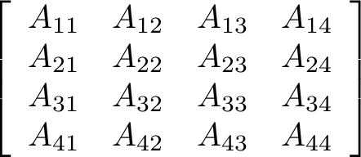
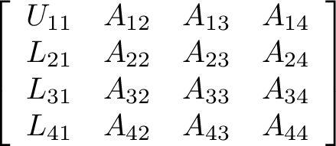
The Problem

Slide 4
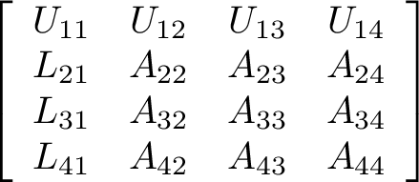
The Problem

Slide 5
The Problem

Slide 6
The Problem
Small parallelism
Small parallelism
Big parallelism

Slide 7
Outline
Overview ⬅
Results
Conclusion

Slide 8
Overview
Four implementations of LU
PLASMA (highly optimized third party library)
Sivan Toledo’s algorithm in Cilk++ (courtesy of Bradley)
Parallel standard “right-looking” in Cilk++
Right-looking in pthreads
All implementations use same base case
GotoBLAS2 matrix routines
Analyze performance
Machine architecture
Cache behavior

Slide 9
Outline
Overview
Results
Summary ⬅
Architectural heterogeneity
Cache effects
Parallelism
Scheduling
Code size
Conclusion

Slide 10
Methodology
Machine configurations:
AMD16: Quad-quad AMD Opteron 8350 @ 2.0 GHz
Intel16: Quad-quad Intel Xeon E7340 @ 2.0 GHz
Intel8: Dual-quad Intel Xeon E5530 @ 2.4 GHz
Xen indicates running a Xen-enabled kernel
All tests still ran in dom0 (outside virtual machine)

Slide 11
Performance Summary
Quite significant performance heterogeneity by machine architecture
Large impact from caches
 | LU performace (gflops on 4k x 4k, 8 cores)
 | AMD16 | Intel16 | Intel16Xen | Intel8Xen
PLASMA | 28.7 | 21.5 | 20.6 | 31.1
Toledo | 17.2 | 19.6 | 17.4 | 32.5
Right | 7.72 | 8.53 | 7.38 | 23.2
Pthread | 12.5 | 11.2 | 10.8 | 22.1

Slide 12
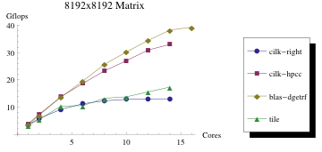
LU Scaling

Slide 13
Outline
Overview
Results
Summary
Architectural heterogeneity ⬅
Cache effects
Parallelism
Scheduling
Code size
Conclusion

Slide 14
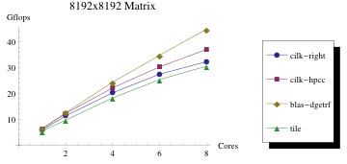
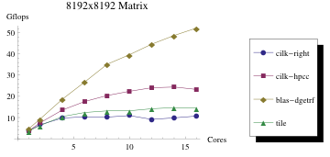
Architectural Variation (by arch.)
AMD16
Intel16
Intel8Xen

Slide 15
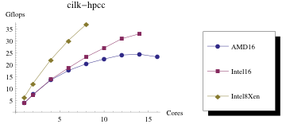
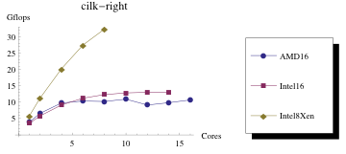
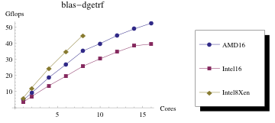
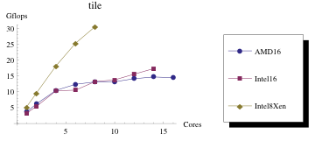
Architectural Variation (by alg’thm)

Slide 16
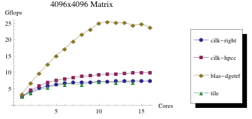
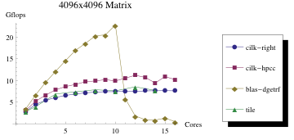
Xen Interference
Strange behavior with increasing core count on Intel16
Intel16Xen →
←Intel16

Slide 17
Outline
Overview
Results
Summary
Architectural heterogeneity
Cache effects ⬅
Parallelism
Scheduling
Code size
Conclusion

Slide 18
Cache Interference
Noticed scaling problem with Toledo algorithm
Tested with matrices of size 2^{n}
Caused conflict misses in processor cache

Slide 19
Cache Interference: example
AMD Opteron has 64 byte cache lines and a 64 Kbyte 2-way set associative cache:
512 sets, 2 cache lines each
Every 32Kbyte (or 4096 doubles) map to the same set
tag
set
offset
63
15
14
6
5
0

Slide 20
Cache Interference: example
4096 elements

Slide 21
Cache Interference: example
4096 elements

Slide 22
Cache Interference: example
4096 elements

Slide 23
Cache Interference: example
4096 elements

Slide 24
Cache Interference: example
4096 elements

Slide 25
Cache Interference: example
4096 elements

Slide 26
Cache Interference: example
4096 elements

Slide 27
Solution: pad matrix rows
4096 elements
8 element pad

Slide 28
Solution: pad matrix rows
4096 elements
8 element pad

Slide 29
Solution: pad matrix rows
4096 elements
8 element pad

Slide 30
Solution: pad matrix rows
4096 elements
8 element pad

Slide 31
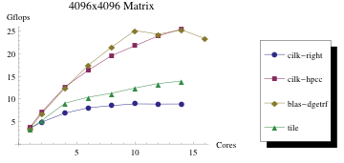
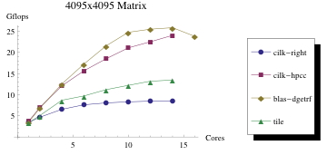
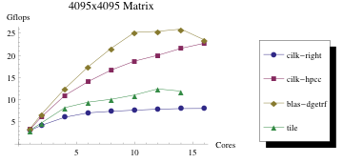
Cache Interference (graphs)
Before:
After:

Slide 32
Outline
Overview
Results
Summary
Architectural heterogeneity
Cache effects
Parallelism ⬅
Scheduling
Code size
Conclusion

Slide 33
Parallelism
Toledo shows higher parallelism, particularly in burdened parallelism and large matrices
Still doesn’t explain poor scaling of right at low numbers of cores
Matrix Size | Toledo |  | Right-looking
 | Parallelism | Burdened Parallelism | Parallelism | Burdened Parallelism
2048x2048 | 15.8 | 15.5 | 16.0 | 12.2
4096x4096 | 38.1 | 37.4 | 34.6 | 26.0
8192x8192 | 92.6 | 91.1 | 72.8 | 57.3

Slide 34
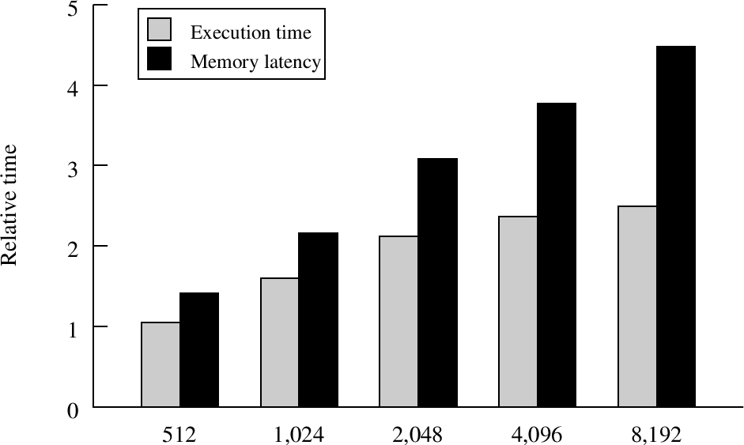
System Factors (Load latency)
Performance of Right relative to Toledo

Slide 35
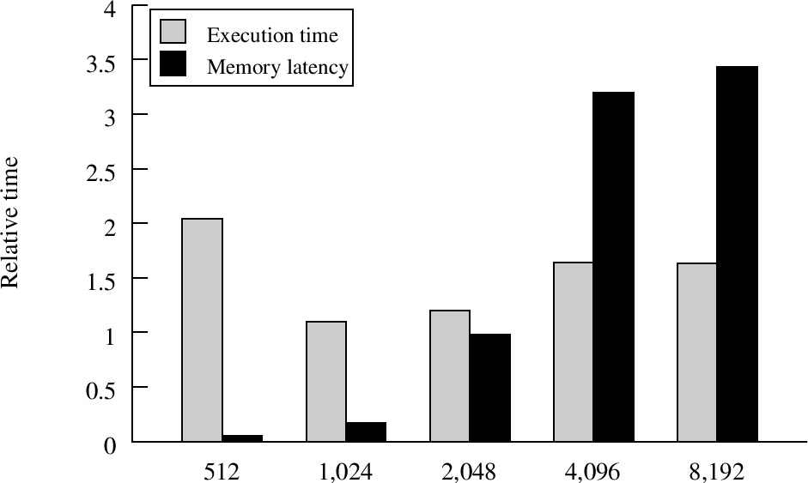
System Factors (Load latency)
Performance of Tile relative to Toledo

Slide 36
Outline
Overview
Results
Summary
Architectural heterogeneity
Cache effects
Parallelism
Scheduling ⬅
Code size
Conclusion

Slide 37
Scheduling
Cilk++ provides dynamic scheduler
PLASMA, pthread use static schedule
Compare performance under multiprogrammed workload

Slide 38
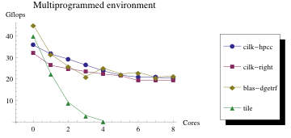
Scheduling Graph
Cilk++ implementations degrade more gracefully
PLASMA does OK; pthread right (“tile”) doesn’t

Slide 39
Outline
Overview
Results
Summary
Architectural heterogeneity
Cache effects
Parallelism
Scheduling
Code size ⬅
Conclusion

Slide 40
Code style
Lines of Code
 | Toledo | Right-looking | PLASMA | Pthread Right
Just LU | 111 | 121 | 143 | 134
Everything | 238 | 257 | 269 | 934*
* Includes base case wrappers
Comparing different languages
Expected large difference, but they are similar
Complexity is in base case
Base cases are shared

Slide 41
Conclusion
Cilk++ can perform competitively with optimized math libraries
Cache behavior is most important factor
Cilk++ shows better performance degradation with other things running
Especially compared to hand-coded pthread versions
Code size not a major factor

