Slide 1
Automated Exposure Notification Schemes
Ran Canetti, Yael T. Kalai, Anna Lysyanskaya, Ronald L. Rivest, Adi Shamir, Emily Shen, Ari Trachtenberg, Mayank Varia, Daniel J. Weitzner

Slide 2
Our Contributions
Formalize the notion of
Automated Exposure Notation (AEN) schemes
Syntax
Security properties: game-based and UC
Propose three schemes
Implemented by Apple and Google, introduced independently by
DP-3T, TCN, UW-PACT, Covid Watch, Trace Together,…
ReBabbler
CleverParrot
Certified CleverParrot
stronger security at a cost to efficiency (and simplicity)

Slide 3
Contact Tracing
Identifying an index case
Determining their contacts
Notifying the contacts
Follow-up
For “passive” and diagnosed users
Privacy??
AEN
Important Properties:
Decentralized
Proximity-based (uses Bluetooth technology)

Slide 4
Overview of the Constructions
Each user has a secret seed
Use this seed to continuously broadcast (using BLE) random-looking chirps
Each chirp is a function of the seed and the time
(and is changed periodically, synchronously with BLE MAC address rerandomization)
Locally store the chirps heard and the corresponding times.
Diagnosed users upload a function of their state to a public database.
Regularly download the database and check for contacts.
contains all chirps sent and heard (including times)
chirps sent
vs
chirps heard

Slide 5
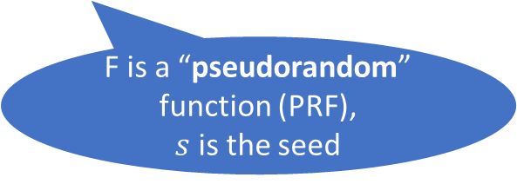
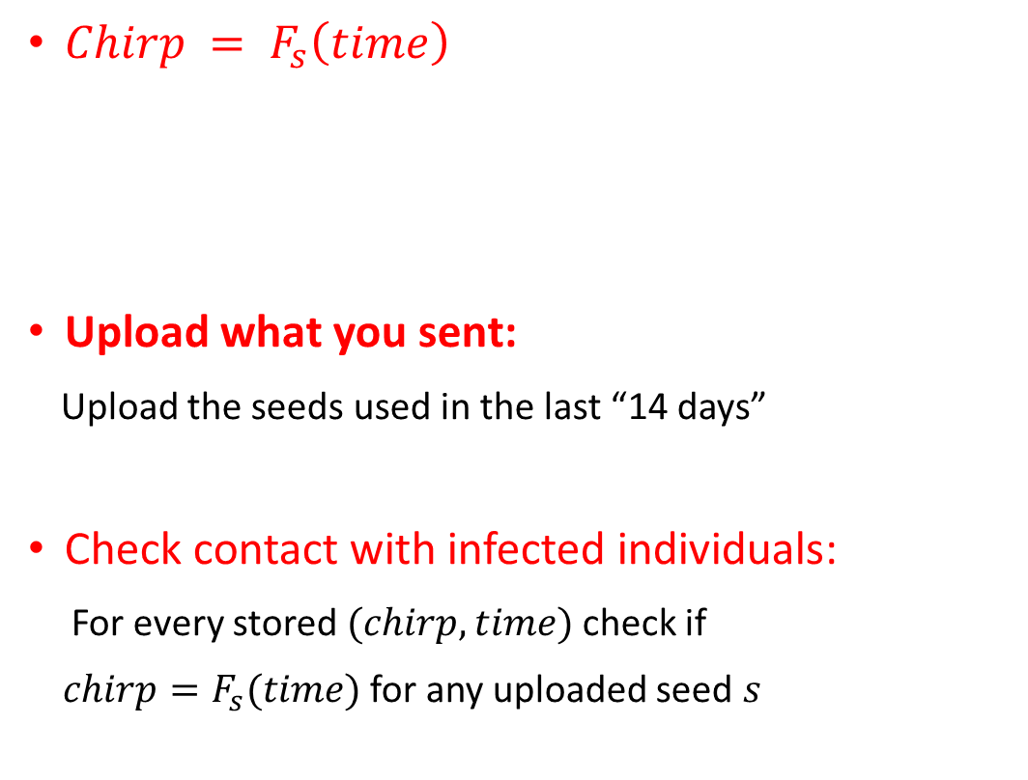
ReBabbler:
Simple
$Chirp = F_{s}\left(time\right)$
Upload what you sent:
Upload the seeds used in the last “14 days”
Check contact with infected individuals:
For every stored $(chirp,time)$check if
$chirp=F_{s}(time)$for any uploaded seed $s$
Efficient
F is a “pseudorandom” function (PRF),
$s$is the seed
PRF ensures
that chirps are unlinkable
Privacy for users who are not diagnosed
Privacy for diagnosed users??
In all “upload what you sent” schemes
a curious user can find the index case

Slide 6
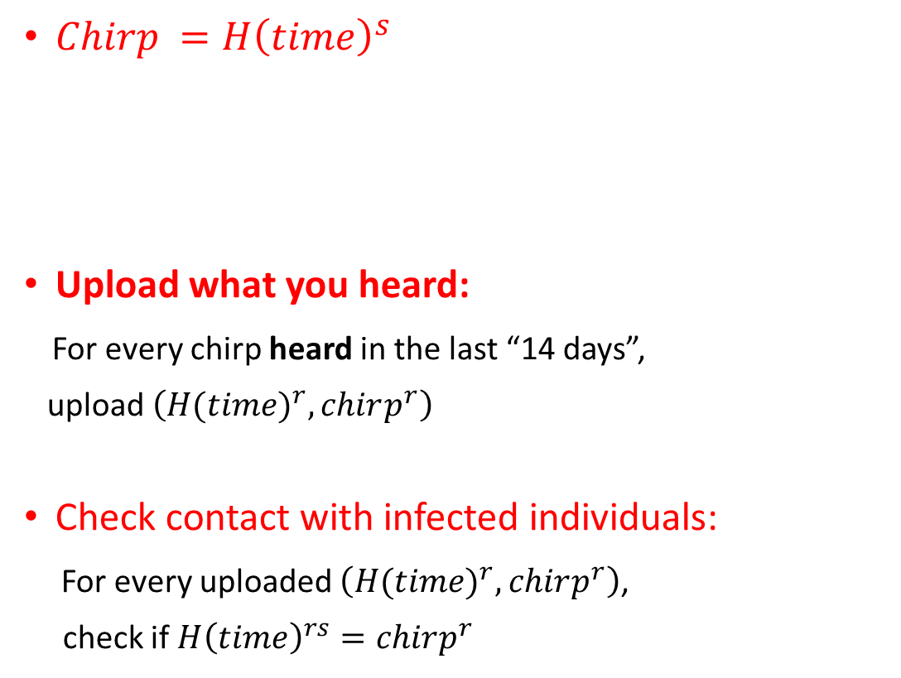
CleverParrot:
Similar to Apple Find My
Less efficient
$Chirp =H{\left(time\right)}^{s}$
Upload what you heard:
For every chirp heard in the last “14 days”,
upload $\left({H(time)}^{r}, chirp^{r}\right)$
Check contact with infected individuals:
For every uploaded $\left({H(time)}^{r}, chirp^{r}\right)$,
check if $H{\left(time\right)}^{rs}=chirp^{r}$
$H\left(time\right)$in group $G,$
$G$ is assumed to have some property (DDH)
Simple
Assuming DDH and $H$is a random function (ROM)
Privacy for users who are not diagnosed

Slide 7
CleverParrot:
Similar to Apple Find My
Less efficient
$Chirp =H{\left(time\right)}^{s}$
Upload what you heard:
For every chirp heard in the last “14 days”,
upload $\left({H(time)}^{r}, chirp^{r}\right)$
Check contact with infected individuals:
For every uploaded $\left({H(time)}^{r}, chirp^{r}\right)$,
check if $H{\left(time\right)}^{rs}=chirp^{r}$
$H\left(time\right)$in group $G,$
$G$ is assumed to have some property (DDH)
Simple
Assuming DDH and $H$is a random function (ROM)
Privacy for users who are not diagnosed
Privacy for diagnosed users??

Slide 8
CleverParrot:
Similar to Apple Find My
Less efficient
$Chirp =H{\left(time\right)}^{s}$
Upload what you heard:
For every chirp heard in the last “14 days”,
upload $\left({H(time)}^{r}, chirp^{r}\right)$
Check contact with infected individuals:
For every uploaded $\left({H(time)}^{r}, chirp^{r}\right)$,
check if $H{\left(time\right)}^{rs}=chirp^{r}$
$H\left(time\right)$in group $G,$
$G$ is assumed to have some property (DDH)
Simple
Assuming DDH and $H$is a random function (ROM)
Privacy for users who are not diagnosed
Privacy for diagnosed users??
Yes!
Unless users change their seed too often

Slide 9
In every AEN scheme where users can change their seeds as often as they wish, it is impossible to protect diagnosed users!

Slide 10
Certified CleverParrot
Add a registration authority that certifies seeds
(to ensure that users register only once)
Only trusted not to collude with the adversary to launch a sybil attack.
Each chirp contains 3-4 group elements
(doesn’t fit in a single BLE packet)
Privacy for users who are not diagnosed
More complicated
(relies on bilinear maps)
Privacy for diagnosed users

Slide 11
Security Analysis
Security properties
Privacy of undiagnosed users
Privacy of diagnosed users
Integrity
UC security [Canetti2000]
Holistic approach to security

