Slide 1
Differential Privacy
6.857
These slides are adapted
from Adam Smith

Slide 2
“Privacy” is changing
So far, we thought of semantic security (or CCA security) as a gold standard for privacy – everything is hidden!
In data-driven systems we want privacy while still getting utility.
Utility
Privacy
Privacy: individual information stays hidden
Utility: release aggregate statistics
Notes:
We are faced with a balancing act: on one hand, getting the benefits of all this data we are now able to collect, and, on the other hand, making sure we have tools to limit the potential negative consequences.

Slide 3
Examples
Healthcare:
E.g., Use data to improve cancer prediction.
Predictive Policing:
Use data to improve recidivism prediction.
Many benefits of data!
(better diagnosis,
lower recidivism,…)

Slide 4
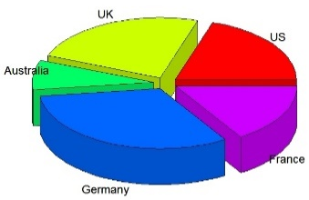
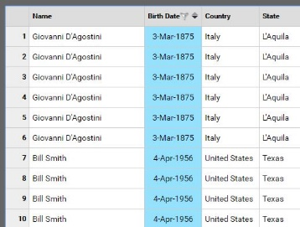
Statistical Data Privacy
Individuals
Researchers
queries
Summaries
Synthetic data
“Agency”
answers
Large collections of personal information
census data
medical/public health
social networks
education
…
Notes:
Privacy can mean many things.
Today we will talk about privacy in statistical databases. A good example to have in mind is the problem faced by the Census.
Imagine you have a server or agency---say the US Census bureau---that collects data from many individuals, and would like to make that data available, to the extent possible, for analysis by researchers.
The census can’t just publish its data – it is bound to keep responses confidential.
Collections of personal information are now ubiquitous, and there are numerous benefits to society for having access to this data.
But what makes these data valuable is exactly what makes them sensitive, namely that they reveal many details about our lives.

Slide 5
How do we Define “Privacy”?
Studied since 1960’s in
Statistics
Databases & data mining
Cryptography
This talk: Differential Privacy [Dwork, McSherry, Nissim, Smith 2006]

Slide 6
Today:
Why is privacy challenging?
Anonymization often fails
Example: membership attacks
Differential Privacy [Dwork, McSherry, Nissim, Smith 2006]
“Privacy” as stability to small changes
Widely studied and deployed
Reports from the frontier
Three topics

Slide 7
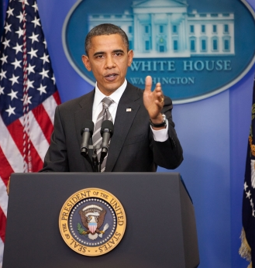
First attempt: Remove obvious identifiers
June 18, 2012:
The "Re-identification" of Governor William Weld's Medical Information: A Critical Re-examination of Health Data Identification Risks and Privacy Protections, Then and Now
Authors: Daniel C. Barth-Jones, Columbia University.
Abstract: The 1997 re-identification of Massachusetts Governor William Weld’s medical data within an insurance data set which had been stripped of direct identifiers has had a profound impact on the development of de-identification provisions within the 2003 Health Insurance Portability and Accountability Act (HIPAA) Privacy Rule. Weld’s re-identification, purportedly achieved through the use of a voter registration list from Cambridge, MA is frequently cited as an example that computer scientists can re-identify individuals within de-identified data with “astonishing ease”.
Image: whitehouse.gov
“AI recognizes blurred faces”
[McPherson Shokri Shmatikov ’16]
Everything is an identifier
Attacker has external information
“Anonymization” schemes are regularly broken
Notes:
the logic underlying re-identification depends critically on being able to demonstrate that a person within health data set is the only person in the larger population who has a set of combined characteristics (known as “quasi-identifiers”) that could potentially re-identify them,

Slide 8
Second Attempt: Aggregate Information
Idea: Lets release only aggregate information
Problem: Statistics may encode secret data
Example: Average salary before/after resignation
More generally: Too many, “too accurate”
statistics reveal individual information
Notes:
Let me illustrate this phenomenon via membership attacks.

Slide 9
Membership Attacks
Population
$d$ attributes
Alice’s data
0 | 1 | 1 | 0 | 1 | 0 | 0 | 0 | 1
0 | 1 | 0 | 1 | 0 | 1 | 0 | 0 | 1
1 | 0 | 1 | 1 | 1 | 1 | 0 | 1 | 0
1 | 1 | 0 | 0 | 1 | 0 | 1 | 0 | 0
$n$ people
data
1 | 0 | 1 | 1 | 1 | 1 | 0 | 1 | 0
“In”/ “Out”
$$\overline{X}$$
.5 | .75 | .5 | .5 | .75 | .5 | .25 | .25 | .5
Attacker
Release $d$ exact column averages
Attacker succeeds with high probability when there are more attributes than people $≪\sqrt{d}$and $error≲\sqrt{d}/n$

Slide 10
Lessons
Everything is an identifier
“Too many, too accurate” statistics allow one to reconstruct the data

Slide 11
This talk
Why is privacy challenging?
Anonymization often fails
Example: membership attacks
Differential Privacy [Dwork, McSherry, Nissim, Smith 2006]
“Privacy” as stability to small changes
Widely studied and deployed
Reports from the frontier
Three topics

Slide 12
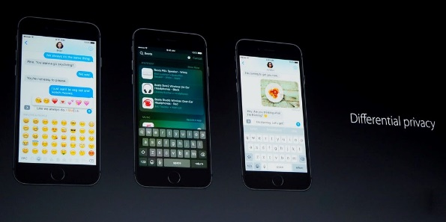
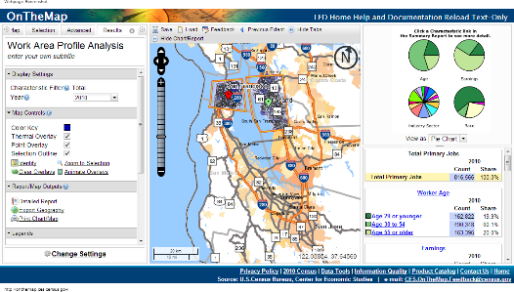
Differential Privacy
Several current deployments
Apple
Google
US Census

Slide 13
Differential Privacy
A
A(x)
random bits
Data set $x$
Domain D can be numbers, categories, tax forms
When is this algorithm
private?

Slide 14
Differential Privacy
A
A(x)
A
A(x’)
random bits
random bits
Data set $x$
Domain D can be numbers, categories, tax forms
When is this algorithm
private?

Slide 15
Differential Privacy
A
A(x)
A
A(x’)
random bits
random bits
$x’$ is a neighbor of $x$ if they differ in one data point
Definition: A is $ε$-differentially private if,
for all neighbors $x$, $x’$,
for all subsets S of outputs
$$Pr[{A\left(x\right)∈S]}≤e^{ε}Pr⁡[A\left(x^{′}\right)∈S]$$
$$1+ε$$
$ε$ is a leakage measure
Notes:
e^\eps is roughly (1+eps).
What is ε? Measure of information leakage
Not too small (about 0.1)
This is a condition on the algorithm A.
Saying a particular output is private makes no sense
Choice of distance measure matters

Slide 16
Randomized Response [Warner 1965]
$$Y_{1}$$
$$Y_{2}$$
$$A\left(x\right)=Y_{1},…,Y_{n}$$
$$Y_{n}$$
A
Want to release the fraction of students who’ve cheated on a test
Each person’s data is a bit: $x_{i}=0$ or $x_{i}=1$
Randomized Response:
Each individual rolls a die
1, 2, 3 or 4: Report $Y_{i}=$ true value $x_{i}$
5 or 6: Report $Y_{i}=$ opposite value $1−x_{i}$
Output $=$ list of reported values $Y_{1},…,Y_{n}$
Notes:
Intuition: $f(x)$ can be released accurately when $f$ is insensitive to individual entries $x_{1},…,x_{n}$

Slide 17
Randomized Response [Warner 1965]
Each individual rolls a die
$1, 2, 3 or 4$: Report true value $x_{i}$
$5 or 6$: Report opposite value $\overline{x_{i}}$
$$Y_{1}$$
$$Y_{2}$$
$$A\left(x\right)=Y_{1},…,Y_{n}$$
$$Y_{n}$$
A
Why is it “private”?
Thought experiment: Change $x_{Bob}$ from $0$to $1$
$Y_{Bob}=1$ happens with probability $\frac{2}{3}$ instead of $\frac{1}{3}$ $∴$ Plausible deniability
Satisfies $ε$-DP with $ε≈0.7$
Why is it “useful”?
Gives a good estimate for fraction of $x_{i}$’s that are $1$, using law of large numbers

Slide 18
Laplace Mechanism
function f
A
$$A\left(x\right)=f\left(x\right)+noise$$
Random bits
Say we want to release a summary $f\left(x\right)∈ℝ^{d}$
e.g., proportion of cheaters: $x_{i}∈\left\{0,1\right\}$ and $f\left(x\right)=\frac{1}{n}\sum_{i}{x_{i}}$
Simple approach: add noise to $f(x)$
How much noise is needed?

Slide 19
Laplace Mechanism
function f
A
$$A\left(x\right)=f\left(x\right)+noise$$
Random bits
Global Sensitivity:
Example:

Slide 20
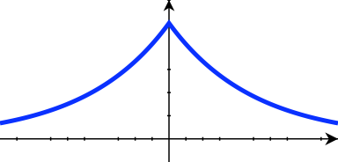
Laplace Mechanism
function f
A
$$A\left(x\right)=f\left(x\right)+noise$$
Random bits
Global Sensitivity:
Theorem: If noise is added from Laplace distribution with
b $≥\frac{GS_{f}}{ε}$, then $A$ is $ε$-DP.
Laplace distribution:$h\left(y\right)=\frac{1}{2b}e^{−\left|y\right|/b}$
Notes:
$$σ^{2}=2b^{2}$$

Slide 21
Laplace Mechanism
Global Sensitivity:
Theorem: If noise is added from Laplace distribution with
b $≥\frac{GS_{f}}{ε}$, then $A$ is $ε$-DP.
Laplace distribution:$h\left(y\right)=\frac{1}{2b}e^{−\left|y\right|/b}$
Proof:
$$\frac{\operatorname{Pr}\left[A\left(x\right)=v\right]}{\operatorname{Pr}\left[A\left(x^{′}\right)=v\right]}=\frac{e^{−\frac{\left|v−f\left(x\right)\right|}{b}}}{e^{\frac{−\left|v−f\left(x^{′}\right)\right|}{b}}}=e^{\frac{\left|v−f\left(x^{′}\right)\right|−\left|v−f\left(x\right)\right|}{b}}≤e^{\frac{\left|f\left(x^{′}\right)−f\left(x\right)\right|}{b}}≤e^{ε}$$
Notes:
$$σ^{2}=2b^{2}$$

Slide 22
Attacks “match” differential privacy
function f
A
$$A\left(x\right)=f\left(x\right)+noise$$
Random bits
Can release $d$ proportions with noise $≈\frac{\sqrt{d}}{εn}$ per entry
Requires “approximate” variant of DP
$$\frac{\sqrt{d}}{n}$$
$$\frac{\sqrt{d}}{εn}$$
Differential privacy
membership attacks
$$1/\sqrt{n}$$
Statistical error

Slide 23
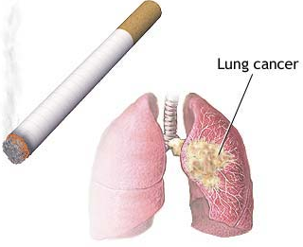
Interpreting Differential Privacy
A naïve hope:
Your beliefs about me are the same after you see the output as they were before
Impossible
Suppose you know that I smoke
Clinical study: “smoking and cancer correlated”
You learn something about me
Whether or not my data were used
Differential privacy implies: No matter what you know ahead of time, you learn (almost) the same things about me whether or not my data are used

Slide 24
A Broad, Active Field of Science
Algorithmic tools and techniques
Theoretical foundations
Feasibility results: Learning, optimization, synthetic data, statistics
Variations on the definition
Domain-specific algorithms
Networking, clinical data, social networks, geographic data, mobile traces …
Connections to other areas
Law and policy
“Adaptive” generalization bounds
Game theory
Google Scholar: 1,000+ articles with “differential privacy” in the title
13,000+ articles with “differential privacy” in text

Slide 25
This talk
Why is privacy challenging?
Anonymization often fails
Example: membership attacks
Differential Privacy
“Privacy” as stability to small changes
Widely studied and deployed
Reports from the frontier
Three topics

Slide 26
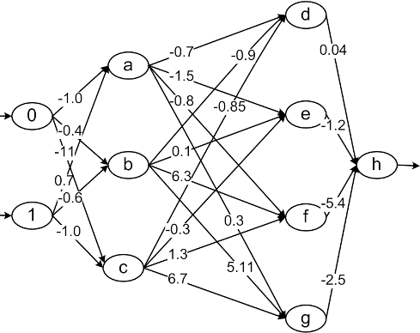
Frontier 1: Learning with DP
[Abadi et al 2016, …]
Parameters
Sensitive Data
Deep Learning
Should be thought of as public
Revealed now, but should be hidden
Model

Slide 27
Frontier 2: From Law to Technical Definitions
Two central challenges
Given a body of law and regulation, what technical definitions comply with that law?
E.g., GDPR
How should we write laws and regulations so they make sense given evolving technology?

Slide 28
Frontier 3: Privacy and overfitting
Problem: In modern data analysis, data is re-used across studies
Choice of what analysis to perform can depend on outcomes of previous analyses
Differentially private algorithms help prevent overfitting due to adaptivity
X
$$A_{1}$$
outcome $1$
Population $P$
data
Adaptive
$$A_{2}$$
outcome $2$

Slide 29
Overfitting
X
$$A$$
outcome
Population $P$
data
method
What we want to study
What we have
Inference: Draw conclusions about $P$ based on $X$
Overfitting / false discovery: Conclusions that hold for $X$ but not for $P$

Slide 30
Overfitting
X
$$A$$
outcome
Population $P$
data
method
Static
Decades of work on preventing overfitting
Cross-validation,…
Designed for static data analysis
Assumes method selected independently of data

Slide 31
Overfitting
X
$$A$$
outcome
Population $P$
data
method
Static
X
$$A_{1}$$
outcome $1$
Population $P$
data
Adaptive
$$A_{2}$$
outcome $2$
…

Slide 32
Getting a Baseline
$$X$$
$$A_{1}$$
$$X^{\left(1\right)}$$
$$A_{1}$$
$$P$$
$$P$$
$$A_{2}$$
$$X^{\left(2\right)}$$
$$A_{2}$$
Adaptive setting
…
Statistical ideal: Fresh sample for each analysis
…
$$A_{k}$$
$$X^{\left(k\right)}$$
$$A_{k}$$
Goal: Relate adaptive setting to statistical ideal worlds
DP prevents adaptive overfitting [Dwork Feldman Hardt Pitassi Reingold Roth ‘15]
Notes:
The i-th analysis depends on the outcomes of the first (i-1).
We don’t know the rule or process used to select the analysis.

Slide 33
This talk
Why is privacy challenging?
Anonymization often fails
Example: membership attacks
Differential Privacy
“Privacy” as stability to small changes
Widely studied and deployed
Reports from the frontier
Three topics

Slide 34
Beyond privacy
Data increasingly used to automate decisions
E.g.: Lending, health, education, policing, sentencing
Modern security must include trustworthiness of data-driven algorithmic systems
Differential privacy formalizes one piece of modern security
What other areas need such scrutiny?
Privacy
Resistance to manipulation
Fairness
Notes:
In the last few decades, we’ve seen enormous changes in how data are used to make decisions and, increasingly, to automate those decisions in domains from the seemingly trivial – advertising—to critical decisions about lending, criminal sentencing, policing, education and health.

