Slide 1
The Evolution of Proofs in Computer Science: Zero-Knowledge Proofs
6.857
Lecture 13

Slide 2
Classical Proofs
$$P$$
$$V$$

Slide 3
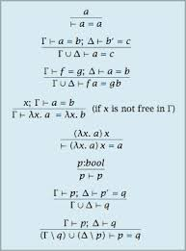
Classical Proofs
$$P$$
$$V$$
Conjecture: $∃$succinct classical proof for correctness of any computation $M\left(x\right)=1$ within $T$steps

Slide 4
Zero-Knowledge Proofs [Goldwasser-Micali-Rackoff85]
Proofs that reveal no information beyond the validity of the statement

Slide 5
Zero-Knowledge Proofs [Goldwasser-Micali-Rackoff85]
Impossible!
This is information!

Slide 6
Interactive Proofs [Goldwasser-Micali-Rackoff85]
$$P$$
$$V$$
Completeness$: ∀x∈L \operatorname{Pr}\left[\left(P,V\right)\left(x\right)=1\right]≥2/3$
Soundness: $∀x∉L, ∀P^{∗} \operatorname{Pr}\left[\left(P^{∗},V\right)\left(x\right)=1\right]≤1/3$
Note: By repetition, we can get completeness $1−2^{−k},$and soundness $2^{−k}$

Slide 7
Interactive Proofs [Goldwasser-Micali-Rackoff85]
For ZK the prover needs to be randomized
$$P$$
$$V$$
[Goldreich-Micali-Wigderson87]: Every statement that has a classical proof has zero-knowledge (ZK) interactive proof, assuming one-way functions exist
Notes:
To obtain ZK the prover needs to be randomized too. Randomness is used to hide secret information.

Slide 8
Defining Zero-Knowledge
This transcript reveals no information
$$x∈L$$
$$P$$
$$V$$
Formally: There exists a $PPT$algorithm $S$ (called a simulator), such that for every $x∈L:$
$$S\left(x\right)≈(P,V)(x)$$
Denotes the transcript

Slide 9
ZK Proofs for NP
Graphs for which vertices can be colored by {1,2,3} s.t. no two adjacent vertices are colored by the same color
For the $NP$-complete language of all 3-colorable graphs
$$G=\left(V,E\right)$$
Locked safe, reveals no information about its content
$$P$$
$$V$$
$C_{1}$
$C_{n}$
Randomly permute the coloring, to obtain valid coloring $(c_{1},…,c_{n})$
Choose a random edge $\left(i,j\right)∈E$
$$\left(i,j\right)∈E$$
Open safes $i,j$
Soundness: Only $1−\frac{1}{\left|E\right|}$but can be amplified via repetition.
Notes:
A graph is 3-colorable if there is a coloring of al the nodes using only three colors such that no two adjacent nodes are colored using the same color.

Slide 10
ZK Proofs for NP
For the $NP$-complete language of all 3-colorable graphs
$$S\left(V,E\right):$$
Choose a random $\left(i,j\right)∈E$
Choose random distinct colors $c_{i},c_{j}$
The simulated transcript is:
$$G=\left(V,E\right)$$
$$P$$
$$V$$
safes $i, j$have values $c_{i}, c_{j}$
$C_{1}$
$C_{n}$
$$\left(i,j\right)∈E$$
$$\left(i,j\right)∈E$$
Open safes $i,j$
Open safes $i,j$
Notes:
ZK proof for any NP complete language implies ZK proof for all of NP, via NP reduction.

Slide 11
Implementing Digital Safes: Commitment Scheme
A commitment scheme is a randomized algorithm $Com$ s.t.:
Hiding:$∀m,m^{′}$ $Com\left(m;r\right)≈Com(m^{′};r^{′})$.
Binding: $∃\left(m,r\right), \left(m^{′},r^{′}\right)$s.t. $m≠m′$ and
$$Com\left(m;r\right)=Com(m^{′};r^{′})$$
Notes:
We have mentioned this notion early on when we talked about one-way functions and collision resistant hash functions, and their applications.

Slide 12
Using Commitments to Construct ZK Proofs
For the $NP$-complete language of all 3-colorable graphs
$$G=\left(V,E\right)$$
$$P$$
$$V$$
Randomly permute the coloring, to obtain valid coloring $(c_{1},…,c_{n})$
$$Com\left(c_{1}\right),…,Com(c_{n})$$
Choose a random edge $\left(i,j\right)∈E$
$$\left(i,j\right)∈E$$
Reveal $c_{i},c_{j},$with corresponding randomness

Slide 13
Constructing a Commitment Scheme
Construction 1:
Let $f:{\left\{0,1\right\}}^{∗}→{\left\{0,1\right\}}^{∗}$be an injective OWF.
$$Com\left(b;(r,s)\right)=(f\left(r\right), s,({⊕r}_{i}s_{i})⊕b)$$
Binding: Follows from the fact that $f$is injective
Hiding: Relies on the fact that if $f$is one-way then:
$$\left(f\left(r\right),s,{ ⊕r}_{i}s_{i}\right)≈\left(f\left(r\right),s\right),U)$$
Known as a hard-core predicate
[Goldreich-Levin89]

Slide 14
Constructing a Commitment Scheme
Construction 2:
Let $G$be a group of prime order p, let $g∈G$ be any generator, and $h$be a random group element.
$$Com_{g,h}\left(m,r\right)=g^{m}h^{r}$$
Hiding: Information theoretically!
Binding: Follows from the Discrete Log assumption.
If $∃PPT$alg $A$s.t.
$A\left(g,h\right)=\left(m_{1},m_{2},r_{1},r_{2}\right)$where $g^{m_{1}}h^{r_{1}}=$ $g^{m_{2}}h^{r_{2}}$then
$m_{1}+sr_{1}=m_{2}+sr_{2}$ mod p,
which implies that $s=\frac{m_{1}−m_{2}}{r_{2}−r_{1}}$ mod p

Slide 15
Constructing Zero-Knowledge Proofs
This is perfect ZK!
But only computationally sound
$$P$$
$$V$$
Perfectly hiding
$$g,h∈G$$
Randomly permute the coloring, to obtain valid coloring $(c_{1},…,c_{n})$
$$Com_{g,h}\left(c_{1}\right),…,Com_{g,h}(c_{n})$$
Choose a random edge $\left(i,j\right)∈E$
All powerful prover can break binding
$$\left(i,j\right)∈E$$
Reveal $c_{i},c_{j},$with corresponding randomness

Slide 16
Interactive Computationally Sound Proofs (a.k.a. Arguments) [Brassard-Chaum-Creapeau88]
$$x∈L$$
$$P$$
$$V$$
Completeness$: ∀x∈L \operatorname{Pr}\left[\left(P,V\right)\left(x\right)=1\right]≥2/3$
Soundness: $∀x∉L, ∀PPT P^{∗} \operatorname{Pr}\left[\left(P^{∗},V\right)\left(x\right)=1\right]≤1/3$

Slide 17
So Far…
Constructed ZK proofs for all of NP
using commitment schemes
Constructed commitment schemes
Based on injective OWF:
computationally hiding, perfectly binding
Based on Discrete Log:
perfectly hiding, computationally binding
Computational ZK proofs
Perfect ZK arguments

Slide 18
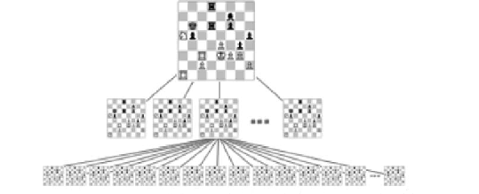
Interactive Proofs are More Efficient! [Lund-Fortnow-Karloff-Nissan90, Shamir90]
Example: Chess

Slide 19
Interactive Proofs are More Efficient! [Lund-Fortnow-Karloff-Nissan90, Shamir90]
correctness of any computation can be proved:
Time to verify
$$≈$$
Space required to do the computation
Interactive
Proof
$$IP=PSPACE$$

Slide 20
Interactive Proofs are More Efficient! [Lund-Fortnow-Karloff-Nissan90, Shamir90]
correctness of any computation can be proved:
Time to verify
$$≈$$
Space required to do the computation
Succinct space succinct interactive proof

Slide 21
Multi-Prover Interactive Proofs [BenOr-Goldwasser-Kilian-Wigderson88]
$$P_{1}$$
$$P_{2}$$
motivated by constructing perfect ZK proofs
$$q_{1}$$
$$q_{2}$$
$$a_{1}$$
$$a_{2}$$
$$V$$
$∀f$computable in time $T:$
2-provers can convince verifier that$f\left(x\right)=y$,
where the runtime of the verifier is only $\left|x\right|⋅polylog\left(T\right)$
and the communication is $polylog(T)$
Theorem [Babai-Fortnow-Lund90]:
Any proof can be made exponentially shorter with a 2-prover interactive proof!
Notes:
After defining IPs and obtaining ZKPs, BGKW asked whether one can get information theoretical ZKPs.
This led them to consider the model of multi-prover interactive proofs.
This is a very interesting proof model, where a verifier is interacting with 2 provers, and the assumption is that these provers are not allowed to interact once the protocol begins.
As before, the MIP model was motivated by cryptography.
Shortly after they were introduced, Babai-Fortnow-Lund show that such MIPs are extremely powerful.
Intuitively, the reason that MIP is so powerful, is that it is hard to cheat in a consistent manner. Think of two suspects that committed a crime. It seems very hard for them to cheat consistently, whereas it seems much easier for a single suspect to cheat. Indeed, a multi-prover interactive proof consists of a bunch of consistency checks.

Slide 22
[Fortnow-Rompel-Sipser88]:
$$P_{1}$$
$$P_{2}$$
$$a_{1}$$
$$a_{2}$$
$$a_{3}$$
$$a_{4}$$
$$a_{1}$$
$$a_{2}$$
$$a_{3}$$
$$a_{4}$$
$$q_{1}$$
$$q_{2}$$
$$a_{1}$$
$$a_{2}$$
$$V$$
Notes:
After defining IPs and obtaining ZKPs, BGKW asked whether one can get information theoretical ZKPs.
This led them to consider the model of multi-prover interactive proofs.
This is a very interesting proof model, where a verifier is interacting with 2 provers, and the assumption is that these provers are not allowed to interact once the protocol begins.
As before, the MIP model was motivated by cryptography.
Shortly after they were introduced, Babai-Fortnow-Lund show that such MIPs are extremely powerful.
Intuitively, the reason that MIP is so powerful, is that it is hard to cheat in a consistent manner. Think of two suspects that committed a crime. It seems very hard for them to cheat consistently, whereas it seems much easier for a single suspect to cheat. Indeed, a multi-prover interactive proof consists of a bunch of consistency checks.

Slide 23
Probabilistically Checkable Proofs
$$V$$
[Feige-Goldwasser-Lovasz-Safra-Szegedy91, Babai-Fortnow-Levin-
Szegedy91, Arora-Safra92, Arora-Lund-Mutwani-Sudan-Szegedy92]
Read only 3 bits of the proof, and obtain soundness 1/8
Notes:
In other words, one can replace the provers with the list of all possible answers (of the two provers), and the verifier can verify correctness by reading only two cells in this proof.
This led to a beautiful line of work, aiming to improve the parameters of such proofs.

Slide 24
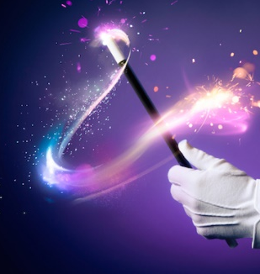
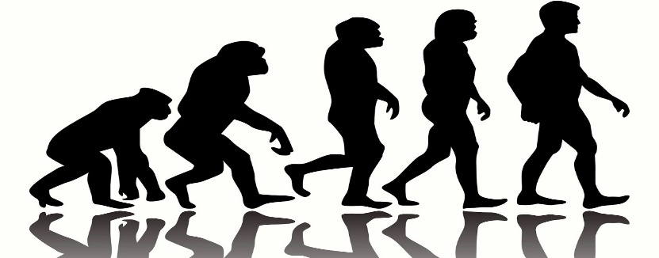
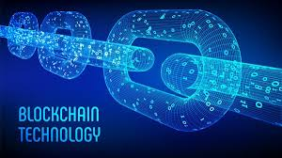
Classical proofs
(Zero-knowledge)
Interactive proofs
Multi-prover
interactive proofs
Probabilistically
checkable proofs (PCPs)
Fiat-Shamir paradigm
Interactive PCP/
Interactive oracle proofs
SNARGs

