Slide 1
Lecture 26: Mobile User Interfaces

Slide 2
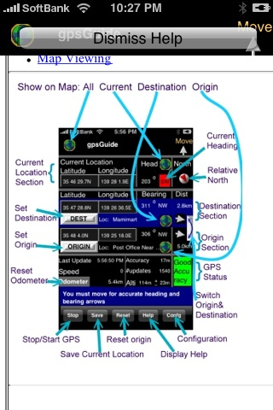
UI Hall of Fame or Shame?
Notes:
gpsGuide. (help screen on the right) http://appshopper.com/navigation/gpsguide

Slide 3
Today’s Topics
Design challenges in mobile UIs
specifically modern smartphones
Design patterns & guidelines
Implementation
Creating web UI for smartphones

Slide 4
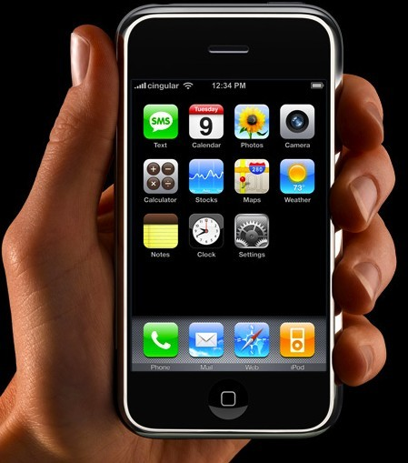
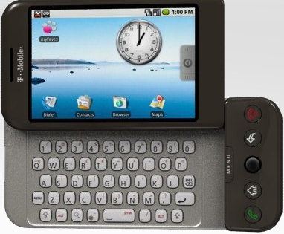
Desktop vs. Mobile

Slide 5
Small Screen

Slide 6
“Fat Finger”
Notes:
large contact surface of a fingertip (compared to a mouse pointer or stylus)
occlusion

Slide 7
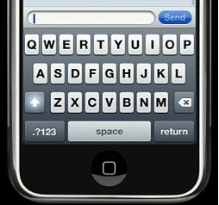
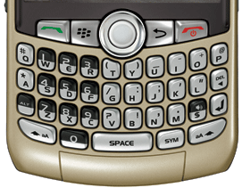
Text Input
Notes:
slower and more error-prone
fullsized keyboard:
average 30-40 wpm
fast 50-80 wpm
peak 120 or more
phone keyboard:
fast typists probably manage half their speed on a fullsize

Slide 8
Context

Slide 9
Other Issues in Mobile
Power & battery life
Network latency, bandwidth, inconsistency
CPU speed

Slide 10
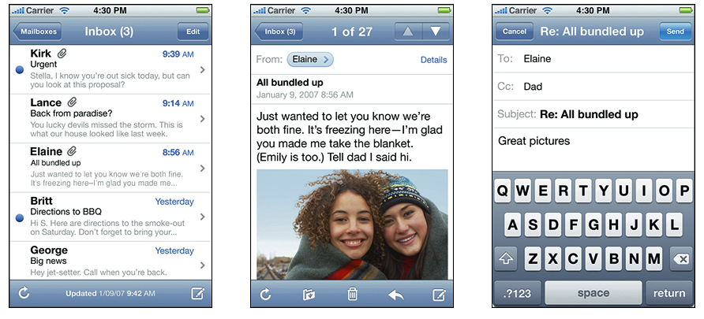
Distinct Screens
Notes:
Example from iPhone Human Interface Guidelines: http://developer.apple.com/library/ios/#documentation/UserExperience/Conceptual/MobileHIG
distinct, focused screens
Android calls each screen like this an “activity.” See Android interface guidelines, http://developer.android.com/guide/practices/ui_guidelines/index.html

Slide 11
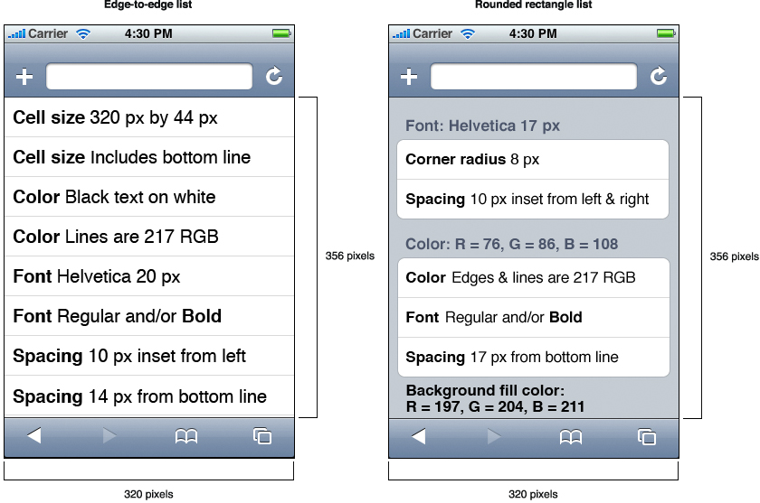
Scrolling Lists
Notes:
Example from iPhone Human Interface Guidelines: http://developer.apple.com/library/ios/#documentation/UserExperience/Conceptual/MobileHIG

Slide 12
Finger-Sized Targets

Slide 13
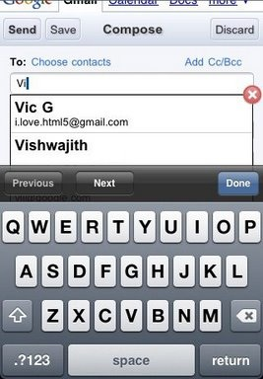
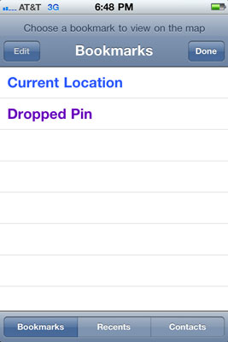
Minimize Text Input

Slide 14
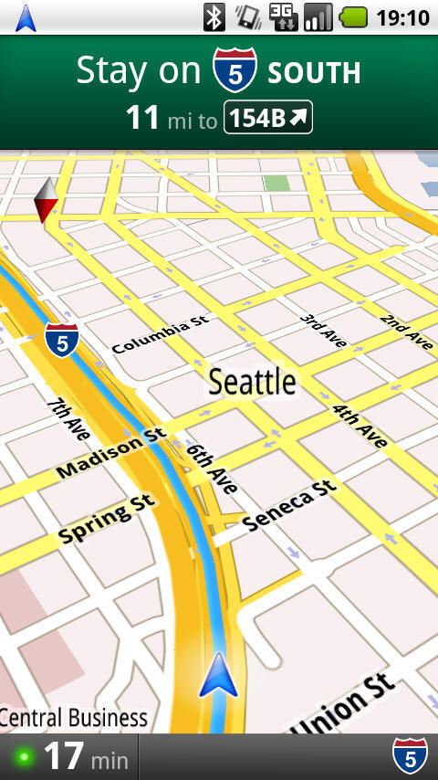
Simplify, Simplify, Simplify!

Slide 15
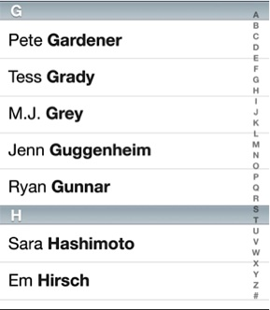
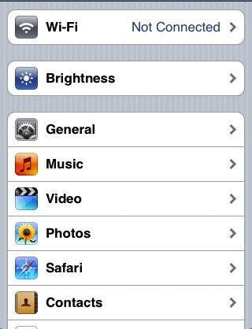
Mobile Widgets

Slide 16
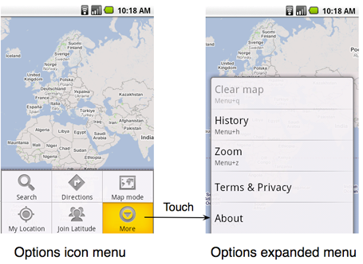
Many Kinds of Menus

Slide 17
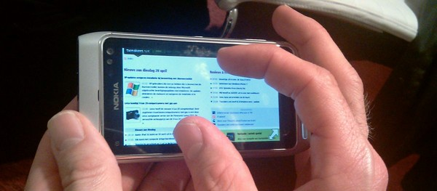
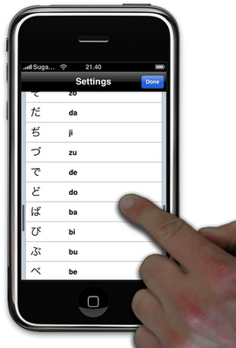
Touch Gestures
Notes:
note all the clutching that happens in pinch-zooming

Slide 18
Web Development for iPhones
Orientation detection
orientationchange
Mouse hover events behave differently
mousemove, mouseover, mouseout
mousedown, mouseup, click sent all at once on touch release
Multitouch events
touchstart, touchmove, touchend, touchcancel
jQuery UI support
jQTouch plugin
Notes:
iPhone dev reference: http://developer.apple.com/library/safari/
http://www.iphonewebdev.com/
http://www.quirksmode.org/blog/archives/2008/08/iphone_events.html

Slide 19
Summary
Mobile UI design faces new challenges
small screens
fat fingers
poor text entry
Simplify
Follow design patterns
Use touch gestures where possible

