Slide 1
Lecture 25: Input/Output Technology
HW2 due Sunday GR5 (final implementation) out Today is the last nanoquiz of the term!

Slide 2
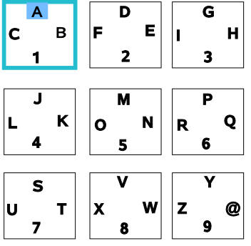
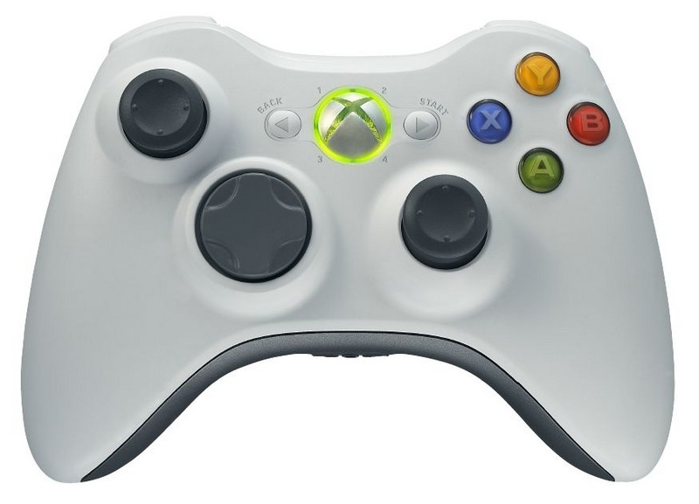
UI Hall of Fame or Shame
Notes:
From Ryan Young:
“While using the Xbox program 'Xbox FTP Client', I stumbled upon this alternative to the tried-and-true approach. The letters are placed like those on a phone pad, three letters and a number to each box. The left analog stick is used to select the box, and the right analog stick is used to highlight the letter/number of your choosing. Once the appropriate glyph is highlighted, you pull the right trigger with your index finger (a very natural motion, with both thumbs resting on the analog sticks) to select the letter/number. Once familiar with the interface, I've found I can type my name ("ryan young") in about 20 seconds, whereas it takes about 50 seconds with a traditional cursor and keyboard combination.”
natural mapping
external consistency

Slide 3
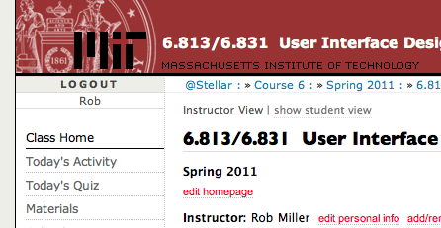
Nanoquiz
closed book, closed notes
submit before time is up (paper or web)
we’ll show a timer for the last 20 seconds

Slide 4
20
19
18
17
16
15
14
13
12
11
10
9
8
7
6
5
4
3
2
1
0
In which of the following situations would animation be likely to help? (choose all that apply) A. Highlighting a button (to show that it’s enabled) when the user mouses over it B. Scrolling when the user clicks on a link to another place in a document C. Displaying a throbber D. Scrolling when the user drags the scrollbar thumb.
jQuery’s animate() method is usually called from an event listener; for example, a click listener might use animate() to animate the appearance of a menu. Which of the following statements are true as a result? (choose all that apply) A. animate() uses timer events. B. animate() uses mouse capture. C. animate() doesn’t return until the animation is complete. D. animate() contains a loop that steps through the frames of the animation.
Which of the following techniques is most useful for animating a fast-moving object? (choose the best answer) A. motion blur B. slow-in, slow-out C. anticipation D. follow-through
Notes:
Note that 2(a) might be false if jQuery uses CSS3 Animation.

Slide 5
Today’s Topics
Displays
Pointing devices

Slide 6
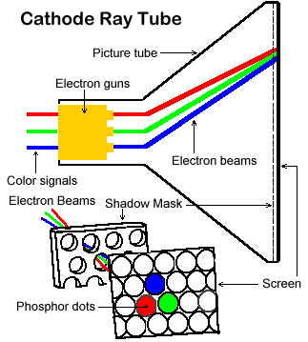
CRT vs. LCD

Slide 7
Properties of Displays
Diagonal size
Pixel dimensions & aspect ratio
Pixel density
Refresh rate
Color depth (# colors or grays)
Color gamut
Gamma

Slide 8
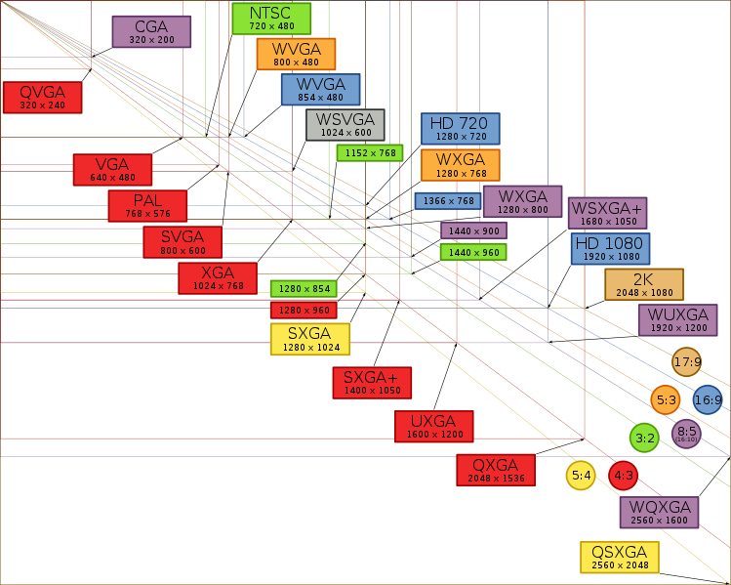
Pixel Dimensions
Notes:
how CRTs can make pixels larger or smaller by changing frequency of scan (analog resampling), but LCD pixels are fixed
display’s natural resolution always looks sharpest
square vs. nonsquare pixels

Slide 9
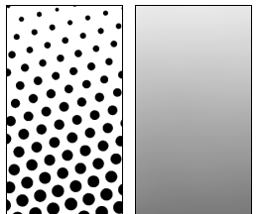
Pixel Density
Pixels per inch (ppi)
CRT, LCD: 60-130 ppi
iPhone 4: 326 ppi
Laser printer: 300-1800 ppi
Lines per inch (lpi) for halftoning
Newspaper: 85 lpi
Magazine: 133 lpi
Art book: 200 lpi
Notes:
Note that DPI and PPI are sometimes used confusingly – sometimes the quoted “dpi” for an LCD panel is actually three times its true ppi, because they’re counting the three subpixels
Smartphone PPI: http://pocketnow.com/index.php?a=portal_detail&t=news&id=4341
Lines per inch refers to number of halftone grid lines per inch. Digital halftoning uses a subgrid of pixels instead of different sizes of dots. So for 100 shades of gray, you’d need 10x10 pixel grid squares, so a 600 ppi printer would only be able to get 60 lpi halftoning.
So a bad rule of thumb is to multiply the lpi by 10 to find the equivalent ppi. Magazine printing using digital halftoning can be up to 2500 ppi!

Slide 10
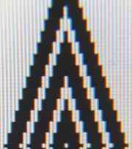
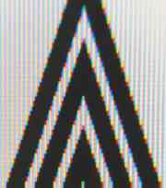
Subpixel Rendering on LCDs
Ideal for text
kerning
boldface
italic
But only horizontal text
Subpixel rendering
Notes:
Subpixel rendering takes this a step further. Every pixel on an LCD screen consists of three discrete pixels side-by-side: red, green, and blue. So we can get a horizontal pixel density which is three times the nominal pixel density of the screen, simply by choosing the colors of the pixels along the edge so that the appropriate subpixels are light or dark. It only works on LCD screens, not CRTs, because CRT pixels are often arranged in triangles, and because CRTs are analog, so the blue in a single “pixel” usually consists of a bunch of blue phosphor dots interspersed with green and red phosphor dots. You also have to be careful to smooth out the edge to avoid color fringing effects on perfectly vertical edges. And it works best for high-contrast edges, like this edge between black and white. Subpixel rendering is ideal for text rendering, since text is usually small, high-contrast, and benefits the most from a boost in horizontal resolution. Windows XP includes ClearType, an implementation of subpixel rendering for Windows fonts. (For more about subpixel rendering, see Steve Gibson, “Sub-Pixel Font Rendering Technology”, http://grc.com/cleartype.htm)

Slide 11
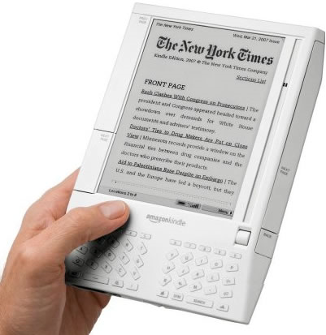
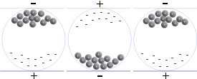
Electronic Paper
Electrophoretic display
charged white particles in a dark-colored oil
made by E Ink
used by Amazon Kindle & Sony Reader
Only consumes power to change display
Low refresh rate (1-2 Hz), low contrast
Kindle is 167 ppi, 16 levels grayscale
Notes:
white particles are titanium dioxide (about a micron in size)

Slide 12
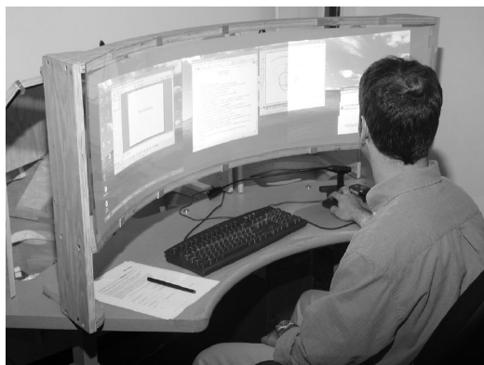
Multiple Monitors and Very Wide Displays
Multiple monitors are increasingly common
Microsoft DSharp prototype
made with 3 LCD projectors = 3072 x 768 pixels
curved, 48” wide, 12” high, 4:1 aspect
Problems with multiple monitors
losing mouse pointer
clutching
bezels & seams
locus of attention

Slide 13
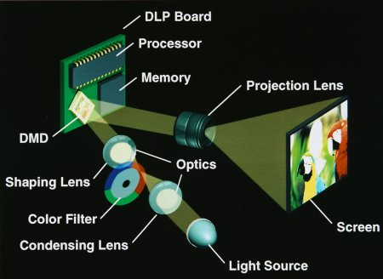
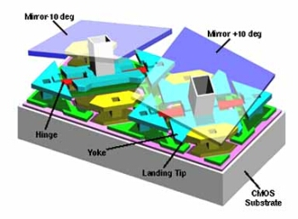
Projectors
LCD projector
basically LCD panel with very bright backlight
DLP (“digital light processing”)
uses a digital micromirror device instead of LCD

Slide 14
Today’s Topics
Displays
Pointing devices

Slide 15
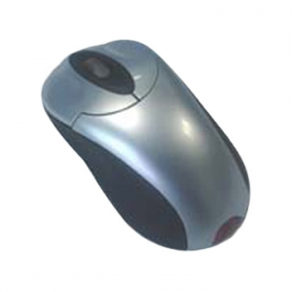
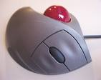
Pointing Devices
Mouse
Touchpad
Joystick
Trackball
Notes:
Mouse
Touchpad
Trackpoint
Trackball
Focusing on indirect pointing devices today – Friday’s lecture will say more about direct touch on the screen

Slide 16
Properties of Pointing Devices
Direct vs. indirect
Direct touch on screen
Indirect control of mouse pointer
Relative vs. absolute
Throughput
Control/display (C/D) ratio
Notes:
more about direct touch on Friday
mouse vs. trackball: Mackenzie et al. “A Comparison of Input Devices in Elemental Pointing and Dragging Tasks.” CHI 1990.
mouse vs. trackball vs. touchpad vs. joystick: MacKenzie et al, “Accuracy Measures for Evaluating Computer Pointing Devices”, CHI 2001.
http://www.yorku.ca/mack/CHI01.htm

Slide 17
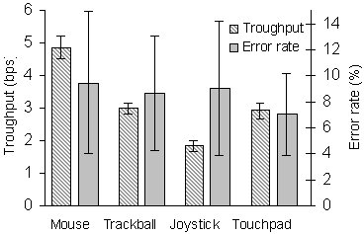
Throughput
Throughput
also called index of performance
mouse: 5 bits/sec
trackball: 3 bits/sec
touchpad: 3 bits/sec
joystick: 2 bits/sec
T = a + b log (D/S + 1) seconds
ID = log (D/S + 1) bits
IP = 1/b bits/second

Slide 18
Control/Display Ratio
Control: how far user’s hand moves
in meters
Display: how far cursor moves on screen
in pixels
Direct touch: C/D = 1
Mouse acceleration
No acceleration
With acceleration

Slide 19
Semantic Pointing
Adapt the C/D ratio to the targets on screen
Highly likely targets have high C/D ratio => pointer moves more slowly, target feels sticky
Less likely targets have low C/D ratio => pointer moves fast, slips over them
“Look” is unchanged
...but “feel” is different
Notes:
Blanch et al. “Semantic pointing: improving target acquisition with control-display ratio adaptation.” CHI 2004.
demo at http://www.infres.enst.fr/~blanch/projects/SemanticPointing/demo/

Slide 20
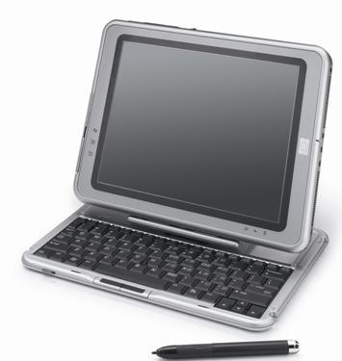
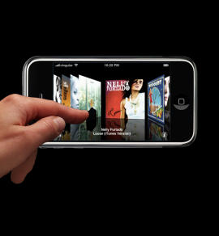
Direct Touch
Mouse = indirect pointing
Stylus or finger = direct pointing

Slide 21
Technology for Direct Touch
Resistive
Two conductive sheets with a gap between
Responds to finger, stylus, any object
Capacitive
Human skin changes surface capacitance
Responds only to bare skin
Inductive
EM field from tablet induces signal from stylus
Responds only to special (expensive!) stylus
Optical
Camera watches the surface
Responds to anything

Slide 22
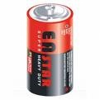
Resistive Touch Sensing

Slide 23
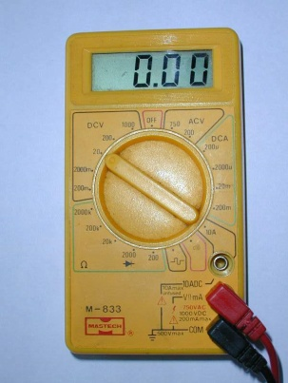
Resistive Touch Sensing
1 V

Slide 24
Resistive Touch Sensing
2 V

Slide 25
Resistive Touch Sensing
Stripped Wire

Slide 26
Resistive Touch Sensing
Stripped Wire

Slide 27
Resistive Touch Sensing
3 V
Stripped Wire

Slide 28
Resistive Touch Sensing

Slide 29
Resistive Touch Sensing

Slide 30
Resistive Touch Sensing
3 V

Slide 31
Resistive Touch Sensing
3 V
3

Slide 32
Resistive Touch Sensing
3

Slide 33
Resistive Touch Sensing
3
2 V

Slide 34
Resistive Touch Sensing
3
2
2 V

Slide 35
Resistive Touch Sensing

Slide 36
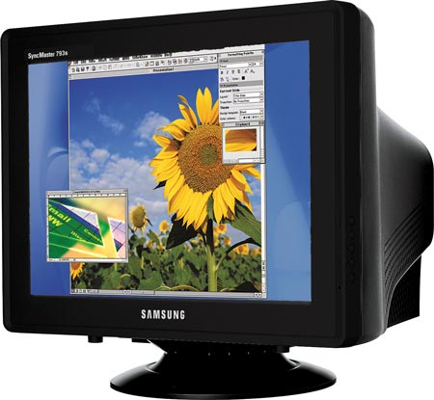
Resistive Touch Sensing

Slide 37
Resistive Touch Sensing

Slide 38
Resistive Touch Sensing
75%

Slide 39
Resistive Touch Sensing
75%
☺
Fast
Accurate
Finger or Stylus

Slide 40
Resistive Touch Sensing
Not Multi-touch
☹
75%
☺
Fast
Accurate
Finger or Stylus

Slide 41
Capacitive Touch Sensing

Slide 42
Capacitive Touch Sensing
-
-
-
-
-
-
-
-
-
-
-
-
-
-
-
-
-

Slide 43
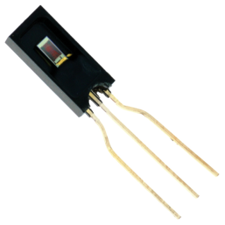
Capacitive Touch Sensing
-
-
-
-
-
-
-
-
-
-
-
-
-
-
-
-
-

Slide 44
Capacitive Touch Sensing
20 C
-
-
-
-
-
-
-
-
20 C
-
-
-
-
-
20 C
-
-
-
-
20 C

Slide 45
Capacitive Touch Sensing
20 C
-
-
-
-
-
-
-
-
20 C
-
-
-
-
-
20 C
-
-
-
-
20 C

Slide 46
Capacitive Touch Sensing
20 C
-
-
-
-
-
-
-
-
-
20 C
-
-
-
-
20 C
-
-
-
-
20 C

Slide 47
Capacitive Touch Sensing
17 C
-
-
-
-
-
-
-
-
-
19 C
-
-
-
-
15 C
-
-
-
-
17 C

Slide 48
Capacitive Touch Sensing
17 C
-
-
-
-
-
-
-
-
-
19 C
-
-
-
-
15 C
-
-
-
-
17 C

Slide 49
Capacitive Touch Sensing
17 C
-
-
-
-
-
-
-
-
-
19 C
-
-
-
-
15 C
-
-
-
-
17 C

Slide 50
Capacitive Touch Sensing
-
-
-
-
-
-
-
-
-
-
-
-
-
-
-
-
-

Slide 51
Capacitive Touch Sensing
-
-
-
-
-
-
-
-
-
-
-
-
-
-
-
-
-

Slide 52
Capacitive Touch Sensing
90%
-
-
-
-
-
-
-
-
-
-
-
-
-
-
-
-
-

Slide 53
Capacitive Touch Sensing
Bare Finger or Conducting Stylus
90%
-
-
-
-
-
-
-
-
-
-
-
-
-
-
-
-
-
Not multi-touch

Slide 54
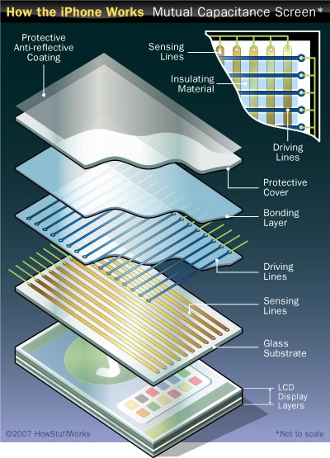
Projected Capacitive Touch Sensing
Multi-touch

Slide 55
Inductive Touch Sensing

Slide 56
Inductive Touch Sensing
EM Field

Slide 57
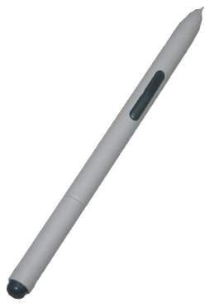
Inductive Touch Sensing

Slide 58
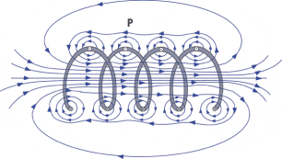
Inductive Touch Sensing

Slide 59
Inductive Touch Sensing

Slide 60
Inductive Touch Sensing
?

Slide 61
Inductive Touch Sensing
Expensive ☹
☹
Not Multi-touch

Slide 62
Vision Touch Sensing

Slide 63
Vision Touch Sensing

Slide 64
Vision Touch Sensing
Light is faster through air than glass,
so it over-shoots and heads back into glass

Slide 65
Vision Touch Sensing
Light is slower through a finger than glass,
and the finger diffuses the light

Slide 66
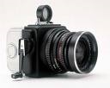
Vision Touch Sensing

Slide 67
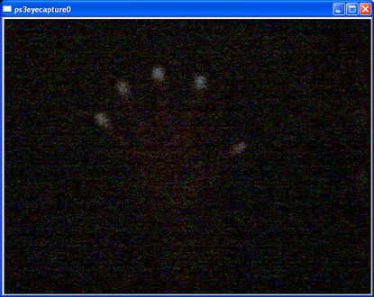
Vision Touch Sensing

Slide 68
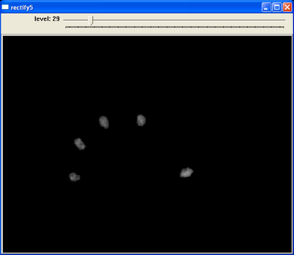
Vision Touch Sensing

Slide 69
Vision Touch Sensing
Infrared

Slide 70
Vision Touch Sensing

Slide 71
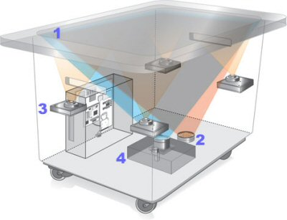
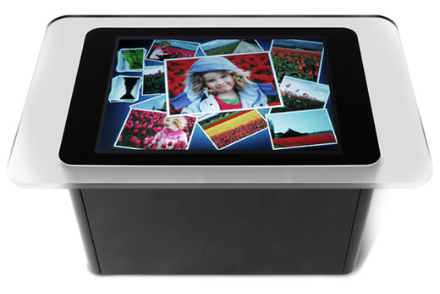
Microsoft Surface

Slide 72
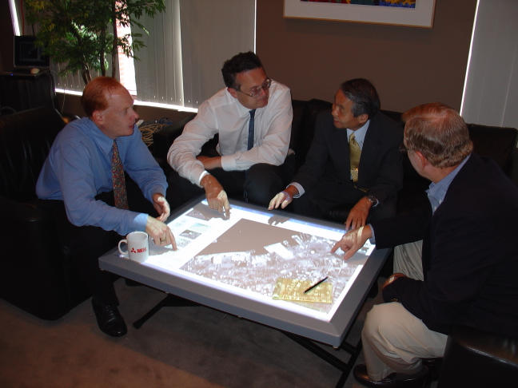
DiamondTouch Table (MERL)
Notes:
designed for multiple users around a tabletop
rotation becomes an important issue
multiple users (and multiple touches per user) are identified by an array of transmitting antennas in the surface and sensors connected to their chairs
front-projected (because the antenna array is presently opaque), so occlusion of the display is worse

Slide 73
Issues for Direct Touch Technology
Finger only, stylus only, or both
Pressure sensitivity
Hovering vs. clicking
Occlusion of display by finger or hand
“Fat finger” problem
Multitouch
Tactile feedback
Multiple users

Slide 74
Summary
Displays
CRT, LCD, e-paper, projector
Dimensions, density, refresh rate, color depth
Pointing devices
Mouse, touchpad, joystick, trackpad
Throughput, C/D ratio
Keyboards
QWERTY, Dvorak, alphabetical
Typing speed, finger movement

