Slide 1
Lecture 24: Animation
HW2 out, due next Sunday
look for your evaluation assignment on Stellar
No class on Wed (meet with your TA instead)
Notes:
Consider adding CSS3 features (animations and transitions) to this lecture.

Slide 2
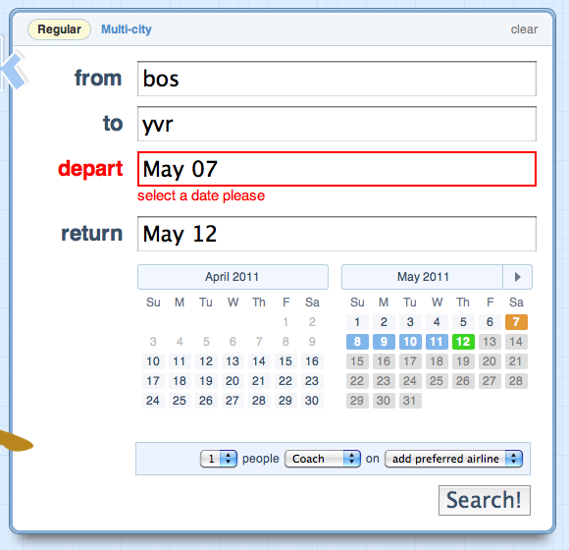
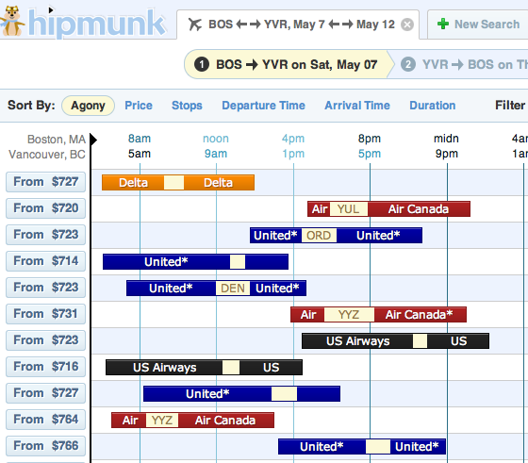
UI Hall of Fame or Shame?
Notes:
For today’s hall of fame and shame, let’s talk about Hipmunk.com, a flight searching web site. Let’s discuss:
simplicity
error handling
graphic design and use of visual variables
efficiency

Slide 3
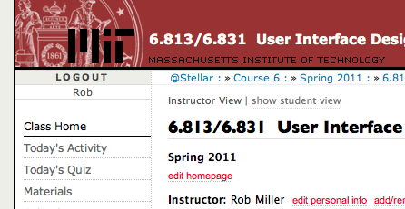
Nanoquiz
closed book, closed notes
submit before time is up (paper or web)
we’ll show a timer for the last 20 seconds

Slide 4
20
19
18
17
16
15
14
13
12
11
10
9
8
7
6
5
4
3
2
1
0
Which of the following are important elements of a heuristic evaluation? (choose all good answers) A. Justifying the problem by naming a design guideline B. Explaining the problem C. Describing the user population that will suffer from the problem D. Sketching a new design of the user interface that will solve the problem E. A screenshot illustrating the problem
Which of the following usability dimensions is heuristic evaluation useful for? (choose all good answers) A. learnability B. visibility C. efficiency D. errors
Suppose you’re building a user interface for self-checkout of equipment from an MIT robotics lab. Which of the following people would be the best choice for heuristic evaluation of this interface? (choose one best answer) A. Kate, a UI designer in your design team B. Lisa, a UI designer outside your design team C. Penny, a robotics student with no UI design experience D. Gina, who sells flowers next to the Kendall T

Slide 5
Today’s Topics
Design principles
Frame animation
Property animation
Pacing & path
Notes:
Today we’re going to talk about using animation in graphical user interfaces.
Some might say, based on bad experiences with the Web, that animation has no place in a usable interface. Indeed, the <blink> tag originally introduced by the Netscape browser was an abomination. And many advertisements on the Web use animation to grab your attention, which distracts you from what you’re really trying to do and makes you annoyed. So animation has gotten a bad rap in UI.
Others complain that animation is just eye candy – it makes interfaces prettier, but that’s all.
But neither of those viewpoints is completely fair. Used judiciously, animation can make an important contribution to the usability of an interface. And it’s not as hard to implement as you might think. We’ll talk about both design issues and implementation today.

Slide 6
Why Animation?
Games
Simulations
Tutorials
Video players
Notes:
Why would we want to use animation in a GUI?
First, it might be an essential part of the application itself. Games and educational simulations generally have to use animation to be realistic and engaging, because they’re simulating a virtual world in which time passes and things move. And a video player would be pointless if the moving pictures didn’t actually move.

Slide 7
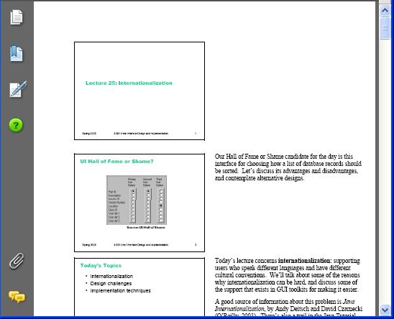
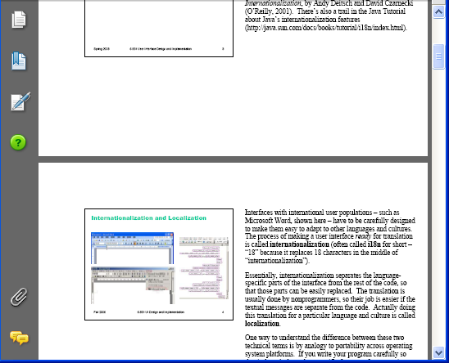
Animation for Feedback
Visualizing changes not made by user
Keeping the user oriented during transitions
Displaying progress
Notes:
Even if the application’s main purpose isn’t animation, animation can enhance feedback, by drawing attention to and explaining changes in the display that would otherwise be hard to follow and understand. One example is a change that was not made by the user – due to actions by other users in a multi-user application, or actions by the software itself. A move made on a checkerboard by another player is an example of a change that might be animated.
Another change is a major transition in the viewpoint of the display, because a sudden drastic shift can disorient the user. What happened? Which direction did I go? How would I get back to where I was before? Scrolling around a large space, or zooming in or out, are examples of these transitions. Problems tend to occur not when the transition is under direct manipulation control (e.g. dragging a scrollbar thumb), but rather when it happens abruptly due to a button press (Page Up) or other action (Zoom pulldown menu, hyperlink press, another user or computer action, etc.) Animating the transition as if the user had done it with fast direct manipulation helps the user stay oriented.
Animation can also be used for progress feedback, to show that something is still happening. Here, the animation basically reassures the user that the program hasn’t crashed. The “throbber” on a web browser (that spinning earth or stomping Mozilla or whatever) is an example of this kind of animation; it’s probably the most trivial kind to do.

Slide 8
Animation for Help
“Animated icons”
Moving mouse around to show how to use UI
Notes:
Animation can also be used for help. There was some research back in the early 90s on animated toolbar icons, which showed a little movie of how the tool worked when you hovered over with your mouse (Baecker, Small & Mander, “Bringing Icons to Life”, 1991). The example shown here (reproduced from the paper) shows the Line tool in a drawing program. A study of 8 users (with varying experience with drawing programs) found that the animation was indeed more effective for helping them correctly understand the icon. For example, novice users typically interpreted the static Paint Bucket icon as a “graduation cap” (i.e., a mortarboard). The animation clarified what it actually did (although one user still called it the “graduation cap that tips paint” after seeing the animation).
Documentation and tutorials can also demonstrate how to use the interface by actually moving the mouse pointer around. (Java has support for this in the java.awt.Robot class, for example.)

Slide 9
Animation for Engagement
Reinforcing illusion of direct manipulation
Aesthetic appeal and engagement
Notes:
Animation also has some subjective and perceptual effects (we’re getting closer to the eye candy argument now, but subjective satisfaction matters too). Animation makes interfaces more lively and engaging, more appealing. It also reinforces the illusion of the physical simulation provided by direct manipulation. If, rather than teleporting instantly from one place to another, objects in the GUI world have to move through the intervening space, then it makes the interface look more physical.

Slide 10
Animation Isn’t Always Needed
Existing events are often enough to provide incremental screen changes
User’s mouse events drive scrolling
Program events can drive a progress bar
But bursty or slow events may need animation
Short distances and short time periods
time < 100 ms
distance < width of the moving object
Notes:
Fortunately, it turns out that in many cases, you don’t need to do anything special to obtain the benefits of animation.
Many event-driven parts of a GUI are already incremental. If the user is dragging the scrollbar thumb, then they’re basically animating the interface themselves – you don’t need to do anything special. (Although we’ll discuss something called motion blur in a moment that may be worth adding to enhance the visual effect.) Similarly, backend events (like bytes read from a file or files copied) may be able to make progress feedback appear animated, simply by coming often enough so that the progress bar fills in smoothly. But if the backend events are bursty or have long gaps between them, you may need to supplement with animation. That’s why web browsers have an animated throbber – because sometimes network connections just sit there generating no backend events to drive the progress.
If feedback is very brief, or a transition very short in distance, then animation is likewise unnecessary. If an object moves on the screen by a distance less than its width, then it’s probably not worth animating that transition. Animations shorter than 100 msec will probably be too fast to be noticed.

Slide 11
Design Principles
Frame rate
Motion blur
Cartoon principles
Short and simple
Notes:
Here are some basic design principles for animation in a GUI.

Slide 12
Frame Rate
Frame rate > 20 frames per second
10 fps is convincing but looks jerky
Film is 24 fps, TV (NTSC) 30 fps
Refresh rate vs. frame rate
Notes:
First, the frame rate should be at least 20 frames per second – i.e., the animation should make an incremental change at least 20 times per second. If animation is the main purpose of the program, then it should be willing to throw CPU cycles into even higher frame rates to improve smoothness and realism. As a guideline, film and TV signals are typically 24-30 fps.
But for feedback, 20 fps is plenty. Feedback animation should be secondary to the real work of the program, and shouldn’t dominate CPU time.
Keep in mind that there’s a difference between the frame rate of an animation and the refresh rate of the whole display system. The refresh rate of a display system is the rate at which the screen is reilluminated. For CRTs, this is the rate that the electron guns sweep across the entire screen illuminating phosphors. Since the phosphors fade if not repeatedly hit by the electron gun, a slow refresh rate will cause the screen to darken between sweeps – producing a noticeable flicker that the eye can perceive. (The flickering is actually more noticeable in peripheral vision, because rods respond more quickly than cones.) The shutter on a film projector has a similar problem, since it makes the movie screen flash between bright and dark. So it actually opens and closes faster than 24 times a second – typically 48 Hz or 72 Hz – in order to make the flicker less perceptible. As a result, each frame of a film is illuminated 2 or 3 times before the projector stutters ahead to the next frame.
So a 20fps animation may be convincing , but if it’s displayed on a CRT using a 20Hz refresh rate, it will have a very noticeable flicker.

Slide 13
Motion Blur
Big discontinuous jumps are disruptive
Use motion blur if object moves more than its width between frames
Smear of color
Multiple overlapping images
Notes:
Big jumps are disruptive, so pay attention when you’re using low frame rates with high object speeds. In the real world, an object doesn’t disappear from one place and reappear in another – it passes through the intervening points, and even if it moves too fast for us to focus on it, it leaves an impression of its path in our visual system – a smear. That smear is called motion blur. If an object is moving so fast that it moves more than its own width between frames, leaving a visible gap between subsequent images of the object, then you should consider filling in the gap with simulated motion blur. Two common ways to do it: (1) a smear of the object’s color, and (2) simply drawing multiple overlapping images of the object. Another solution is to crank up the frame rate, if that’s possible.

Slide 14
Cartooning Principles
Solidity (motion blur, fading in/out)
Anticipation (wind up before starting to move)
Slow-in/slow-out
Follow through (wiggle back and forth when stopping)
Notes:
There are several useful ways to use animation to enhance the illusion of direct manipulation (Chang & Ungar, “Animation: From Cartoons to the User Interface”, UIST ’93, http://doi.acm.org/10.1145/168642.168647), which were originally drawn from the experience of Disney cartoonists (J. Lasseter, “Principles of Traditional Animation applied to 3D Computer Animation”, SIGGRAPH ‘87, http://doi.acm.org/10.1145/37401.37407).
The principle of solidity says that the animated behavior of an object should give clues about its squishiness – so a ball, when it strikes the ground, should flatten out into an ellipse before rebounding. (See http://www.siggraph.org/education/materials/HyperGraph/animation/character_animation/principles/bouncing_ball_example_of_slow_in_out.htm for an example.) Most objects in GUIs are rigid, so the solidity principle is mostly about preventing high-speed GUI objects from appearing to teleport across the screen (using motion blur), and having them fade into and out of view rather than appearing and disappearing abruptly.
Anticipation means that an object winds up a bit (moving backwards to get more leverage) before starting a motion. The wind-up draws the user’s attention, and resembles what animate creatures in the real world do when they move. Slow-in, slow-out describes how a realistic animation should be paced – rather than keeping a constant speed throughout, the object should accelerate up to a cruising speed, and then decelerate to a stop. Finally, follow-through says that objects should wiggle back and forth a bit when they finish a motion, to expend the remaining kinetic energy of the motion. (For examples of all these effects, see Daniel Bodinof, Principles of Animation, http://www.kirupa.com/developer/flash8/principles_animation_pt2_pg1.htm)

Slide 15
Short and Simple
Keep feedback animation short
Many users will wait for it to stop before continuing
Use animation sparingly
Constant motion is distracting and agitating
Notes:
Feedback animations should be kept short. Many users will wait for it to stop before continuing, so there’s a tradeoff between the duration of the animation and the efficiency of the interface. Don’t block user control – allow the user to start on their action while the animation is still going on.
Finally, use animation judiciously. As we know from ads on web sites, constant motion is distracting and agitating.

Slide 16
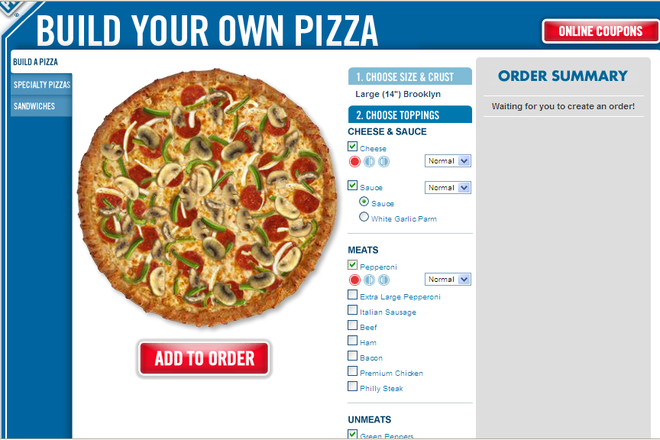
Good Feedback Animation
suggested by Jonathan Goldberg
Notes:
We’ve talked about the Domino’s Pizza ordering site before. This UI has excellent animated feedback. First, it’s very short, so the user won’t lose efficiency waiting for the animation to end. Second, the toppings rain down on the pizza as individual pieces, which helps distinguish them from the possibly complex state of existing toppings. So the explanatory part of the animation is also successful.

Slide 17
Pixel Approach: Frame Animation
Frame animation
Animated GIF
Or loop through a sequence of images yourself (using drawImage() or showing/hiding image objects)
Notes:
Now let’s focus on how to implement animation, starting with animations in the pixel model.
Frame animation is probably the easiest kind of animation. It consists of a sequence of images, each a little different from the previous, that are displayed at regular intervals. Most of the moving pictures you know -- movies, television, digital video – work this way. Animated GIFs are an easy and widely supported way to put frame animation into a GUI. GIFs have only 8-bit color resolution, unfortunately; if you need richer color, look at APNG (Animated PNG), which is supported by some browsers but not accepted as a standard, or MNG, which is promoted by a standards group but supported by even fewer browsers. Still another choice is to do it yourself, by displaying a sequence of PNGs.

Slide 18
Pixel/Stroke Approach: Event Loop
Approach
Set a periodic timer for 1/frame rate
Repaint your canvas every timer tick
Use the current clock time to compute positions/sizes/etc to draw animated objects
Stop timer when animation complete or interrupted
May be hard to achieve smooth animation
Event-handling may be bursty
Getting from timer tick to paint method requires two passes through event queue
Processing user input events has priority over animation repaints
Notes:
Suppose you can’t use animated GIFs. How do you animate changes to a pixel model or stroke model output?
When animation is merely used a feedback or help effect in an application that otherwise isn’t concerned with animation, the best solution is the event loop approach. The basic idea is to use a timer object (such as javax.swing.Timer), which delivers periodic events to the GUI event queue. Set the timer interval to the desired frame rate (e.g. 50 msec for 20 fps). Every time the timer fires, use the current clock time to determine where to redraw the objects. Stop the timer when the animation is done.
This technique integrates very well with an existing GUI application, because automatic-redraw and input-handling support of the GUI toolkit continue to be supported even while the animation runs.
But this is also the main drawback of the event-loop approach. Event handling is often bursty, and user input events generally get priority over repaints, so the animation may be jerky if the user is (e.g.) typing or waving the mouse around. Also, getting from the timer tick (when the timer fires) to actually updating the screen (painting the next step of the animation) requires two passes through the event queue: first the timer event is put on the queue, and then it’s handled merely by putting a repaint event on the queue.
So animation has low priority in an implementation like this – but that’s appropriate if it’s just used for feedback.

Slide 19
Pixel/Stroke Approach: Animation Loop
Tight animation loop approach
Repeat as fast as possible,
Check and handle input events
Paint everything for current clock time
(Optional: sleep a bit to yield to other processes)
Notes:
Applications that demand smooth, high-frame-rate animations often forgo the standard GUI event loop and write their own animation loop. This custom loop can give greater priority to the animation, and it can avoid overhead like managing damage rectangles by just assuming that most of the screen will have to be repainted every frame. It can also maximize the frame rate for the user’s processor, simply by running at top speed, without having to configure a timer with a fixed frame rate.
A tight animation loop like this often used for games and simulations, but it doesn’t mesh well with the component model of a standard UI toolkit, which expects you to use the event loop and automatic redraw. So programs that use tight custom animation loops often do not use standard widgets from a toolkit.
Don’t mix these two approaches. In particular, don’t try to implement animated feedback by putting a tight animation loop inside an event handler. (Why not? What will happen?)

Slide 20
Component Approach: Property Animation
Set periodic timer
Every timer tick, update component properties as a function of current clock time
Position, size, color, opacity
Notes:
The component model enables a more modular approach to animation. Rather than putting animation code into the paint method, we can simply update the changing properties of the component (position, size, etc.) on every timer tick. So the animation effect can be entirely decoupled from the component itself (as long as the component exposes properties for all the visual effects we might need to animate). This technique is called property animation.

Slide 21
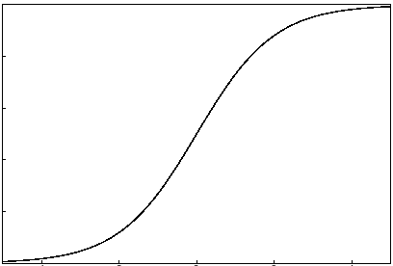
Easing and Path
Easing function maps time t to parameter s [0,1]
Linear: s = t / duration
Slow-in/slow-out
s ~ atan(t)
s ~ 1/(1+e^-t)
Path function maps s to property value v
Linear: [x,y] = (1-s) [x₀,y₀] + s [x₁,y₁]
Quadratic Bezier curve: (x,y) = (1-s)² [x₀,y₀] + 2s(1-s) [x₁,y₁] + s² [x₂,y₂]
Color: HSV vs. RGB
Notes:
Pacing and path are relevant to animating both stroke and component models.
Easing concerns how the animation evolves over time. It’s a function that maps clock time to an abstract parameter, usually 0 to 1, representing the completeness of the animation (0% to 100%). Easingis how you can implement slow-in/slow-out. Slow-in/slow-out is done with a sigmoid (S-shaped) function. The arctangent is a good, easy sigmoid; so is 1/(1+e^-x). Note that you have to tweak the domain and range of these functions so that the desired time domain (0 to the duration of the animation) maps to the desired s-parameter range (typically 0..1). Normally arctangent maps the domain [-inf, +inf] to the range [–PI/2, PI/2].
Path describes how the animated property moves through its value space. For position, this is easy – it’s the curve of points that the position traces out. If you want to add some visual appeal to a moving object, make it move through an arc. A quadratic Bezier curve has this effect and is trivial to implement – you just need a control point between the start point and end point. (The control point pulls the curve away from the straight line between the endpoints – to be precise, the curve is tangent at each endpoint to the line that connects the endpoint with the control point.)
For 1-dimensional properties, like size or opacity (alpha value), it’s just a starting point and an ending point. For multidimensional properties like color, you’ll want to think about what color space the path should go through, and whether you want the path to be simply a line in that color space or something more complicated. For color animation, it may be more effective to animate in HSV space.

Slide 22
Property Animation in jQuery
$(“#menu”).animate(
{
opacity: 0.0,
width: 0px
},
200,
“linear”
);
property target values
duration (in milliseconds)
easing function
Notes:
jQuery has nice support for CSS property animation. You can set up an animation using a single call to the animate() method, which takes a set of properties and their target values. For example, if you specify “opacity: 0.0”, then the animation will change the opacity property steadily from its initial value (which might be 1.0 if the object is currently opaque) until it reaches the target value. You also specify a duration for the whole animation (a simple shortcut here is “fast”, which is 200ms, or “slow”, which is 600ms – take those to heart!). And you can specify an easing function. By default, jQuery uses slow-in-slow-out easing, but you can switch to linear easing, or if you install the jQuery UI easing plugin, you get a whole basket of different sigmoid functions (sines, polynomials, exponentials) and anticipation and bouncing to boot. See http://james.padolsey.com/demos/jquery/easing/ for a great demo of these various easing functions that graphs their actual behavior.

Slide 23
Summary
Animation is useful for feedback and explanation
Use cartooning effects like motion blur
Often implemented with timers

