Slide 1
Lecture 18: Graphic Design
GR3 due tonight at midnight
PS3, RS3 released, due Sunday
GR4 released, due in 2 weeks
Notes:
There is TOO MUCH in this lecture.
Add SATURATION as a visual variable. Make sure to update the visual variables slide in L19 too.
“Characteristics of Visual Variables” is a terrible slide. The properties (NOQ) need to have examples, with pictures of how it’s done right & wrong. Similarly, the length needs examples.

Slide 2
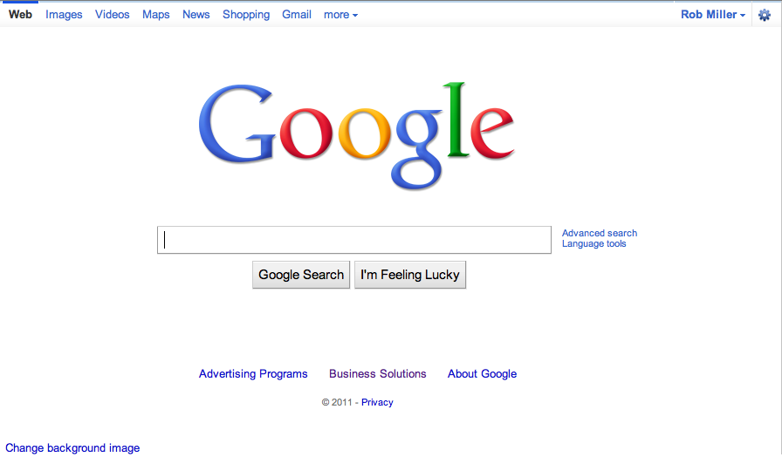
UI Hall of Fame or Shame?
Notes:
Google is an outstanding example of aesthetic and minimalist design. Its interface is as simple as possible. Unnecessary features and hyperlinks are omitted, lots of whitespace is used. Google is fast to load and trivial to use.
But maybe Google goes a little too far! Take the perspective of a completely novice user coming to Google for the first time.
What does Google actually do? The front page doesn’t say.
What should be typed into the text box? It has no caption at all.
The button labels are almost gibberish. “Google Search” isn’t meaningful English (although it’s gradually becoming more meaningful as Google enters the language as a noun, verb, and adjective). And what does “I’m Feeling Lucky” mean?
Where is Help? Turns out it’s reachable from About Google, but the scent isn’t too strong for that.
Although these problems would be easy for Google to fix, they are actually minor, because Google’s interface is simple enough that it can be learned by only a small amount of exploration. (Except perhaps for the I’m Feeling Lucky button, which probably remains a mystery until a user is curious enough to hunt for the help. After all, maybe it does a random choice from the search results!)
Notice that Google does not ask you to choose your search domain first. It picks a good default (web pages), includes a mix of results if they seem relevant (e.g. images & videos & maps too, not purely web pages), and makes it easy to change.

Slide 3
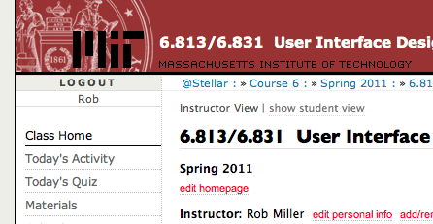
Nanoquiz
closed book, closed notes
submit before time is up (paper or web)
we’ll show a timer for the last 20 seconds

Slide 4
20
19
18
17
16
15
14
13
12
11
10
9
8
7
6
5
4
3
2
1
0
A good prototyping technique for evaluating efficiency is: (choose one best answer) A. task analysis B. scenario C. computer prototype D. paper prototype E. Wizard of Oz
Which of the following are advantages of paper as a prototyping technique? (choose all good answers) A. It’s cheaper than coding B. A paper prototype can’t be shipped as the final product C. Users may act more deliberately when using a paper prototype D. Hand-sketching encourages different kinds of feedback from users
Suppose you’re designing a new tab bar for Internet Explorer, and you build a paper prototype of the tab bar. Which of the following areas will have the best fidelity in this prototype? (choose one best answer) A. look B. feel C. breadth D. depth
Notes:
Which of the following is best for testing the interactive feedback of the interface? (Choose one answer)
A. Paper prototype
B. Computer prototype
C. Wizard of Oz
Answer: B

Slide 5
Today’s Topics
Human perception
Chunking
Visual variables
Gestalt principles of grouping
Graphic design guidelines
Simplicity
Contrast
White space
Balance
Alignment
Notes:
Today, we’re going to look at some guidelines for graphic design. These guidelines are drawn from the excellent book Designing Visual Interfaces by Kevin Mullet and Darrell Sano (Prentice-Hall, 1995). Mullet & Sano’s book predates the Web, but the principles it describes are timeless and relevant to any visual medium.
Another excellent book is Edward Tufte’s The Visual Display of Quantitative Information. Some of the examples in this lecture are inspired by Tufte.
Still another good book is Colin Ware, Information Visualization: Perception for Design, Morgan Kaufmann, 2000. Ware’s book is much more technically and scientifically oriented than Mullet & Sano or Tufte. Ware discusses the psychological and anatomical basis for perception, while relating it to practical design principles. MIT Libraries have an electronic version of Ware’s book that you can read online.

Slide 6
Simplicity
“Perfection is achieved not when there is nothing more to add, but when there is nothing left to take away.”
Antoine de St-Exupery
“Simplicity does not mean the absence of any decor… It only means that the decor should belong intimately to the design proper, and that anything foreign to it should be taken away.”
Paul Jacques Grillo
“Keep it simple, stupid.” (KISS)
“Less is more.”
“When in doubt, leave it out.”
Notes:
Okay, we’ll shout some slogans at you now. You’ve probably heard some of these before. What you should take from these slogans is that designing for simplicity is a process of elimination, not accretion. Simplicity is in constant tension with task analysis, information preconditions, and other design guidelines, which might otherwise encourage you to pile more and more elements into a design, “just in case.” Simplicity forces you to have a good reason for everything you add, and to take away anything that can’t survive hard scrutiny.

Slide 7
Techniques for Simplicity: Reduction
Remove inessential elements
Notes:
Here are three ways to make a design simpler. We talked about two of these techniques in the design sketching lecture; here we’ll focus on the graphic design aspects.
We talked about reduction means that you eliminate whatever isn’t necessary. This technique has three steps: (1) decide what essentially needs to be conveyed by the design; (2) critically examine every element (label, control, color, font, line weight) to decide whether it serves an essential purpose; (3) remove it if it isn’t essential. Even if it seems essential, try removing it anyway, to see if the design falls apart.
Icons demonstrate the principle of reduction well. A photograph of a pair of scissors can’t possibly work as a 32x32 pixel icon; instead, it has to be a carefully-drawn picture which includes the bare minimum of details that are essential to scissors: two lines for the blades, two loops for the handles. The standard US Department of Transportation symbol for handicapped access is likewise a marvel of reduction. No element remains that can be removed from it without destroying its meaning.
We’ve already discussed the minimalism of Google and the Tivo remote in earlier classes. Here, the question is about functionality. Both Google and Tivo aggressively removed functions from their primary interfaces. There’s a good NY Times article about the Tivo design process (http://query.nytimes.com/gst/fullpage.html?res=9c0de2d6123df93aa25751c0a9629c8b63).

Slide 8
Techniques for Simplicity: Regularity
Use a regular pattern
Limit inessential variation among elements
Notes:
For the essential elements that remain, consider how you can minimize the unnecessary differences between them with regularity. Use the same font, color, line width, dimensions, orientation for multiple elements. Irregularities in your design will be magnified in the user’s eyes and assigned meaning and significance. Conversely, if your design is mostly regular, the elements that you do want to highlight will stand out better.
PowerPoint’s Text Layouts menu shows both reduction (minimalist icons representing each layout) and regularity. Titles and bullet lists are shown the same way.

Slide 9
Techniques for Simplicity: Double-Duty
Combine elements for leverage
Find a way for one element to play multiple roles
title bar
scrollbar thumb
selection handles
help prompt
Notes:
Finally, you can combine elements, making them serve multiple roles in the design. We talked about this “double duty” idea in the design sketching lecture. For example, the “thumb” in a scroll bar actually serves three roles. It affords dragging, indicates the position of the scroll window relative to the entire document, and indicates the fraction of the document displayed in the scroll window. Similarly, a window’s title bar plays several roles: label, dragging handle, window activation indicator, and location for window control buttons.

Slide 10
Chunking
“Chunk”: unit of perception or memory
Chunking depends on:
What you already know
How the information is presented
Hard: M W B C R A L O A B I M B F I
Easier: MWB CRA LOA BIM BFI
Easiest: BMW RCA AOL IBM FBI
3-4-character chunking is good for presenting unrelated digits or letters
Notes:
Presentation of information can often be simplified by dividing it up. The elements of perception and memory are called chunks, which we first saw in the learnability lecture.
It turns out that our working memory is helped by presenting material in an organized way. With lists of 4 items or fewer, it doesn’t matter – unorganized lists are as easy to remember as organized ones. But for lists longer than 4 items, uncued recall of organized lists is far better. There’s a clear implication for HCI here: that long lists should be organized.
Our ability to form chunks in working memory depends strongly on how the information is presented – a sequence of individual letters tend to be chunked as letters, but a sequence of three-letter groups tend to be chunked as groups. It also depends on what we already know. If the three letter groups are well-known TLAs (three-letter acronyms) with well-established chunks in long-term memory, we are better able to retain them in working memory.
If you have to display a long number or a long code, you should divide it into shorter chunks for presentation. 3-4 characters per chunk is a good rule of thumb.

Slide 11
Contrast & Visual Variables
Contrast encodes information along visual dimensions
value
hue
texture
shape
position
orientation
size
Notes:
Contrast refers to perceivable differences along a visual dimension, such as size or color. Contrast is the irregularity in a design that communicates information or makes elements stand out. Simplicity says we should eliminate unimportant differences. Once we’ve decided that a difference is important, however, we should choose the dimension and degree of contrast in such a way that the difference is salient, easily perceptible, and appropriate to the task.
Crucial to this decision is an understanding of the different visual dimensions. Jacques Bertin developed a theory of visual variables that is particularly useful here (Bertin, Graphics and Graphics Information Processing, 1989). The seven visual variables identified by Bertin are shown above. Bertin called these dimensions retinal variables, in fact, because they can be compared effortlessly without additional cognitive processing, as if the retina were doing all the work.
Each column in this display varies along only one of the seven variables. Most of the variables need no explanation, except perhaps for hue and value. Hue is pure color; value is the brightness or luminance of color. (Figure after Mullet & Sano, p. 54).

Slide 12
Characteristics of Visual Variables
Scale = kinds of comparisons possible
Nominal (=)
All variables
Ordered (<, >)
Ordered: position, size, value, texture granularity
Not ordered: orientation, hue, shape
Quantitative (amount of difference)
Quantitative: position, size
Not quantitative: value, texture, orientation, hue, shape
Length = number of distinguishable levels
Shape is very long (infinite variety)
Position is long and fine-grained
Orientation is very short (~ 4 levels)
Other variables are in between (~ 10 levels)
Notes:
The visual variables are used for communication, by encoding data and drawing distinctions between visual elements. But the visual variables have different characteristics. Before you choose a visual variable to express some distinction, you should make sure that the visual variable’s properties match your communication. For example, you could display a temperature using any of the dimensions: position on a scale, length of a bar, color of an indicator, or shape of an icon (a happy sun or a chilly icicle). Your choice of visual variable will strongly affect how your users will be able to perceive and use the displayed data.
Two characteristics of visual variables are the kind of scale and the length of the scale.
A nominal scale is just a list of categories. Only comparison for equality is supported by a nominal scale. Different values have no ordering relationship. The shape variable is purely nominal. Hue is also purely nominal, at least as a perceptual variable. Although the wavelength of light assigns an ordering to colors, the human perceptual system takes no notice of it. Likewise, there may be some cultural ordering imposed on hue (red is “hotter” than blue), but it’s weak, doesn’t relate all the hues, and is processed at a higher cognitive level.
An ordered scale adds an ordering to the values of the variable. Position, size, value, and to some extent texture (with respect to the grain size of the texture) are all ordered.
With a quantitative variable, you can perceive the amount of difference in the ordering. Position is quantitative. You can look at two points on a graph and tell that one is twice as high as the other. Size is also quantitative, but note that we are far better at perceiving quantitative differences in one dimension (i.e., length) than in two dimensions (area). Value is not quantitative; we can’t easily perceive that one shade is twice as dark as another shade.
The length of a variable is the number of distinguishable values that can be perceived. We can recognize a nearly infinite variety of shapes, so the shape variable is very long, but purely nominal. Position is also long, and particularly fine-grained. Orientation, by contrast, is very short; only a handful of different orientations can be perceived in a display before confusion starts to set in. The other variables lie somewhere in between, with roughly 10 useful levels of distinction, although size and hue are somewhat longer than value and texture.

Slide 13
Selectivity
Selective perception: can attention be focused on one value of the variable, excluding other variables and values?
Selective: position, size, orientation, hue, value, texture
Not selective: shape
Notes:
There are two ways that your choice of visual variables can affect the user’s ability to attend to them.
Selectivity is the degree to which a single value of the variable can be selected from the entire visual field. Most variables are selective: e.g., you can locate green objects at a glance, or tiny objects. Shape, however, is not selective in general. It’s hard to pick out triangles amidst a sea of rectangles.

Slide 14
N
N
M
Z
Z
M
K
N
M
K
K
N
N
Z
K
M
M
Z
M
K
K
K
Z
N
M
Z
Z
N
M
N
M
N
K
M
K
Z
N
K
K
N
Z
M
Notes:
Ask yourself these questions:
- find all the letters on the left edge of the page (position)
- find all the red letters (hue)
- find all the K’s (shape)
Which of these questions felt easy to answer, and which felt hard? The easy ones were selective visual variables.

Slide 15
Associativity
Associative perception: can variable be ignored when looking at other variables?
Associative: position, hue, value, texture, shape, orientation
Not associative: size, value
Small size and low value interfere with ability to perceive hue, value, texture, and shape
Notes:
Associativity refers to how easy it is to ignore the variable, letting all of the distinctions along that dimension disappear. Variables with poor associativity interfere with the perception of other visual dimensions. In particular, size and value are dissociative, since tiny or faint objects are hard to make out.

Slide 16
Techniques for Contrast
Choose appropriate visual variables
Use as much length as possible
Sharpen distinctions for easier perception
Multiplicative scaling, not additive
Redundant coding where needed
Cartoonish exaggeration where needed
Use the “squint test”
Notes:
Once you’ve decided that a contrast is essential in your interface, choose the right visual variable to represent it, keeping in mind the data you’re trying to communicate and the task users need to do with the data. For example, consider a text content hierarchy: title, chapter, section, body text, footnote. The data requires an ordered visual variable; a purely nominal variable like shape (e.g., font family) would not by itself be able to communicate the hierarchy ordering. If each element must communicate multiple independent dimensions of data at once (e.g., a graph that uses size, position, and color of points to encode different data variables), then you need to think about the effects of associativity and selectivity.
Once you’ve chosen a variable, use as much of the length of the variable as you can. Determine the minimum and maximum value you can use, and exploit the whole range. In the interests of simplicity, you should minimize the number of distinct values you use. But once you’ve settled on N levels, distribute those N levels as widely across the variable as is reasonable. For position, this means using the full width of the window; for size, it means using the smallest and the largest feasible sizes.
Choose variable values in such a way as to make sharp, easily perceptible distinctions between them. Multiplicative scaling (e.g., size growing by a factor of 1.5 or 2 at each successive level) is makes sharper distinctions than additive scaling (e.g., adding 5 pixels at each successive level). You can also use redundant coding, in several visual variables, to enhance important distinctions further. The title of a document is not only larger (size), but it’s also centered (position), bold (value), and maybe a distinct color as well. Exaggerated differences can be useful, particularly when you’re drawing icons: like a cartoonist, you have to give objects exaggerated proportions to make them easily recognizable.
The squint test is a technique that simulates early visual processing, so you can see whether the contrasts you’ve tried to establish are readily apparent. Close one eye and squint the other, to disrupt your focus. Whatever distinctions you can still make out will be visible “at a glance.”

Slide 17
Choosing Visual Variables for a Display
Notes:
Let’s look at an email inbox to see how data associated with email messages are encoded into visual variables in the display. Here are the data fields shown above, in columns from left to right:
Spam flag: nominal, 2 levels (spam or not)
Subject: nominal (but can be ordered alphabetically), infinite (but maybe only ~100 are active)
Sender: nominal (but can be ordered alphabetically), infinite (but maybe ~100 people you know + everybody else are useful simplifications)
Unread flag: nominal, 2 levels (read or unread)
Date: quantitative (but maybe ordered is all that matters), infinite (but maybe only ~10 levels matter: today, this week, this month, this year, older)
This information is redundantly coded into visual variables in the display shown above, for better contrast. First, all the fields use position as a variable, since each is assigned to a different column. In addition:
Spam: shape, hue, value, size (big colorful icon vs. little dot)
Subject: shape
Sender: shape
Unread: shape, hue, value, size (big green dot vs. little gray dot) and value of entire line (boldface vs. non)
Date: shape, size (today is shorter than earlier dates), position (list is sorted by date)
Exercise: try designing a visualization with these encodings instead:
Spam: size (this takes advantage of dissociativity)
Subject: shape
Sender: position
Unread: value
Date: position

Slide 18
Designing Information Displays
Notes:
Here’s another example showing how redundant encoding can make an information display easier to scan and easier to use. Search engine results are basically just database records, but they aren’t rendered in a simplistic caption/field display like the one shown on top. Instead, they use rich visual variables – and no field labels! – to enhance the contrast among the items. Page titles convey the most information, so they use size, hue, and value (brightness), plus a little shape (the underline). The summary is in black for good readability, and the URL and size are in green to bracket the summary.
Take a lesson from this: your program’s output displays do not have to be arranged like input forms. When data is self-describing, like names and dates, let it describe itself. (This is yet another example of the double duty technique for achieving greater simplicity – data is acting as its own label.) And choose good visual variables to enhance the contrast of information that the user needs to see at a glance.

Slide 19
Contrast in Publication Styles
Title
Heading
This is body text. It’s smaller than the heading, lighter in weight, and longer in line length. We’ve also changed its shape to a serif font, because serifs make small text easier to read. Redundant encoding produces an effective contrast that makes it easy to scan the headings and distinguish headings from body text.¹
¹This is a footnote. It’s even smaller, and positioned at the bottom of the page.
Figure 1. This is a caption, which is smaller than body text, and set off by
position, centering, and line length.
Notes:
Titles, headings, body text, figure captions, and footnotes show how contrast is used to make articles easier to read. You can do this yourself when you’re writing papers and documentation. Does this mean contrast should be maximized by using lots of different fonts like Gothic and Bookman? No, for two reasons – contrast must be balanced against simplicity, and text shape variations aren’t the best way to establish contrast.

Slide 20
Simplicity vs. Contrast
max
75%
50%
25%
min
Tukey
Tufte #1
Tufte #2
Notes:
Conversely, here’s a case where simplicity is taken too far, and contrast suffers. Simplicity and contrast seem to fight with each other. The standard Tukey box plot shows 5 different statistics in a single figure. But it has unnecessary lines in it! Following the principle of simplicity to its logical extreme, Edward Tufte proposed two simplifications of the box plot which convey exactly the same information – but at a great cost in contrast. Try the squint test on the Tukey plot, and on Tufte’s second design. What do you see?

Slide 21
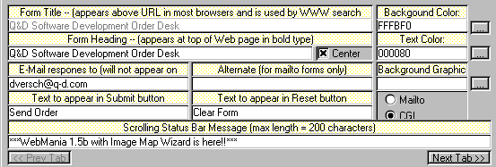
Contrast Problems
Source: Interface Hall of Shame
Notes:
Here’s an example of too little contrast. It’s important to distinguish captions from text fields, but in this design, most of the visual variables are the same for both:
- the position is very similar: the box around each caption and text field begins at the same horizontal position. The text itself begins at different positions (left-justified vs. aligned), but it isn’t a strong distinction, and some of the captions fill their column.
- the size is the same: captions and text fields fill the same column width
- the background hue is slightly different (yellow vs. white), but not easily differentiable by the squint test
- the background value is the same (very bright)
- the foreground hue and value are the same (black, plain font)
- the orientation is the horizontal, because of course you have to read it.
The result is that it’s hard to scan this form. The form is also terribly crowded, which leads us into our next topic…

Slide 22
White Space
Use white space for grouping, instead of lines
Use margins to draw eye around design
Integrate figure and ground
Object should be scaled proportionally to its background
Don’t crowd controls together
Crowding creates spatial tension and inhibits scanning
Notes:
White space plays an essential role in composition. Screen real estate is at a premium in many graphical user interfaces, so it’s a constant struggle to balance the need for white space against a desire to pack information and controls into a display. But insufficient white space can have serious side-effects, making a display more painful to look at and much slower to scan.
Put margins around all your content. Labels and controls that pack tightly against the edge of a window are much slower to scan. When an object is surrounded by white space, keep a sense of proportion between the object (the figure) and its surroundings (ground). Don’t crowd controls together, even if you’re grouping the controls. Crowding inhibits scanning, and produces distracting effects when two lines (such as the edges of text fields) are too close. Many UI toolkits unfortunately encourage this crowding by packing controls tightly together by default, but Java Swing (at least) lets you add empty margins to your controls that give them a chance to breathe.

Slide 23
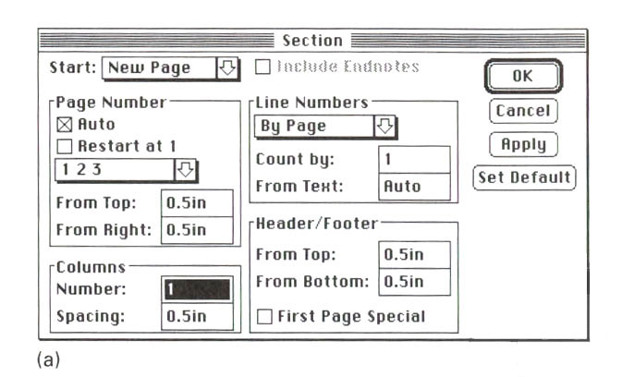
Crowded Dialog
Source: Mullet & Sano, p. 110
Notes:
Here’s an example of an overcrowded dialog. The dialog has no margins around the edges; the controls are tightly packed together; and lines are used for grouping where white space would be more appropriate. Screen real estate isn’t terribly precious in a transient dialog box.
The crowding leads to some bad perceptual effects. Lines appearing too close together – such as the bottom of the Spacing text field and the group line that surround it – blend together into a thicker, darker line, making a wart in the design. A few pixels of white space between the lines would completely eliminate this problem.

Slide 24
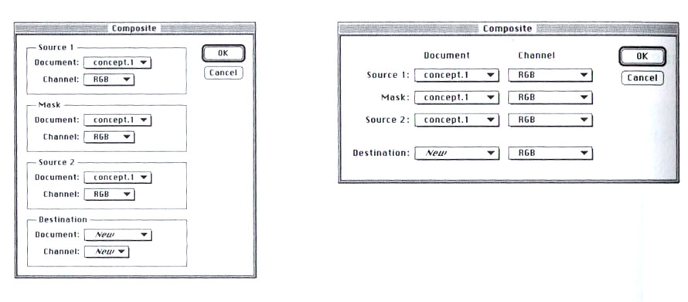
Using White Space to Set Off Labels
(b)
(a)
Source: Mullet & Sano, p. 96
Notes:
A particularly effective use of white space is to put labels in the left margin, where the white space sets off and highlights them. In dialog box (a), you can’t scan the labels and group names separately; they interfere with each other, as do the grouping lines. In the redesigned dialog (b), the labels are now alone on the left, making them much easier to scan.
For the same reason, you should put labels to the left of controls, rather than above.

Slide 25
The Gestalt Principles of Grouping
Gestalt principles explain how eye creates a whole (gestalt) from parts
proximity
similarity
continuity
closure
area
symmetry
Notes:
The power of white space for grouping derives from the Gestalt principle of proximity. These principles, discovered in the 1920’s by the Gestalt school of psychologists, describe how early visual processing groups elements in the visual field into larger wholes. Here are the six principles identified by the Gestalt psychologists:
Proximity. Elements that are closer to each other are more likely to be grouped together. You see four vertical columns of circles, because the circles are closer vertically than they are horizontally.
Similarity. Elements with similar attributes are more likely to be grouped. You see four rows of circles in the Similarity example, because the circles are more alike horizontally than they are vertically.
Continuity. The eye expects to see a contour as a continuous object. You primarily perceive the Continuity example above as two crossing lines, rather than as four lines meeting at a point, or two right angles sharing a vertex.
Closure. The eye tends to perceive complete, closed figures, even when lines are missing. We see a triangle in the center of the Closure example, even though its edges aren’t complete.
Area. When two elements overlap, the smaller one will be interpreted as a figure in front of the larger ground. So we tend to perceive the Area example as a small square in front of a large square, rather than a large square with a hole cut in it.
Symmetry. The eye prefers explanations with greater symmetry. So the Symmetry example is perceived as two overlapping squares, rather than three separate polygons.
A good paper about perceptual grouping in HCI and information visualization is Rosenholtz et al, “An Intuitive Model of Perceptual Grouping for HCI Design”, CHI 2009.

Slide 26
White Space Avoids Visual Noise
Notes:
Here’s an interesting idea from Tufte: get rid of the grid rules on a standard bar chart, and use whitespace to show where the grid lines would cross the bars. It’s much less noisy. (But alas, impossible to do automatically in Excel.)

Slide 27
Balance & Symmetry
Choose an axis (usually vertical)
Distribute elements equally around the axis
Equalize both mass and extent
Notes:
Balance and symmetry are valuable tools in a designer’s toolkit. In graphic design, symmetry rarely means exact, mirror-image equivalence. Instead, what we mean by symmetry is more like balance: is there the same amount of stuff on each side of the axis of symmetry. We measure “stuff” by both mass (quantity of nonwhite pixels) and extent (area covered by those pixels); both mass and extent should be balanced.

Slide 28
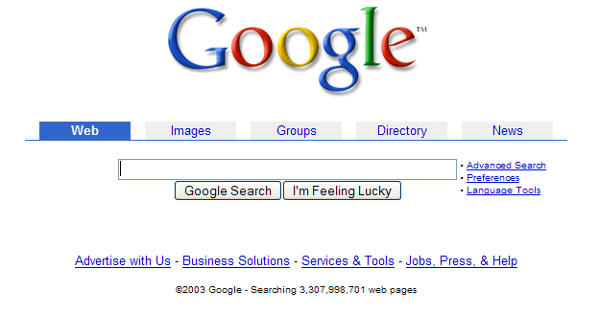
Symmetry Example
Notes:
An easy way to achieve balance is to simply center the elements of your display. That automatically achieves balance around a vertical axis. If you look at Google’s home page, you’ll see this kind of approach in action. In fact, only one element of the Google home page breaks this symmetry: the stack of links for Advanced Search, Preferences, and Language Tools on the right. This slight irregularity (a kind of contrast) actually helps emphasize these links slightly.

Slide 29
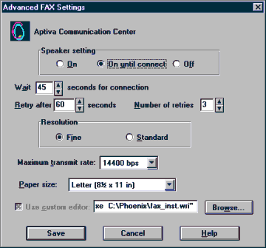
Alignment
Align labels on left or right
Align controls on left and right
Expand as needed
Align text baselines
Notes:
Finally, simplify your designs by aligning elements horizontally and vertically. Alignment contributes to the simplicity of a design. Fewer alignment positions means a simpler design. The dialog box shown has totally haphazard alignment, which makes it seem more complicated than it really is.
Labels (e.g. “Wait” and “Retry after”). There are two schools of thought about label alignment: one school says that the left edges of labels should be aligned, and the other school says that their right edges (i.e., the colon following each label) should be aligned. Both approaches work, and experimental studies haven’t found any significant differences between them. Both approaches also fail when long labels and short labels are used in the same display. You’ll get best results if you can make all your labels about the same size, or else break long labels into multiple lines.
Controls (e.g., text fields, combo boxes, checkboxes). A column of controls should be aligned on both the left and the right. Sometimes this seems unreasonable -- should a short date field be expanded to the same length as a filename? It doesn’t hurt the date to be larger than necessary, except perhaps for reducing its perceived affordance for receiving a date. You can also solve these kinds of problems by rearranging the display, moving the date elsewhere, although be careful of disrupting your design’s functional grouping or the expectations of your user.
So far we’ve only discussed left-to-right alignment. Vertically, you should ensure that labels and controls on the same row share the same text baseline. Java Swing components are designed so that text baselines are aligned if the components are centered vertically with respect to each other, but not if the components’ tops or bottoms are aligned. Java AWT components are virtually impossible to align on their baselines. The dialog shown here has baseline alignment problems, particularly among the controls in the last row: the checkbox “Use custom editor”, the text field, and the Browse button.

Slide 30
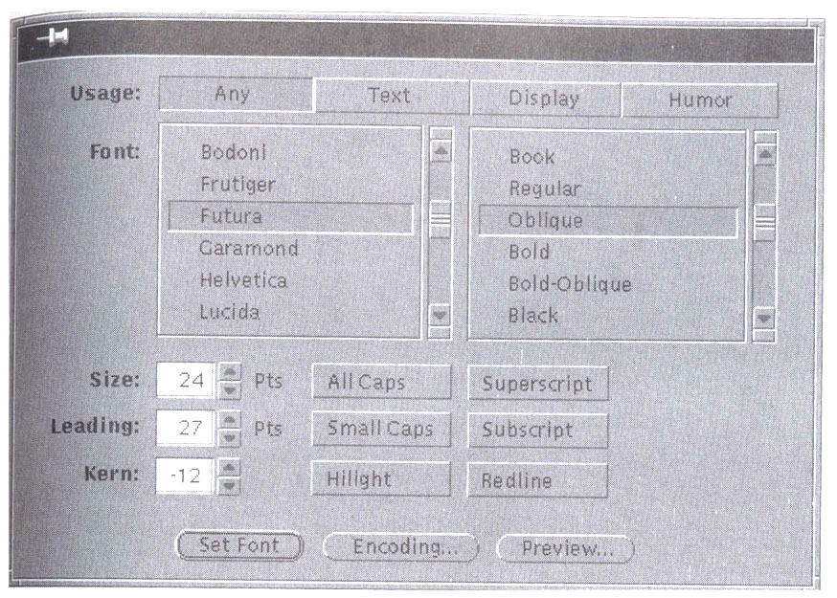
Grids Are Effective
Source: Mullet & Sano, p. 165
Notes:
A grid is one effective way to achieve both alignment and balance, nearly automatically. Notice the four-column grid used in this dialog box (excluding the labels on the left). The only deviation from the grid is the row of three command buttons at the bottom which are nevertheless still balanced. In fact, their deviation from the grid helps to set them off, despite the minimal white space separating them from the rest of the display.
One criticism of this dialog is false grouping. The controls for Size, All Caps, and Superscript tend to adhere because of their proximity, and likewise for the next two rows of the display. This might be fixed by pushing the toggle buttons further to the right, to occupy columns 3 and 4 instead of 2 and 3, but at the cost of some balance.

Slide 31
Summary
Use contrast to emphasize important distinctions
Choose appropriate visual variables
Squint test
Simplify unimportant distinctions
Remember Gestalt grouping
Alignment, balance, symmetry

