Slide 1
Lecture 16: Web-Scale Research Methods

Slide 2
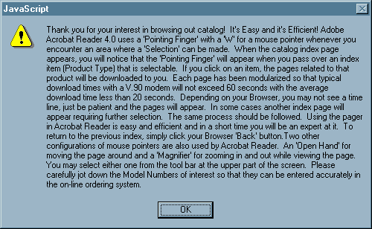
UI Hall of Fame or Shame?
Source: Interface Hall of Shame
Notes:
Once upon a time, this bizarre help message was popped up by a website (Midwest Microwave) when users requested to view the site’s product catalog. The message appears before the catalog is displayed. Clearly this message is a patch for usability problems in the catalog itself. But the message itself has a lot of usability problems of its own! How many problems can you find? Here are a few:
Overwhelming the user with detail. What’s important here, and what isn’t? (minimalist design)
Horrible layout: no paragraphs, no headings, no whitespace to guide the eye (aethestic design)
No attempt to organize the material into chunks so that it can be scanned, to find out what the user doesn’t already know (visibility)
This information is useless and out of context before the user has seen the task they’ll be faced with (help and documentation)
It’s a modal dialog box, so all this information will go away as soon as the user needs to get to the catalog (minimize memory load)
Using technical terms like V.90 modem (speak the user’s language)
“Please carefully jot down the Model Numbers” (recognition, not recall)
Poor response times: 20-60 second response times (user control and freedom), though in fairness this was common for the web at the time, and maybe Acrobat has sufficient progress interfaces to make up for it.
Misspelling “our catalog” in the first line (speak the user’s language)

Slide 3
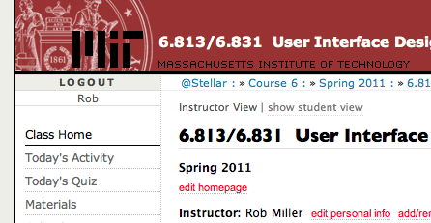
Nanoquiz
closed book, closed notes
submit before time is up (paper or web)
we’ll show a timer for the last 20 seconds

Slide 4
20
19
18
17
16
15
14
13
12
11
10
9
8
7
6
5
4
3
2
1
0
In hypothesis testing, the null hypothesis: (choose all good answers) A. is the hypothesis you want to prove B. is the hypothesis that a skeptic might assume C. is a hypothesis that has approximately zero (“null”) probability D. provides the probability distribution from which a p value is calculated
For an experiment comparing user performance with four different pointing devices, a good statistical test is likely to be: (choose one best answer) A. ANOVA B. t test C. Wilcoxon signed-rank test D. chi square test
Suppose we run more subjects in an experiment that’s measuring time performance. The extra data is likely to: (choose all good answers): A. shrink the standard deviation B. shrink the standard error of the mean C. shrink the 95% confidence interval of the mean D. shrink the p-value of the statistical test

Slide 5
Today’s Topics
Web site A/B testing
Remote usability testing
Online subject recruitment
Notes:
Today’s lecture is about usability evaluation in the brave new world of the Web. The Web enables experiments on a larger scale, for less time and money, than ever before. Web sites with millions of visitors (such as Google, Amazon, Microsoft) are capable of answering questions about the design, usability, and overall value of new features simply by deploying them and watching what happens. The trick lies in how to conduct those experiments. Today’s lecture will discuss some of the latest practices in online experimentation.
The content of this lecture is based in part on Kohavi, Henne, Sommerfeld, “Practical Guide to Controlled Experiments on the Web”, KDD 2007. http://exp-platform.com/Documents/GuideControlledExperiments.pdf

Slide 6
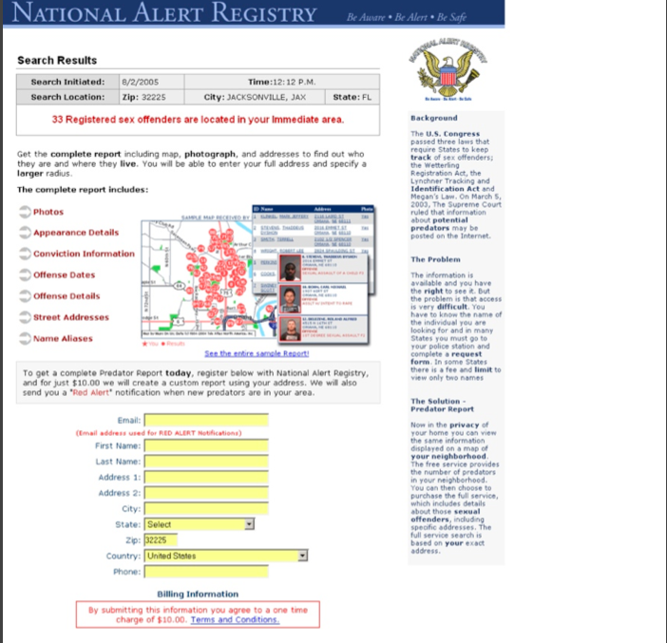
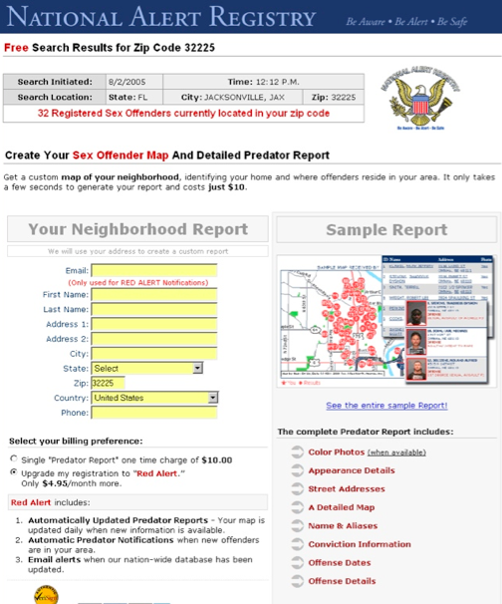
Which Is Better?
Notes:
Let’s start with an example. Here are two versions of a web page, for a site that sells customized reports about sex offenders living in your area. The goal of the page is to get visitors to fill out the yellow form and buy the report. Both versions of the web page have the same information; they just present it in different ways. In fact, the version on the right is a revised design, which was intended to improve the design by using two fat columns, so that more content could be brought “above the fold” and the user wouldn’t have to do as much scrolling.
We could look closely at these examples and pick them apart with respect to usability principles (visibility, learnability, efficiency, etc.), and the designers were doubtlessly thinking about principles and justifications for the design decisions they made. But at the end of the day, which design is more effective for the end goal of the web site – converting visitors into sales?
The designers answered this question by conducting an experiment. Half the users to their web site were randomly assigned to see one version of the page, and the other half saw the other version. The users were then tracked to see how many of each actually filled out the form to buy the report. In this case, the revised design actually failed – 244 users bought the report from the original version, but only 114 users bought the report from the revised version.
The important point here is not which aspects of the design caused the failure (which I frankly don’t know, because a variety of things changed in the redesign). The point is that the web site conducted a randomized experiment and collected data that actually tested the revision. That’s not the same as just rolling out the revised version and seeing what happens – there’s a subtle but important difference. This kind of experiment is often called an A/B test.
Source: http://www.alistapart.com/articles/designcancripple

Slide 7
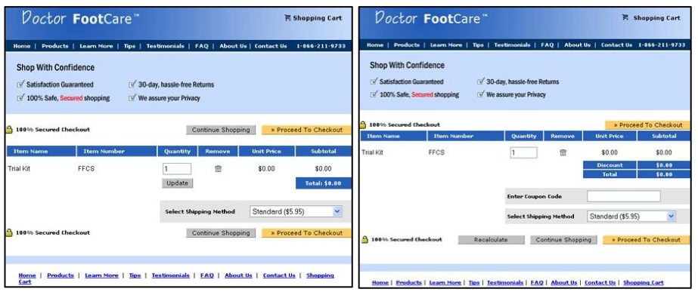
Which is Better?
Notes:
Here’s another example – a shopping cart for a web site. Again, a number of changes have been made between the left side (the original version) and the right side (the revised version). When this redesign was tested with an A/B test, it produced a startling difference in revenue – users who saw the cart on the left spent ten times as much as users who saw the cart on the right! The designers of this site explored further and discovered that the problem was the “Coupon Code” box on the right, which led users to wonder whether they were paying too much if they didn’t have a coupon, and abandon the cart. Without the coupon code box, the revised version actually earned more revenue than the original version.

Slide 8
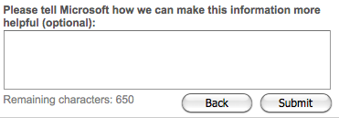
Which is Better?
Was this information helpful? Please rate it from 1 to 5 stars.
Notes:
One more example. At the end of every page in Microsoft’s online help (e.g. for Word and Excel) is the question on the left, asking for feedback about the article. If you press any of the buttons, it displays a textbox asking for more details.
A proposed revision to this interface is shown on the right. It was motivated by two arguments: (1) it gives more fine-grained quantitative feedback than the yes/no question; and (2) it’s more efficient for the user, because it takes only one click rather than the minimum two clicks of the left interface.
When these two interfaces were A/B tested on Microsoft’s site, however, it turned out that the 5-star interface produced an order of magnitude fewer ratings – and most of them were either 1 star or 5 stars, so they weren’t even fine-grained.

Slide 9
A/B Testing
A/B testing goes by other names as well
controlled experiment, randomized experiment, single-factor design, split test, parallel flights
Similar approach to lab controlled experiment
Choose an independent variable with 2 conditions
e.g. the UI design to present
may have more than 2 conditions, e.g. A/B/C testing
Choose dependent variable(s) to measure
might be usability: time, errors, success rate
might be business criteria: conversions, # items bought, revenue
During a testing interval, randomly assign arriving users to one condition or the other
Do statistical testing
Notes:
The term “A/B testing” actually comes from marketing. Other fields have other names for the idea – in the context of usability studies in the lab, we’ve been calling them controlled experiments. The setup is basically the same: you choose an independent variable (like the UI design) with at least two alternatives to test; you choose a dependent variable that you’re going to use to measure the difference between those alternatives.
The distinction in web-based A/B testing is that your web site automatically and randomly assigns users to a condition.

Slide 10
Ramp-up
A/B testing can be risky
you’re doing your testing with real users on a deployed system
so bugs have real consequences
Don’t go to 50/50 ratio between Control and Treatment immediately
Ramp up slowly: first 99.9% / 0.1%, then 99%/1%, etc.

Slide 11
Assigning Users to Conditions
Use hashing to partition users
MD5 hash of (user id, experiment name) => 128-bit value
split the 128-bit space into Control and Treatment
for rampup, initially the partition is unbalanced (e.g. 99% / 1%); gradually shift the split point until you reach 50/50
Why is this better than random number generation?
Doesn’t require storing the random assignment
Can be done independently by different servers

Slide 12
Power Analysis
How many users do I need for significance?
If the experiment involves too few users, then it may fail to reject the null hypothesis even though it’s false
Power: probability of correctly rejecting the null hypothesis when it’s false
Number of users you need depends on:
power desired (typically 80-90%)
number of conditions
variance of the dependent variable
effect size: how much of a difference in dependent variable you care about for decision making
statistical test you’re using
Number of users required determines running time
Based on the visit rate of your web site

Slide 13
A/A Tests
An “experiment” that divides users into two groups with the same condition for both groups
Good for testing the experimentation infrastructure
You shouldn’t see any difference between the groups
But wait! If you run 20 A/A tests and test them at the 5% significance level, then on average one of the tests will show a (phantom) significant difference
A/A tests also allow estimating the variance of the dependent variable
which is useful for power calculations

Slide 14
Issues with A/B Testing
Ethics
Predictability
Numbers, but no explanations
Short-term vs. long-term
Notes:
Ethics: A/B testing never asks the user’s permission to be involved in the test, and doesn’t get informed consent. What do you think about that?
Predictability: when a user visits the web site, things might (randomly) be different. What’s the effect of that?
Numbers, but no explanations: as we saw in our examples at the beginning of the lecture, you get data about how a new design affected bottom-line indicators, but you don’t really find out why. One solution to that is to break down a design with several changes into a few experiments, testing changes individually. Another is to complement large-scale A/B testing with small-scale user testing in the lab, where you have the advantage of think-aloud protocols.
Short-term vs. long-term: a typical A/B test runs only for days or weeks, while the real effect of a new design might be seen only over a long term, as users learn how to use it well. But it’s worth noting that even days or weeks is a longer term than a typical lab-based user study, which might last at most a few hours.

Slide 15
Remote Usability Testing
Remote synchronous testing
using webcam, audio, remote desktop connection
shown to be just as effective as face-to-face
Remote asynchronous testing
Approach 1: user identifies and reports critical incidents themselves
like bug reporting, but for usability problems
users slow down by 3x and report only half as many problems as trained observers would
Approach 2: install instrumentation in the web site to track a user’s actions
e.g. userfly.com
shows details of interaction, but lacks think-aloud and insight into user’s goals and intentions
Notes:
See Andreason et al., “What Happened to Remote Usability Testing? An Empirical Study of Three Methods”, CHI 2007.

Slide 16
Recruiting Users Online
Craigslist is a good source for lab subjects
for MIT subjects, the freemoney mailing list also helps
Mechanical Turk is a labor market for tiny online tasks
e.g. paying $0.01 to give some keywords for an image
increasingly used by HCI researchers and social scientists to recruit users
Google AdWords is another way to get users
generates high flow, and possibly high cost
Notes:
See Kittur, Chi, Suh, “Crowdsourcing user studies with Mechanical Turk”, CHI 2008.

Slide 17
Summary
A/B testing offers fast, accurate testing of new web site designs in actual deployment
Remote usability testing is getting there
Web makes it much easier to recruit users than ever before

