Slide 1
Julia in Arma 3
Midterm Project, 18.377, 2016
Kyle Kotowick

Slide 2
Background
ARMA 3 is a military simulation video game developed by Bohemia Interactive Studios
Includes a proprietary scripting language (“SQF”) to control units/objects
Allows for extensive modification and programmatic control
Often used for human-participant experiment simulations
Can collect extensive amount of data from user actions
Can precisely control experimental parameters and scenario
Can integrate various algorithms to test them
No graphics/game-design knowledge required

Slide 3
Motivation
While powerful in what it is able to do in-game, SQF is SLOW
Generate array of 1,000,000 random floats between 0 and 1:
Julia: 28ms
SQF: 1359ms
SQF is SLOPPY
Generate array of 1,000,000 random floats between 0 and 1:
Julia:
vals = rand(1000000)
SQF:
_vals = [];
for "_i" from 0 to 999999 do {
_vals pushBack (random 1);
};

Slide 4
Motivation
Some applications use a lot of math
Orientation conversions (unusual ARMA 3 format to DCM/quaternion/Euler)
Distance/angle calculations between objects/players
Custom A.I.
Testing of various other algorithms (path planning, scheduling, etc.)
Large detrimental impact on performance if this is done in SQF
Some applications require such calculations on every frame
Next frame will not be drawn until script for last frame is complete

Slide 5
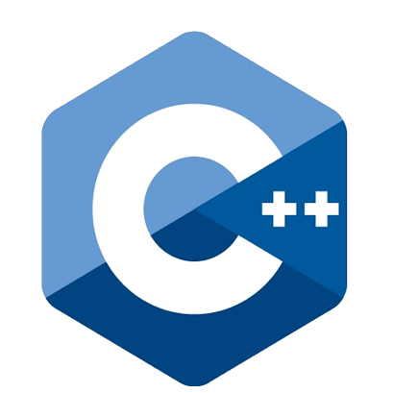
Solution
Julia can be embedded in a C/C++ program
ARMA 3 can call a C++ program from within SQF
Let’s chain them together!

Slide 6
Complications
ARMA 3 can only pass one argument (a string) when it calls the C++ function
All numerical arguments must be formatted into a string, then parsed by the C++ function
The C++ function can only return a single string back to ARMA
The length of this return string is limited based on platform type
Needs a system where repeated calls returns successive parts of the result string
Julia’s embedding limitations
Can only initialize Julia in one C++ thread
“addprocs” command opens a new terminal for each added proc
Documentation for embedding Julia is atrocious
Integration issues:
ARMA 3 is 32-bit, most Julia installs are 64-bit
Dynamic/static library conversion

Slide 7
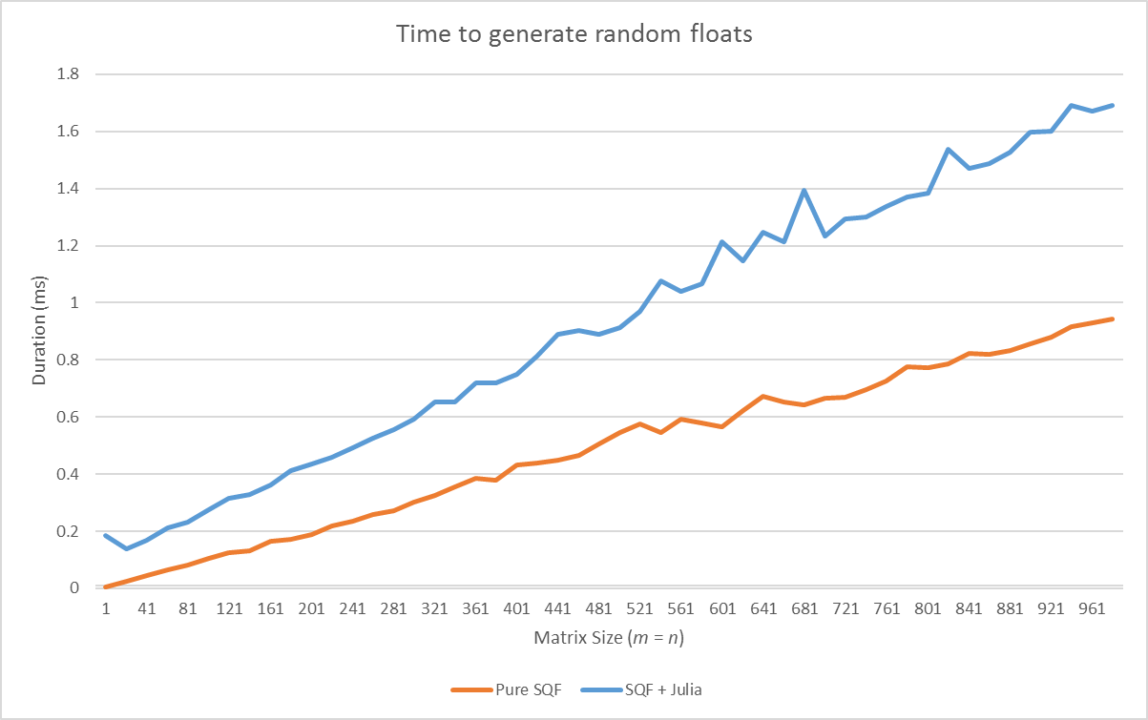
Example: Random Numbers
Generate an array of random floats
Small input, large output

Slide 8
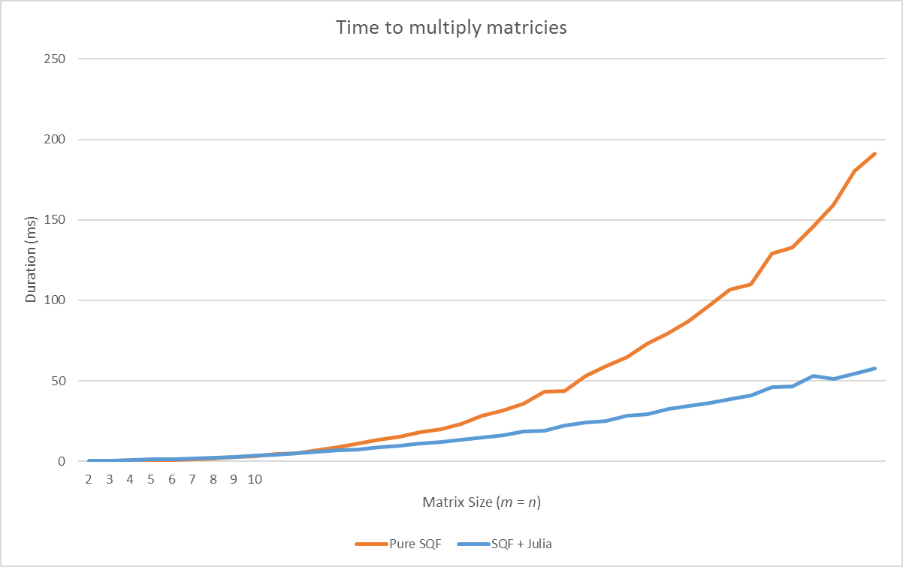
Example: Matrix Multiplication
Multiply two square matrices of equal size
Medium input, medium output

Slide 9
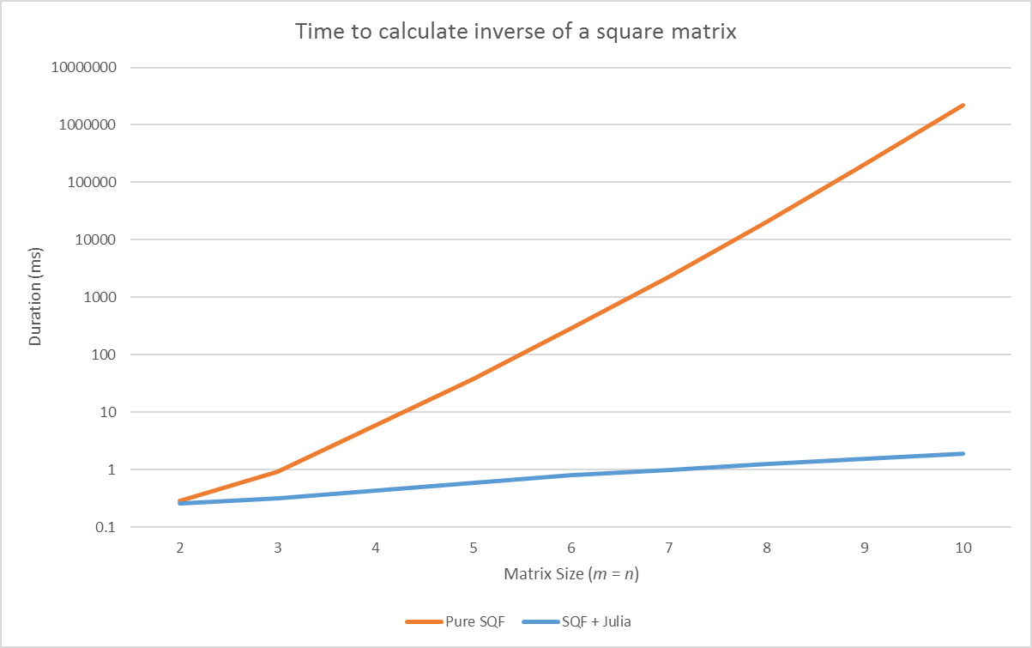
Example: MATRIX INVERSE
Find the inverse of a square matrix
Medium input, medium output
NOTE: logarithmic scale

Slide 10
Conclusion
It works!!
Strings-only restriction really slows it down
Worthwhile when input/output string is short, but operation is complex
Does not significantly improve any existing functions we use, but is a good tool for potential future use

