Slide 1
GWAS Analysis in Julia
Kayla McCue

Slide 2
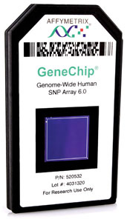
Genome Wide Association Study (GWAS)
Want to be able to associate phenotypes with SNPs across the whole genome
This is done using a SNP array
Image Source: http://www.photonics.com/Product.aspx?PID=1&VID=46&IID=324&PRID=38499

Slide 3
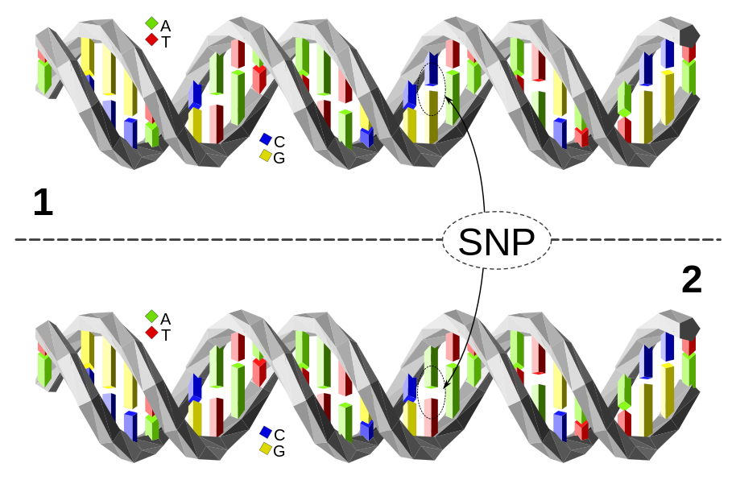
GWAS Vocabulary
Single Nucleotide Polymorphism (SNP)
Allele Frequency
Phenotype
Image Source: https://en.wikipedia.org/wiki/Single-nucleotide_polymorphism

Slide 4
Analysis in Julia
IHT Package
https://github.com/klkeys/IHT.jl
PLINK Package
https://github.com/klkeys/PLINK.jl
Iterative Hard Thresholding
$ℓ_{0}$-penalized multivariate regression
NP-hard, so use the heuristic projected gradient update
$$\frac{1}{2}{\left\|y−Xβ\right\|}_{2}^{2}+λ{\left\|β\right\|}_{0}$$
$$β^{m+1}=P_{S_{k}}\left[β^{m}−μ∇\left(β^{m}\right)\right]$$

Slide 5
Analysis in Julia
Simulating data and testing IHT compared with Lasso and MCP gives favorable results
Provides reasonable results on real GWAS data
Julia implementation reduces run time compared to original analysis

Slide 6
Analysis of Multiple Simulated Datasets
 | Simulation Method 1 |  | Simulation Method 2 |  | Simulation Method 3
 | Precision | Recall | Precision | Recall | Precision | Recall
IHT | .50 | .70 | .58 | .70 | 1.00 | .70
Lasso | 1.00 | 1.00 | .09 | 1.00 | .17 | .90

