Slide 1
The Swept Rule for Breaking the Latency Barrier in Time-Advancing PDEs
FINAL PROJECT MIT 18.337 Fall 2015
Project supervisor: Professor qiqi wang
Maitham ALHUBAIL
Mohamad Sindi
Abdulaziz alBaiz
Mohammad AlAdwani

Slide 2
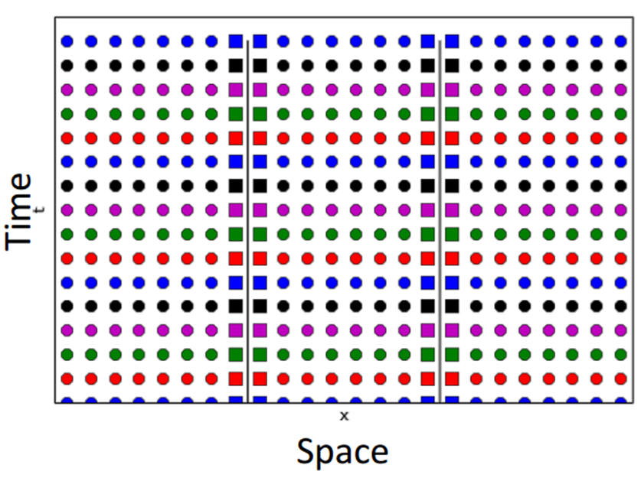
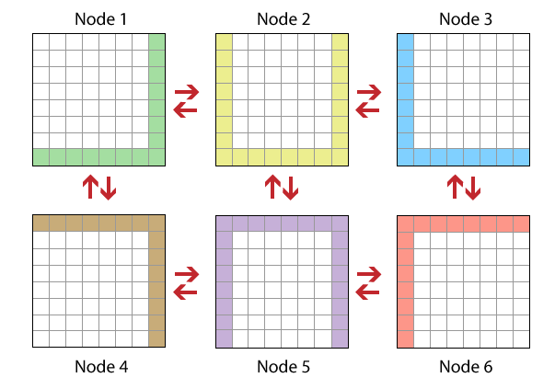
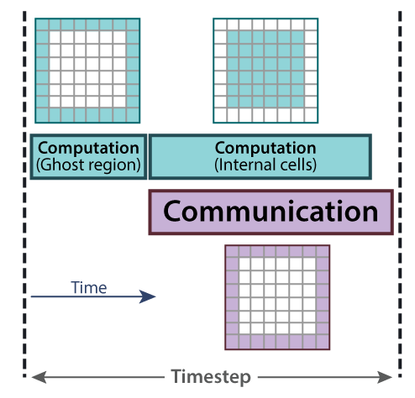
Motivation
Many parallel PDE solvers are deployed in computer clusters
The number of processing cores in compute nodes is increasing
Engineers demand this compute power to speedup the solution of unsteady PDEs
Network Latency is the major factor limiting the scalability of PDE solvers
What Can we do to help??

Slide 3
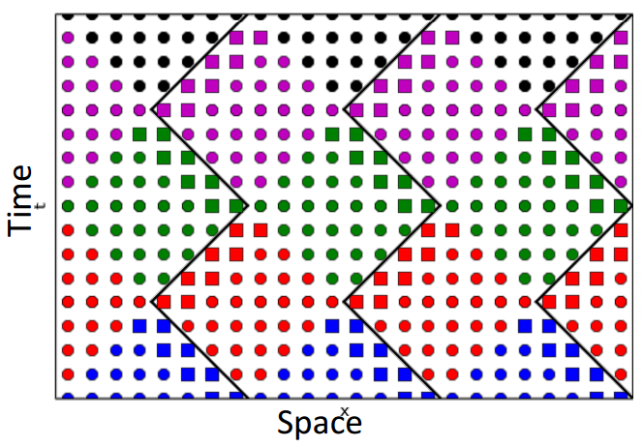
The Swept Rule
It is all about following the domain of influence and the domains of dependency while explicitly solving PDEs!!
Follow the way that allows you to proceed further without communication!
Cells move between processors!!!!!!

Slide 4
Swept Rule in 1D

Slide 5
Swept Rule in 1D cont…

Slide 6
Swept Rule in 1D cont…

Slide 7
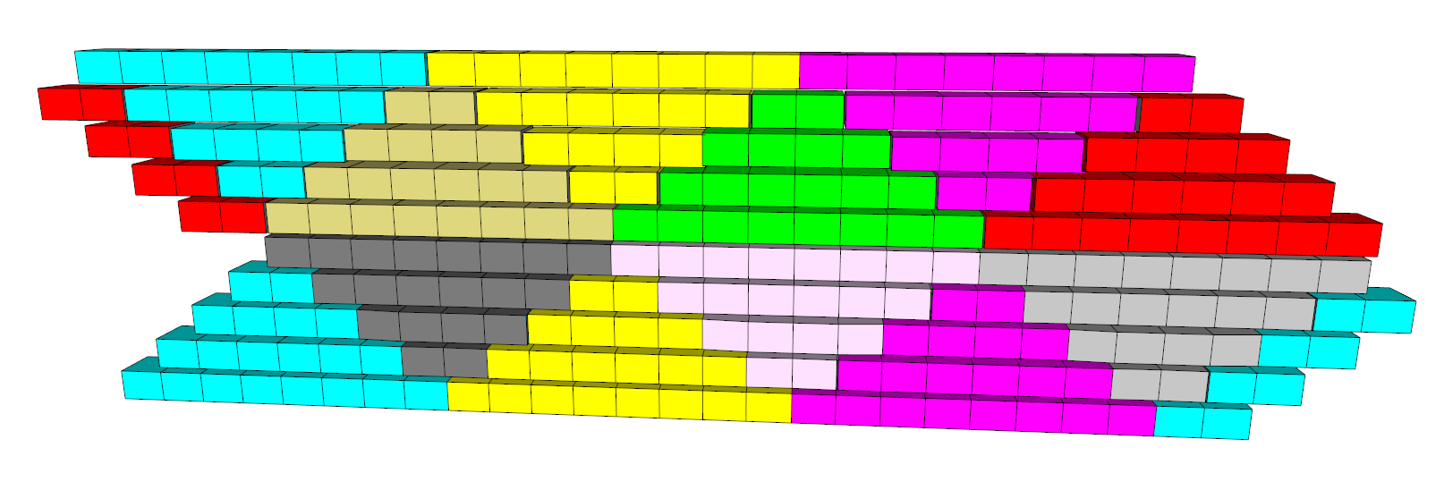
Swept Rule in 1D cont…

Slide 8
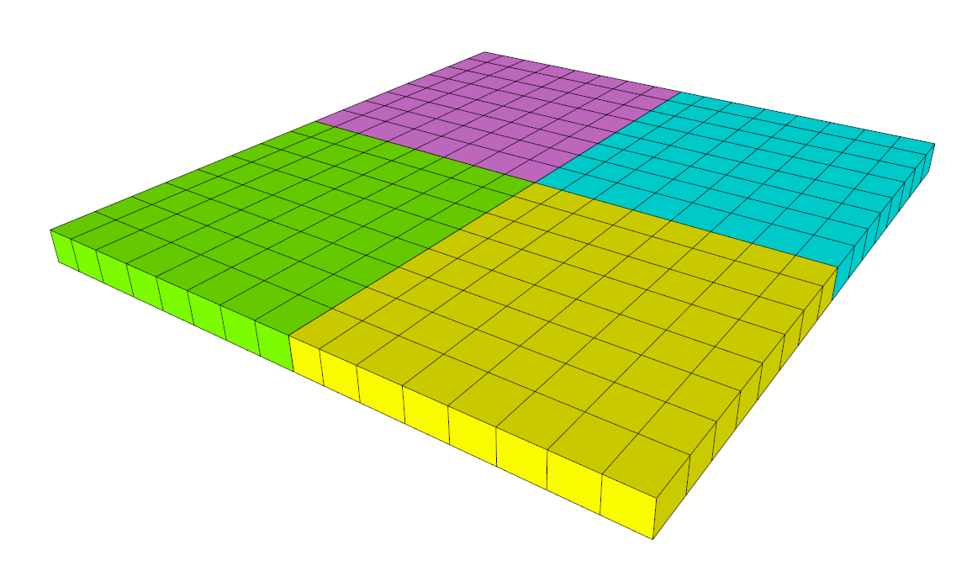
Swept Rule in 2D
This is a 3D problem
Decompose as squares and assign those to different processors
Staring from an initial condition
1
2
3
4

Slide 9
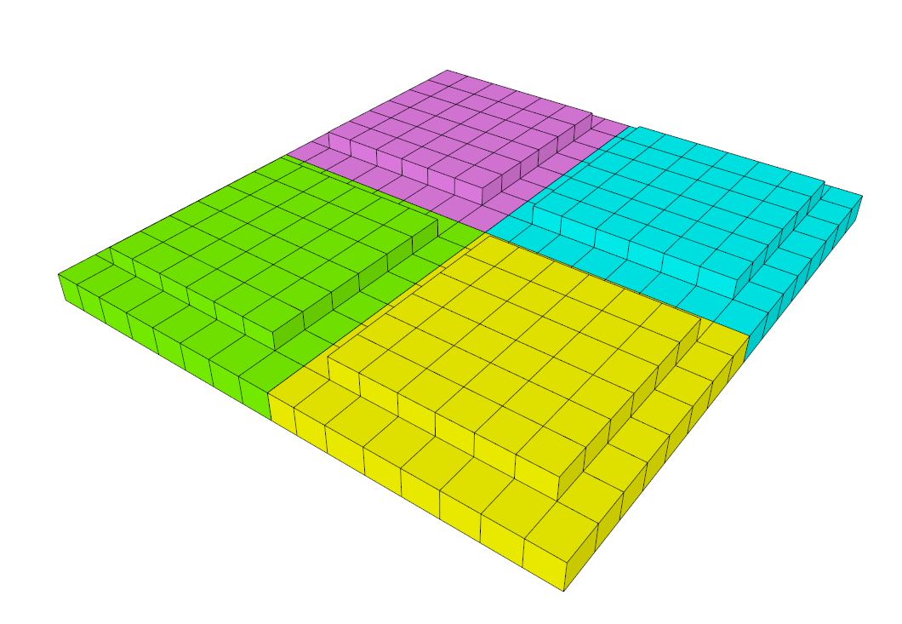
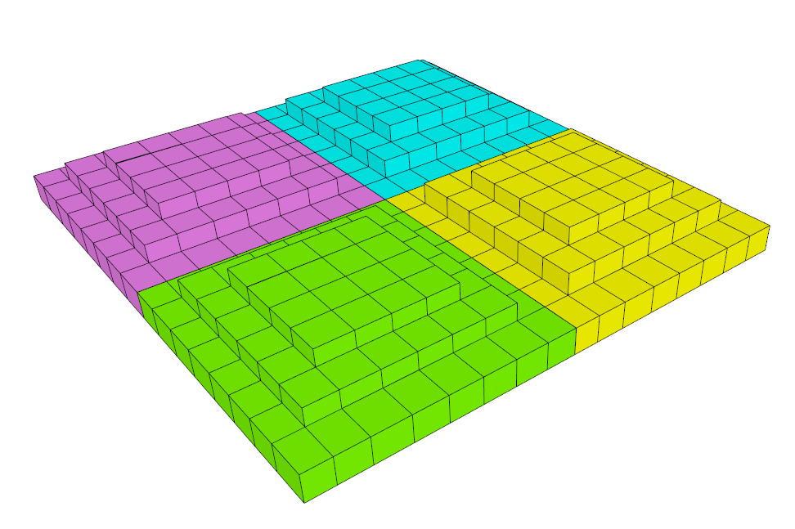
Swept Rule in 2D cont…
Timestepping

Slide 10
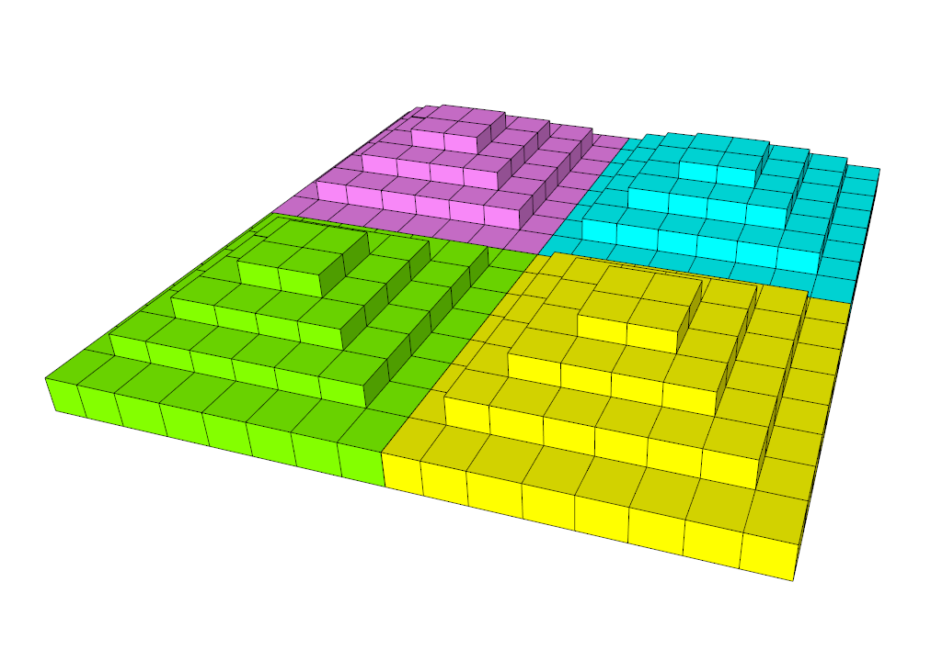
Swept Rule in 2D cont…
At this stage, no further processing is possible
Prepare for the first communication!!
But, communicate WHAT??

Slide 11
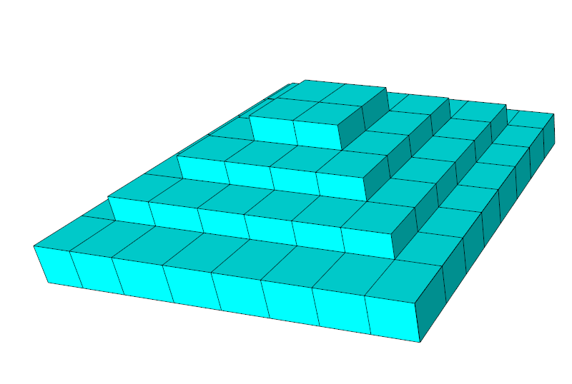
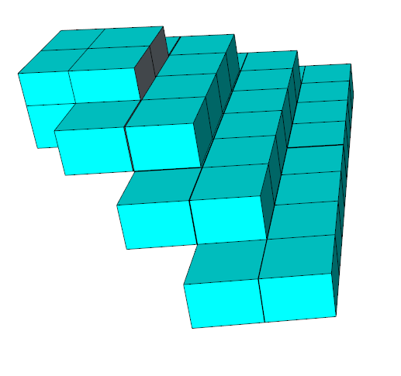
Swept Rule in 2D cont…
The Panels of the Pyramids become our communication UNIT
It encapsulates data for different cells at different timesteps!
4x

Slide 12
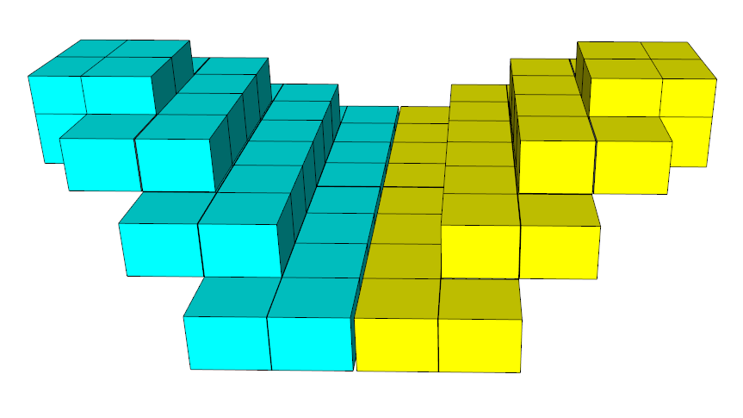
Swept Rule in 2D cont…
Merging 2 panels of different pyramids generate valleys
1 owned, 1 guest
Those can be filled as we have the full stencil for the internal cells

Slide 13
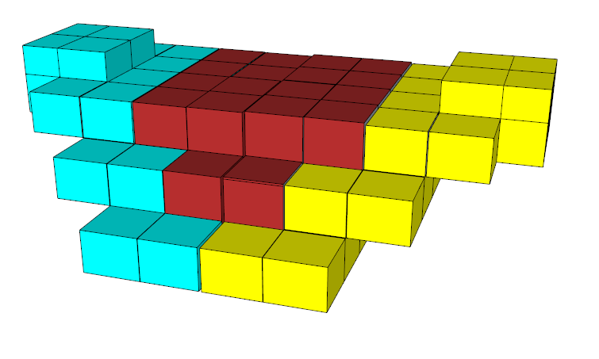
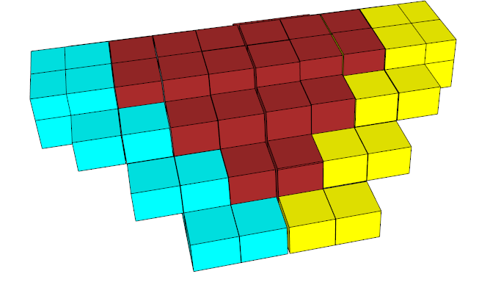
Swept Rule in 2D cont…
Timestepping

Slide 14
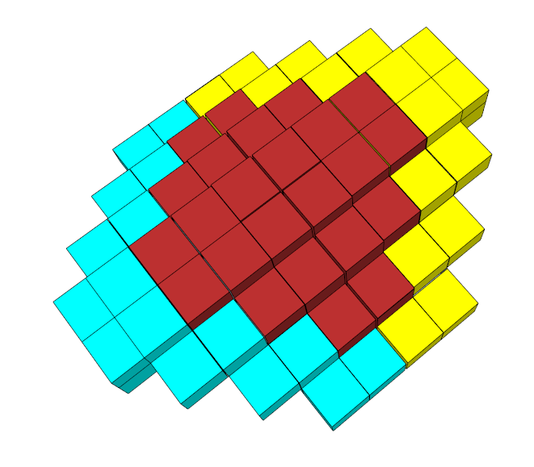
Swept Rule in 2D cont…
After the valley between 2 panels is filled, no further processing is possible
We call these results bridges!
Prepare for the second communication!
Now, WHAT to communicate?!

Slide 15
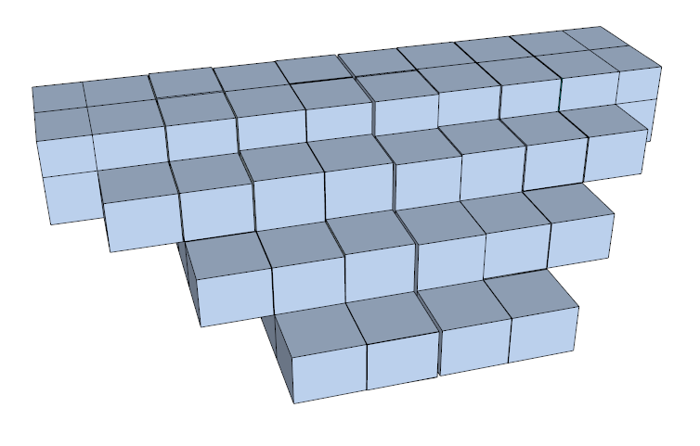
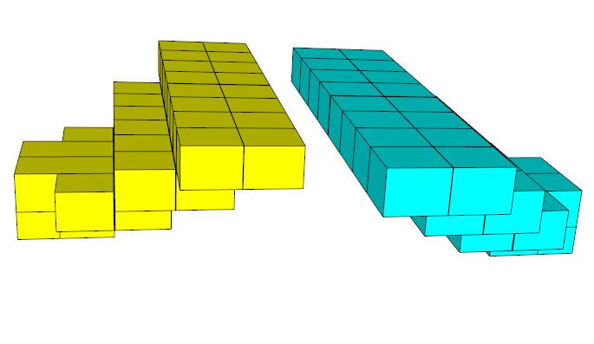
Swept Rule in 2D cont…
Again, we will communicate panels. This time, the sides of the bridges!!
They have the same size as the previously communicated panels (the pyramid sides)!
2x

Slide 16
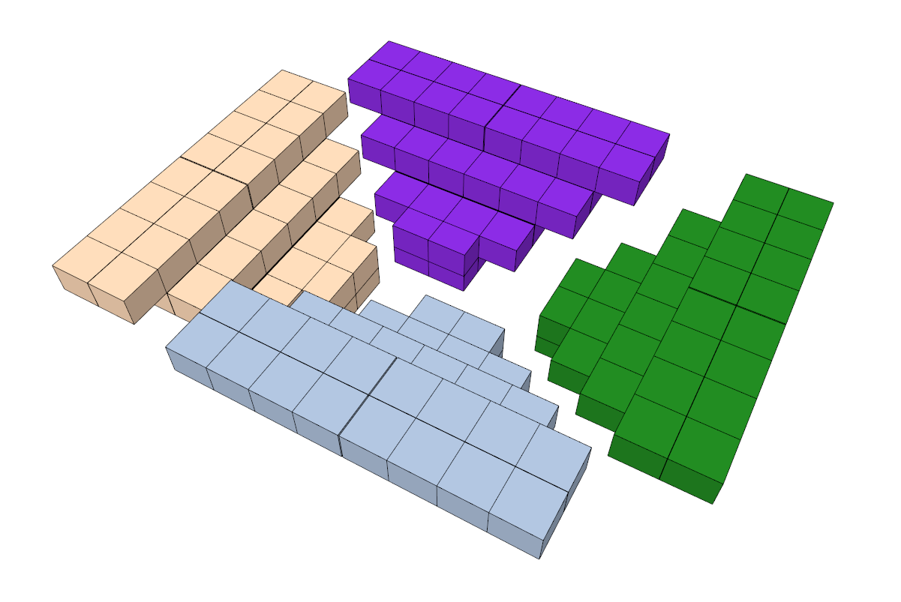
Swept Rule in 2D cont…
Arrange 4 of the communicated panels!
2 guests, 2 owned!

Slide 17
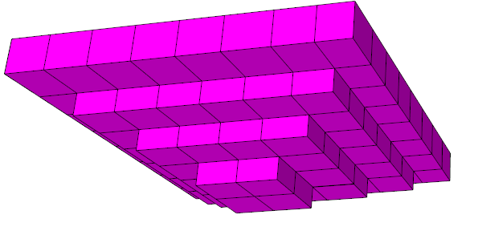
Swept Rule in 2D cont…
Properly placing the 4 panels provides the full stencil to fill the gaps between the panels!
Fill

Slide 18
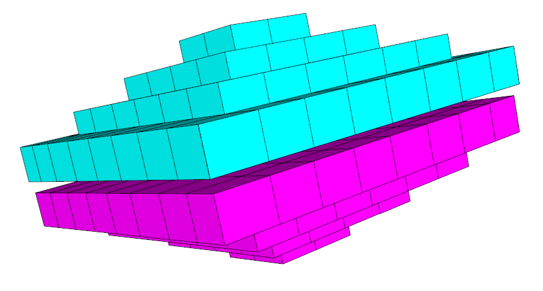
Swept Rule in 2D cont…
By Now, all the gaps are filled!
And Swept2D goes ON!

Slide 19
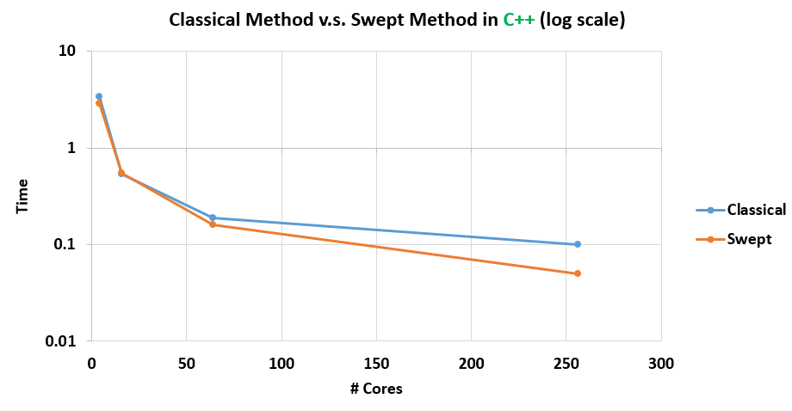
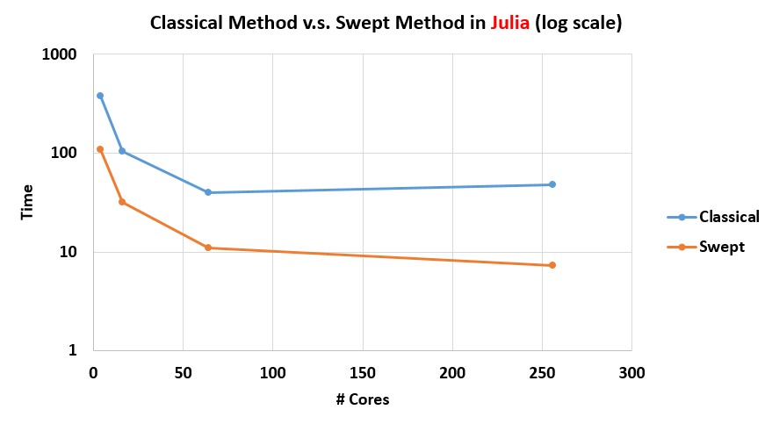
Results

Slide 20
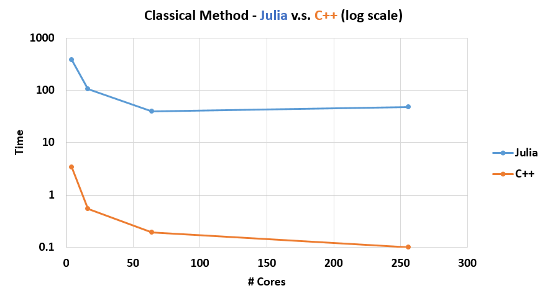
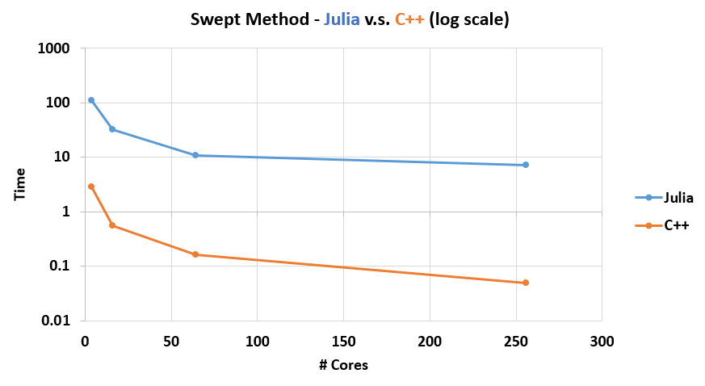
Results

Slide 21
Our Contribution to the Julia Language
A swept2D.jl Julia library implementing the Swept algorithm in 2D
(~1000 lines of 100% Julia all the way code).
For parallelization we use Julia’s low level remote calls, we didn’t want to use MPI since it’s C based and we wanted to keep everything Julia all the way down:
remotecall_fetch(procesesor id, function, args...)
The library is easy to include and use in your code to solve PDEs, you just need to setup your PDE of interest and its initial condition and the parallelization part is taken care of by our library.

Slide 22
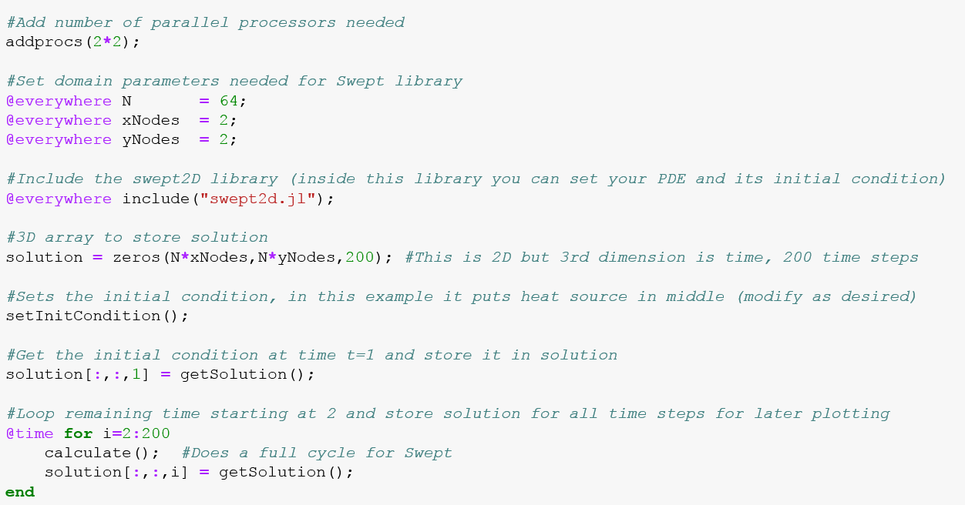
Example of How to Use the Library:

Slide 23
Challenges Encountered During Project
The “include” statement seems to be very slow when running on a large number of cores:
e.g. on 256 cores, it took ~80 seconds just to execute the include statement, while the actually parallel computation only took 7 seconds!
@everywhere include("swept2d.jl");
The machinefile option didn’t seem to work properly, we had to construct the host string manually in the code and pass it to the addprocs function as a workaround.
Out of boundary errors were difficult to debug especially when running in parallel, debug info doesn’t provide proper line numbers and using print statements to debug in parallel wasn’t convenient when running on a large number of cores (e.g. 256 cores).

Slide 24
Live Demo

